Slide 1
How many samples do we need to be confident that mean TP is not greater than some value?
How many samples do we need to be confident of detecting a trend?
POWER ANALYSIS
Power is the probability of rejecting the null hypothesis when it is false
In other words, the probability of detecting a difference or trend if is actually there
There is always noise/random error when taking samples
How many samples do we need to collect to be reasonably sure we would find a signal amidst the noise?
There are four elements in statistical hypothesis testing that are inter-related
Sample size
Effect size (how big a difference are we looking for, relative to the noise?)
Also called the “scaled minimum detectable difference”
For a one-sample case, the effect size is the difference between the true population mean and the population mean hypothesized under the null hypothesis
Significance level of the test (i.e. “p value”), which is the number of false positive we will tolerate
Power (1-β where β is the probability of a Type II error, i.e. a false negative)

Slide 2
How many samples do we need to be confident that mean TP is not greater than some value?
How many samples do we need to be confident of detecting a trend?
POWER ANALYSIS
Power is the probability of rejecting the null hypothesis when it is false
In other words, the probability of detecting a difference or trend if is actually there
There is always noise/random error when taking samples
How many samples do we need to collect to be reasonably sure we would find a signal amidst the noise?
There are four elements in statistical hypothesis testing that are inter-related
Sample size
Effect size (how big a difference are we looking for, relative to the noise?)
Also called the “scaled minimum detectable difference”
For a one-sample case, the effect size is the difference between the true population mean and the population mean hypothesized under the null hypothesis
Significance level of the test (i.e. “p value”), which is the number of false positive we will tolerate
Power (1-β where β is the probability of a Type II error, i.e. a false negative)

Slide 3
Effect Size:
Difference we want to detect /signal
Standard deviation we expect /noise
For example:
2 ug/L difference in phosphorus
3.811 -> average stdev for LMP lakes
w/ normal distribution
Effect size = 0.52
What standard deviation to use?
Also note: Analysis is quite a bit more complicated when data are not normally distributed

Slide 4
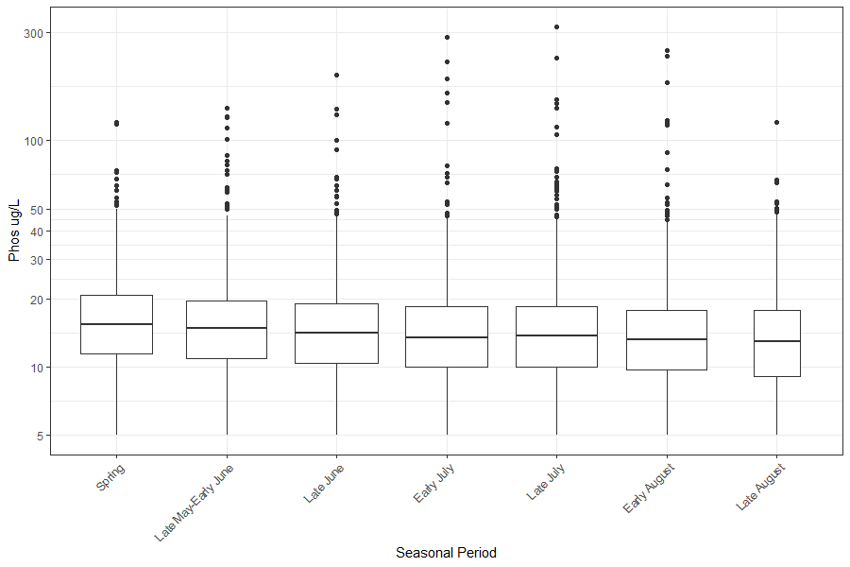
LMP data – is seasonality important?

Slide 5
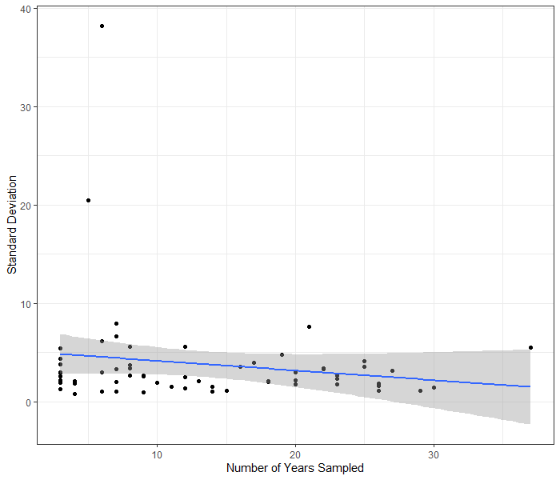
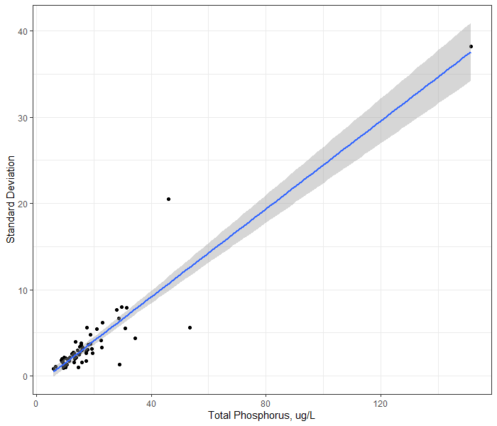
For lakes with normally distributed data (63 out of 70 lakes)
Number of Years Sampled versus Standard Deviation
Mean TP versus Standard Deviation

Slide 6
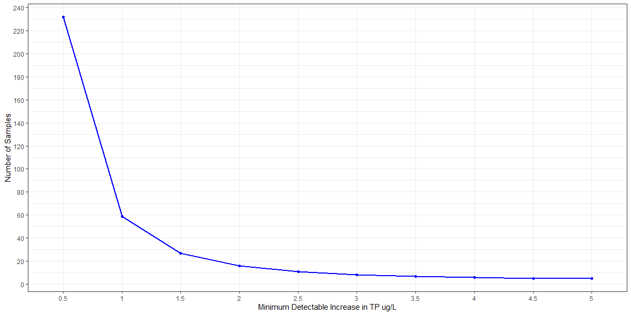
EXAMPLE – Miles Pond (stable trend)
13 years sampled | mean=11.4 | stdev=2.05 (95% c.i. = 1.33~3.05)
Take the worst-case scenario, stdev = 3
How many years of samples would we need to have an 80% probability of detecting an increase of X ug/L TP, with a p-value of 0.05?

Slide 7
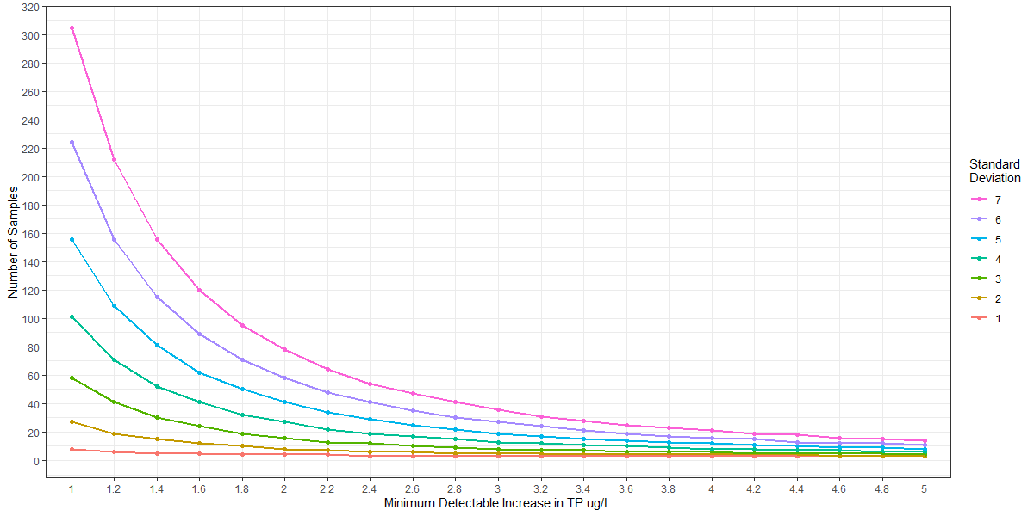
All lakes for a range of standard deviations - LMP Annual Means – lakes with normally distributed data
How many years of samples would we need to have an 80% probability of detecting an increase of X ug/L,
with a p-value of 0.05, given a certain standard deviation?
Some Example Lakes
Lake | N | Mean | St. Dev.
CARMI | 37 | 30.9 | 5.53
CASPIAN | 26 | 9.3 | 1.82
CURTIS | 25 | 18.1 | 3.58
DUNMORE | 23 | 12.8 | 2.73
JOES (DANVLL) | 14 | 20.2 | 7.24
MAIDSTONE | 26 | 6.8 | 1.09
MEMPHREMAGOG | 27 | 19.3 | 3.13
RAPONDA | 18 | 11.4 | 2.00
SEYMOUR | 23 | 9.0 | 2.41
SHELBURNE | 6 | 151.4 | 38.20
WILLOUGHBY | 25 | 10.5 | 3.70

Slide 8
All lakes for a range of standard deviations - LMP Annual Means – lakes with normally distributed data
How many years of samples would we need to have an 80% probability of detecting an increase of X ug/L,
with a p-value of 0.05, given a certain standard deviation?
Some Example Lakes
Lake | N | Mean | St. Dev.
CARMI | 37 | 30.9 | 5.53
CASPIAN | 26 | 9.3 | 1.82
CURTIS | 25 | 18.1 | 3.58
DUNMORE | 23 | 12.8 | 2.73
JOES (DANVLL) | 14 | 20.2 | 7.24
MAIDSTONE | 26 | 6.8 | 1.09
MEMPHREMAGOG | 27 | 19.3 | 3.13
RAPONDA | 18 | 11.4 | 2.00
SEYMOUR | 23 | 9.0 | 2.41
SHELBURNE | 6 | 151.4 | 38.20
WILLOUGHBY | 25 | 10.5 | 3.70

Slide 9
All lakes for a range of standard deviations - LMP Annual Means – lakes with normally distributed data
How many years of samples would we need to have an 80% probability of detecting an increase of X ug/L,
with a p-value of 0.05, given a certain standard deviation?
Some Example Lakes
Lake | N | Mean | St. Dev.
CARMI | 37 | 30.9 | 5.53
CASPIAN | 26 | 9.3 | 1.82
CURTIS | 25 | 18.1 | 3.58
DUNMORE | 23 | 12.8 | 2.73
JOES (DANVLL) | 14 | 20.2 | 7.24
MAIDSTONE | 26 | 6.8 | 1.09
MEMPHREMAGOG | 27 | 19.3 | 3.13
RAPONDA | 18 | 11.4 | 2.00
SEYMOUR | 23 | 9.0 | 2.41
SHELBURNE | 6 | 151.4 | 38.20
WILLOUGHBY | 25 | 10.5 | 3.70

Slide 10
All lakes for a range of standard deviations - LMP Annual Means – lakes with normally distributed data
How many years of samples would we need to have an 80% probability of detecting an increase of X ug/L,
with a p-value of 0.05, given a certain standard deviation?
Some Example Lakes
Lake | N | Mean | St. Dev.
CARMI | 37 | 30.9 | 5.53
CASPIAN | 26 | 9.3 | 1.82
CURTIS | 25 | 18.1 | 3.58
DUNMORE | 23 | 12.8 | 2.73
JOES (DANVLL) | 14 | 20.2 | 7.24
MAIDSTONE | 26 | 6.8 | 1.09
MEMPHREMAGOG | 27 | 19.3 | 3.13
RAPONDA | 18 | 11.4 | 2.00
SEYMOUR | 23 | 9.0 | 2.41
SHELBURNE | 6 | 151.4 | 38.20
WILLOUGHBY | 25 | 10.5 | 3.70

Slide 11
EXAMPLE – Miles Pond (stable trend) – LMP including all 8+ summer samples
13 years sampled | mean=11.4 | stdev=2.05 (95% c.i. = 1.33~3.05)
Take the worst-case scenario, stdev = 3
How many years of samples would we need to have an 80% probability of detecting an increase of X ug/L TP, with a p-value of 0.05?

Slide 12
All lakes for a range of standard deviations - LMP Annual Means – lakes with normally distributed data
How many years of samples would we need to have an 80% probability of detecting an increase of X ug/L,
with a p-value of 0.05, given a certain standard deviation?
Some Example Lakes
Lake | N | Mean | St. Dev.
CARMI | 37 | 30.9 | 5.53
CASPIAN | 26 | 9.3 | 1.82
CURTIS | 25 | 18.1 | 3.58
DUNMORE | 23 | 12.8 | 2.73
JOES (DANVLL) | 14 | 20.2 | 7.24
MAIDSTONE | 26 | 6.8 | 1.09
MEMPHREMAGOG | 27 | 19.3 | 3.13
RAPONDA | 18 | 11.4 | 2.00
SEYMOUR | 23 | 9.0 | 2.41
SHELBURNE | 6 | 151.4 | 38.20
WILLOUGHBY | 25 | 10.5 | 3.70

Slide 13
All lakes for a range of standard deviations - LMP Annual Means – lakes with normally distributed data
How many years of samples would we need to have an 80% probability of detecting an increase of X ug/L,
with a p-value of 0.05, given a certain standard deviation?
Some Example Lakes
Lake | N | Mean | St. Dev.
CARMI | 37 | 30.9 | 5.53
CASPIAN | 26 | 9.3 | 1.82
CURTIS | 25 | 18.1 | 3.58
DUNMORE | 23 | 12.8 | 2.73
JOES (DANVLL) | 14 | 20.2 | 7.24
MAIDSTONE | 26 | 6.8 | 1.09
MEMPHREMAGOG | 27 | 19.3 | 3.13
RAPONDA | 18 | 11.4 | 2.00
SEYMOUR | 23 | 9.0 | 2.41
SHELBURNE | 6 | 151.4 | 38.20
WILLOUGHBY | 25 | 10.5 | 3.70

Slide 14
All lakes for a range of standard deviations - LMP Annual Means – lakes with normally distributed data
How many years of samples would we need to have an 80% probability of detecting an increase of X ug/L,
with a p-value of 0.05, given a certain standard deviation?
Some Example Lakes
Lake | N | Mean | St. Dev.
CARMI | 37 | 30.9 | 5.53
CASPIAN | 26 | 9.3 | 1.82
CURTIS | 25 | 18.1 | 3.58
DUNMORE | 23 | 12.8 | 2.73
JOES (DANVLL) | 14 | 20.2 | 7.24
MAIDSTONE | 26 | 6.8 | 1.09
MEMPHREMAGOG | 27 | 19.3 | 3.13
RAPONDA | 18 | 11.4 | 2.00
SEYMOUR | 23 | 9.0 | 2.41
SHELBURNE | 6 | 151.4 | 38.20
WILLOUGHBY | 25 | 10.5 | 3.70

Slide 15
All lakes for a range of standard deviations - LMP Annual Means – lakes with normally distributed data
How many years of samples would we need to have an 80% probability of detecting an increase of X ug/L,
with a p-value of 0.05, given a certain standard deviation?
Some Example Lakes
Lake | N | Mean | St. Dev.
CARMI | 37 | 30.9 | 5.53
CASPIAN | 26 | 9.3 | 1.82
CURTIS | 25 | 18.1 | 3.58
DUNMORE | 23 | 12.8 | 2.73
JOES (DANVLL) | 14 | 20.2 | 7.24
MAIDSTONE | 26 | 6.8 | 1.09
MEMPHREMAGOG | 27 | 19.3 | 3.13
RAPONDA | 18 | 11.4 | 2.00
SEYMOUR | 23 | 9.0 | 2.41
SHELBURNE | 6 | 151.4 | 38.20
WILLOUGHBY | 25 | 10.5 | 3.70

Slide 16
Next Steps
Finish all lakes graph
Incorporate multiple samples per year
What to do about non-normal data?
power tests that assume log-normal distribution
non-parametric power tests
Other power levels (e.g. 90%) or alpha levels (e.g. 0.15)
Other parameters (Chla, SpringTP, etc.)

