Slide 1
IMEL7011
Design, simulation and results
A second-order mechanical model
Two equivalent Simulink implementations
Part 1 Design workflow
Part 2 Model construction, step by step
Part 3 Simulation results
Part 4 AI use in this course
Part 5 Optional bonus projects
Demonstration environment: MATLAB / Simulink R2024b
01
Notes:
This session covers the design workflow and the construction of an editable second-order Simulink model. Students will replace the demonstration parameters with parameters from a traceable literature source. The tutorial uses the same assumed parameters as the locally verified Simulink experiment.

Slide 2
Accelerometer design flow
Stage | Decision | Record / output
1. Specifications | Range, sensitivity, frequency response | A stated target and acceptable error
2. Transduction | Capacitive, piezoresistive or piezoelectric | The measured physical quantity
3. Parameter selection | Literature values and model assumptions | A consistent parameter set with units
4. System model | Mechanical equation and readout scope | Transfer function and state equations
5. Simulation and evaluation | Input tests and parameter comparisons | Curves, checks and design tradeoffs
Revisit the parameter choices when the predicted response misses the target.
02
Notes:
Keep a design record at each stage. Specifications motivate parameter selection. The mechanical model predicts relative motion. A transduction and readout model can extend the mechanical output to voltage. This tutorial implements the mechanical stage and checks the response.

Slide 3
Specifications and simulation scope
Specification | Question to answer
Measurement range | What maximum acceleration must the sensor measure?
Sensitivity | How much displacement or voltage corresponds to 1g?
Frequency response | What amplitude and phase errors are acceptable?
Transient response | How much overshoot and settling time are acceptable?
This tutorial: acceleration a(t) as input, relative displacement x(t) as output.
Capacitance and voltage readout can be added in a later model.
03
Notes:
A natural frequency is a model parameter. A usable measurement bandwidth also needs an accuracy criterion. A specified acceleration range needs structural clearance and linearity checks before it can be claimed for a device. We model displacement only; electrical sensitivity and resolution need further transduction, readout and noise models.

Slide 4
Parameter selection from literature
What to record | What to check
Paper, figure or table | Device type, operating conditions and model assumptions
m, k and b | Effective mass, stiffness and damping with SI units
Alternative: m, fn and zeta | Undamped natural frequency fn and dimensionless zeta
Consistency check | k = m(2 pi fn)^2 b = 2 zeta m (2 pi fn)
Missing parameter | State the assumption and examine its effect
Optional: use COMSOL to extract structural parameters for the same mode and coordinate.
04
Notes:
Ask students to cite the paper and identify where every adopted value appears. Parameters should correspond to the same mechanical coordinate and mode. Do not mix a damped resonance peak with the undamped natural frequency without checking the definition. An assumed damping ratio must be stated clearly. COMSOL is optional and is not taught in this session.

Slide 5
Mechanical model and sign convention
x = casing position - proof-mass position
m d²x/dt² + b dx/dt + kx = ma(t)
X(s) / A(s) = 1 / [s² + (b/m)s + k/m]
x(0) = 0 dx/dt(0) = 0
The opposite displacement convention gives a negative input term.
05
Notes:
Let y be the casing position and z the proof-mass position in an inertial frame. Define x = y - z and a = d^2y/dt^2. Substitution into the proof-mass force balance gives m*xddot + b*xdot + k*x = m*a. This coordinate choice matches the positive numerator used in the supplied model. Choosing x = z - y changes the input sign. Initial displacement and velocity are zero.

Slide 6
Assumed demonstration parameters
Parameter | Value | Unit
Mass m | 1e-6 (1 mg) | kg
Undamped natural frequency fn | 1000 | Hz
Damping ratio zeta | 0.7 | dimensionless
Stiffness k | 39.4784176 | N/m
Damping b | 0.00879645943 | N s/m
Gravity reference g0 | 9.80665 | m/s²
Static sensitivity: 0.2484 um/g Example input range: +/-2g
06
Notes:
These are assumed teaching values, not a reported physical device. Select m, fn and zeta first, then compute k and b. The static sensitivity follows directly from m/k. The plus or minus 2g example only specifies the illustrative input range of the linear model and does not prove mechanical range or linearity.

Slide 7
Verification plan
Test | Expected check
1g step | Final x = 0.2484 um, overshoot about 4.60%
Settling time | About 0.952 ms after the step, using a 2% band
100, 1000, 5000 Hz sine inputs | Gain and phase agree with the transfer function
Transfer Fcn versus two integrators | Both displacement signals overlap
Damping comparison | Change b consistently with the selected zeta
The checks apply to the mechanical model and the assumed demonstration parameters.
07
Notes:
The numerical values are from the actual local Simulink runs saved with this course workspace. A step checks steady-state sensitivity and transients. Sine inputs check gain and phase. Comparing two realizations catches equation-to-block mapping mistakes. The reference settling time is measured from the input step, using the final exit from the plus or minus two-percent band.

Slide 8
Simulink blocks for the complete model
Library / role | Blocks to add | Count
Sources | Step, Sine Wave, Constant | 3
Continuous | Transfer Fcn, two Integrators | 3
Math Operations | Sum, four Gains | 5
Signal Routing | Switch, Mux | 2
Sinks | Scope, three To Workspace blocks | 4
Build the Step / Transfer Fcn / Gain / Scope chain first.
Add the second realization and optional input/logging blocks after the first run works.
08
Notes:
Students can search for each named block in the Library Browser or use quick insert. The complete model contains 17 blocks. Four Gain blocks provide two mechanical feedback coefficients and two displacement unit conversions. Three To Workspace blocks store acceleration and both displacement outputs.
Sources:
https://www.mathworks.com/help/simulink/ug/add-blocks-to-models.html

Slide 9
Step 1: A new blank model
1. Open Simulink from MATLAB.
simulink
2. Select Blank Model and save with Ctrl+S.
mems_accelerometer_lab.slx
3. Double-click the canvas and type the block name.
Alternative: open the Library Browser and drag blocks into the model.
09
Notes:
Open the Simulink start page using the MATLAB Home tab or the command shown. Choose Blank Model, save the model with the specified name, and search for blocks by double-clicking the canvas. The block name matters because quick insert can return similarly named blocks from other libraries.
Sources:
https://www.mathworks.com/help/simulink/gs/create-a-simple-model.html
https://www.mathworks.com/help/simulink/ug/add-blocks-to-models.html

Slide 10
Step 2: Variables in Model Workspace
Model Explorer
m = 1e-6;
fn_hz = 1000;
zeta = 0.7;
wn = 2*pi*fn_hz;
k = m*wn^2;
b = 2*zeta*m*wn;
g0 = 9.80665;
input_g = 1;
step_time = 0.005;
freq_hz = 100;
input_mode = 0;
Select the model and Model Workspace.
Set Data source to MATLAB Code.
Paste the definitions shown.
Click Reinitialize from Source.
Save the model.
Command Window shortcut: daexplr
Model variables take precedence over same-named base-workspace variables.
10
Notes:
Open Model Explorer, for example by entering daexplr in the MATLAB command window while the model is open. Select this model and its Model Workspace. Use its properties to choose MATLAB Code as the data source, paste the definitions, and click Reinitialize from Source. Save the model. Keeping the initialization code in the model allows the derived parameters to be recomputed together. Parameter names on the right are used as block expressions in later slides.
Sources:
https://www.mathworks.com/help/simulink/ug/specify-source-for-data-in-model-workspace.html

Slide 11
Step 3: Solver and simulation settings
Model Settings (Ctrl+E), Solver pane
Setting | Value
Start time | 0
Stop time | 0.03
Type | Fixed-step
Solver | ode4 (Runge-Kutta)
Fixed-step size | 1e-6
Continuous input blocks use Sample time = 0.
11
Notes:
The model uses continuous-time Integrator and Transfer Fcn blocks. Open Model Settings using Ctrl+E. In the Solver pane, select fixed-step ode4 and set the step to one microsecond. Use 30 milliseconds for the first step experiment. The fixed-step size controls numerical integration and is different from a source block sample time. These settings match the verified local experiment.

Slide 12
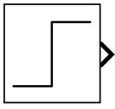
Step 4: The acceleration Step block
Step parameter | Value
Step time | step_time
Initial value | 0
Final value | input_g*g0
Sample time | 0
1g input = 9.80665 m/s²
Rename the block Step acceleration.
12
Notes:
Add Step from Sources and enter the listed values. The output is acceleration in SI units. input_g is the amplitude in g, and multiplying by g0 converts it to m/s^2. The step occurs at five milliseconds. The screenshot is an actual model-diagram export from local Simulink.

Slide 13
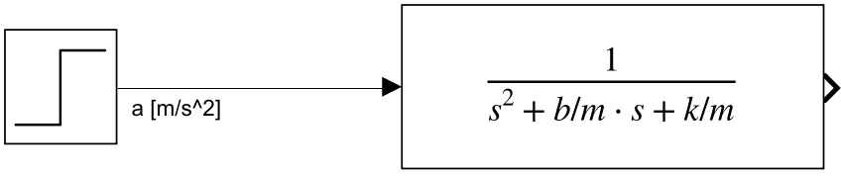
Step 5: The mechanical Transfer Fcn
Transfer Fcn parameter | Value
Numerator coefficients | [1]
Denominator coefficients | [1 b/m k/m]
Coefficients follow descending powers of s. The output is displacement in meters.
13
Notes:
Add the continuous Transfer Fcn block and connect Step to its input. The acceleration-to-displacement transfer function has a normalized denominator and numerator one. If the input were force, the transfer function would instead use denominator m*s^2+b*s+k. Do not combine a force-input denominator with an acceleration input without including the mass factor.
Sources:
https://www.mathworks.com/help/simulink/slref/transferfcn.html

Slide 14
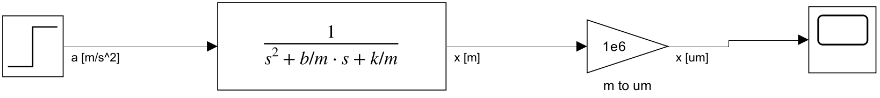
Step 6: Displacement units and Scope
Add Gain with value 1e6, then add Scope.
Signal location | Unit
Transfer Fcn output | m
Gain output / Scope display | um
14
Notes:
Add Gain and Scope, then connect Transfer Fcn to Gain and Gain to Scope. A gain of one million converts meters into micrometers for display. The mechanical equation and transfer function still operate in SI units. Rename the unit-conversion block clearly so students do not confuse it with physical sensor gain.

Slide 15
Step 7: First run and steady-state check
Click Run. Open Scope and use Autoscale to fit the signal.
At 1g: x(final) = g0 m/k = 0.2484 um
15
Notes:
Run the minimal model, open Scope and use autoscale if needed. The example curve comes from the completed local experiment, with the same transfer-function branch. The two traces overlap because the other realization is mathematically equivalent. After the step at five milliseconds, the final displacement should be 0.2484 micrometers. Pause here and check students can explain why the final value equals g0*m/k.

Slide 16
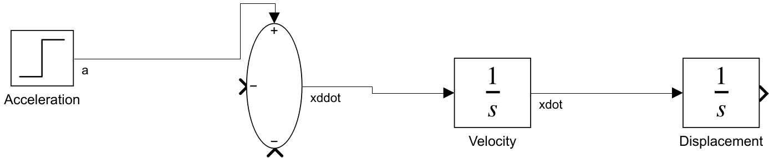
Step 8: The two-integrator realization
xddot = a - (b/m) xdot - (k/m) x
Block | Setting
Sum | List of signs: +--
Both Integrators | Initial condition: 0
16
Notes:
Start a second branch from the same acceleration signal. Add Sum and two continuous Integrator blocks. Set the Sum list of signs to +-- and both initial conditions to zero. Sum outputs xddot; the first integrator outputs xdot; the second outputs x. The two negative inputs will be connected on the next slides. This partial model is not ready to run yet.

Slide 17
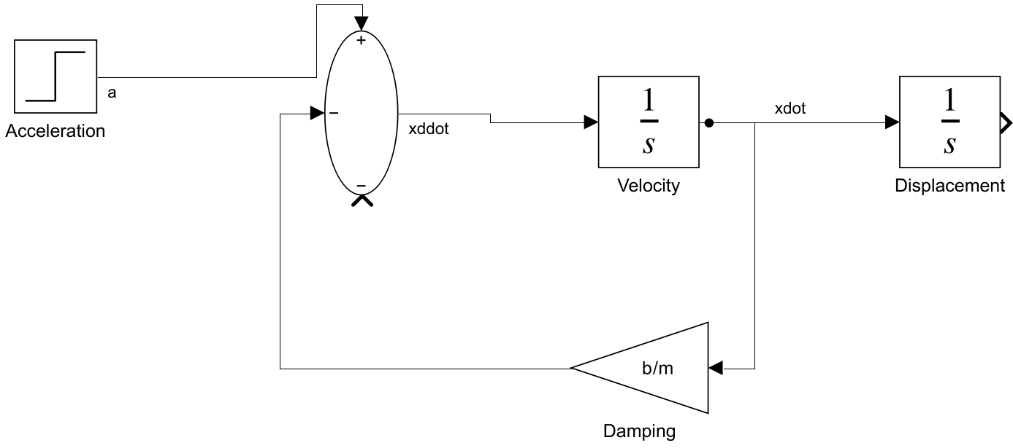
Step 9: Damping feedback
Branch xdot through a positive Gain b/m to a negative Sum port.
Physical term: -(b/m) xdot
17
Notes:
Branch the signal between the two integrators. Add Gain with value b/m, orient it to fit the return path, and connect its output to a negative Sum port. The negative sign is in the Sum block, so the Gain value stays positive. This return path implements the damping term. The stiffness port is still unconnected.

Slide 18
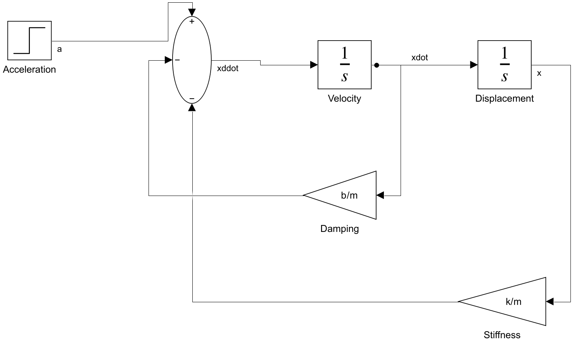
Step 10: Stiffness feedback
Branch x through a positive Gain k/m to the other negative Sum port.
Physical term: -(k/m) x
18
Notes:
Branch the displacement signal after the second integrator. Add Gain k/m and return it to the remaining negative Sum port. With both feedback terms in place, the acceleration equation is complete. Again, the sign is supplied by the Sum port rather than a negative Gain value.

Slide 19
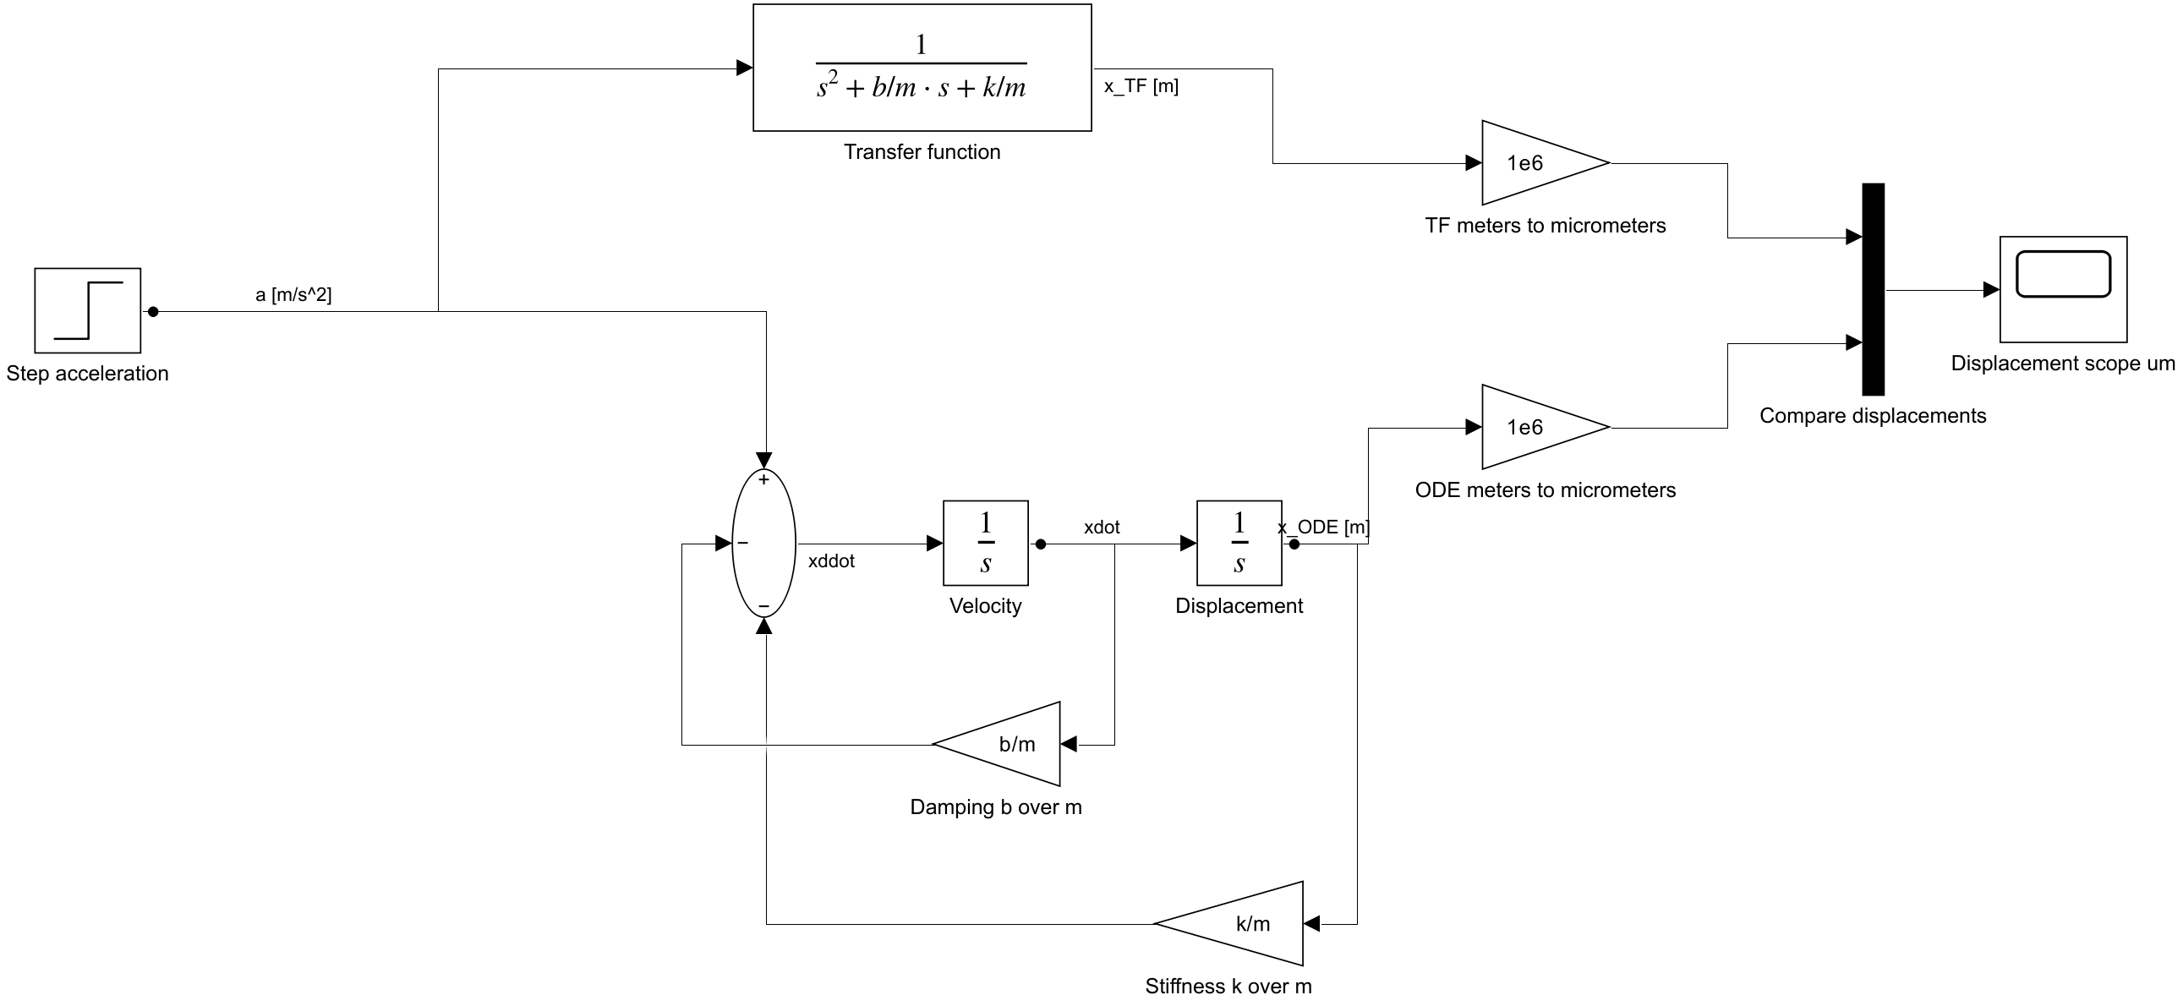
Step 11: Comparison of both outputs
Add a second 1e6 Gain and a Mux with Number of inputs = 2.
Scope channel 1: x_TF in um Channel 2: x_ODE in um
19
Notes:
The Step signal drives both mechanical realizations. Keep one Gain of one million on the transfer-function output and add another on the second integrator output. Add Mux with two inputs, connect these converted signals to its two data ports, and connect Mux to the existing Scope. The screenshot shows the complete mechanical comparison before sine selection and logging are added.

Slide 20
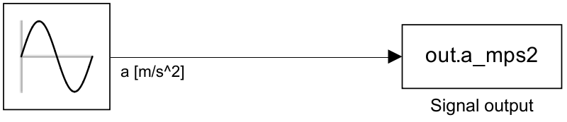
Step 12: A continuous Sine Wave input
Sine Wave parameter | Value
Sine type / time source | Time based / Use simulation time
Amplitude | input_g*g0
Bias / Phase | 0 / 0
Frequency (rad/sec) | 2*pi*freq_hz
Sample time | 0
For 100 Hz, enter 2*pi*100 rad/s through the freq_hz variable.
20
Notes:
Use the Simulink Sources Sine Wave block with time-based behavior and simulation time as the source. Set the amplitude in SI acceleration units and frequency in radians per second. freq_hz remains a convenient user variable in hertz. The diagram export shows the source connected to an input log for clarity.
Sources:
https://www.mathworks.com/help/simulink/slref/sinewave.html

Slide 21
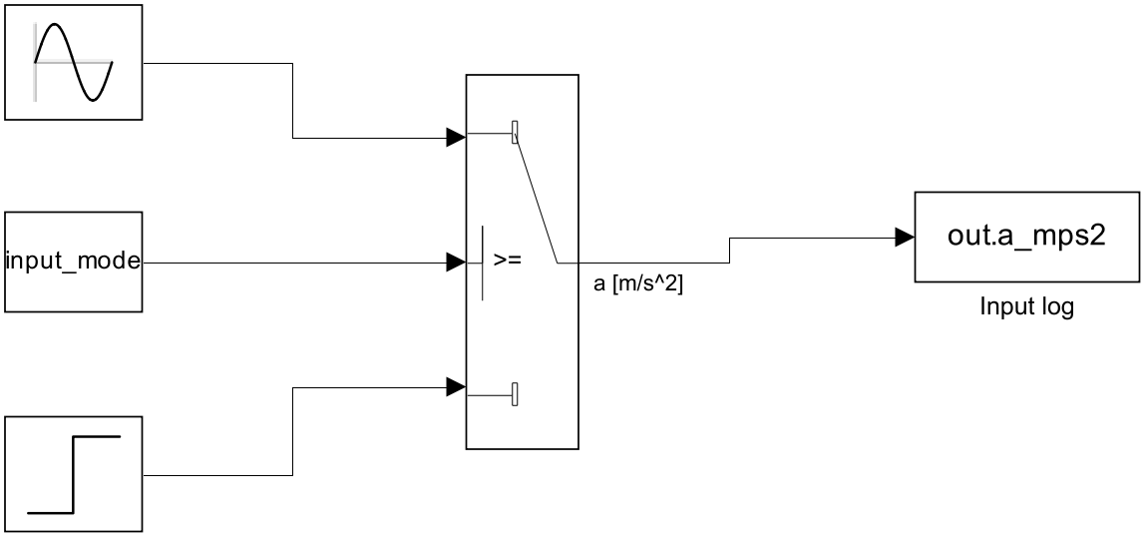
Step 13: Step / sine input selection
Switch port | Connect
Top data port | Sine Wave
Middle control port | Constant: input_mode
Bottom data port | Step
Criterion: u2 >= Threshold
Threshold: 0.5
input_mode = 0 selects Step
input_mode = 1 selects Sine
21
Notes:
Add Constant and Switch. Set Constant to input_mode, the Switch criterion to u2 >= Threshold, and the threshold to 0.5. The top data port receives sine, the middle port receives the constant control, and the bottom data port receives step. Replace the old direct Step connection so Switch output feeds both mechanical branches. Keep input_mode numeric, as in the initialization code.
Sources:
https://www.mathworks.com/help/simulink/slref/switch.html

Slide 22
Step 14: Time-series logging
Signal to branch | Variable name | Stored unit
Switch output | a_mps2 | m/s²
Transfer Fcn output, before Gain | x_tf_m | m
Second Integrator output, before Gain | x_ode_m | m
Each To Workspace: Save format = Timeseries
Model Settings: Data Import/Export, Single simulation output enabled.
out.a_mps2 out.x_tf_m out.x_ode_m
22
Notes:
Add three To Workspace blocks and branch the indicated signals into them. Use unique variable names, Timeseries format, decimation one and no limit on the number of saved data points. Keep the logs before the micrometer conversion, so the displacement arrays remain in SI units. Enable Single simulation output in Model Settings, Data Import/Export. With an output object named out, use the three listed fields to access the logged data.
Sources:
https://www.mathworks.com/help/simulink/slref/toworkspace.html

Slide 23
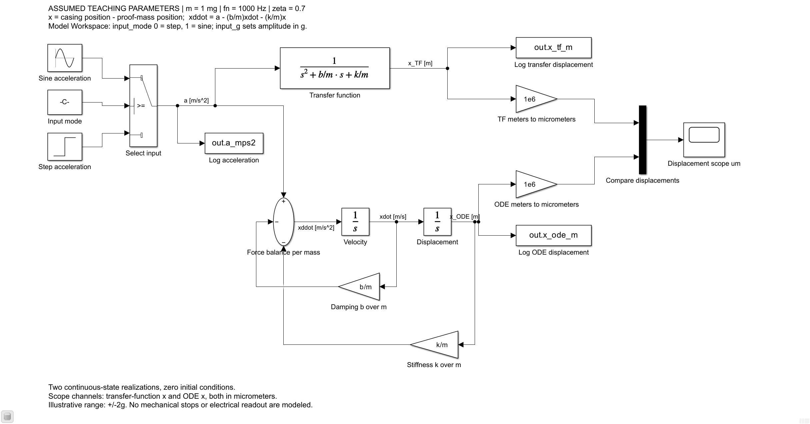
Completed Simulink model
One input, two mechanical realizations, a shared Scope and three data logs.
23
Notes:
This is the original screenshot supplied by the instructor. Preserve it as the reference overview. Students should identify the shared input, the transfer-function branch, the two integrators and the two feedback gains, then identify the unit-conversion Gains and data logging blocks. The coordinate convention is shown in the screenshot.

Slide 24
Step 15: Final run and acceptance checks
Run | Model Workspace / setting | Expected result
Step | input_mode = 0, Stop time = 0.03 | Final displacement 0.2484 um
Sine at 100 Hz | input_mode = 1, freq_hz = 100, Stop time = 0.08 | Relative gain 1.00015
Sine at 1000 Hz | freq_hz = 1000, Stop time = 0.03 | Relative gain 0.71429
Sine at 5000 Hz | freq_hz = 5000, Stop time = 0.03 | Relative gain 0.04000
Relative gain = sine displacement amplitude / static displacement at 1g.
24
Notes:
Start with the step input and confirm both displacement traces coincide. The listed step checks are from the actual local baseline run. For the 100-hertz sine, use at least 80 milliseconds so the first few cycles do not dominate the measurement; inspect the last three cycles. For one and five kilohertz, 30 milliseconds is sufficient for the chosen model. Change only the appropriate Model Workspace variables and save.

Slide 25
Common setup errors
Symptom | Check
Undefined m, b, k or input variable | Model Workspace initialization and exact variable names
Wrong oscillation or instability | Sum signs +--, positive Gains b/m and k/m
Displacement is too large or small | Acceleration in m/s², 1e6 Gain only for Scope display
Sine frequency is incorrect | Sine Wave Frequency uses 2*pi*freq_hz in rad/s
Wrong input appears | Sine top, control middle, Step bottom, threshold 0.5
Parameter edits have no effect | Edit the Model Workspace and reinitialize its source
For your own experiment, replace assumed values with a cited, consistent literature set.
25
Notes:
Use this slide while students debug their own models. An undefined expression often indicates a variable is not in the model workspace or the initialization code has not run. A rising or unstable response may be a feedback sign mistake. A unit mistake can create a million-fold scale error. Model Workspace variables can hide changes made to identically named variables in the base workspace.

Slide 26
Simulation results: 1g step response
m = 1 mg, fn = 1000 Hz, zeta = 0.7, zero initial conditions
Both models reach 0.2484 um after the same transient.
26
Notes:
The input jumps from zero to 1g at t = 5 ms. Both displacement signals below are saved outputs of actual local Simulink runs. The traces overlap. Their agreement checks the mapping between the normalized transfer function and the two-integrator equation. Source: simulation_results.mat and sine_validation.csv from the verified local MATLAB R2024b / Simulink 24.2 run. Assumed teaching parameters, not a measured device.

Slide 27
Step-response metrics
Metric | Simulink result | Theory / interpretation
Steady-state displacement | 0.248405 um | g0 m/k = 0.248405 um
Overshoot | 4.598793% | 4.598791%
2% settling time | 0.952 ms | Approximation: 0.909457 ms
Maximum model difference | 1.29e-26 m | Floating-point agreement
Settling time starts at the input step, not at simulation time zero.
A tolerance band and a stated time reference make the metric reproducible.
27
Notes:
The final displacement is obtained from the saved baseline output. The overshoot prediction uses exp(-pi*zeta/sqrt(1-zeta^2)). The measured 2-percent settling time is the time after the step when the output finally remains within the tolerance band. The expression 4/(zeta*wn) is only a common approximation. The difference between the two realizations is at floating-point precision. Source: simulation_results.mat and sine_validation.csv from the verified local MATLAB R2024b / Simulink 24.2 run. Assumed teaching parameters, not a measured device.

Slide 28
Damping comparison: step response
Same m and k. Only b changes to set zeta = 0.1, 0.7 or 1.5.
Damping changes the transient. Static sensitivity remains m/k.
28
Notes:
Mass and stiffness remain fixed. Damping is recalculated using b = 2*zeta*m*wn for each chosen ratio. All traces are actual local Simulink output. Normalization uses the common steady-state displacement at 1g. A small damping ratio produces strong ringing. The overdamped case rises more slowly without overshoot. Source: simulation_results.mat and sine_validation.csv from the verified local MATLAB R2024b / Simulink 24.2 run. Assumed teaching parameters, not a measured device.

Slide 29
Damping comparison: frequency response
Analytical response of the three mechanical parameter sets
Lower damping produces a stronger resonance peak.
29
Notes:
The frequency curves are evaluated analytically from the same parameter sets. They are not a new broadband Simulink sweep. Frequency is logarithmic and gain is normalized to DC. The small-damping peak is near 990 Hz for zeta = 0.1, rather than exactly at the undamped natural frequency. A clearly visible peak is not required for zeta = 0.7. Source: simulation_results.mat and sine_validation.csv from the verified local MATLAB R2024b / Simulink 24.2 run. Assumed teaching parameters, not a measured device.

Slide 30
Sinusoidal response at 100 Hz
Last three cycles, 1g input, baseline damping ratio 0.7
Relative gain 1.00015 Phase -8.049 deg
30
Notes:
Input amplitude is 1g. This plot uses the final three steady-state cycles from the original Simulink run. The input is divided by 1g and displacement is divided by the static displacement at 1g. Therefore the relative output amplitude directly gives the transfer-function gain normalized to DC. Amplitude and phase were estimated by sine/cosine least-squares fitting. Source: simulation_results.mat and sine_validation.csv from the verified local MATLAB R2024b / Simulink 24.2 run. Assumed teaching parameters, not a measured device.

Slide 31
Sinusoidal response at 1000 Hz
Last three cycles, 1g input, baseline damping ratio 0.7
Relative gain 0.71429 Phase -90.000 deg
31
Notes:
Input amplitude is 1g. This plot uses the final three steady-state cycles from the original Simulink run. The input is divided by 1g and displacement is divided by the static displacement at 1g. Therefore the relative output amplitude directly gives the transfer-function gain normalized to DC. Amplitude and phase were estimated by sine/cosine least-squares fitting. Source: simulation_results.mat and sine_validation.csv from the verified local MATLAB R2024b / Simulink 24.2 run. Assumed teaching parameters, not a measured device.

Slide 32
Sinusoidal response at 5000 Hz
Last three cycles, 1g input, baseline damping ratio 0.7
Relative gain 0.04000 Output amplitude 9.936 nm Phase -163.740 deg
32
Notes:
Input amplitude is 1g. This plot uses the final three steady-state cycles from the original Simulink run. The input is divided by 1g and displacement is divided by the static displacement at 1g. Therefore the relative output amplitude directly gives the transfer-function gain normalized to DC. Amplitude and phase were estimated by sine/cosine least-squares fitting. Source: simulation_results.mat and sine_validation.csv from the verified local MATLAB R2024b / Simulink 24.2 run. Assumed teaching parameters, not a measured device.

Slide 33
Sinusoidal response: numerical validation
Frequency | Gain: theory | Gain: Simulink | Phase: theory | Phase: Simulink
100 Hz | 1.00015 | 1.00015 | -8.049 deg | -8.049 deg
1000 Hz | 0.71429 | 0.71429 | -90.000 deg | -90.000 deg
5000 Hz | 0.04000 | 0.04000 | -163.740 deg | -163.740 deg
All three frequencies agree with the analytic gain and phase.
For the baseline model: static displacement at 1g = 0.248405 um.
33
Notes:
The table compares the analytic transfer function against estimates extracted from the actual Simulink sine outputs. The output gain is normalized to DC and phase is in degrees. Agreement is shown at the displayed precision. In the original validation script all three frequencies met a relative gain tolerance of 1e-5 and a phase tolerance of 0.01 degree. Source: simulation_results.mat and sine_validation.csv from the verified local MATLAB R2024b / Simulink 24.2 run. Assumed teaching parameters, not a measured device.

Slide 34
Bode magnitude: model and simulation
Continuous curve: analytical model. Points: Simulink sine runs.
Mechanical half-power bandwidth: 1010.05 Hz
34
Notes:
The blue curve is the normalized analytic transfer function. Orange points are gain measurements extracted from the three actual Simulink sine runs. The dashed horizontal line is the half-power amplitude level 1/sqrt(2), which is -3.0103 dB. Its crossing is about 1010.05 Hz. The source data for both the analytic line and the measured points remain editable in the presentation. Source: simulation_results.mat and sine_validation.csv from the verified local MATLAB R2024b / Simulink 24.2 run. Assumed teaching parameters, not a measured device.

Slide 35
Bode phase: model and simulation
Baseline mechanical response, zeta = 0.7
Phase at 1000 Hz: -90 deg. High-frequency lag approaches -180 deg.
35
Notes:
The analytic model predicts increasing phase lag as frequency rises. At the undamped natural frequency, this normalized second-order transfer function has -90-degree phase. At high frequency the lag approaches -180 degrees. Orange points are fitted phase values from actual Simulink sine runs. Frequency is on a logarithmic scale. Source: simulation_results.mat and sine_validation.csv from the verified local MATLAB R2024b / Simulink 24.2 run. Assumed teaching parameters, not a measured device.

Slide 36
Sensitivity and bandwidth interpretation
Quantity | Baseline value | Definition
Static sensitivity | 0.248405 um/g | Mechanical displacement per 1g
Displacement at 2g | 0.496811 um | Linear-model prediction
Undamped natural frequency | 1000 Hz | sqrt(k/m) / (2 pi)
Half-power bandwidth | 1010.05 Hz | Gain relative to DC = 1/sqrt(2)
Example 1% amplitude band | About 405 Hz | Amplitude error <= 1%, no phase limit
Measurement bandwidth requires stated amplitude and phase tolerances.
36
Notes:
The mechanical sensitivity is m/k and has displacement-per-acceleration units. Multiply by g0 and convert to micrometers for the listed value. The example 2g displacement is a linear-model prediction rather than a proof of available travel. Half-power bandwidth is an amplitude criterion. An example amplitude-error requirement of one percent gives a much smaller frequency range, about 404.8 Hz for this model. This latter estimate uses the analytical magnitude response only and imposes no phase constraint. Source: simulation_results.mat and sine_validation.csv from the verified local MATLAB R2024b / Simulink 24.2 run. Assumed teaching parameters, not a measured device.

Slide 37
Results for the student experiment report
Include | Explain
Parameter provenance | Paper citation, units, coordinate and assumptions
Step-response plot | Static sensitivity, overshoot and settling definition
Damping comparison | What changes when b changes at fixed m and k?
Sine response and Bode plots | Measured gain and phase against model predictions
Performance interpretation | Measurement accuracy criterion and model scope
Compare your literature-based device with the demonstration model.
37
Notes:
The assumed data establish a reproducible reference experiment. Students should explain how their literature parameter set changes the response and why. Ask them to include input conditions, plots with units, numerical metrics and comparison with theory. Readout noise and mechanical nonlinearity are not covered by the current linear model. Their report should state the scope of any additional claims.

Slide 38
AI use in this course
AI is optional
Responsible AI use is encouraged
100 / 100
AI may assist literature searches, modeling, code, simulation, figures and writing.
Excellent AI-free work can earn full marks.
The same academic standards apply to every student.
The university does not provide free AI access.
There is no bonus simply for using AI.
You are not required to purchase or use an AI tool.
38
Notes:
Course policy specified by the instructor: AI is optional because the university does not provide free AI access. Excellent AI-free work can receive 100/100. Encourage responsible AI assistance while applying the same academic standards to all reports. There is no score bonus simply for using AI. Assessment remains report-only.

Slide 39
Requirements for AI-assisted reports
Requirement | What the report must show
1. Responsibility and verification | Check original sources, units, assumptions, settings and results against theory. You are responsible for the final report.
2. AI assistance and verification record | Record 2–3 important contributions or decisions: AI input, your check, and what you adopted, modified or rejected.
3. Agent and model identification | List each agent/tool, version when available, LLM provider and exact displayed model/version, and the tasks it supported.
Failure to meet these requirements constitutes AI misuse in this course.
39
Notes:
Course policy specified by the instructor. AI-assisted submissions must meet technical responsibility and verification requirements, include a concise AI assistance and verification record covering two or three important contributions or decisions, and disclose every agent/tool plus the model provider and exact displayed model/version. Missing or false disclosure and failure to meet these conditions constitute improper AI use in this course. Ordinary technical mistakes should be distinguished from fabricated evidence or false claims of verification. No oral examination or extra submission is introduced.

Slide 40
AI disclosure inside the report
Disclosure field | Required content
Agent / tool | Each product or agent name, plus its version when available
Large language model | Provider and exact displayed model name / version
Role in the work | Which parts of the report or experiment it assisted
Verification and decisions | 2–3 entries: AI contribution, your check, final decision and evidence
If no AI was used: a brief declaration is sufficient. No AI decision log is required.
If a tool hides its model identity, ask the instructor before assessed use. Never invent it.
40
Notes:
Students submit only the report. Add a short AI use and verification subsection when AI has been used. Every agent or tool must be identified separately, even if several tools use the same model. Record the provider and exact model/version label shown by the tool, rather than guessing the backend. If the model identity is hidden, seek clarification from the instructor before using that tool for assessed work. An AI-free report needs no AI decision log; a brief No AI tools were used statement is sufficient. Correct AI recommendations can be adopted after verification. Do not require fabricated errors or complete chat histories.

Slide 41
Optional bonus routes
Core experiment: 100 points. Optional extension: up to 10 bonus points.
AI use in the assessed work | Eligible bonus project
No AI used anywhere | Independent COMSOL structural modeling, parameter extraction and validation
AI used in any part | Create or improve a reusable MEMS skill and test its function
For AI-assisted work, COMSOL modeling alone earns no bonus.
One eligible route. No stacking. Both extensions are optional.
41
Notes:
Instructor-approved course policy. The core experiment is marked out of 100 and excellent work without AI can earn 100/100. Additional work can earn up to 10 bonus points. No AI use throughout the assessed work, including the core experiment, report and extension, qualifies for the COMSOL route. Any AI use places the student on the reusable skill route. COMSOL modeling alone earns no bonus for AI-assisted work. The routes are optional and mutually exclusive. A COMSOL automation skill can qualify on the skill route when the submission meets the skill requirements. Report-only assessment continues.

Slide 42
COMSOL extension without AI
Report evidence | What to show
Physical model | Geometry, materials, constraints, loads and assumptions
Structural results | Relevant displacement or mode-shape plots and extracted parameters
Verification | Mesh-refinement comparison and an analytical or cited check
Simulink connection | Consistent coordinate, mode and parameter definitions
COMSOL operation is not taught in this session.
State damping assumptions. Include a model link and the tested version in the report.
42
Notes:
This is independent optional work, not a COMSOL tutorial. The entire assessed submission must be prepared without AI for this bonus route. A small, physically meaningful structure is sufficient. The report should state geometry and sources, materials, constraints and loads, studies and mesh settings. Show displacement or relevant mode-shape results, mesh refinement and an independent analytical or cited comparison. Explain which structural parameters are extracted and how they enter the same coordinate and mode of the Simulink model. State assumptions for damping; an undamped eigenfrequency alone does not determine damping. Include a teacher-accessible link to the COMSOL model and its reported version in the report.

Slide 43
A small reusable MEMS skill
One clear function, with a workflow another agent can follow.
Element | What the skill specifies
Purpose and interface | When to use it, required inputs, units and expected outputs
Technical workflow | Sources, assumptions and actionable execution steps
Verification and limits | Output checks and handling of missing or unsuitable input
Reusable package | SKILL.md, with scripts, references or templates as needed
Code is optional. Explain your own choices and improvements.
43
Notes:
A narrowly scoped function is enough. Students organize their technical understanding into a reusable agent workflow. The Agent Skills specification defines a skill directory with a required SKILL.md containing name, description and instructions. Supporting scripts, references and assets are optional. For this course, require explicit inputs and outputs, technical sources, steps, verification and limitations. AI may assist skill authoring. Students may adapt an existing open-source skill with attribution and a clear explanation of their improvements. A generic prompt or paper collection needs an actionable workflow and output checks to qualify. Do not require a complete device design or universal agent compatibility.
Sources:
https://agentskills.io/specification

Slide 44
Example skill functions
Small function | Example output
Create one Simulink branch | A second-order model, one run and exported response data
Extract paper parameters | Values, units, source locations and missing information
Convert m, fn and zeta | Consistent k and b, with unit and input checks
Analyze response data | Sensitivity, overshoot or settling time with definitions
Generate Bode plots | Magnitude and phase with stated conventions
Estimate capacitive readout | Displacement-to-capacitance results for a specified geometry
A small, well-tested function can earn full bonus credit.
44
Notes:
Examples are course project suggestions, not requirements to implement every function. Each student selects one small function or proposes a similar one. A Simulink skill may use supported scripting rather than GUI control. Literature extraction must record provenance and missing values. Parameter conversion must preserve units and physical definitions. Response metrics must state their definitions. Bode plots include magnitude and phase with clear units and conventions. A capacitive conversion skill should specify its ideal geometry and validity range. A COMSOL result-processing or automation skill is also acceptable on the AI route if it is packaged, tested and evaluated as a reusable skill.

Slide 45
Skill testing and report evidence
Test case | What to demonstrate
1. Basic task | The skill performs the function it claims to perform
2. Changed input | It works with another parameter set or dataset
3. Boundary case | It handles missing information or input outside its stated scope
Each case: input, expected result and its basis, actual result, conclusion.
Include actual runs and independent checks. Instructors will test the submitted version.
45
Notes:
Require at least three actual test cases: basic operation, changed input and a boundary case. A boundary case can use naturally missing data or a value outside the stated scope; no artificial AI error is required. For every case, report input, expected result and its basis, actual result and conclusion. Use an independent analytical calculation, hand calculation, cited reference or independent software output as appropriate. Specify acceptance criteria and numerical tolerances appropriate to the task. Instructors will test the version linked in the report in the documented environment and may change an input within the stated scope. Full chat histories and oral demonstrations are not required.

Slide 46
Bonus assessment and sharing
COMSOL route: no AI
Skill route: AI-assisted work
Criterion | Points
Model and physical assumptions | 3
Mesh refinement and validation | 3
Parameters and Simulink connection | 2
Report and reproducibility | 2
Criterion | Points
Useful, correct function | 3
Tests and independent evidence | 3
Instructions and reproducibility | 2
Contribution and limitations | 2
Open source is encouraged. Include the GitHub URL and tested commit or release in the report.
Teacher-accessible private links are acceptable. A repository link alone earns no points.
46
Notes:
Both eligible routes have a maximum of 10 bonus points. COMSOL rubric: correct model and physical assumptions 3; mesh refinement and independent validation 3; consistent parameter extraction and Simulink connection 2; clear report and reproducible model 2. Skill rubric: useful correct function 3; testing with independent evidence 3; clear usage and reproducibility 2; student contribution and stated limitations 2. Only one route applies based on actual AI use across assessed work. Encourage open-source skills, but public release is optional and a link itself earns no marks. Report the repository URL and tested commit or release, setup, agent/model/software versions, test records, sources, improvements and limits. A teacher-accessible private repository or download link is acceptable. Public releases should include README and license. Cite papers rather than redistributing full texts without permission. Assessment remains report-only.

Slide 47
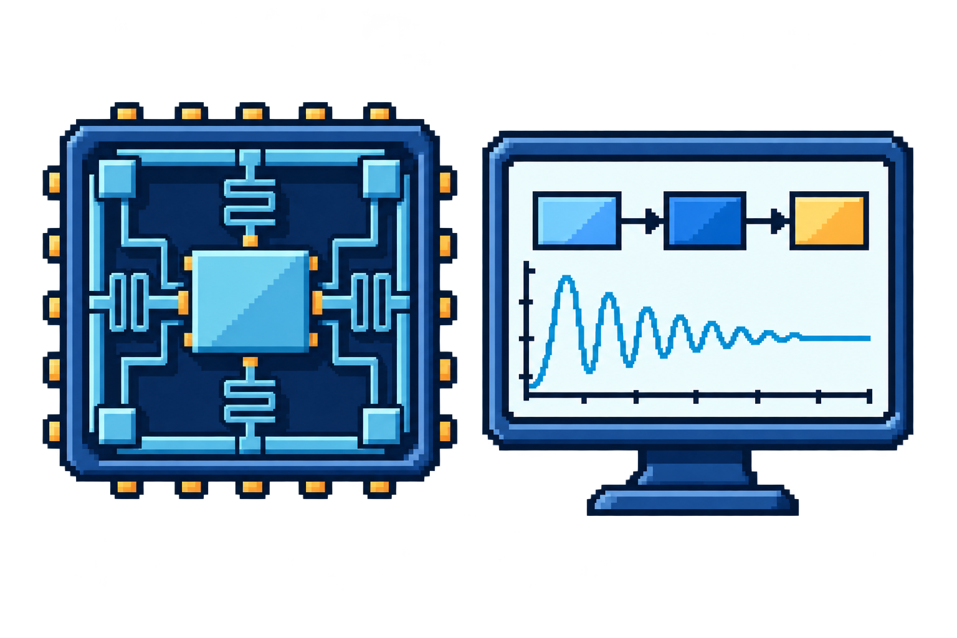
IMEL7011
Thank you!
Questions and ideas are welcome.
MEMS modeling · Simulink · Responsible AI
47
Notes:
Thank you for your attention. Questions and ideas are welcome. Pixel illustration generated with the built-in image_gen tool for this closing slide. It is a decorative course recap, not a quantitative simulation result. Asset: classroom/assets/imel7011-closing-pixel.png.

