Slide 1
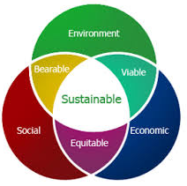
PROJECT STI2D SIN:
CHICKEN COOP
Mr. COULÉON
Mr. MORLET
Mrs. BERNARD
PREVOST Hugo
AJAVON Ralph
CARPENTIER Jérémy
GEOFFROY Alexandre
MARCHAND Romain
Global goal:
Ensure the ventilation and automatic lighting of a chiken coop farm, in order to optimize the development of its occupants.
Personal task:
Acquire and transmit the CO2 level
and display quantities at the entrance to the chiken coop.

Slide 2
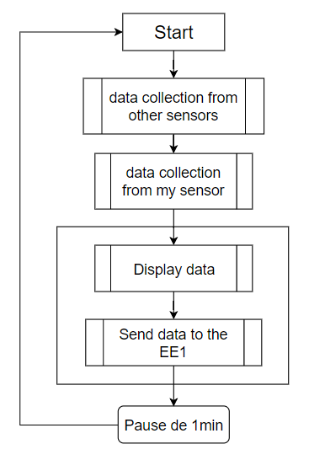
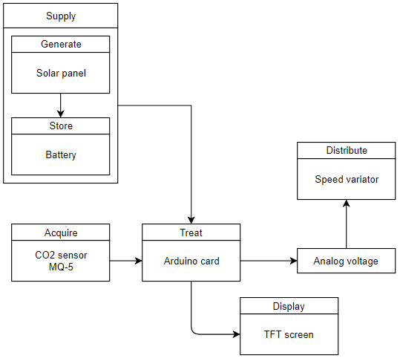
SOLUTION:
Flowchart
Chain of information and energy
2

Slide 3
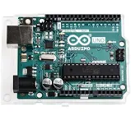
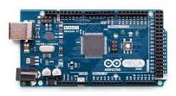
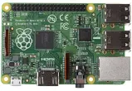
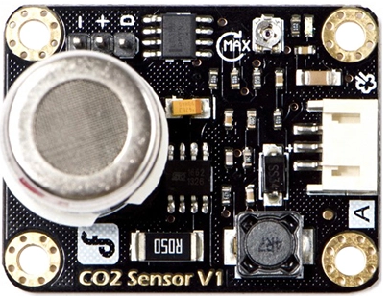

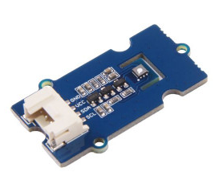
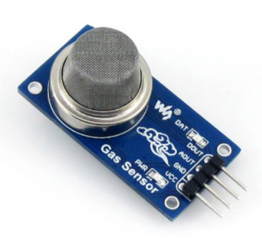
 | Price (€) | Analog PIN | Digital PIN | Consomation (Wh)
Arduino UNO | 5 | 5 | 13 | 0,14
Arduino MEGA | 10 | 16 | 54 | 0,35
Raspberry PI3 | 35 | 17 | 17 | 8
 | Price (€) | Precision (ppm) | Range (ppm)
MG-811 | 62.39 | 13 | 400 - 10k
Gas Groove | 16.90 | 54 | 400 - 60k
MQ-135 | 6.20 | NI | NI
3
NI : Not Identified

Slide 4
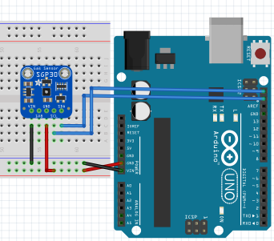
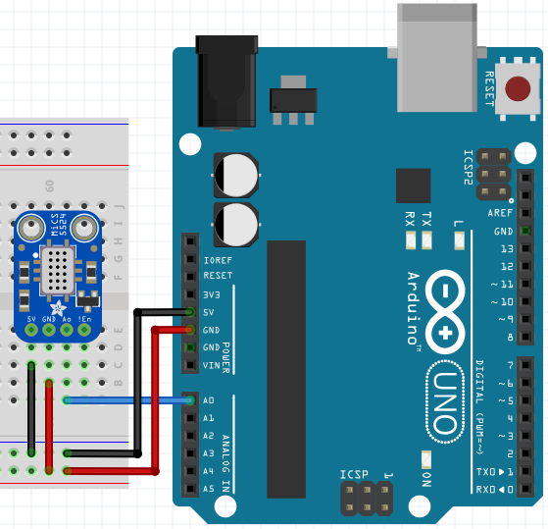
CABLING:
Gas groove:
MQ-811:
4

Slide 5
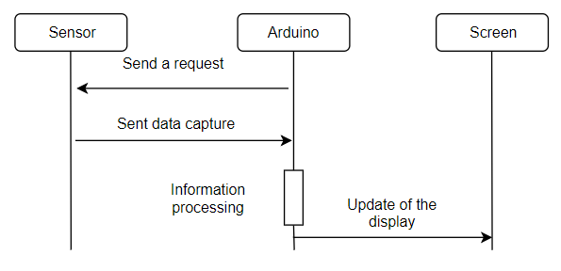



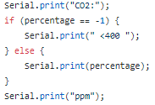

PROGRAMMATION:
Sensor
5

