Slide 1
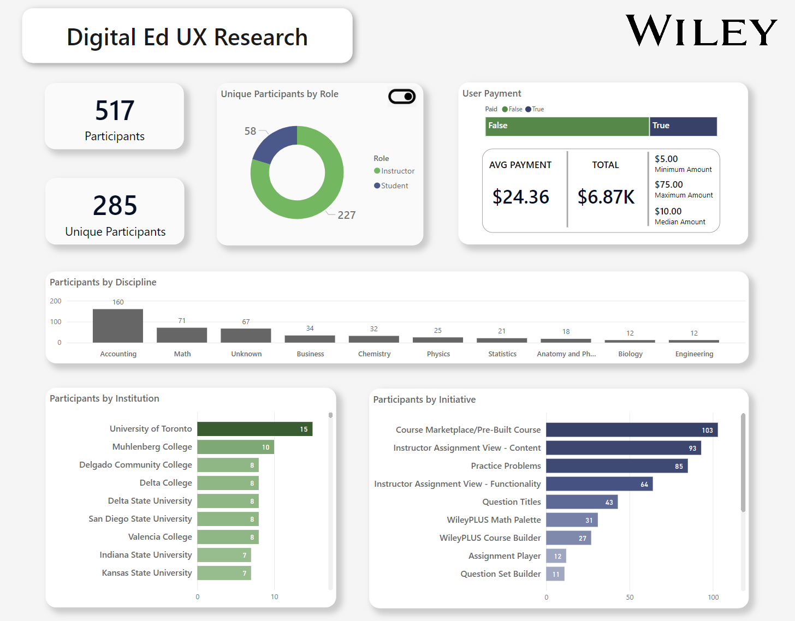

This dashboard (with drill through feature) serves as a repository for UX Research initiatives.

Slide 2
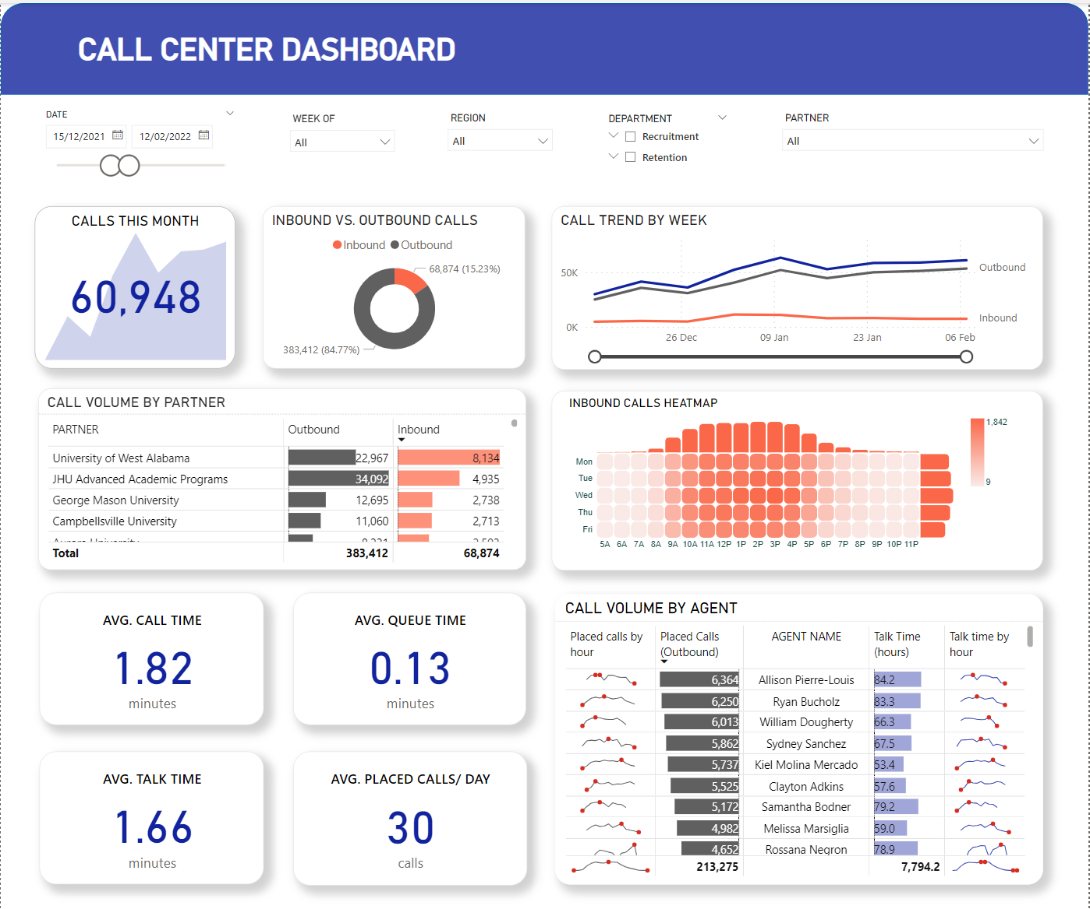







Call center dashboard – built by integrating data from Five9 call system and Salesforce CRM system.
Heatmap created with Deneb custom visual.

Slide 3
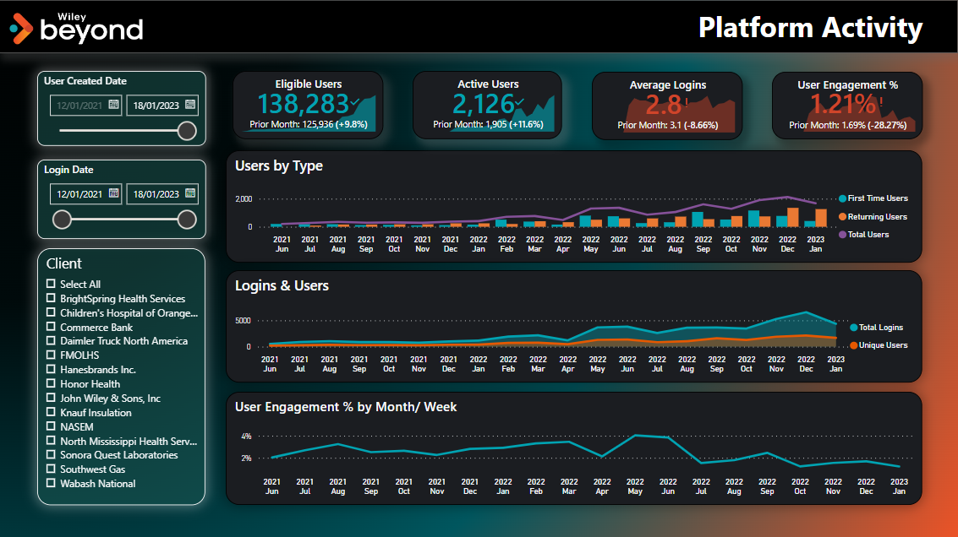

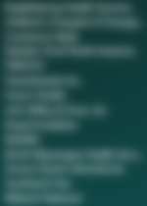
Report on User Activity to an employee (internal and external) benefits program.

Slide 4
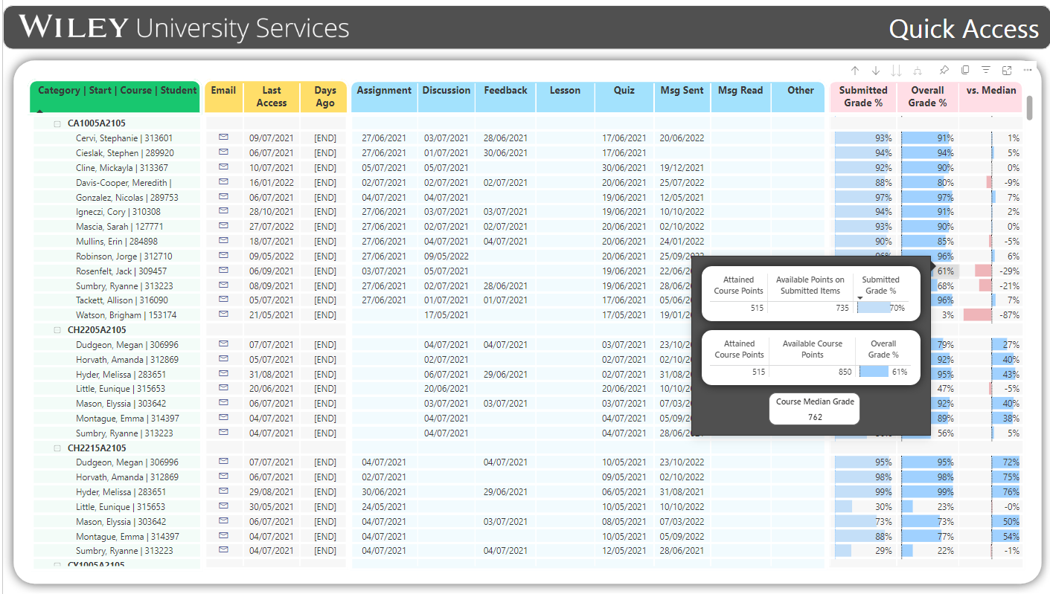



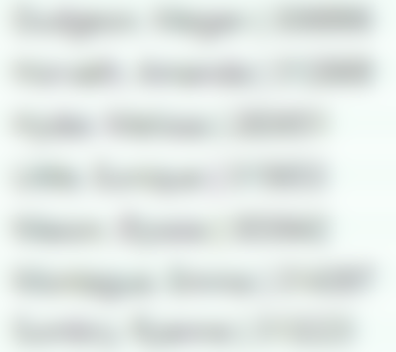
Report on Student Activity, built on Moodle’s Learning Management System data.

Slide 5
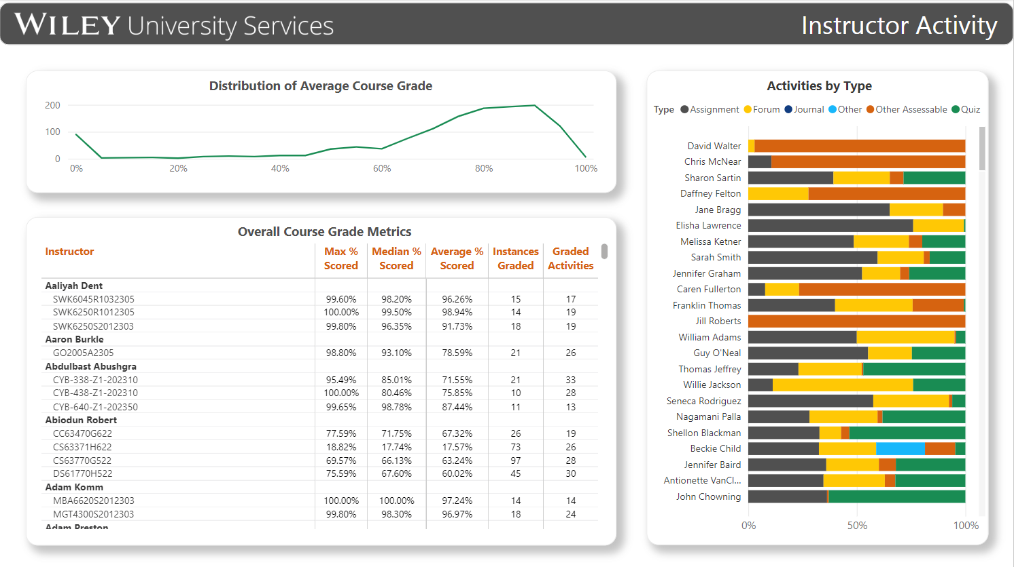


Report on Instructor Activity, built on Moodle’s Learning Management System data.

Slide 6
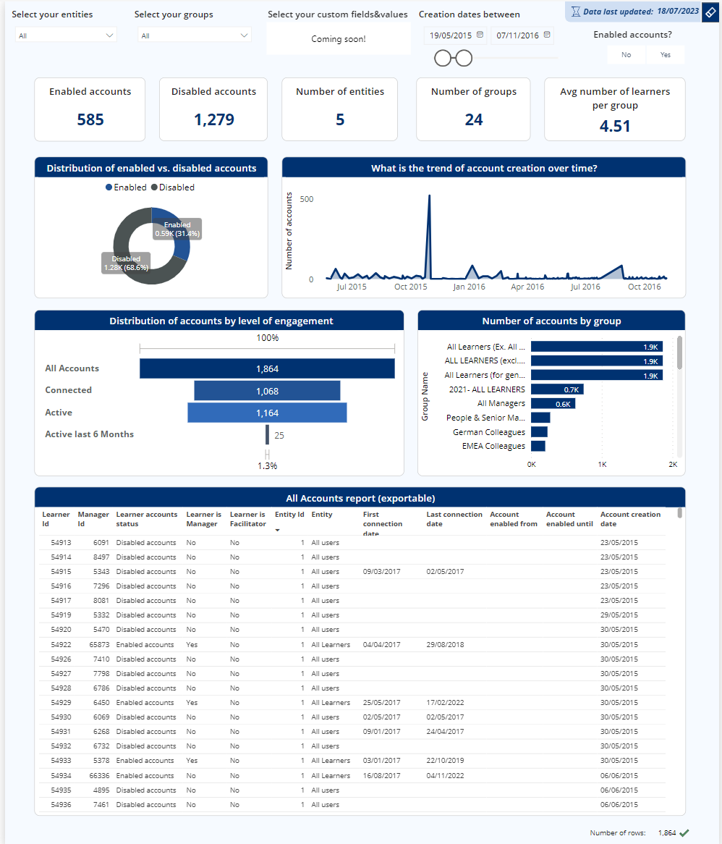


Report on Account statuses, built on an internal Learning Management System data.
This platform serves accounts across multiple countries.

Slide 7
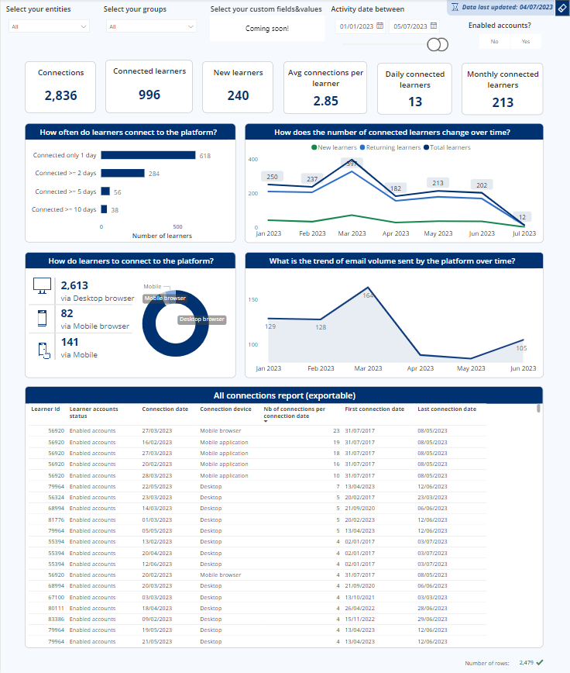

Report on Connections status to a learning platform, built on an internal Learning Management System data.
This platform serves accounts across multiple countries.

