Slide 1

MEDIMATCH · NATIONAL REDISTRIBUTION COMMAND
See surplus. Detect need. Coordinate impact.
Leveraging geospatial intelligence for equitable medical-supply redistribution
Lesnar Gitonga · USIU–Africa · 23 June 2026
Conference demo · synthetic inventory · no patient records

Slide 2
01
SECTION 01
The coordination gap
Why medical-supply redistribution fails today

Slide 3
THE COORDINATION GAP
The problem is not only scarcity. It is disconnected visibility.
Facilities can hold usable surplus while others face urgent shortfalls. MediMatch makes both sides visible in one operating picture.
56.3%
82.8%
57.8%
89.1%
face weekly or monthly stockouts
rate manual methods ineffective or slow
report wastage of valid supplies
willing to pilot the system
A supply gap becomes a coordination question
57%
KEMSA national order-fill rate, as of mid-2025 (per the abstract)
Which available source is close enough, sufficiently stocked, verified, product-compatible—and practical to move now?
The baseline is historical; the deck does not present it as the current 2026 rate.
MEDIMATCH
Sources: MediMatch Nairobi County field study (n=64 healthcare professionals, 80% response, 2025); KEMSA order-fill rate 57%, mid-2025

Slide 4
02
SECTION 02
The field evidence
What 64 healthcare professionals told us

Slide 5
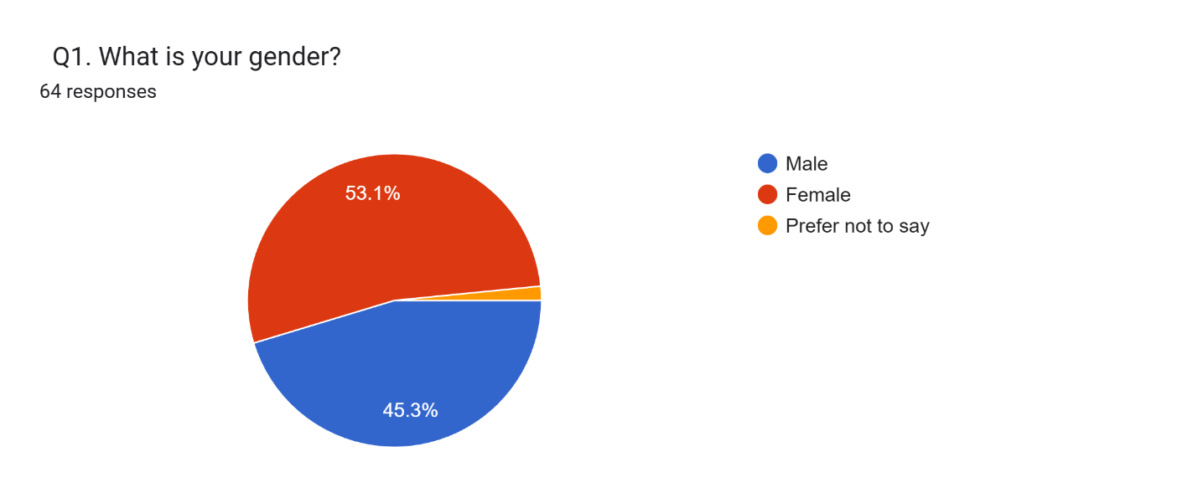
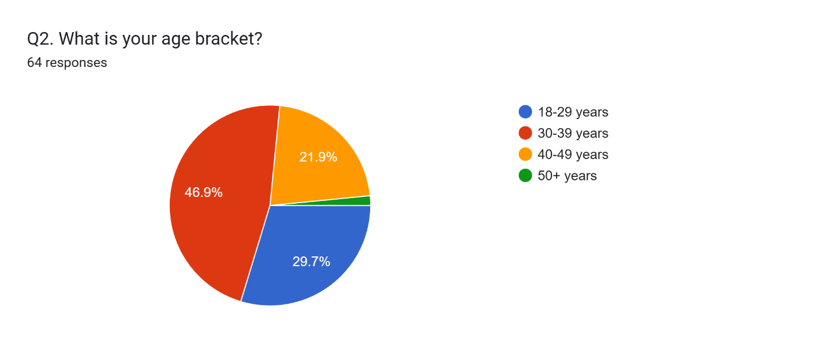
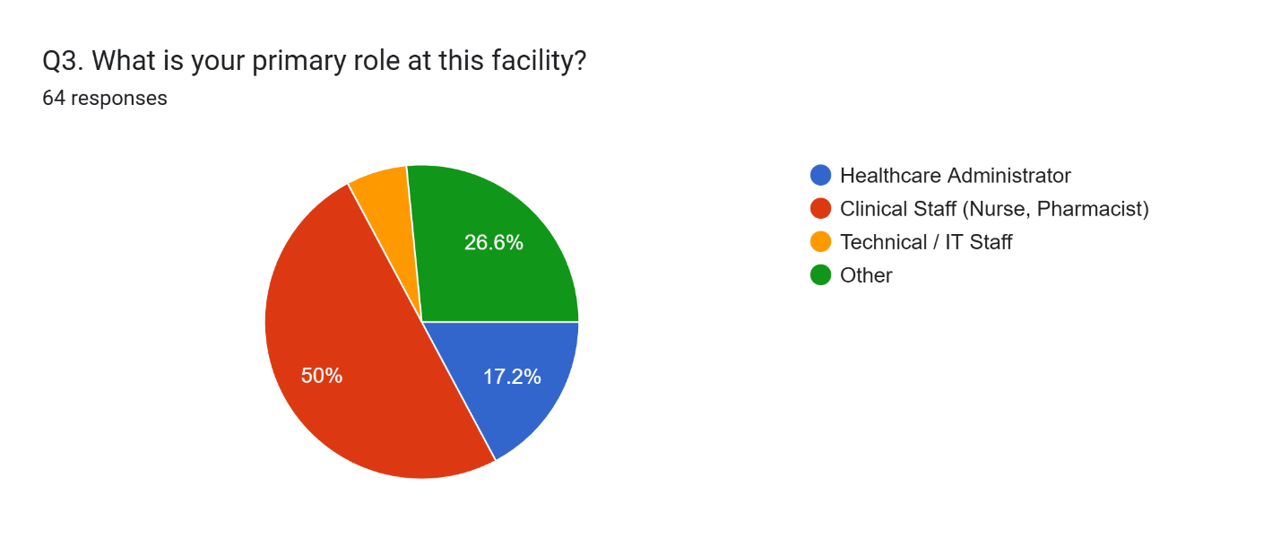
THE FIELD EVIDENCE
Who we surveyed
64 healthcare professionals · Nairobi County · 80% response rate · unedited Google Forms output
A frontline sample — the clinicians and staff who manage stock every day.
Q1 · Gender — slight female majority
Q2 · Age — majority under 40
Q3 · Role — clinical staff majority
MEDIMATCH
Source: MediMatch Nairobi County field study · n=64 · 2025

Slide 6
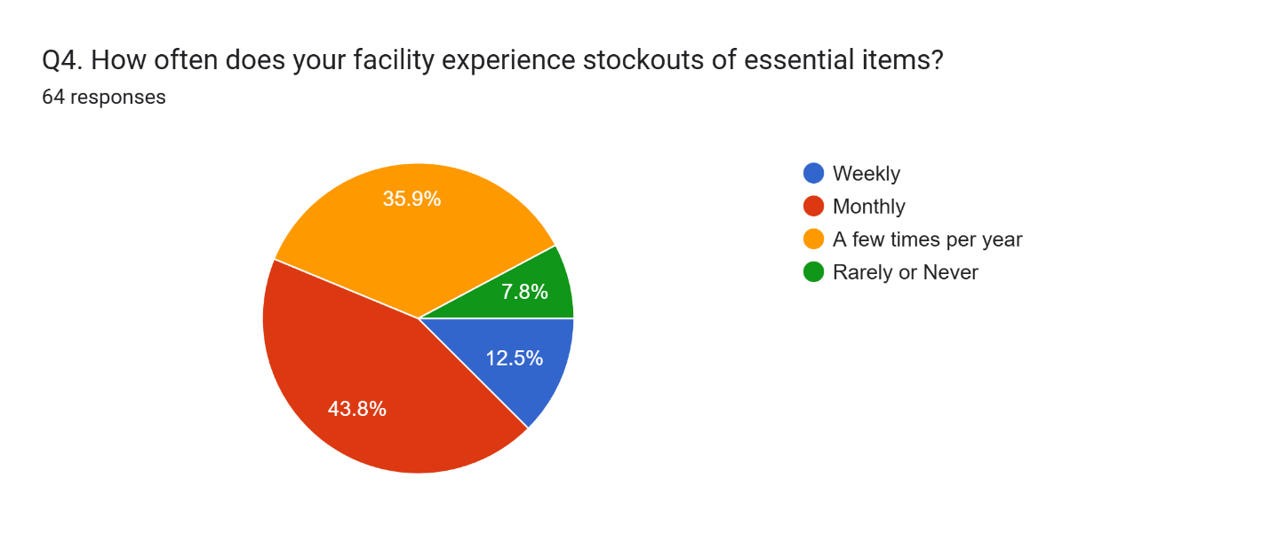
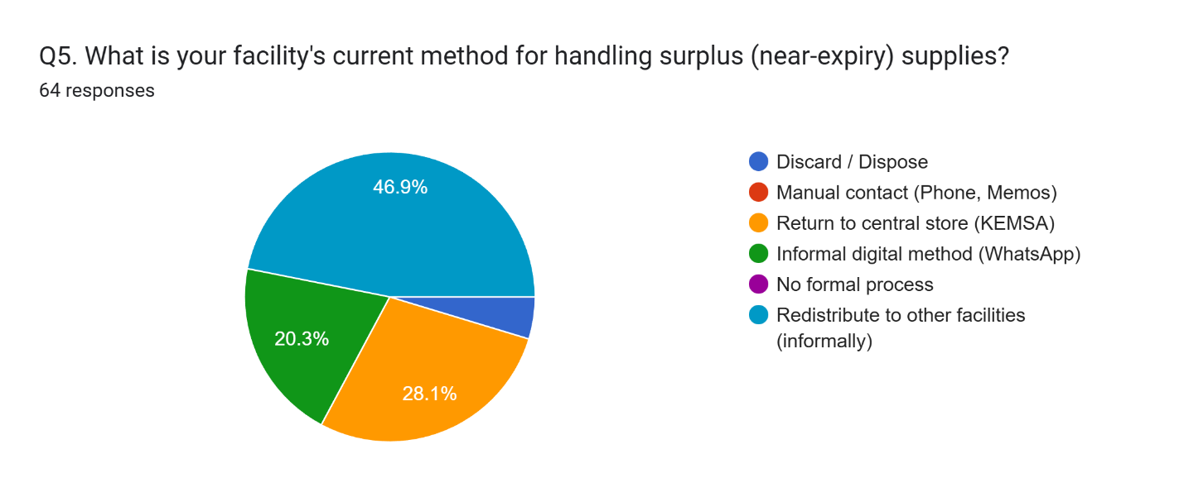
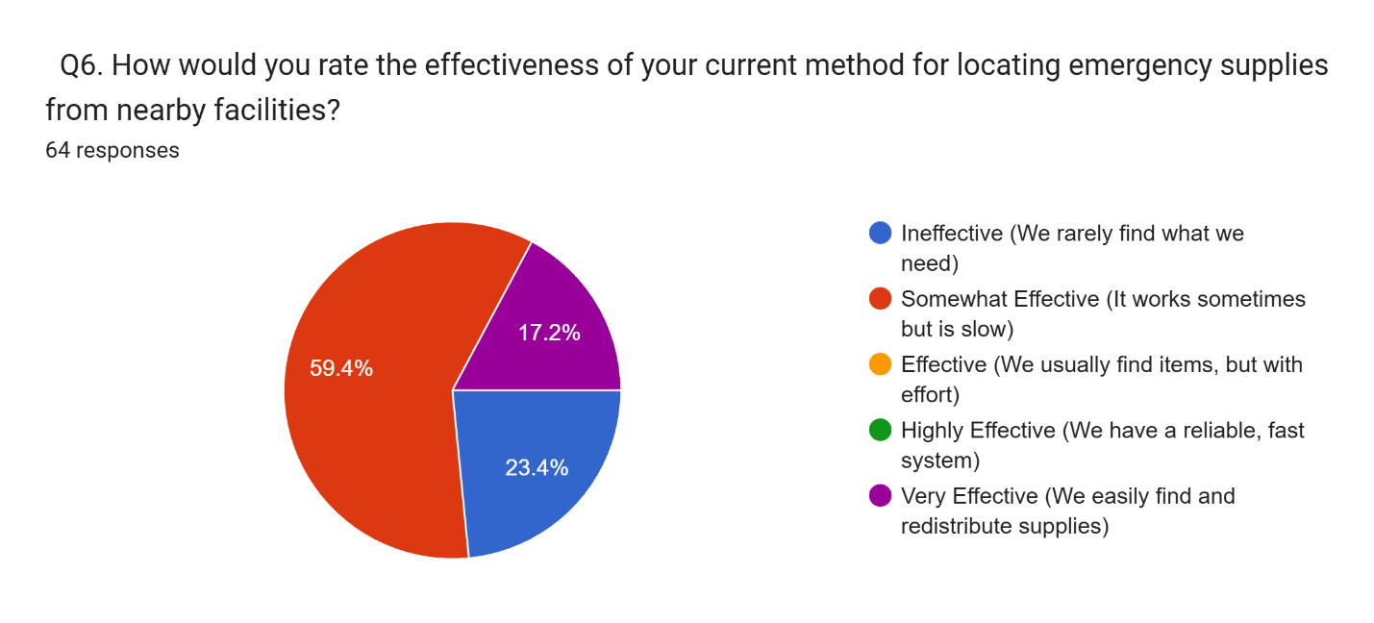
THE FIELD EVIDENCE
The current system, in their words
Questions 4–6 · frequency of stockouts, how surplus is handled, and how they rate today’s methods
Frequent stockouts, ad-hoc handling, and locating methods they rate as ineffective or slow.
Q4 · 56.3% weekly or monthly stockouts
Q5 · Surplus handled ad-hoc
Q6 · 82.8% ineffective or slow
MEDIMATCH
Source: MediMatch survey, n=64 · Q4 and Q6 are the abstract’s 56.3% and 82.8% figures, shown from the raw responses

Slide 7
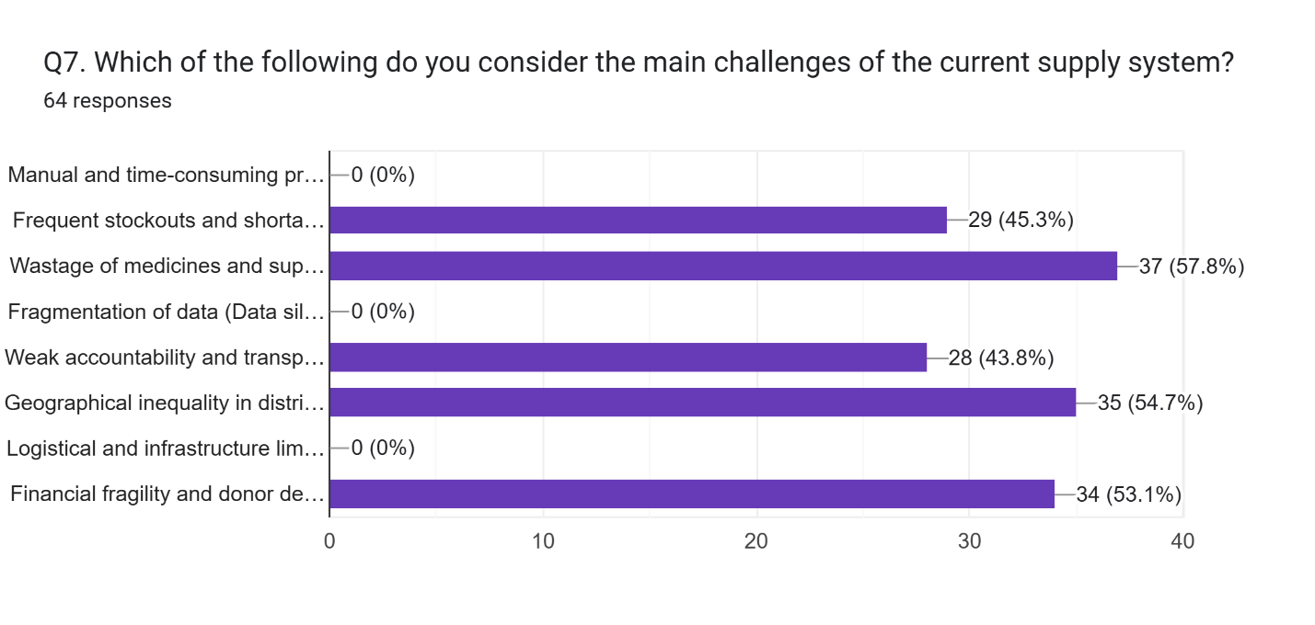
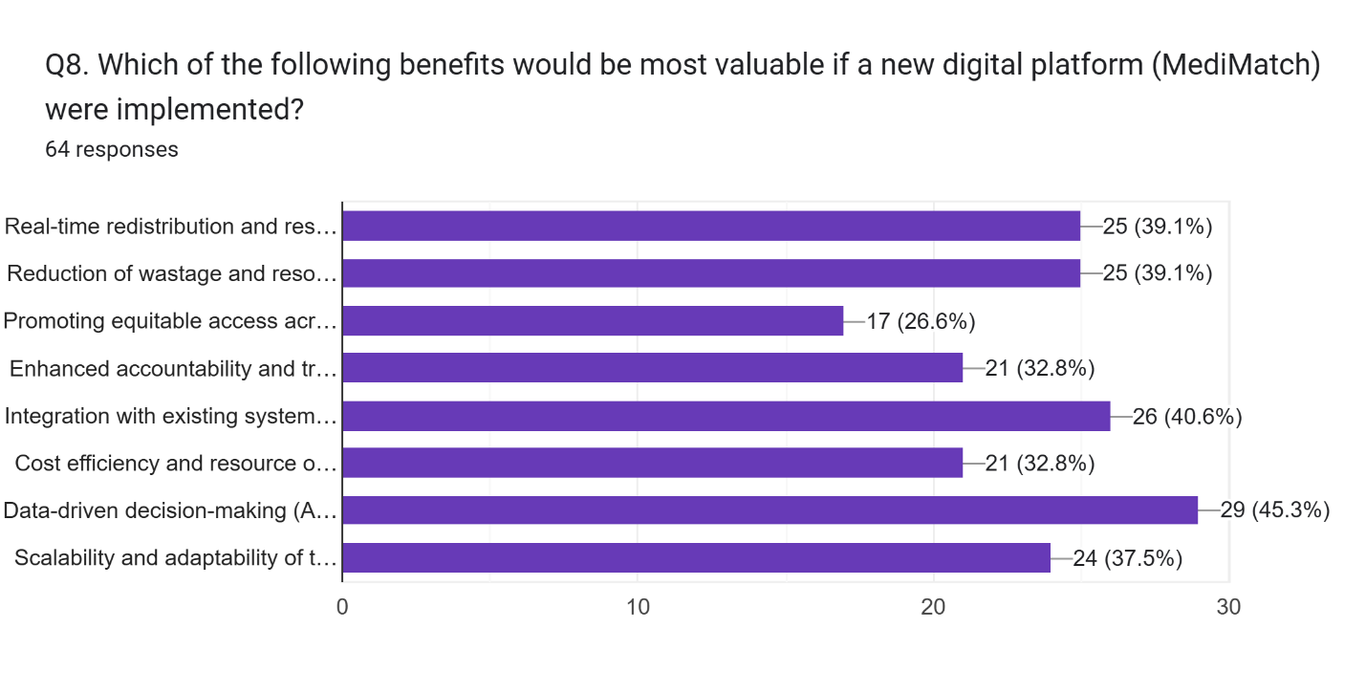
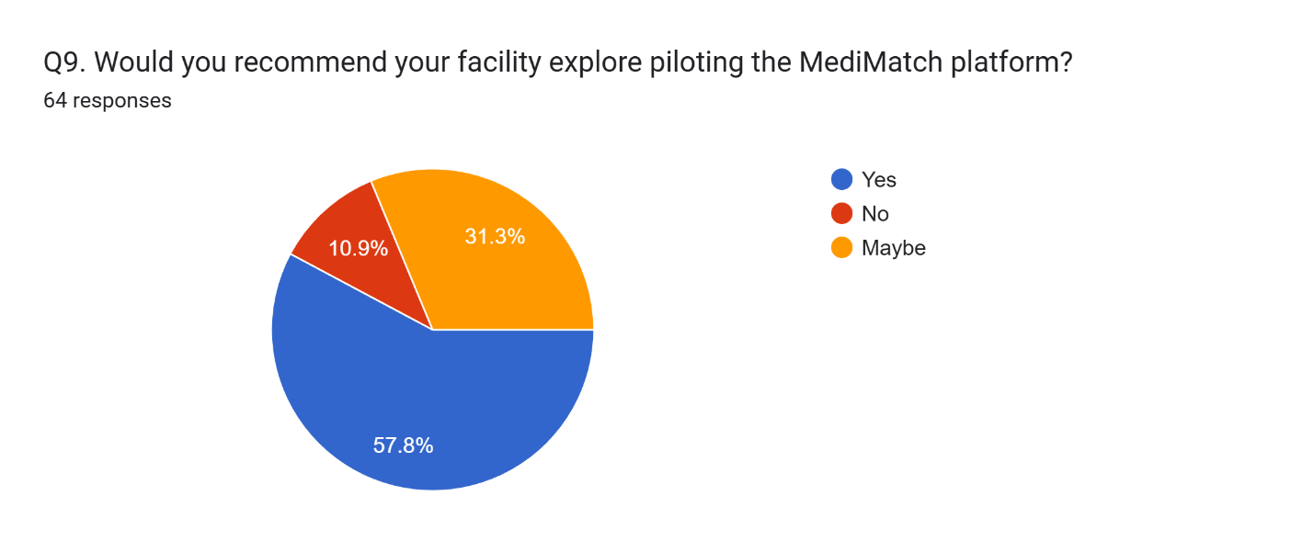
THE FIELD EVIDENCE
Challenges, value & readiness
Questions 7–9 · the main system challenges, the benefits they value, and willingness to pilot
Wastage tops the operational challenges — and readiness to pilot MediMatch is high.
Q7 · 57.8% cite wastage of supplies
Q8 · Most-valued benefits
Q9 · 89.1% would pilot (Yes + Maybe)
MEDIMATCH
Source: MediMatch survey, n=64 · Q7 and Q9 are the abstract’s 57.8% and 89.1% figures, shown from the raw responses

Slide 8
03
SECTION 03
The platform
From redistribution engine to live demonstration

Slide 9
HOW IT WORKS
How the redistribution engine works
Every listing becomes a geocoded surplus offer or an urgent request, then flows through a transparent pipeline.
DETECT
RANK
ROUTE
VERIFY
→
→
→
Parse each listing into a geocoded surplus or need
Score candidates urgent-first on multiple signals
Resolve real road geometry via OSRM, arc fallback
Coordinator confirms before any real-world transfer
Ranking signals
Proximity
Urgency
Product fit
Quantity
Verification
routed distance
clinical priority
category & cold-chain
full or partial cover
trusted source
Beyond routing: a demand heatmap surfaces clusters, a one-year impact projection models the gain, and a live Copilot answers from current state — all shown next in the demo.
MEDIMATCH
Explainable matching · plain-language situation briefs · human verification before any transfer

Slide 10
ARCHITECTURE AND SAFEGUARDS
A production-minded spatial stack with a human decision boundary
Experience
Coordination API
Spatial + routing
Intelligence
→
→
→
React · TypeScript MapLibre · three.js
Node.js · Express matching · auth · messages
PostgreSQL · PostGIS OSRM · Nominatim · CARTO
Curated fallback optional Claude briefs
Human verification is the final control
No diagnosis · no autonomous transfers · synthetic demo inventory · explicit assumptions · coordinator sign-off
MEDIMATCH
Production data layer: PostgreSQL 15 + PostGIS 3

Slide 11
LIVE DEMONSTRATION
See it run — live
Switching to the running platform.
1
National command floor
Detect, rank and route surplus to urgent need across Kenya
2
Demand heatmap
Where shortfall concentrates, against hubs and corridors
3
Nairobi research base
The 64-facility study area at street scale
4
Impact projection
A transparent one-year model of the gain
5
Copilot
Live coordination questions, answered from current state
MEDIMATCH
Recommended demo uses curated local briefs and synthetic inventory

Slide 12
CLOSING
Location is not just a field. It is a coordination advantage.
Evidence-based
64 healthcare professionals quantified the coordination gap.
MEDIMATCH
Location-aware
Real-time, road-routed matching of surplus to urgent need.
See surplus. Detect need. Coordinate impact.
Explainable
Transparent, multi-factor scoring — no black box.
Human-governed
Thank you
Coordinator verification before every transfer.
MEDIMATCH
Dr Lesnar Gitonga · USIU-Africa · Global Public Health 2026

Slide 13
REFERENCES
References & sources
Davis, F. D. (1989). Perceived usefulness, perceived ease of use, and user acceptance of information technology. MIS Quarterly, 13(3), 319–340.
HealthcareMEA. (2025). Supply chain challenges and the impact of wastage in East African healthcare.
Kenya Medical Supplies Authority (KEMSA). (2025). Supply chain performance and order-fill rates: Mid-year report 2025. Nairobi: KEMSA.
Kenya Ministry of Health. (2023). National health supply chain strategy and universal health coverage. Nairobi: Ministry of Health.
Kenya News Agency. (2025). Addressing stockouts: Inter-county redistribution measures.
Lee, H. L., Padmanabhan, V., & Whang, S. (1997). Information distortion in a supply chain: The bullwhip effect. Management Science, 43(4), 546–558.
MedShare. (2024). Recovering surplus medical supplies: Global impact report.
Ministry of Health Kenya. (2020). Kenya National e-Health Policy 2016–2030. Nairobi: Ministry of Health.
Mugenda, O. M., & Mugenda, A. G. (2003). Research methods: Quantitative and qualitative approaches. Nairobi: Acts Press.
Nation Africa. (2024). Global Fund audit reveals inconsistencies in Kenya’s stock management. Daily Nation.
NHS England. (2022). NHS supply chain redistribution programme: Lessons from the COVID-19 pandemic. London: NHS.
Republic of Kenya. (2019). The Data Protection Act. Nairobi: Government Printer.
MEDIMATCH
Primary data: MediMatch Nairobi County field study (n=64 healthcare professionals, 80% response, 2025)

