Slide 1
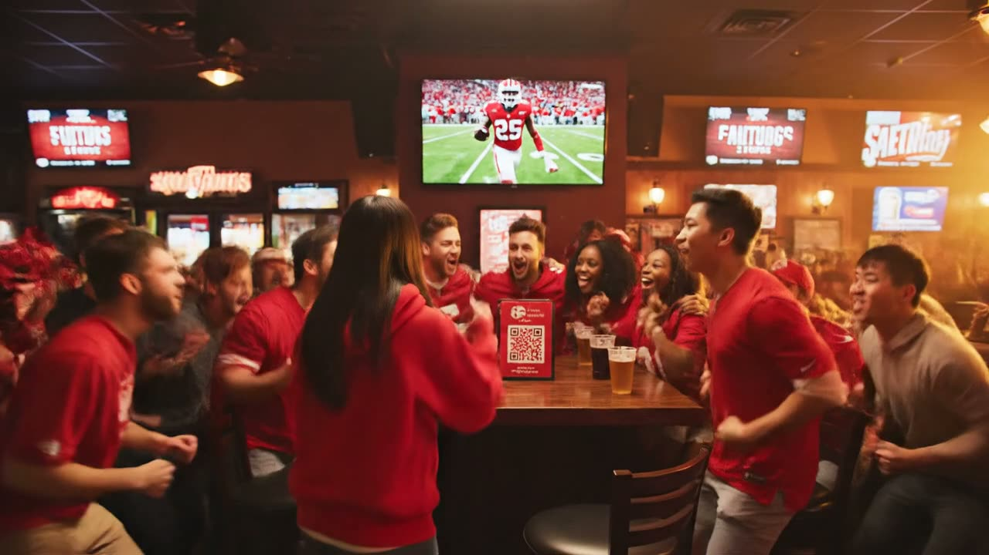
FUZEBOX EVENTPULSE · RUTGERS FOOTBALL 2026
EventPulse gives every Rutgers fan one live game-day plan
A hyper-personalized, two-way fan companion connecting fans, Athletics and Alumni Relations
November 2026

Slide 2
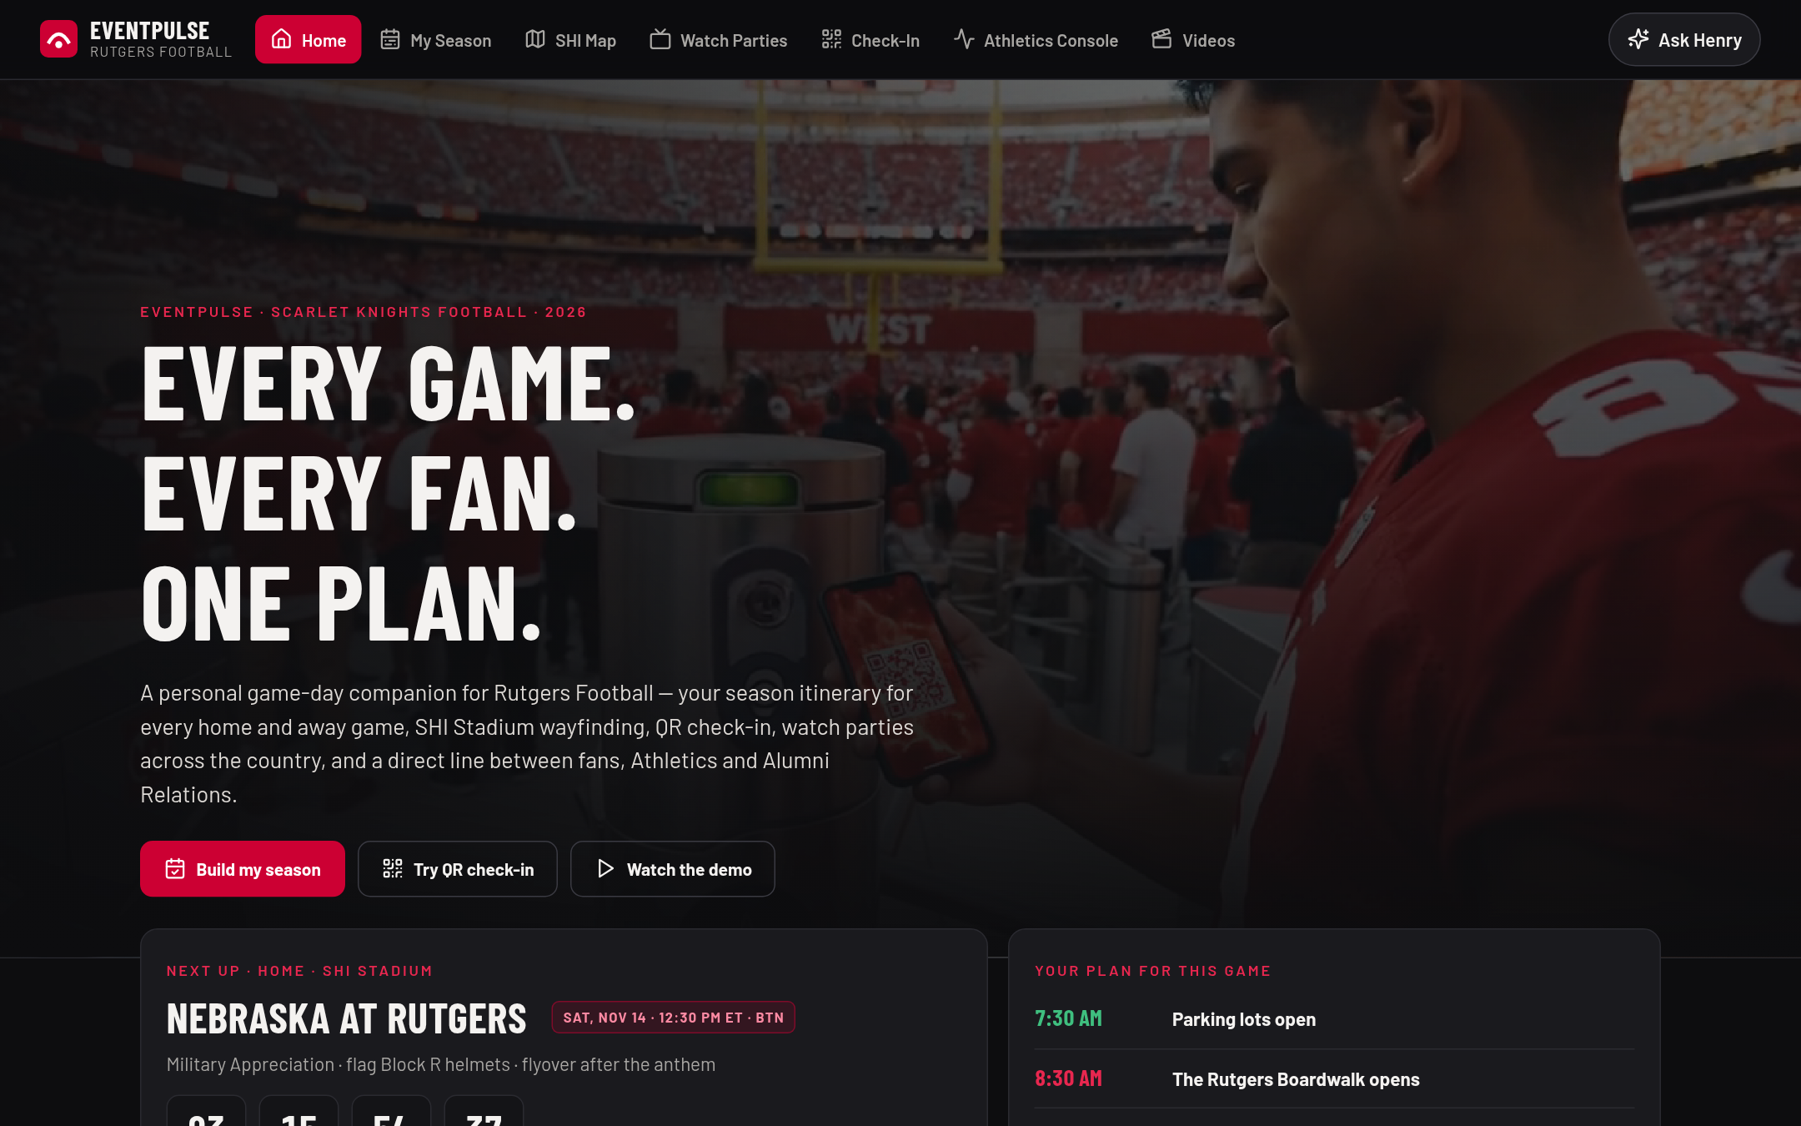
WHAT IT IS
EventPulse turns a Rutgers ticket into a personal season plan that talks back
What it is
A mobile web companion for every Scarlet Knights fan — no app download, opened from a link or a QR code.
What it does
Builds each fan’s itinerary, routes them around SHI Stadium, checks them in by QR and keeps a live channel open.
Who it serves
Fans at the stadium, fans at alumni watch parties nationwide, and the Athletics and Alumni Relations staff who serve them.
02
Source: Rutgers EventPulse demo

Slide 3
WHY IT MATTERS
Hyper-personalization gives each fan a plan instead of generic game-day pages
01
02
03
For the fan
For Athletics
For Alumni Relations
One plan, not a dozen web pages: when to leave, where to park, which gate, where friends are, what is waiting for them.
Knows who actually showed up, where and when — at the stadium and at every watch party — instead of only who bought a ticket.
Reaches each fan in the moment with context: a welcome at the bar, a gift at the gate, an invitation to the next event.
03

Slide 4
REAL-TIME, TWO-WAY
Real-time, two-way data lets fans and Rutgers respond to each other on game day
Fan signal (real time)
Rutgers response
Fan shares seat section, arrival mode, kids or first visit
Itinerary rebuilds: gate, parking, shuttle timing and fan-zone stops
Fan scans the QR code at West Gate
Gift unlocks on the phone and the next itinerary step appears
Fan checks in at a Hoboken watch party
Alumni club welcome plus an invitation to save a spot next time
Fan replies “Yes” to an outreach message
Reply lands in the staff console queue for direct follow-up
Note: Demo responses are simulated; production rules would be set by Rutgers staff.
Source: Rutgers EventPulse demo
04

Slide 5
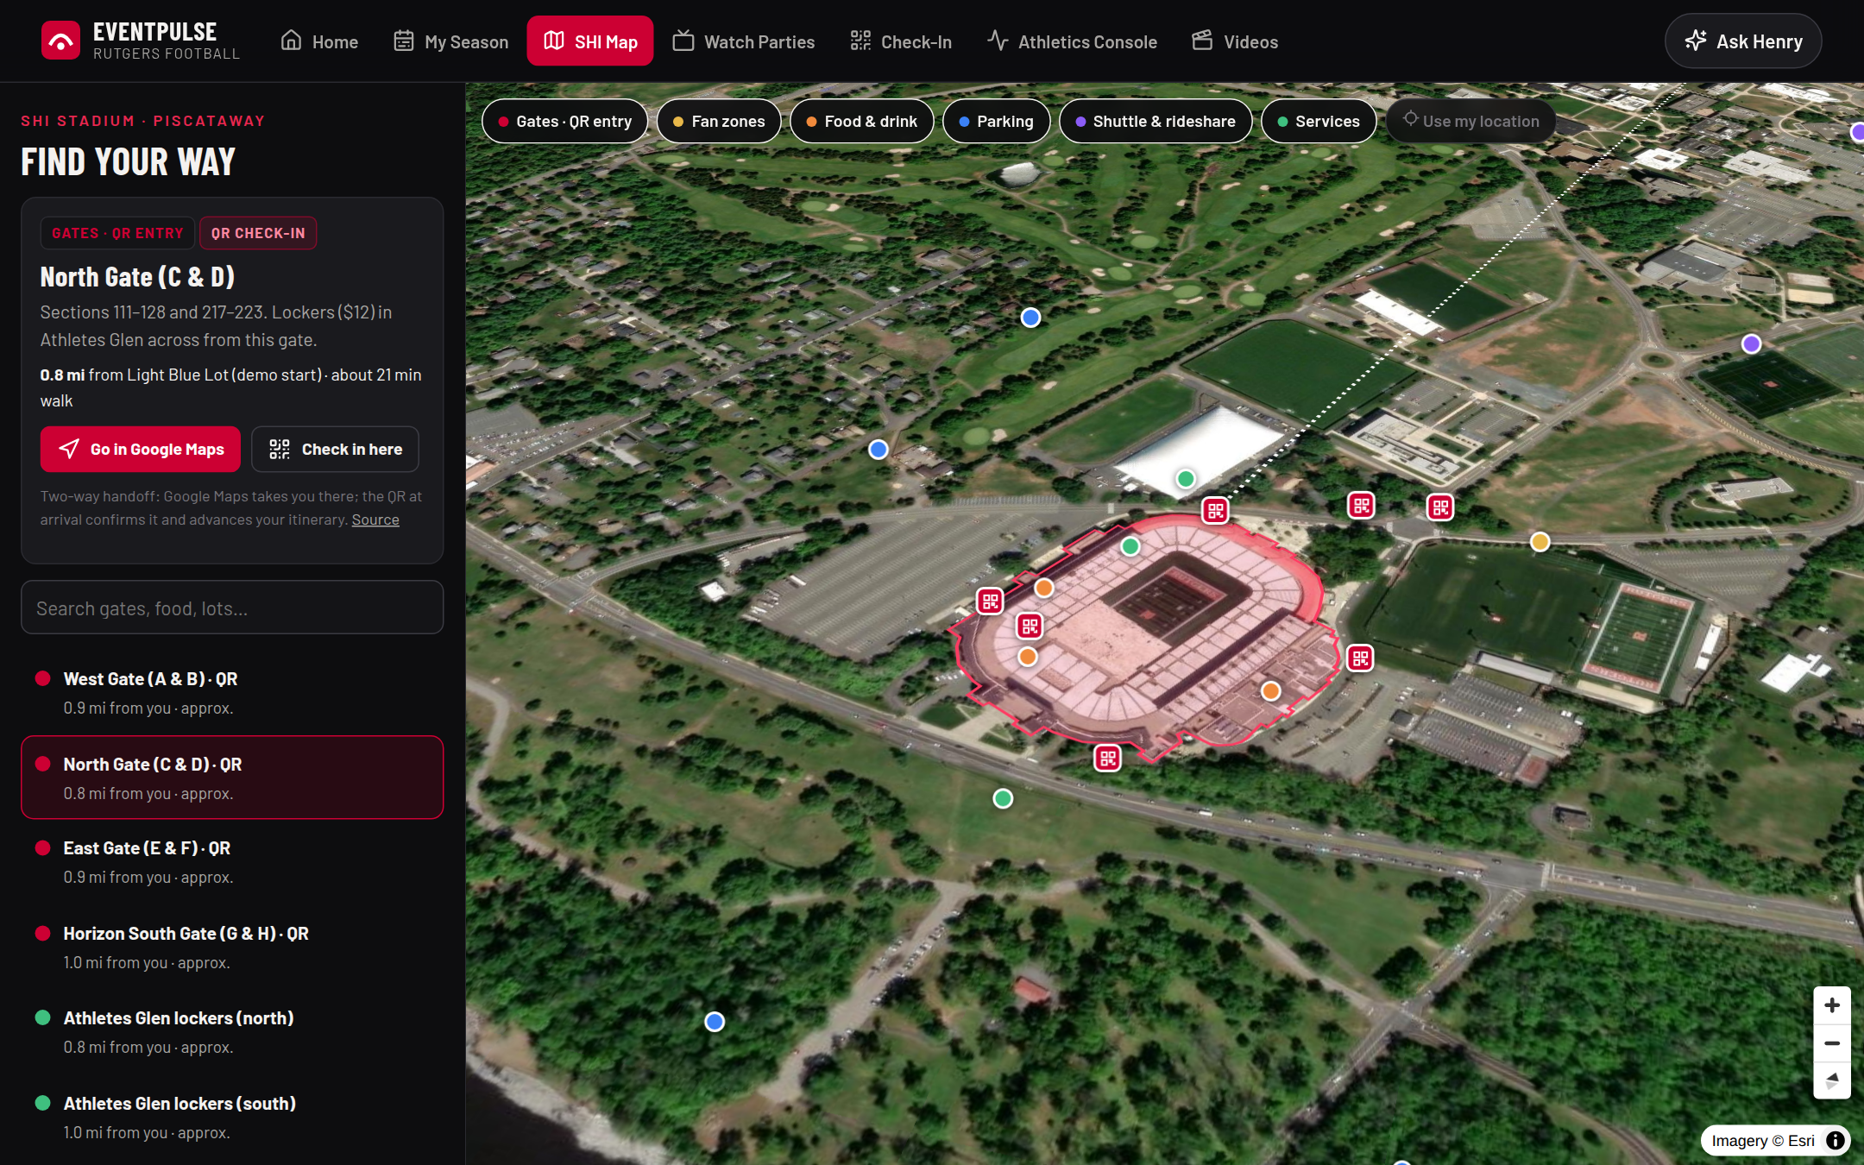
LOCAL CONTEXT
Ticket-linked local context routes each fan from the parking lot to the right gate
Seat section to gate
Sections map to West, North, East or South gates; students route to South Gate G and H.
Every local option
Lots open 5 hours before kickoff, Boardwalk 4 hours, Busch shuttle 3 hours, rideshare at Light Blue Lot.
Two-way Google Maps
FuzeBox states it is one of only two companies in the world, other than Waymo, with a two-way Google Maps interface.
Note: The Waymo comparison is a FuzeBox company statement and has not been independently verified. The demo uses Google Maps directions handoff links.
Source: FuzeBox company statement; Scarlet Knights: SHI Stadium Know Before You Go
05

Slide 6
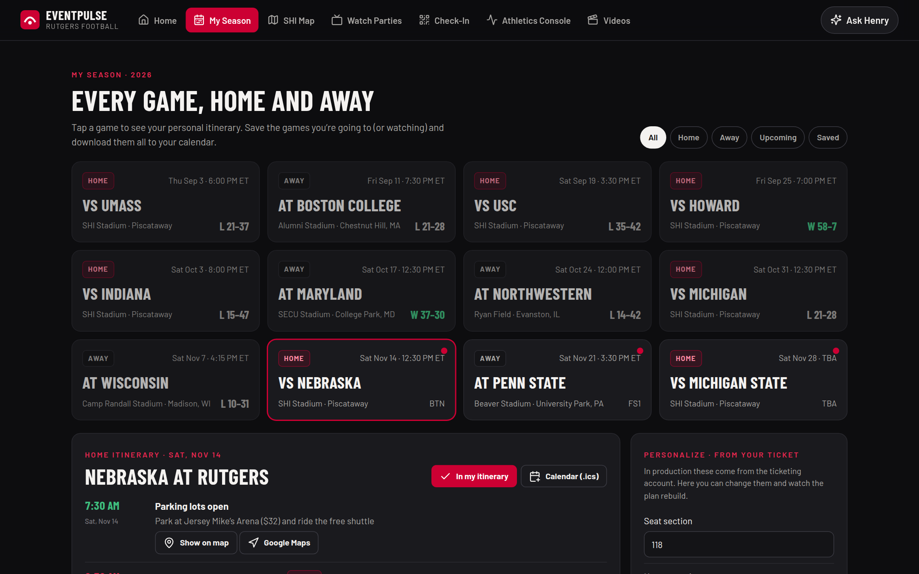
PERSONAL ITINERARY
All 12 games, home and away, get their own personal itinerary
7 home, 5 away
Home games at SHI Stadium; away games include travel and Rutgers Off the Banks events.
Built for each fan
Adjusts for seat, arrival mode, kids, first visit or student ticket; one-tap calendar export.
Next up
Nebraska at SHI Stadium, Sat Nov 14, 12:30 PM ET on BTN — Military Appreciation game.
06
Source: Scarlet Knights 2026 schedule; Scarlet Knights: Game 10 vs Nebraska

Slide 7
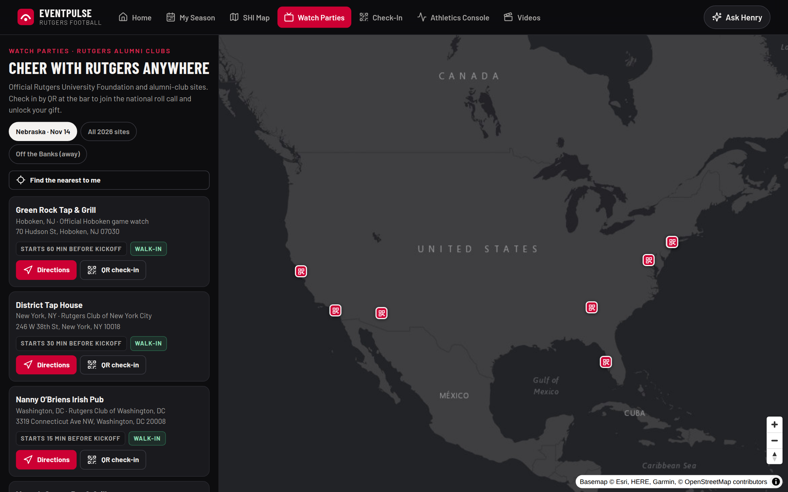
WATCH PARTIES
Watch parties bring 14 alumni sites into the same game-day network
Every official site
From Hoboken and New York to Tempe, San Francisco and Portland, with directions and start times.
QR at the bar
Each venue carries its own code, so a scan joins the fan to the national roll call.
Away-game events
Off the Banks gatherings near Boston College, Maryland and Northwestern are included.
Note: Site list from the Rutgers alumni watch-party pages; some map pins are approximate.
Source: Rutgers alumni watch parties
07

Slide 8
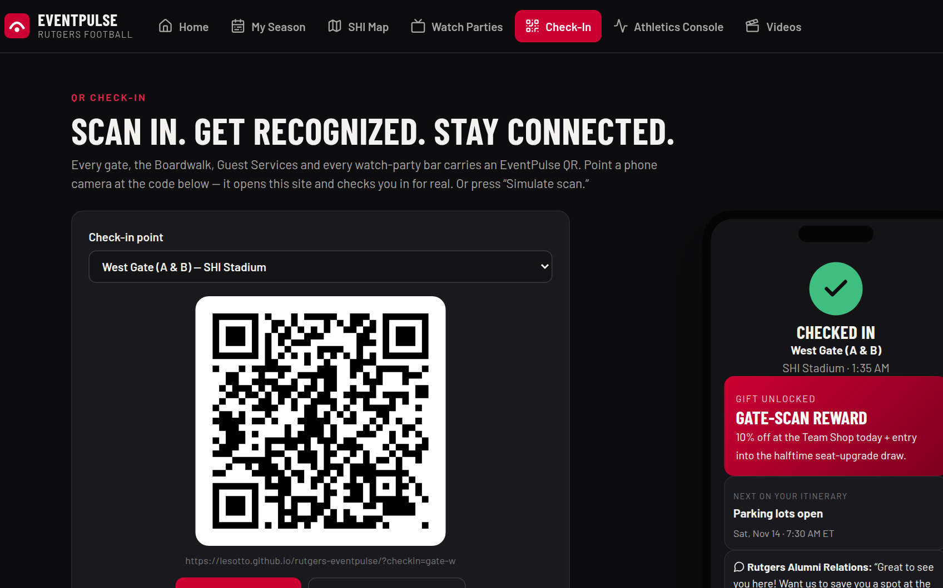
QR ENTRANCE CHECK-IN
Each entrance QR scan becomes a check-in, a gift and a conversation
Scan
Codes at every gate, the Boardwalk, Guest Services and each watch-party bar.
Reward
A gift unlocks on the spot, and the itinerary moves to the next step.
Connect
Alumni Relations opens a two-way thread the fan can answer with one tap.
Note: QR codes are live: scanning one opens the public demo and records a check-in in that browser. Gifts are illustrative.
Source: Rutgers EventPulse demo
08

Slide 9
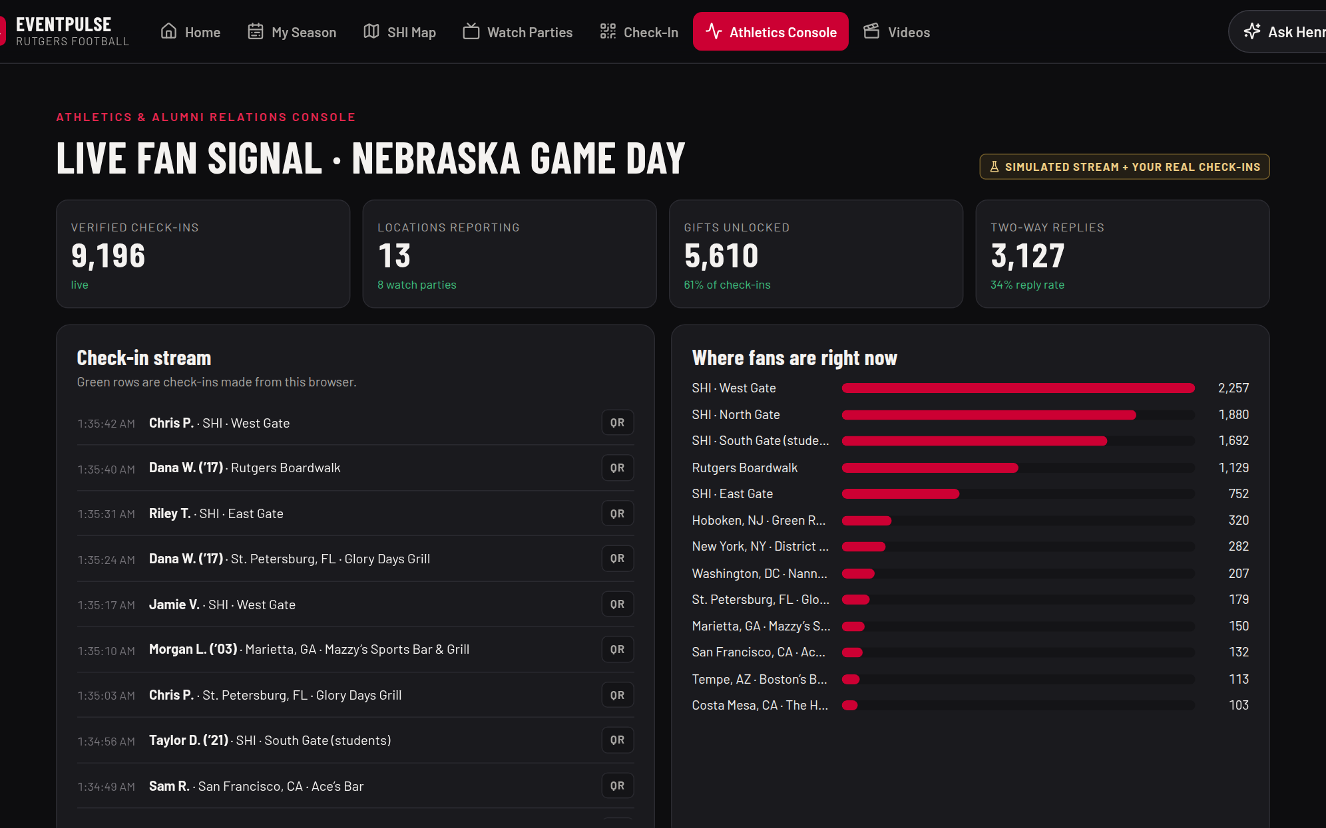
ATHLETICS & ALUMNI CONSOLE
Athletics and Alumni Relations see who arrived and can reach out directly
Live fan signal
Check-ins, locations reporting, gifts unlocked and replies, updated as fans scan.
Direct outreach
Suggested messages wait in a queue until staff approve them.
Fan replies
Answers come back into one view for follow-up by staff.
Note: Console figures are a simulated stream mixed with real check-ins from the viewing browser. Every outreach requires staff approval.
Source: Rutgers EventPulse demo
09

Slide 10
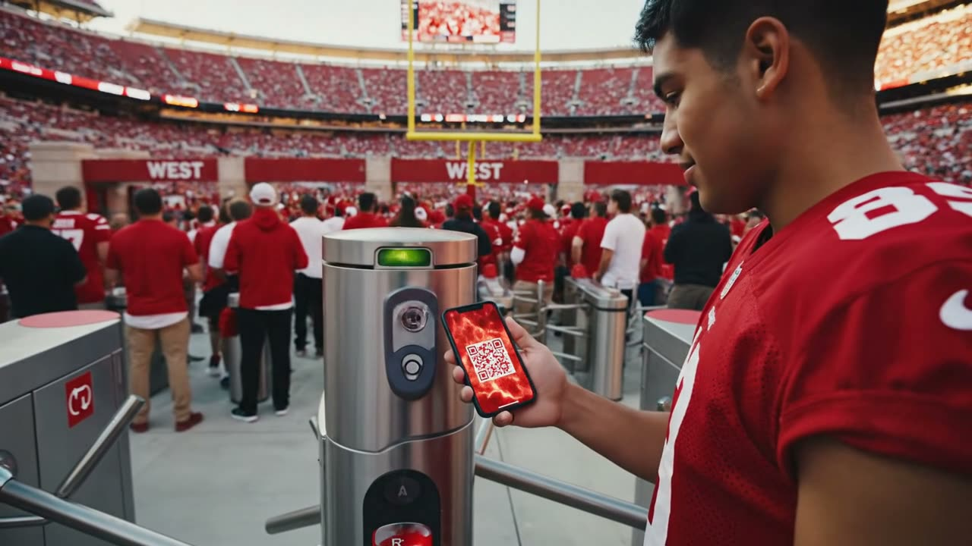
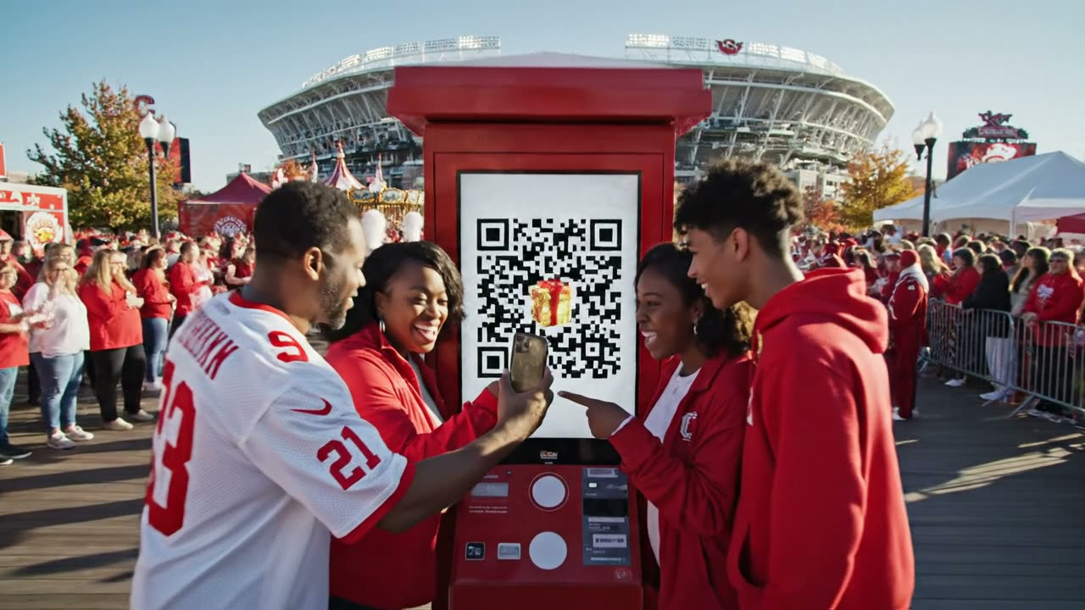
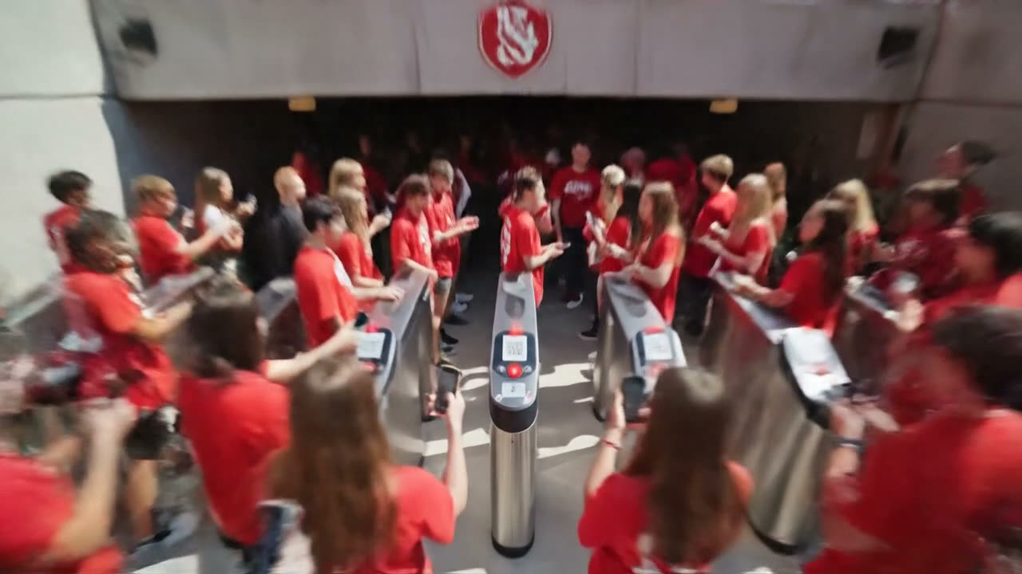
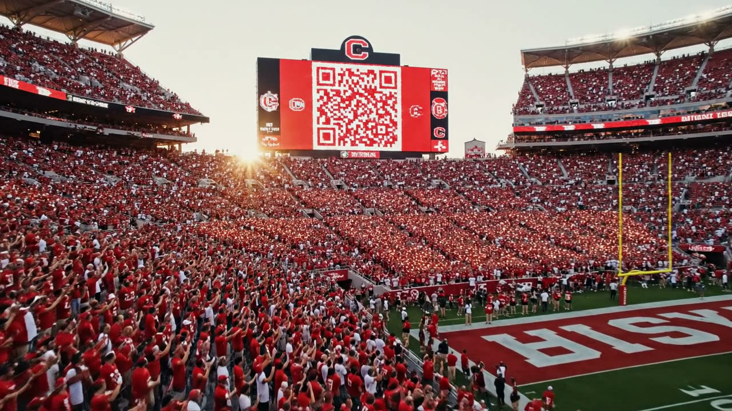
VIDEO DEMOS
Five concept videos show the scan-in moment at a bar and around SHI Stadium
West Gate QR
Boardwalk QR
Student gate QR
Bowl and scoreboard
Watch party: scan in, find your crew
Note: AI-generated concept footage, 8 seconds each; some generated stadium lettering is not legible text.
Source: Rutgers EventPulse demo
10

Slide 11
NEXT STEPS · TIMING TBD
The public demo is live now; a Rutgers pilot needs data access and approvals first
NEXT STEPS
01
Approve pilot scope and outreach rules
Athletics
TBD
02
Grant ticketing and alumni CRM data access
Rutgers IT
TBD
03
Confirm gift partners and watch-party hosts
Joint
TBD
lesotto.github.io/rutgers-eventpulse · github.com/lesotto/rutgers-eventpulse

