Slide 1
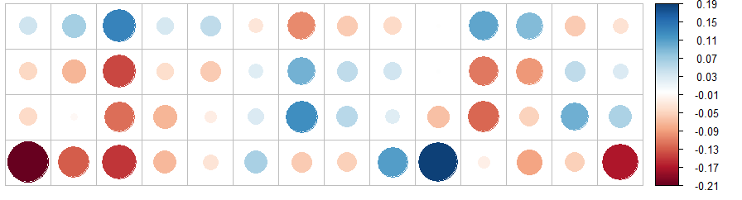
MAMMAL TRAITS
DIET
ACTIVITY
SIZE
nectar
seed
plant
nocturnal
crepusc.
diurnal
mass
inv
end
ect
fish
unk
scav
fruit
Acaulescent
Erect
PALM TRAITS
Trait correlation
Stem Height
Fruit Length

