Slide 1
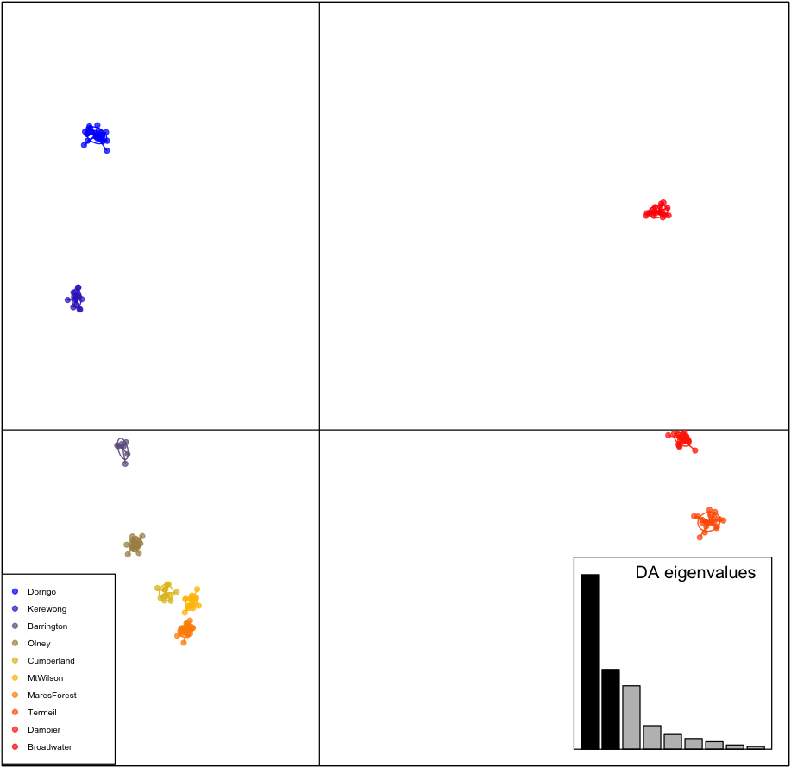
Filter threshold = .6

Slide 2
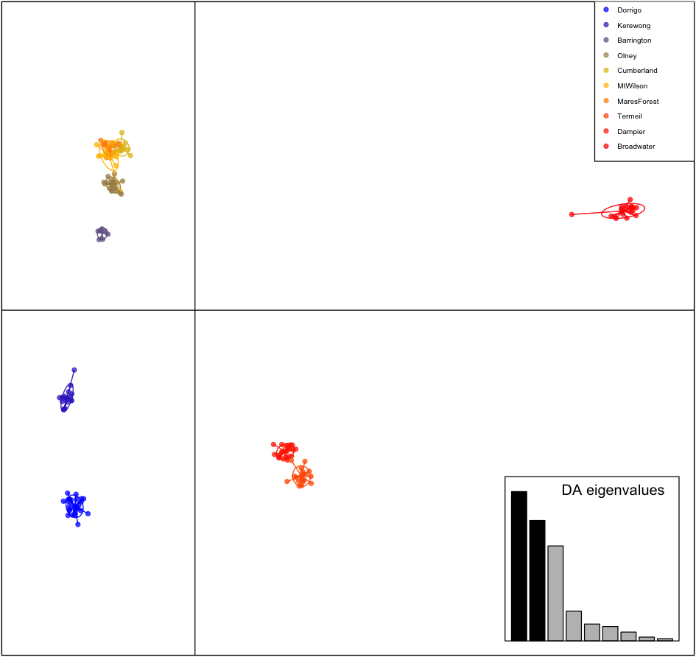
Filter threshold = .7

Slide 3
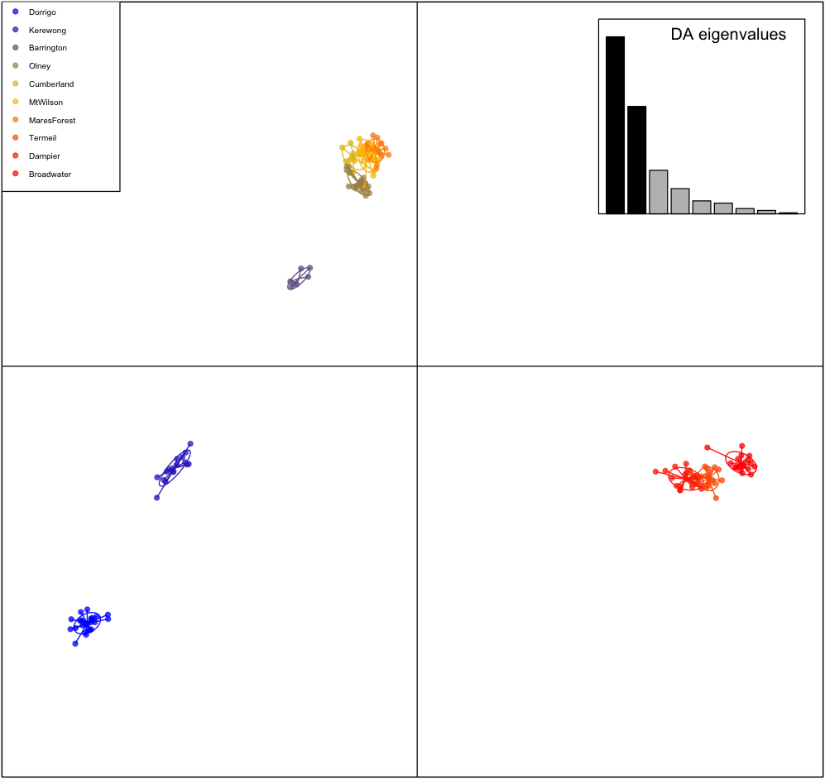
Filter threshold =.8

Slide 4
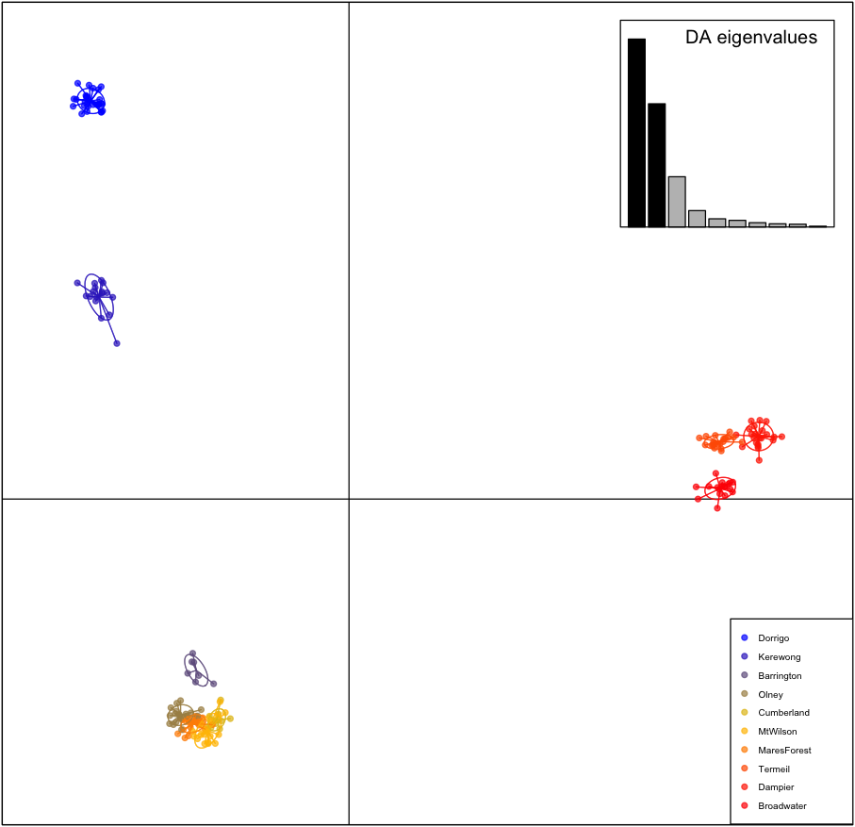
Filter threshold = .9

