Slide 1
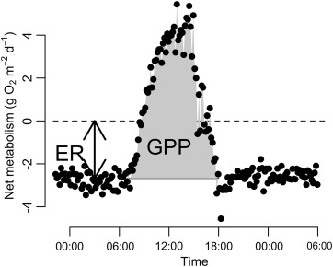
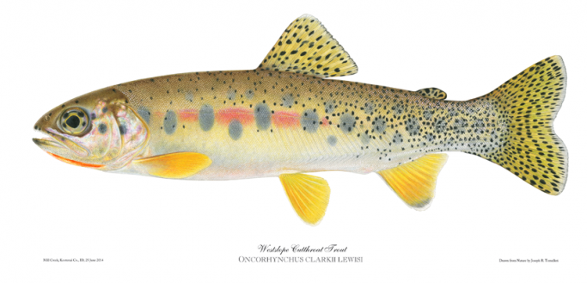
Does Fish Biomass Relate to Ecosystem Metabolism in Headwater Streams of Kittitas County?
A Thesis Defense by
Zach Lessig
Tuesday, July 23
3:00 PM
Science Room 240

