Slide 1
Coincidence By Jainam Shah(046)

Slide 2
Project Overview
Coincidence- A hacking tool
This provided us the information about the vulnerable website and information about the person.
This hacking tool is divided in 4 Modules:
1. Information Gathering
2. Web Vulnerability Scanning
3. LSB Steganography
4. Key Logger

Slide 3
Index
Information Gathering
Web Vulnerability Scanning
LSB Steganography
Key Logger

Slide 4
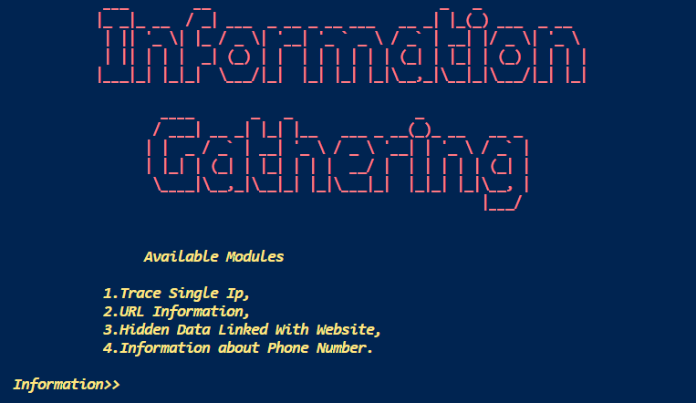
Information Gathering
Trace Single Ip,
URL Information,
Hidden Data Linked With Website,
Information about Phone Number.

Slide 5

Trace Single Ip
Tracing with Ip address
Simply by entering the Ip address here;
We will get the information about the user like Continent, country, city also we will get the location from the google maps.

Slide 6
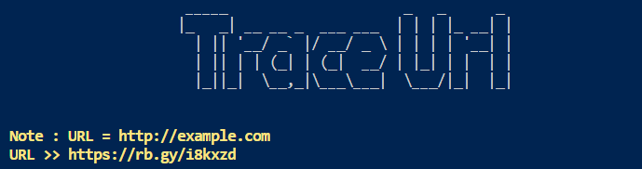
URL Information
URL Information:
Simply by entering URL here it will trace the real URL behind.
This helps in finding the malicious link like the phishing link etc.

Slide 7
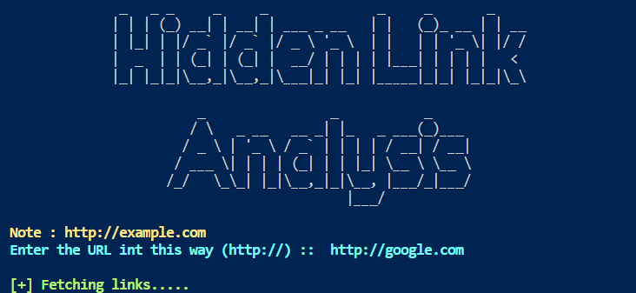
Hidden Data Analysis
Hidden Sites or Data Analysis.
Here it will trace all the data or the hidden URL which is residing under the given URL.

Slide 8

Phone Number Information
Phone Number Information:
Here we will get the information about the phone number and related to that like the service provider, which can be use for social engineering attacks.

Slide 9
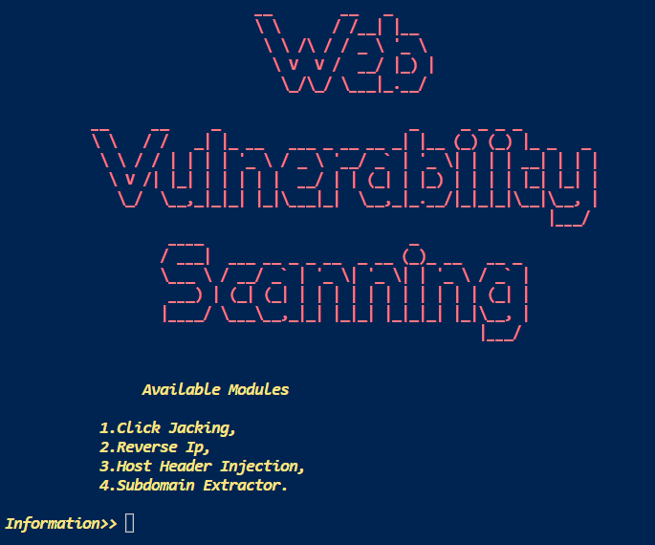
Web Vulnerability Scanning
Click Jacking,
Reverse Ip,
Host Header Injection,
Subdomain Extractor.

Slide 10
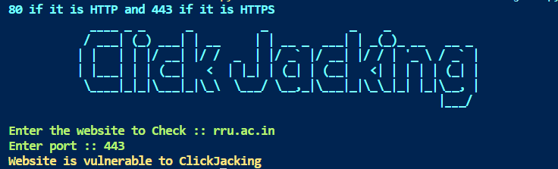
Click Jacking
Click Jacking:
Clickjacking is an attack that tricks a user into clicking a webpage element which is invisible or disguised as another element.
Here this will give the status of the URL that it is vulnerable or not.

Slide 11
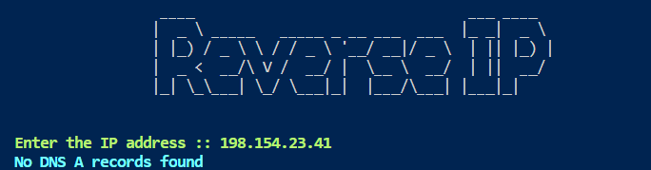
Reverse IP
Reverse Ip:
It will find all the domains hosted on a given IP address.
In output it will give the information about the record.

Slide 12
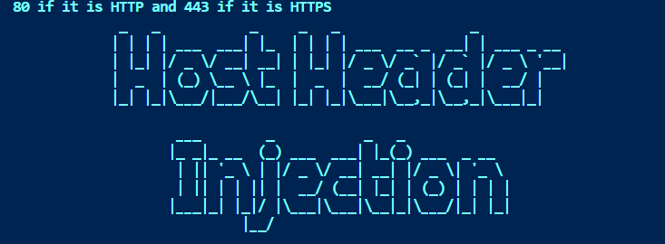
Host Header Injection
Host Header Injection:
It is common practice for the same web server to host several websites or web applications on the same IP address. This why the host header exists. The host header specifies which website or web application should process an incoming HTTP request.
Here it will show the status that it is vulnerable or not.

Slide 13
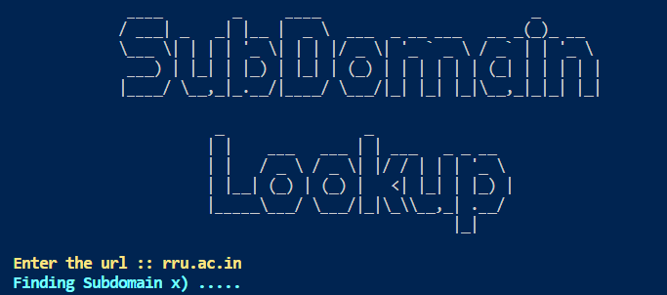
Sub domain Extractor
Sub Domain Extractor:
In penetration testing usually a single Ip address is given, and we must find the subdomain related to it.
Here this works exactly like this it will give all the sub URL related to the URL.

Slide 14

LSB Steganography
Here the Image based Steganography is used.

Slide 15

Key Logger
We will see this Keylogger file in Virtual Box
As it is dangerous.

Slide 16
Now Lets See the Working of project

Slide 17
Thank You!

