Slide 1
CS3342 Software Design Project EVENTIFY - Online Event Holding System
Group 14
CHEN Qianxun 53050023
CHEN Zong 52911585
CHU Ka Fai 53551604
FUNG Chung Kit 53563688
GO Ming Tsun 53552489

Slide 2




Background & Problem
Hong Kong, a dynamic place where lot of events going on
Difficult to search various kind of events in one single platform
Small organizations/individuals cannot afford huge promotion cost
Current promotion paths are not effective/ limited influence

Slide 3
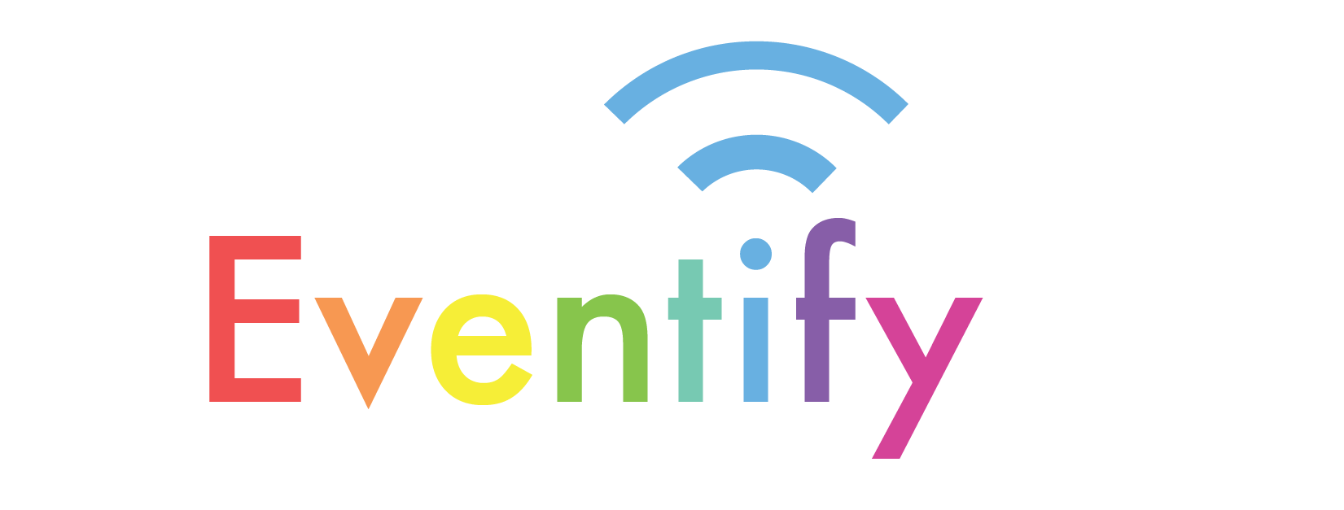
Event-based platform
Free to use!
User friendly Interface

Slide 4
Objectives
Provide people with a solution to find events according to their own time flexibility and taste
Provide free promotion platform for event holders
Reduce the waste of resource by linking the event participants with the event hosts more efficiently
Assemble the existing scattered interest groups by grouping the events with categories and tags, especially sub cultures.

Slide 5
How EVENTIFY works?
Everyone:
Search events with genre/time/price filters, add the event to calendar
Members :
can like/join/comment on/share events ,
get personalized event recommendations
Notification to joiner (upcoming notifications, update information, host messages)

Slide 6
How EVENTIFY works?
Hosts:
Create Events, check how many participants, communicate with the participants
Manage Host Page: displaying passed/upcoming events, self promotion materials

Slide 7
User Requirements

Slide 8
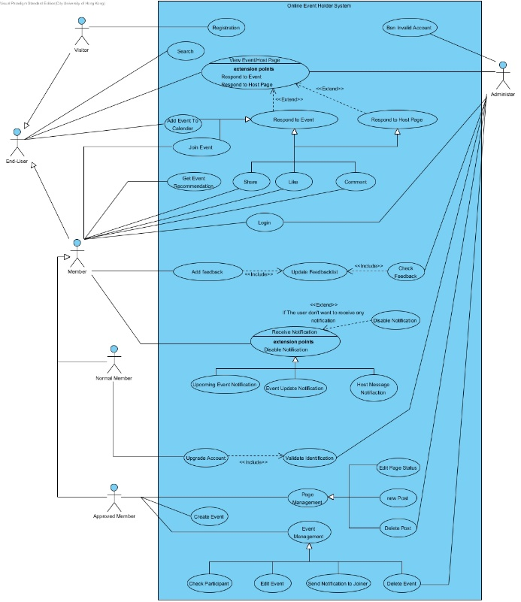
Use Case Diagram

Slide 9
User Requirements
Visitor
Normal Member
Approved Member
For all users | search and view host page search and view event add event to calendar
For members |  | like, comment on and share event/host page join event get event recommendation receive notification add feedback
For individual type of users | register for member account | upgrade to host account | create and manage event manage host page
Notes:
3 notifications (upcoming events, event update, host message)
Feedback->comment to admin

Slide 10
User Requirements
Administer
Account operation | validate identification ban invalid account
Comments and reports management | check feedback
Host page and event management | view event/host page delete post delete event

Slide 11
Use Case Specification
Use Case Name: | Send Notification to joiner
Actor(s): | Approved Member
Description: | This use case describes the process of an Approved Member send a message to member who joined the event.
Typical Course of Events: | Actor Action Step 1: This use case is initialed when an Approved Member select this function Step 3: Approved Member type in the message Step 5: Approved Member confirm detail | System Response Step 2: The system provide an interface for receiving message Step 4: An preview which display the content seen by receiver is shown to Approved Member Step 6: The system make a notification to members who joined the event

Slide 12
Use Case Specification
Use Case Name: | Send Notification to joiner
Alternate Courses: | Step 5a: Approved Member want to edit the message, system back to Step 3, Approved Member edit the message
Precondition: | At least one participant joined the event
Postcondition: | Use case “Host message notification” is performed
Assumptions: | An event is selected to manage

Slide 13
Use Case Specification
Use Case Name: | Host Message Notification
Actor(s): | Member
Description: | This use case describes the process of a member receive the message sent by event holder
Typical Course of Events: | Actor Action Step 3: The member read the message | System Response Step 1: This use case is initialed when a new message is made by host Step 2: The system send a reminder to members for receiving new message
Alternate Courses: | Step 2a: [Extension point: if the member disable the notification, the reminder will disabled]
Precondition: | The member joined the event Approved Member holding the event execute use case “Send Notification to Joiner”
Postcondition: | The member acknowledge the message
Assumptions: | Nil

Slide 14
Use Case Specification
Use Case Name: | Add feedback
Actor(s): | Member
Description: | This use case describes the process of a member giving feedback, whether positive or negative, concerning a particular post or page
Typical Course of Events: | Actor Action Step 1: This use case is initialed when the member sees a page or post to report on Step 2: The member hits the feedback button and types in the content in the feedback window Step 3: The member chooses to either report the feedback anonymously or by name Step 4: the member hits submit | System Response Step 5: The system processes the feedback, submits it to the feedback list, and returns “successfully submitted”.

Slide 15
Use Case Specification
Use Case Name: | Add feedback
Alternate Courses: | Step 4a: if the member hits cancel, the feedback editor will be closed without further actions Step 5a: If error occurs during submission, the system returns “Submission error. Please try again”
Precondition: | Nil
Postcondition: | Invoke the use case “Update Feedbacklist”
Assumptions: | Nil

Slide 16
Use Case Specification
Use Case Name: | Check feedback
Actor(s): | Administer
Description: | This use case describes the process of an administer reviewing feedback regarding a particular post or page from a member
Typical Course of Events: | Actor Action Step 1: This use case is initialed when the administer receives a notification to check the new feedbacks Step 2: The administer reviews the feedback and gives a decision Step 3: The administer submits the decision | System Response
Alternate Courses: | Step 2a: If the administer decides that the page or post is improper, the administer can decide to delete the page or post Step 3a: If error occurs during submission, the system returns “Submission error. Please try again”
Precondition: | There is one or more feedback submitted
Postcondition: | Invoke the use case “Update Feedbacklist”
Assumptions: | Nil

Slide 17
Software Design Object Modelling

Slide 18
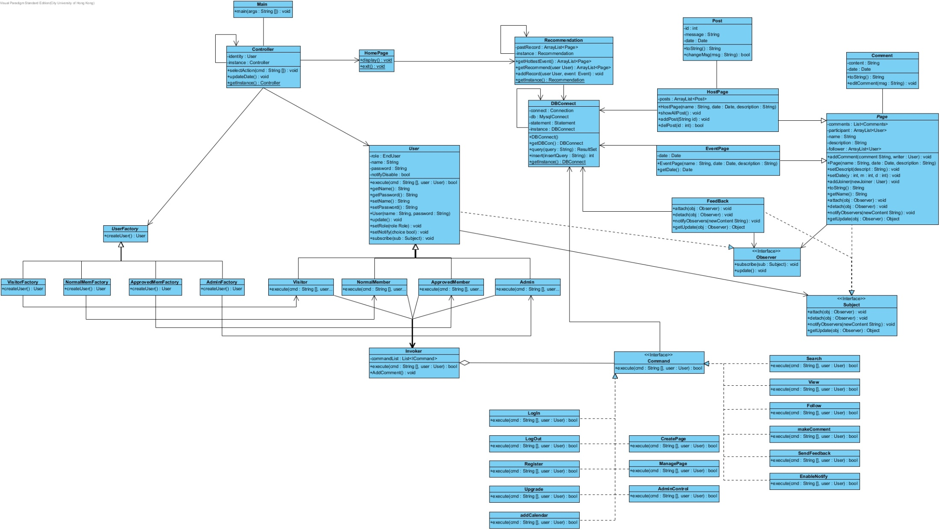
Class Diagram

Slide 19
Design Principles Applied
Open-Closed
Liskov Substitution
Dependency Inversion
Law of Demeter

Slide 20
Open-Closed Principle
“Software entities like classes, modules and functions
should be open for extension but closed for modifications.”
Easy to extend
New function, [Share]:
public class Share implements Command
New user type, [Mod]
public class Mod extends User
public class ModFactory extends UserFactory
Original code remains unaffected

Slide 21
Liskov Substitution Principle
Every subclass can fully utilize operations provided by its super class
All concrete User subclasses use the superclass’s functions
Both HostPage & EventPage utilize Page ‘s functions
Concrete UserFactory & Command classed
“Derived types must be completely substitutable for their base types.”

Slide 22
Dependency Inversion Principle
“High-level modules should not depend on low-level modules.”
“ Both should depend on abstractions.”
“Abstractions should not depend on details. Details should depend on abstractions.”
Abstraction layer between high level classes and low level classes
Controller depends on the abstract classes User and UserFactory
Detail of operation depend on the abstract classes User , UserFactory ,Command
Help to achieve OCP

Slide 23
Law of Demeter
“Only talk to your immediate friends.”
All objects should only interact to their neighbors’ methods.
User -> Invoker -> Command ->DBConnect -> Page

Slide 24
Design Patterns Used
Factory
Singleton
Command
Observer
*Slightly modified diagrams for the sake of presentation*

Slide 25
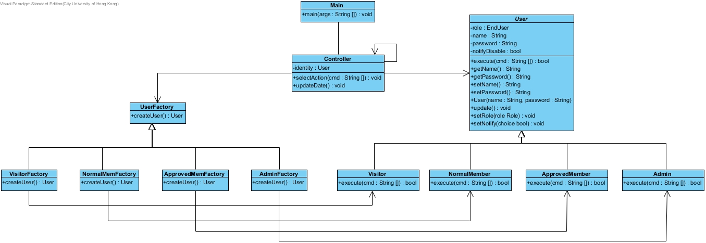
Factory Pattern
Different types of user
(Concrete factory, concrete User) class pair
NormalMemberFactory (Create) > NormalMember
Creation determined at run-time

Slide 26
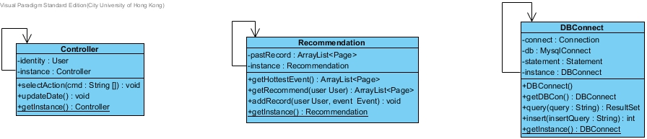
Singleton Pattern
Need exactly one instance
Contain shared fields
Provide global point of access
Prevent duplicate objects from flooding the system

Slide 27
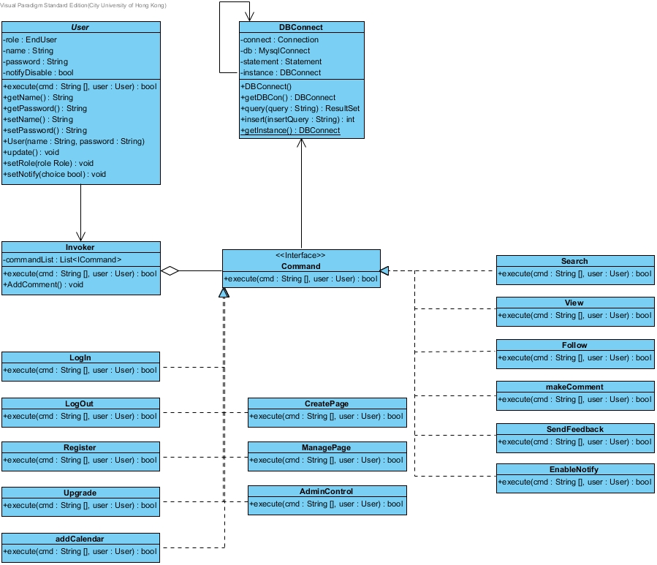
Command Pattern
Client User perform its function by calling Invoker
Invoker determines the corresponding Command class
Command class call the receiver DBConnect to perform the action

Slide 28
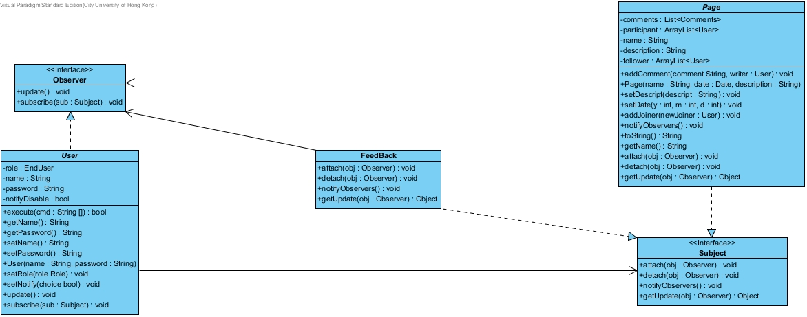
Observer Pattern
Following Page
A page is updated
Notify subscribed users
User get the update
from the page
Feedback
A report/feedback is submitted
Notify all admins
Admin get the report

Slide 29
Software Design Object Interaction
Sequence Diagrams

Slide 30
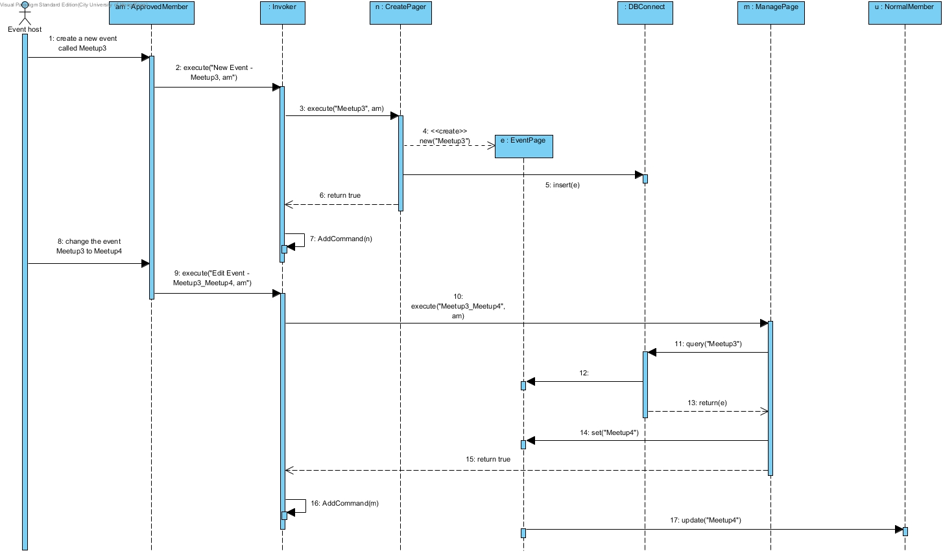
User creates an event and edits it

Slide 31
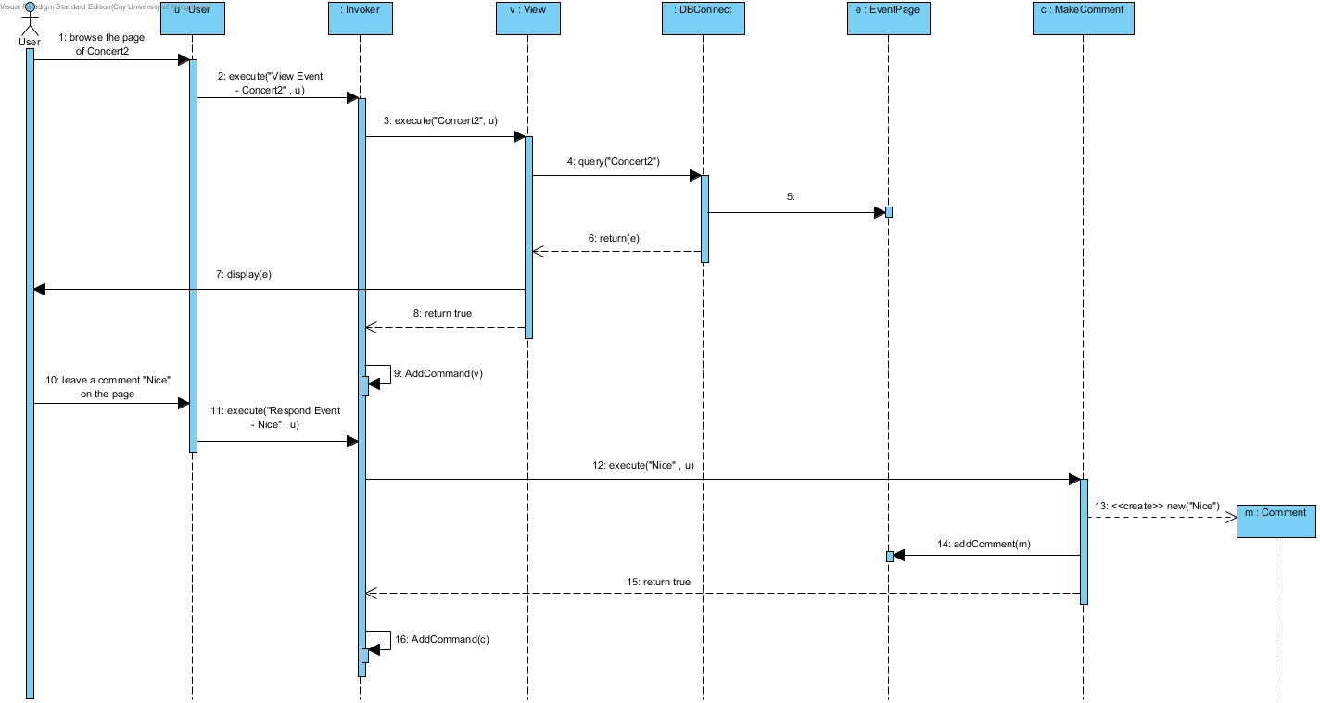
User views an event and comments

Slide 32
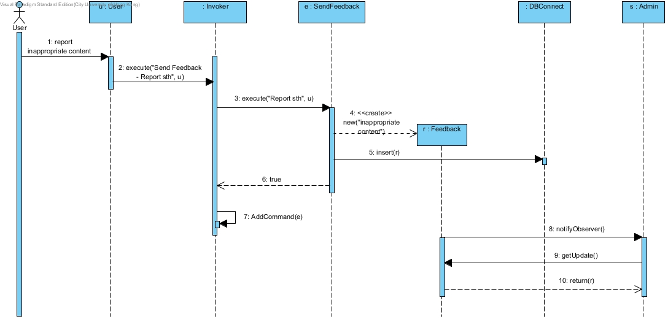
User submits a report

Slide 33
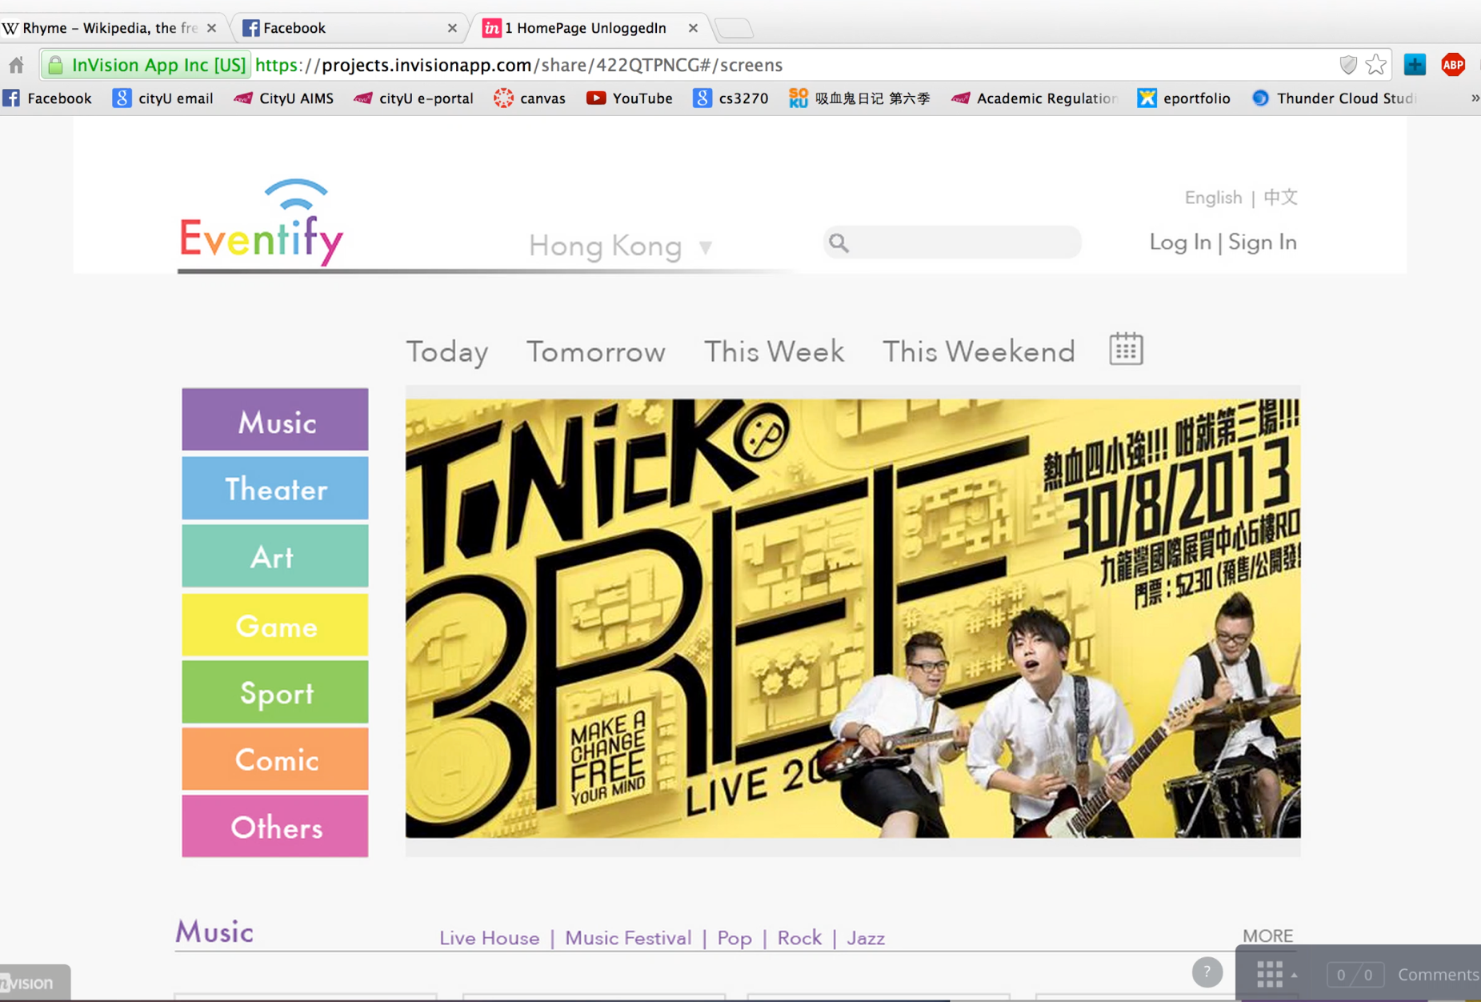
System Prototype
Demo link:
https://www.youtube.com/watch?v=vr6EUXHN88c&feature=youtu.be
Notes:
http://invis.io/422QTPNCG

Slide 34
Project Management
Team Member | Post | Responsibilities
CHU Ka Fai | Project Manager | Requirement analysis Use Case diagram Class diagram | Design pattern analysis Sequence diagram
GO Ming Tsun | Assistant Project Manager | Requirement analysis Use case diagram Use case specification | Sequence diagram Project assembly
FUNG Chung Kit | Designer | Requirement analysis Use case diagram Class diagram | Design pattern analysis Sequence diagram
CHEN Zong | Designer | Background research Requirement analysis Use case diagram | Use case specification Prototype visualization
CHEN Qianxun | Designer | Background research Requirement analysis Use case diagram | Prototype design Prototype visualization
Notes:
Responsibilities distributed evenly according to areas of interest
Everyone participated in requirement analysis and use case diagrams
Tom and Ka Fai are devoted to the design of class diagrams and design patterns
Buster is responsible for most of the use case specifications, sequence diagrams and project assembly
Sally and I are focusing mostly on background research and prototype visualization
All of us consult and help each other with parts that we are not certain about
We take time to work with each other and discuss together
And break down the project in small parts so we can work individually
For example….

Slide 35
Overall reflection
Learn:
Construct the structure of a system from zero
UML graphing
OOP design
Most important: Open-closed principle
Meet all user requirement
Improve:
Interface Segregation Principle
Single Responsibility Principle

Slide 36
Conclusion
Design a online event holding system
Apply OOP principle & pattern
Diagram
Use case
Class
Sequence
Documentation
Prototype

