Slide 1
LastMile
Delivery Route Optimizer
CS3342 Software Design Project
Optimizing delivery routes using heuristic algorithms & design patterns

Slide 2
Group Members — Team 26
Project: LastMile — Delivery Route Optimizer
Lessov Akniyet
Bulatov Smadiyar
Project Lead & Architect
Backend Developer
▸ Project planning & management
▸ System architecture design
▸ Strategy pattern (algorithm/)
▸ 2-Opt algorithm implementation
▸ Maven build & CI/CD pipeline
▸ Nearest Neighbor algorithm
▸ Greedy Edge + Union-Find
▸ Route & DeliveryGraph models
▸ Capacity splitting logic
▸ Input validation & exceptions
Naumov Iusuf
Tursynov Birzhan
QA & Observer Module
I/O & Reporting
▸ Observer pattern (observer/)
▸ ConsoleLogger & FileLogger
▸ ConstraintChecker implementation
▸ JUnit 5 test suite (30+ tests)
▸ Test strategy & coverage
▸ Template Method (report/)
▸ Console & File ReportGenerator
▸ CsvMatrixReader & JsonReader
▸ User Manual & Install Guide

Slide 3
Introduction
What does it do?
Who are the users?
Why this project?
A Java CLI application that computes
optimized delivery routes.
Compares 3 routing algorithms on a
given distance matrix.
Handles real-world constraints:
- Vehicle capacity limits
- Time window enforcement
- Delivery priority ordering
Logistics companies planning
daily delivery schedules.
Fleet managers optimizing
driver routes.
Route planners seeking to
minimize fuel costs and
delivery time.
Manual route planning is
inefficient and costly.
Optimized routing reduces:
- Fuel costs
- Delivery time
- CO2 emissions
Based on the TSP — a classic
NP-hard optimization problem.

Slide 4
Project Objective
Build a modular, extensible route optimization CLI tool that compares multiple heuristic algorithms under real-world delivery constraints.
Load Inputs
3 Algorithms
Capacity Splitting
CSV distance matrices JSON package data
· Nearest Neighbor · Greedy Edge
· 2-Opt
Multi-trip routing when vehicle weight exceeded
Constraint Checking
Report Generation
Event Logging
Time windows & priority enforcement
Output with comparison tables
Real-time observer-based console & file logging

Slide 5
Use Case Modeling
Primary Actor: Route Planner / Fleet Manager
UC1
Load Distance Matrix
Import CSV file with inter-stop distances
UC2
Load Package Data
Import JSON with delivery details, priorities, time windows
UC3
Select Algorithm
Choose NN, Greedy Edge, 2-Opt, or compare all three
UC4
Set Capacity Constraint
Define vehicle weight limit for multi-trip splitting
UC5
Run Optimization
Compute optimal delivery routes with selected algorithm
UC6
View Report
See route sequence, distances, time windows, violations
UC7
Export Report
Save detailed results to output file
Includes: Input validation · Constraint checking · Multi-trip splitting · Observer notifications

Slide 6
System Prototype & Demo

Slide 7
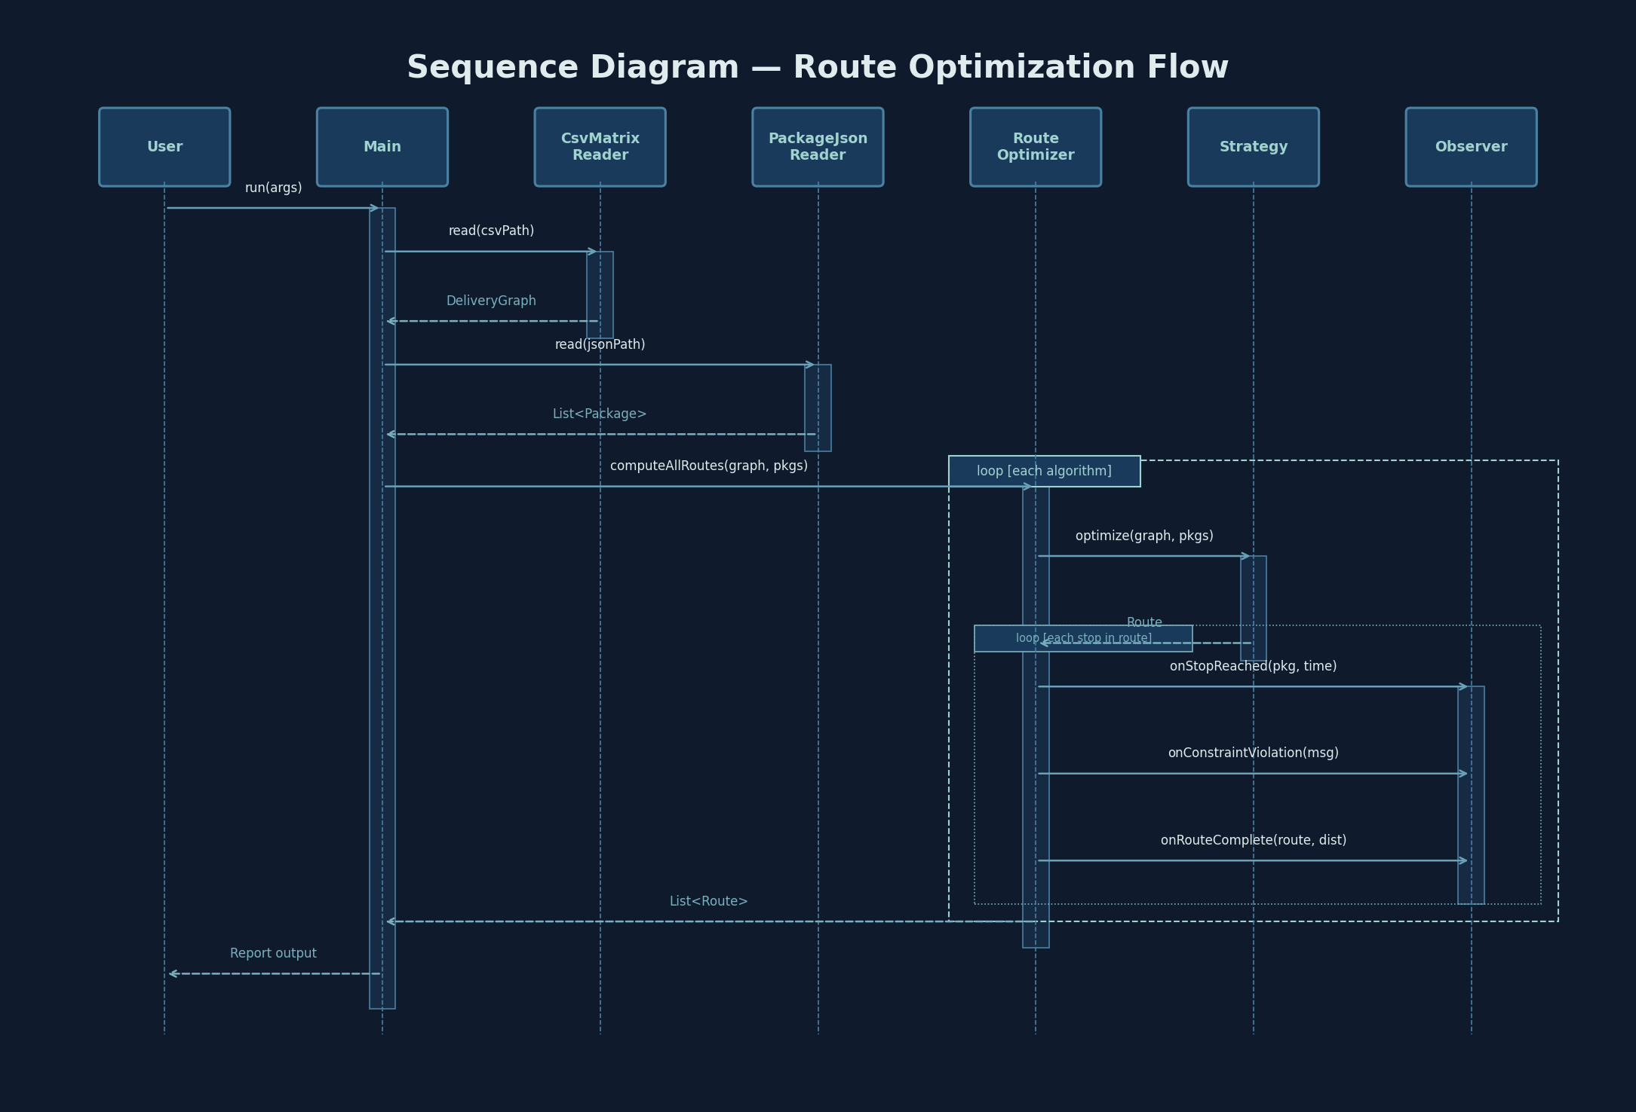

Slide 8
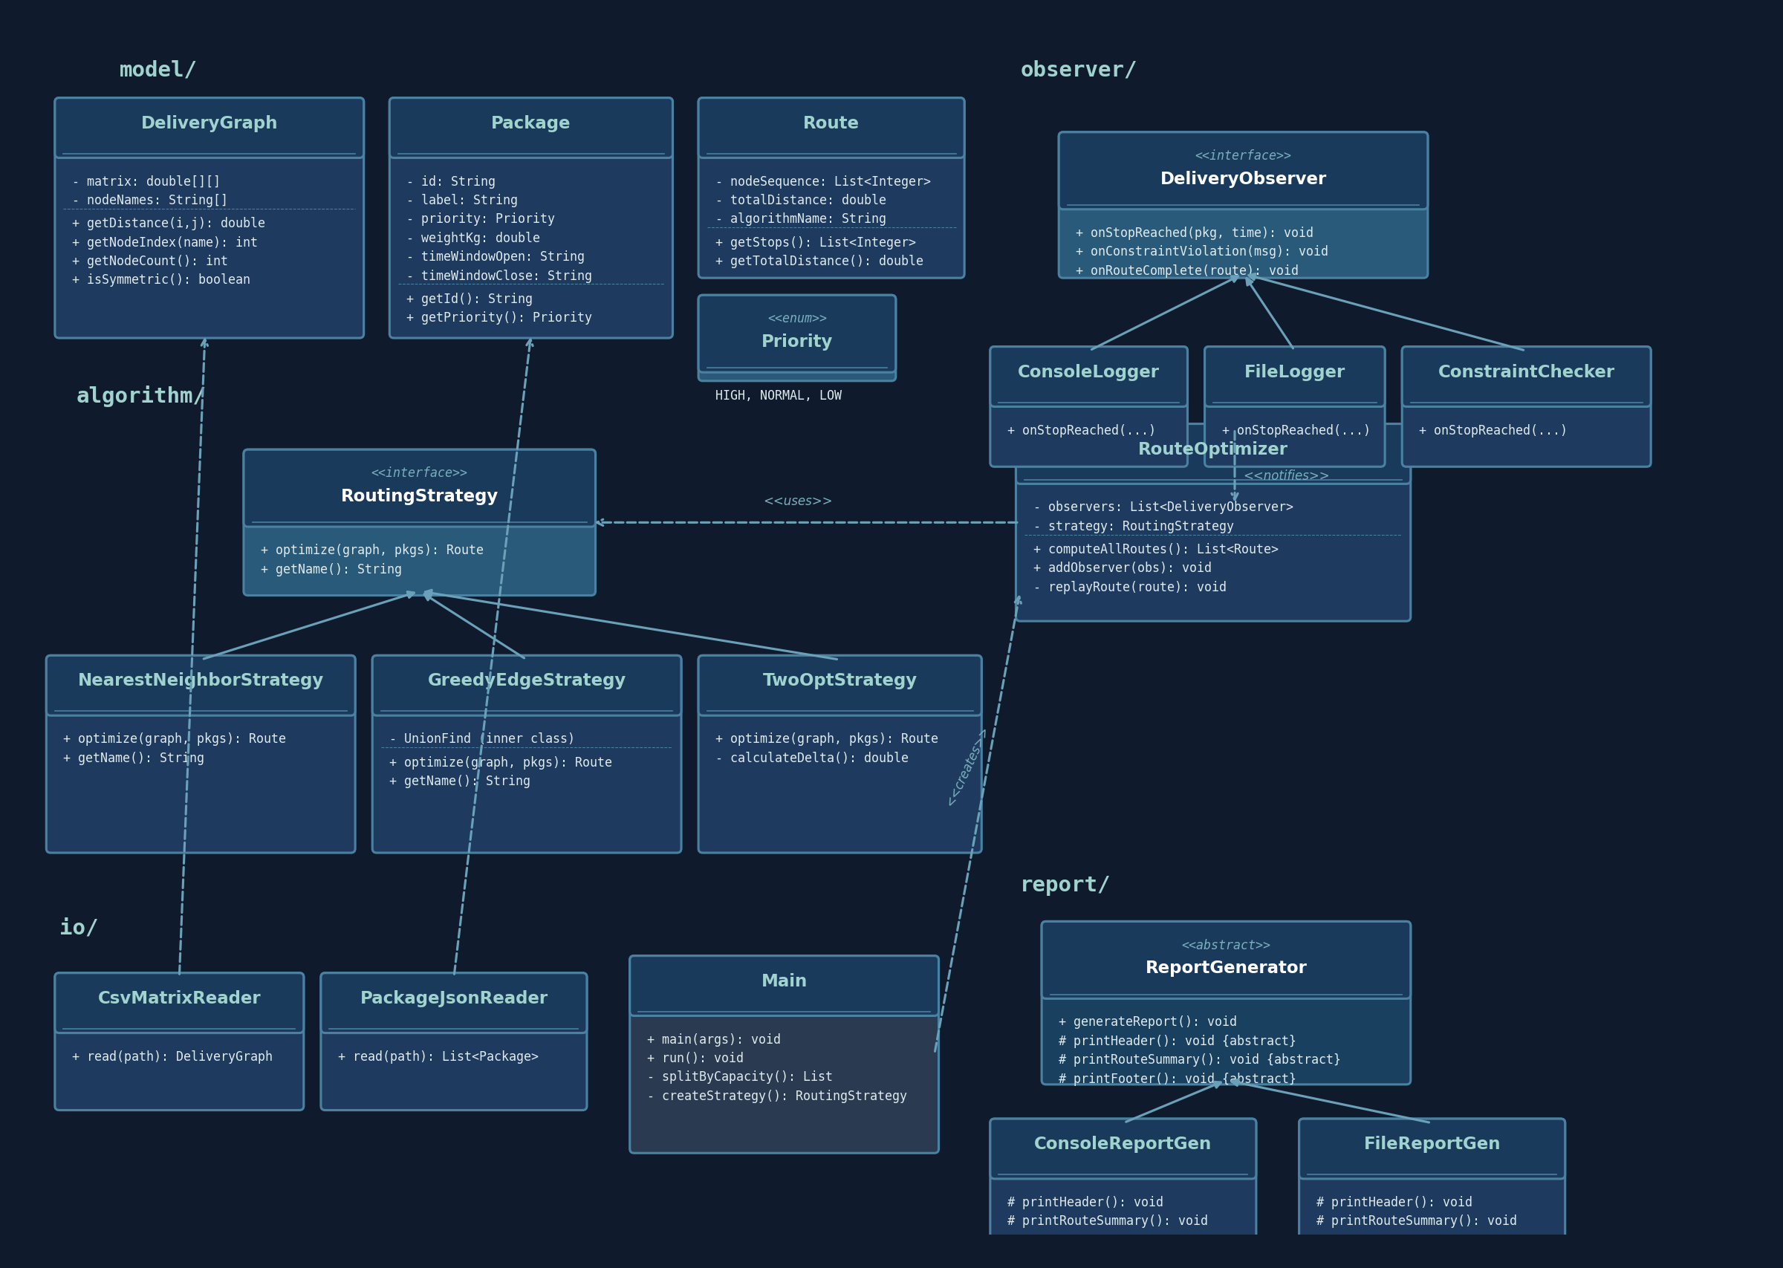
Class Diagram Design
Full UML class diagram showing all packages, interfaces, and relationships

Slide 9
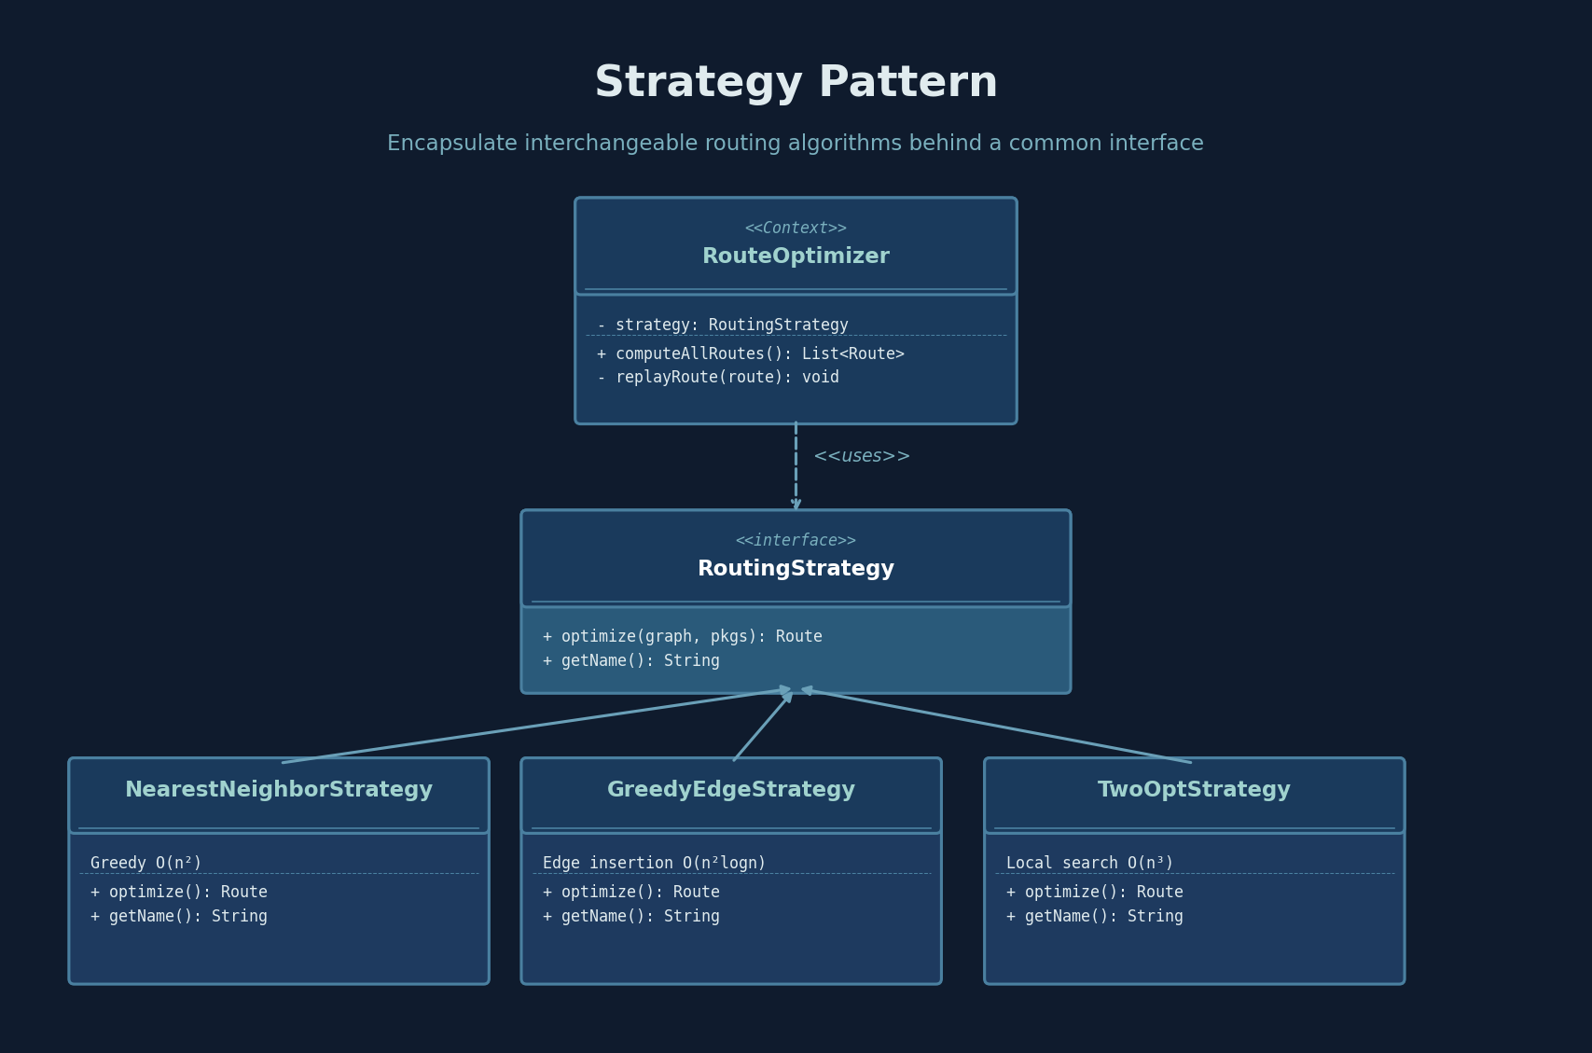

Slide 10
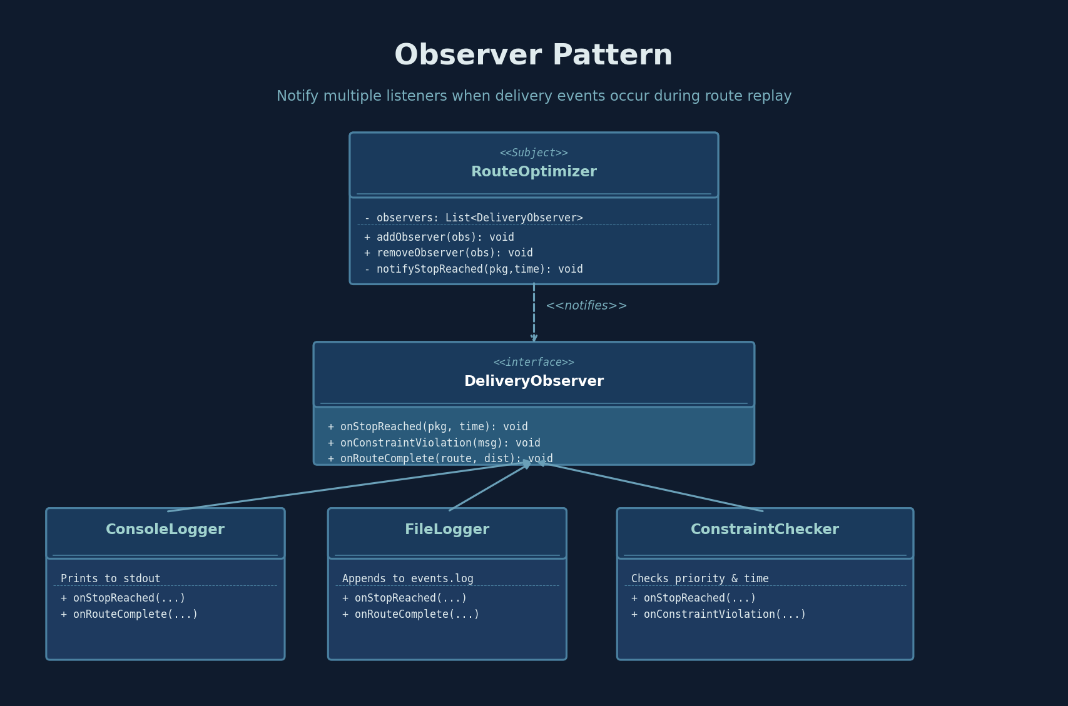

Slide 11
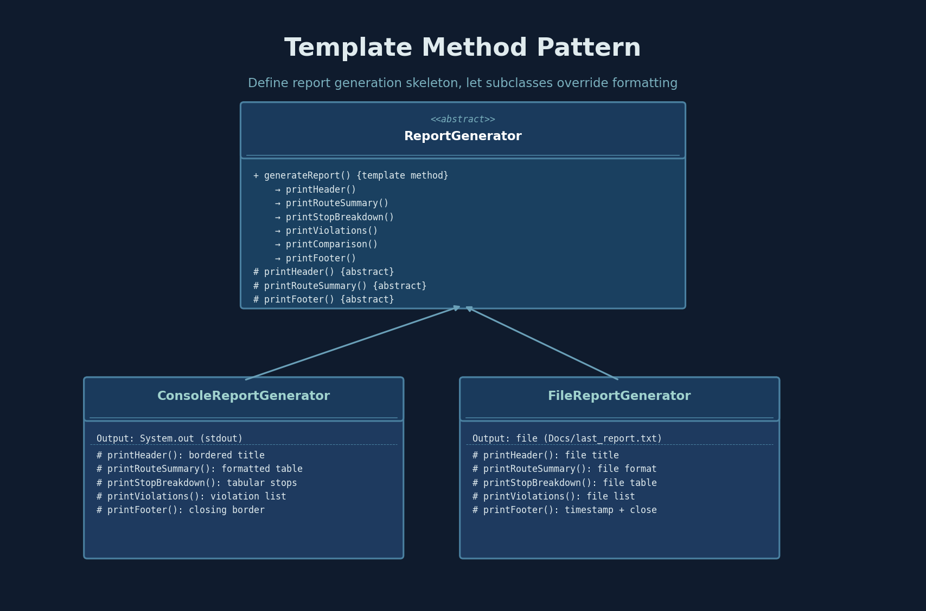

Slide 12
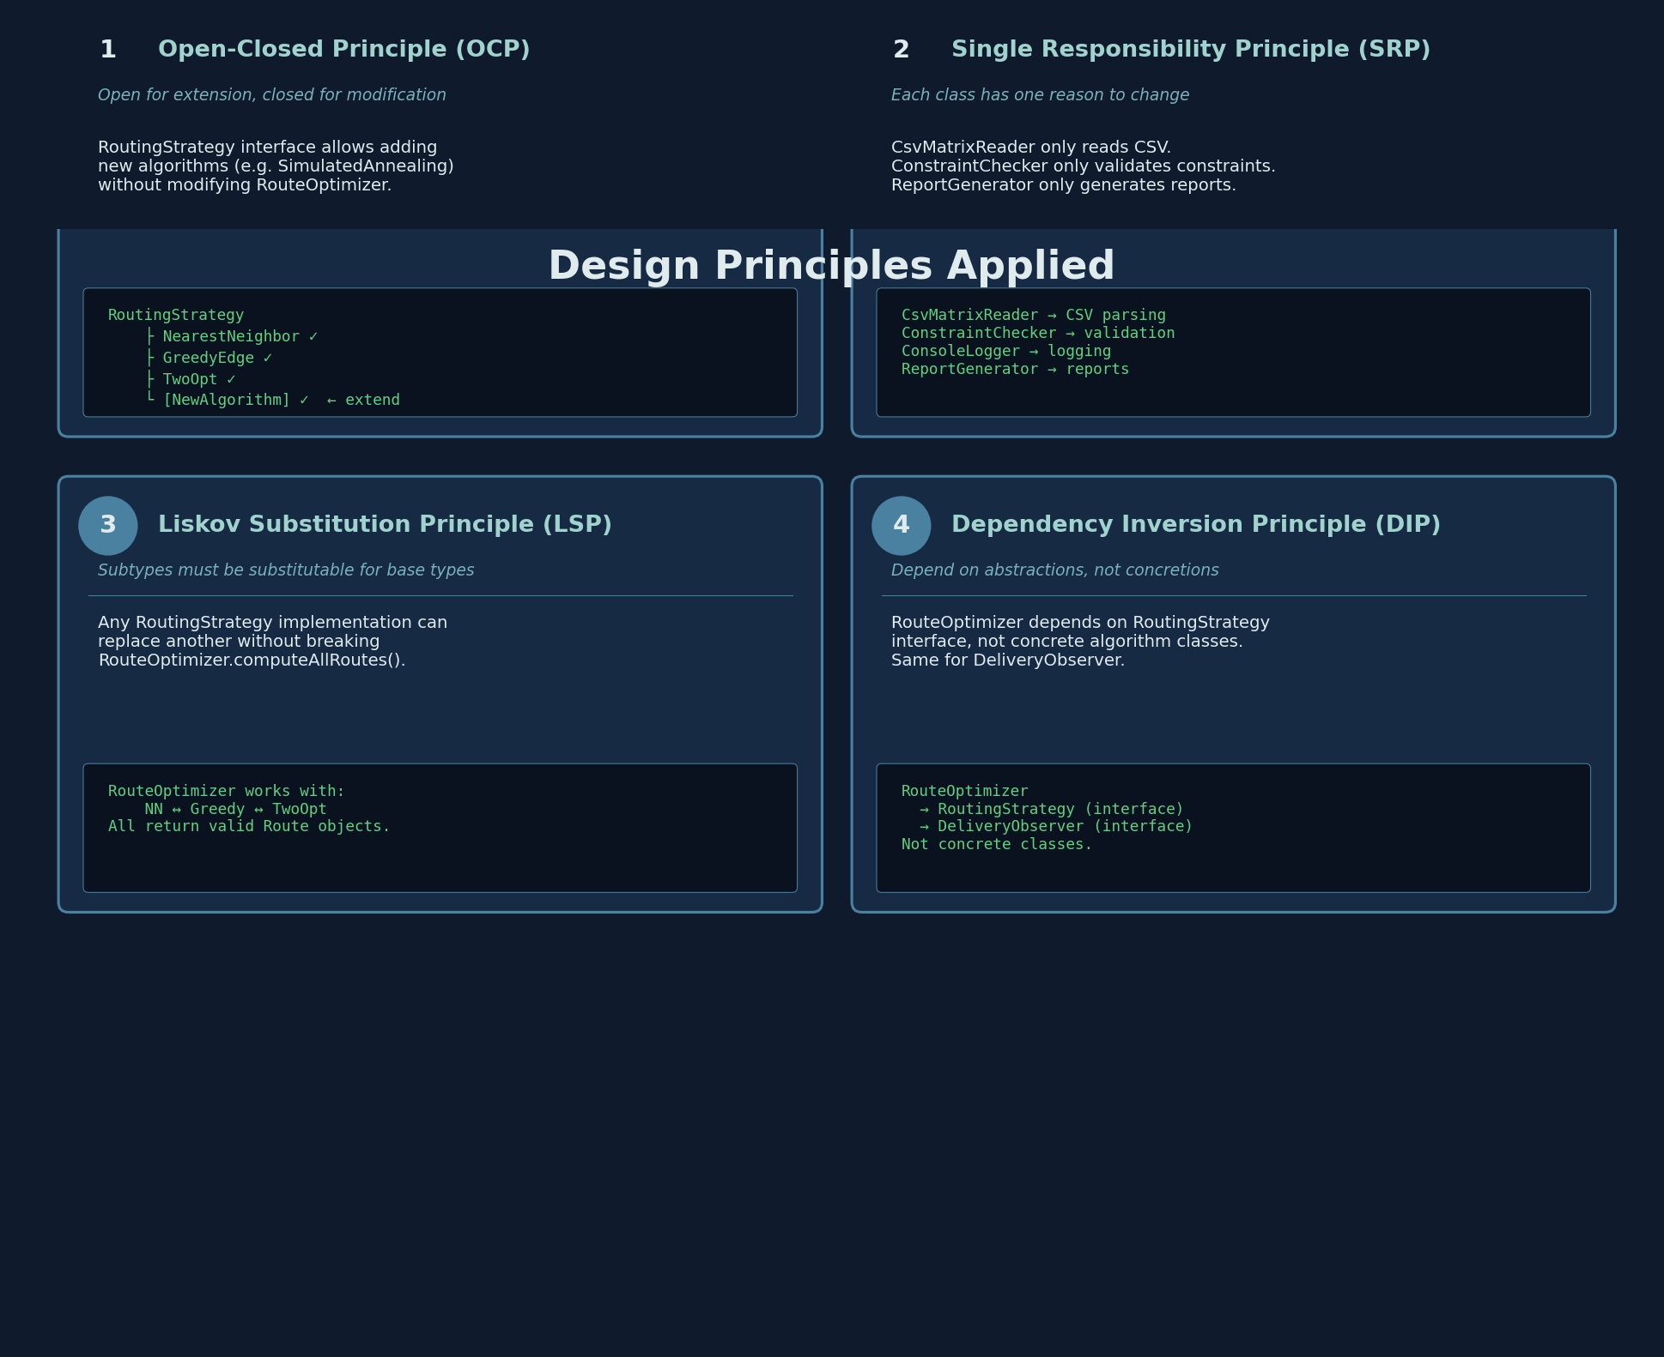

Slide 13
Algorithm Details
Nearest Neighbor
Greedy Edge Insertion
2-Opt Improvement
O(n²)
O(n² log n)
O(n³) iterative
Greedy heuristic — always visit the closest unvisited stop from current position. Fast but often suboptimal (no backtracking). Used as baseline and seed for 2-Opt.
Sort all edges by distance, greedily add shortest valid edges. Uses Union-Find for cycle detection. Degree constraint ≤ 2 per node.
Starts with NN solution, iteratively reverses sub-segments. If reversing [i..j] reduces distance → swap. Repeats until convergence (local optimum).
Performance Comparison (6-node graph)
· Nearest Neighbor: 95.25 km 143 min
· Greedy Edge: 89.50 km 134 min
· 2-Opt: 87.50 km 131 min

Slide 14
Test Case Strategy
JUnit 5 · 30+ Tests · 8 Test Classes · All Passing
Test Class | # Tests | What's Tested
NearestNeighborStrategyTest | 5 | Basic routing, equal distances, single stop, depot return
GreedyEdgeStrategyTest | 8 | All stops visited, correct distance, depot first/last
TwoOptStrategyTest | 5 | Improves on NN, already optimal, single stop valid
DeliveryGraphTest | 7 | Symmetric/asymmetric, non-square, negative distances
CsvMatrixReaderTest | 6 | Valid parse, non-square throws, missing file
ConstraintCheckerTest | 7 | Priority ordering, time windows, early/late arrival

Slide 15
Team Work
Challenges Faced
How We Addressed Them
1. Greedy Edge with Union-Find
Implementing cycle detection with disjoint
sets and degree constraints was complex.
2. Multiple Constraint Types
Balancing capacity, time windows, and
priority ordering simultaneously.
3. Extensibility
Designing for easy addition of new
algorithms without breaking existing code.
4. Coordination & Integration
Merging work from 4 members across
algorithm, observer, and reporting modules.
Strategy Pattern
Plug-and-play algorithm architecture.
Each member implemented their strategy.
Observer Pattern
Decoupled logging from business logic.
Observer module developed independently.
Template Method Pattern
Standardized report sections.
I/O team only overrides formatting.
Regular Team Meetings
Weekly sync to review progress, resolve
integration issues, and plan next steps.

Slide 16
Lifecycle Management
Build System: Maven
CI/CD Pipeline
maven-compiler-plugin → Java 11 compilation
maven-surefire-plugin → automated test execution
maven-shade-plugin → fat JAR to Release/
Dependencies:
Gson 2.10.1 (JSON) · JUnit 5.10.2 (Testing)
Build: ./mvnw clean package
Test: ./mvnw test (30+ tests, all passing)
Package: JAR → Release/DeliveryRouteOptimizer.jar
Version Control: Git + GitHub
Structured commits · Feature branching
Project Structure
Source/ Maven project (src/main/java + src/test/java) 8 packages, 15+ classes
Release/ Compiled JAR (DeliveryRouteOptimizer.jar) Ready-to-run artifact
data/ Sample input files (distances.csv, packages.json) Test data included
Docs/ User Manual, Installation Guide, Reports Full documentation suite
logs/ Runtime event logs (events.log) Observer-generated

Slide 17
Conclusion
✓
Modular Architecture
Clean separation via Strategy, Observer, Template Method patterns
✓
3 Algorithms
Nearest Neighbor, Greedy Edge Insertion, 2-Opt Improvement
✓
Real-world Constraints
Vehicle capacity, time windows, delivery priorities
✓
Comprehensive Testing
30+ JUnit 5 tests across 8 test classes
✓
Production-ready CLI
Fat JAR with Maven build, sample data, demo script
Acknowledgement of AI usage: AI tools were used to brainstorm project ideas and assist with code generation during the problems faced

