Slide 1
Rochester MN Clustering Analysis
Coursera IBM Data Science Capstone

Slide 2
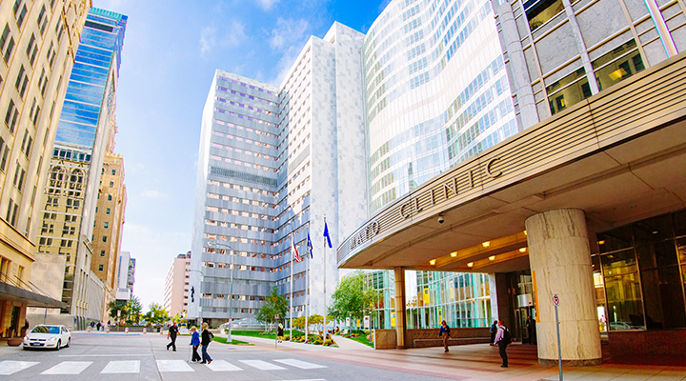
Rochester, Minnesota, USA

Slide 3
Introduction
Rochester, Minnesota USA is a city in the southeaster part of the state of Minnesota in Olmsted County. It is primarily known as the home of the world renown Mayo Clinic which serves over 1 million patients per year and conducts crucial medical research and training.
In 2013 the State Government of Minnesota initiated a “Destination Medical Center” initiative intended to invest over 5 billion dollars into infrastructure and expansion in Olmsted County to further support the Economic impacts of the Mayo Clinic. In 20 years’ time the area’s population is expected to have grown between 50 and 100%.
The increased population and increased patient volume expected presents key business problems across all sectors of the regional economy. All types of businesses from lodging, housing, business services, restaurants, and so on will need to be opened to handle the expansion. Cluster analysis may help to identify which types are missing in each natural cluster.

Slide 4
DATA
The data for this project needs to come from three sources.
There is a online database of zip codes and population data housed at https://www.zip-codes.com/county/mn-olmsted.asp This gives a breakdown of the county and metro area.
The “GeoPy” package in Python will allow us to append latitude and longitude data to our zip code and population data from the prior source
Finally, with the Foursquare API we can pull popular venues of interest for each of the latitude and longitude values from the DataFrame

Slide 5
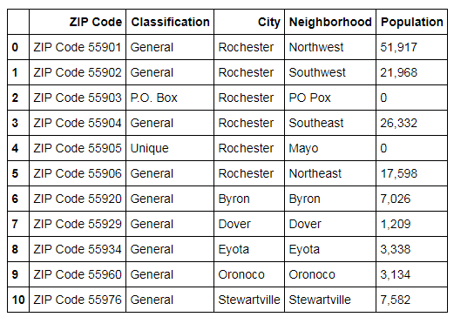
Here’s The Zip Code Data

Slide 6
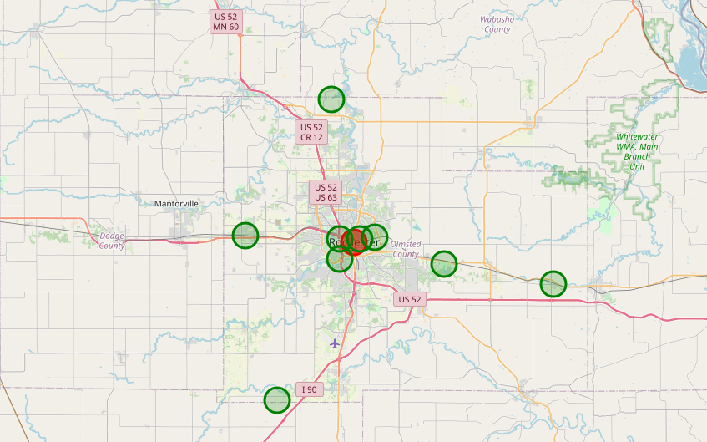
Here’s the Region Map with the Zip Code Center Groupings Highlighted

Slide 7
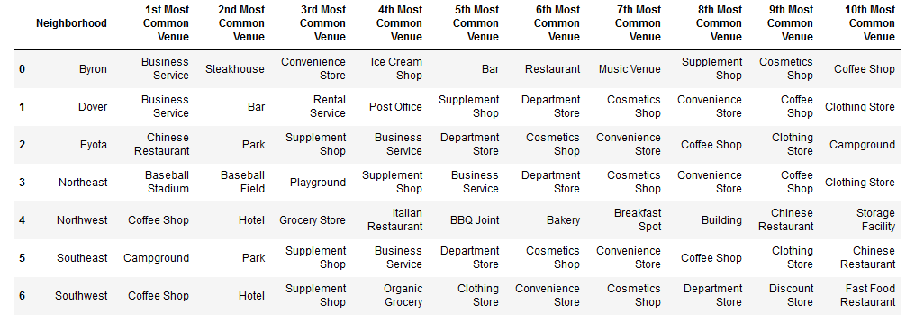
Here are some popular venues in the different Zip Codes

Slide 8
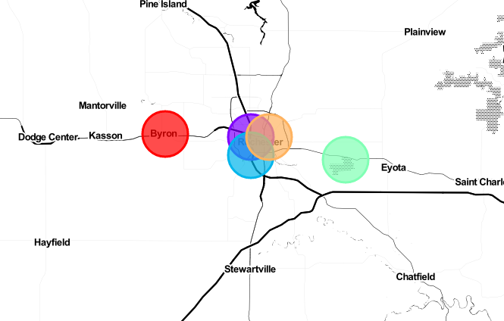
Clustering Results

Slide 9
Conclusions
Cluster Number 1 encompassing Northwest Rochester, Byron, and Dover is lacking in activities such as campgrounds or sports facilities compared to the others. These are likely good business options.
Cluster Number 2 encompassing Southwest Rochester seems to have a balance of all types, any well run business would be appropriate.
Cluster Number 3 encompassing Eyota seems to lack restaurant venues, this may be a good option in this area.
Cluster Number 4 encompassing Southeast Rochester is primarily sevices and shops. Lodging or Restaurants may be optimal.
Cluster Number 5 encompassing Northeast Rochester seems to be underdeveloped from a business perspective. Any options would likely be feasible

