Slide 1
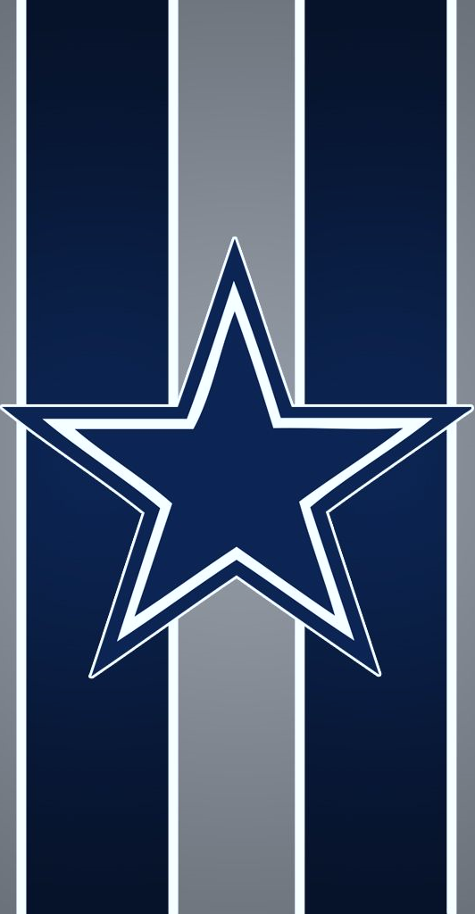
Dallas Cowboys
By: Yanhao Li
Blue star logo: representative of Texas as "The Lone Star State“
Team colors: Navy Blue, Metallic Silver, White
References: -https://en.wikipedia.org/wiki/Dallas_Cowboys
-http://www.dallascowboys.com/

Slide 2
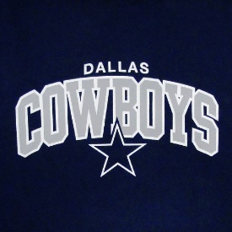
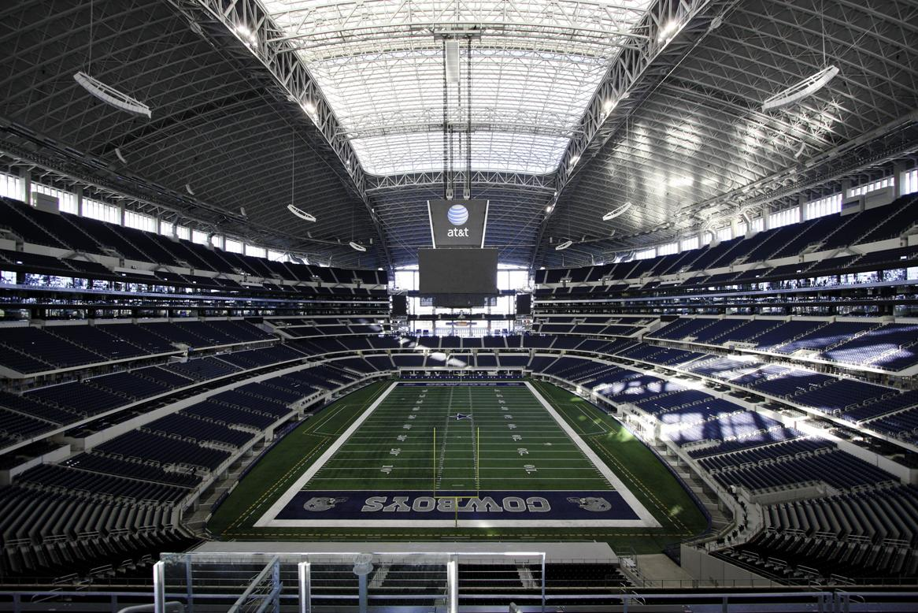
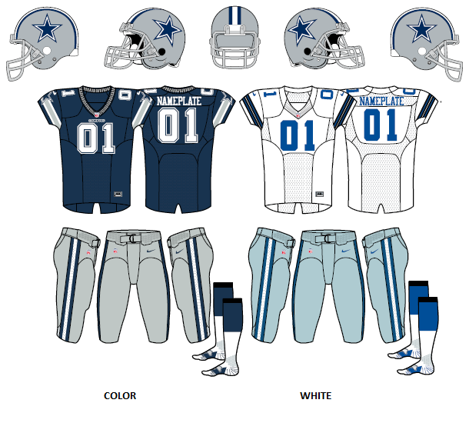
Facts about the Cowboys…
Conference: NFC East (with Giants, Eagles and Redskins)
Stadium: AT&T Stadium, Arlington, Texas
Established in 1960 as an expansion team
Current owner: Jerry Jones
Current head coach: Jason Garrett

Slide 3
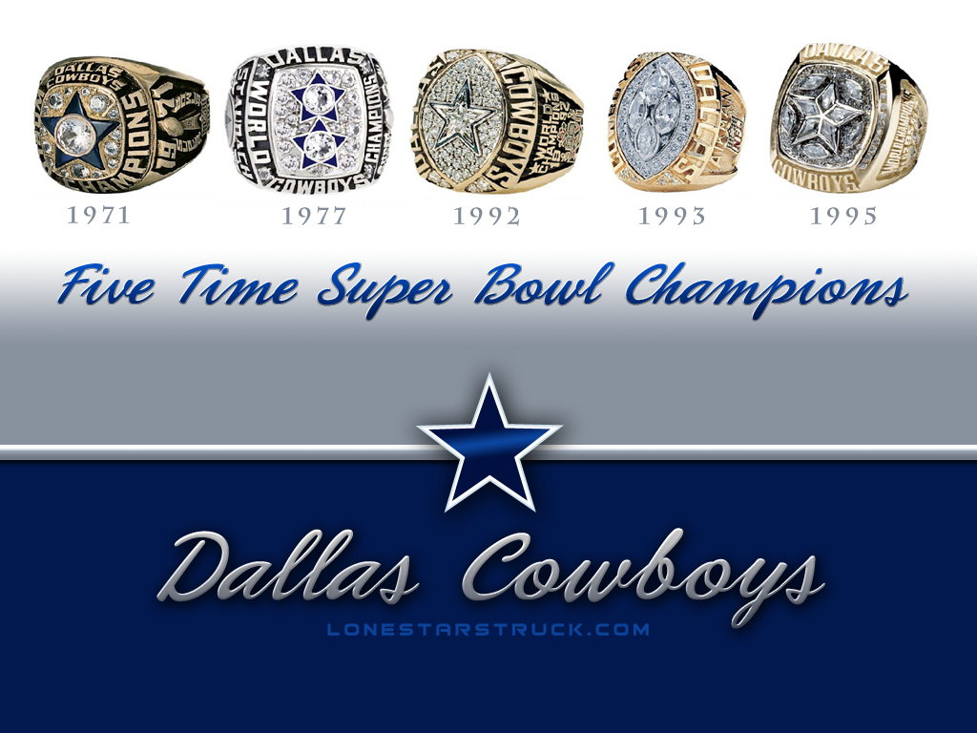
“America’s team”
5 Super Bowl championships (1971, 1977, 1992, 1993, 1995) , tied 2nd most in NFL history
8 times appearances in Super Bowl, the most. (shared with Steelers, Patriots and Broncos)
The first team to win 3 championships in 4 straight years (1992, 1993, 1995)
The only team to record 20 straight winning seasons (1966-1985)
Nickname dubbed by the team’s 1978 highlight film, as a result of the Cowboys’ national popularity and glorious history

