Slide 1

2023–2024 Review / Feedback Analysis
Check out the Code Source: Webscraper (Colab Notebook): https://colab.research.google.com/drive/1cQ_53GyXsGPfi5YsvyQO7mbEVhIVz3YU?usp=sharing
Data Analysis (Colab Notebook): https://colab.research.google.com/drive/1JlrWv3khw8qyyOj0DAF63bOM-SpC-jkZ?usp=sharing
27 February 2025,
By: Lester Liam

Slide 2
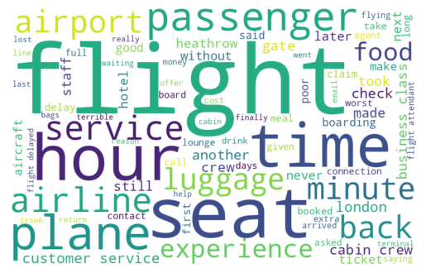
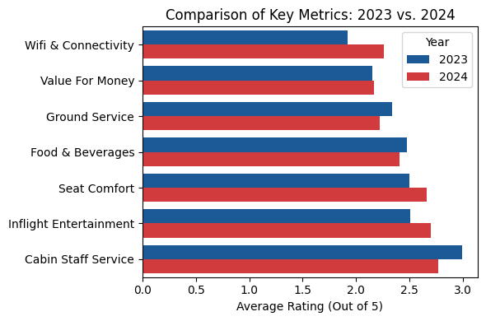
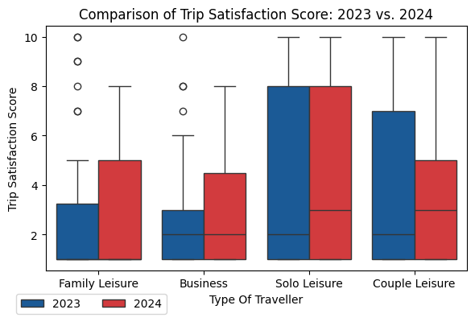
SOLELY FOR PURPOSES OF FORAGE WORK EXPERIENCE
KEY HIGHLIGHTS (2023 vs 2024)
28.6% of Passengers them wound British Airway, up by 1.2% compared to 2023
Negative Reviews frequently mentioned terms like: “flight”, “service”, “seat”, “plane” and “time”
Cabin Staff Service remains as Best Performing Metric despite falling compared to 2023
Rating for Wifi & Connectivity, Seat Comfort & Inflight Entertainment increased
Solo Leisure Travellers remained most satisfied with the highest average trip score
Family Leisure, Business Travellers trip scores improved while Couple Leisure fell

