Slide 1

Customer Booking Predictions Machine Learning
Check out the Source Code: Machine Learning (Colab Notebook): https://colab.research.google.com/drive/1vmatebzMSfiUN9I8KX19aXBVjT-MEkjY?usp=sharing
27 February 2025,
By: Lester Liam

Slide 2
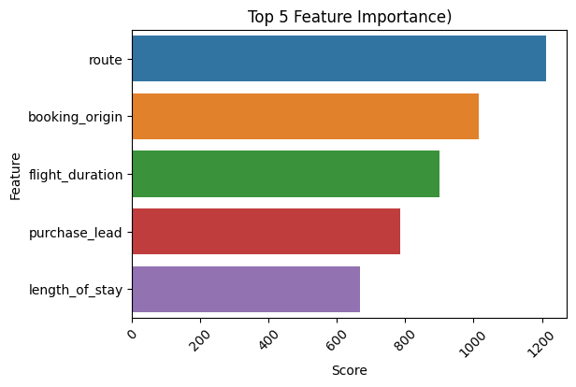
SOLELY FOR PURPOSES OF FORAGE WORK EXPERIENCE
MODEL PERFORMANCE SUMMARY
Model | Accuracy | Precision | Recall
A: XGBoost (No Sampling) | 84.74% | 0: 0.86 1: 0.46 | 0: 0.97 1: 0.12
B: XGBoost (SMOTE) | 77.38% | 0: 0.90 (▲0.04) 1: 0.33 (▼0.13) | 1: 0.82 (▼0.15) 0: 0.49 (▲0.37)
C: XGBoost (SMOTE+Tuning) | 75.64% | 0: 0.91 (▲0.01) 1: 0.32 (▼0.01) | 0: 0.80 (▼0.02) 1: 0.54 (▲0.06)
Best Model: XGBoost Classifier
80% of the Dataset was used to train Ridge Classifier, RandomForest and XGBoost. XGBoost resulted in best accuracy and performed.
To handle the imbalanced, SMOTE was applied on training dataset.
Which model to choose?
Model C can detect 54% of Booking Customer, but has higher chance False Positives
Model A is slightly lower chance of False Positives but is only able to detect 12% of Booking Customers
If accuracy on Non-Booking Customers matters, Model A is better, however, if detection is more important, Model C is more suitable!

