Slide 1
The $30B Lifeline
Understanding OFW Remittance Trends
Business Task
Analyze OFW remittance data to identify high-volume corridors underserved by formal banking channels, and provide a Philippine commercial bank with data-driven recommendations on where to prioritize digital remittance expansion.
Lester John Taborda · Last Updated: March 26, 2026

Slide 2
GOALS FOR THIS DISCUSSION
What this analysis will answer — and how it helps the bank decide.
01
02
Where does the money flow?
How has it grown over time?
Identify and rank the top OFW remittance corridors by volume using BSP data (2019–2024).
Track corridor-level trends across 6 years to reveal which markets are expanding fastest.
03
04
05
What did COVID reveal?
How big is the untapped opportunity?
Where should the bank act first?
Examine how corridors responded differently to the 2020 shock — resilience vs. contraction.
Estimate the non-bank remittance volume per corridor using PSA mode-of-transfer data.
Translate data findings into prioritized, corridor-specific recommendations for digital expansion.

Slide 3
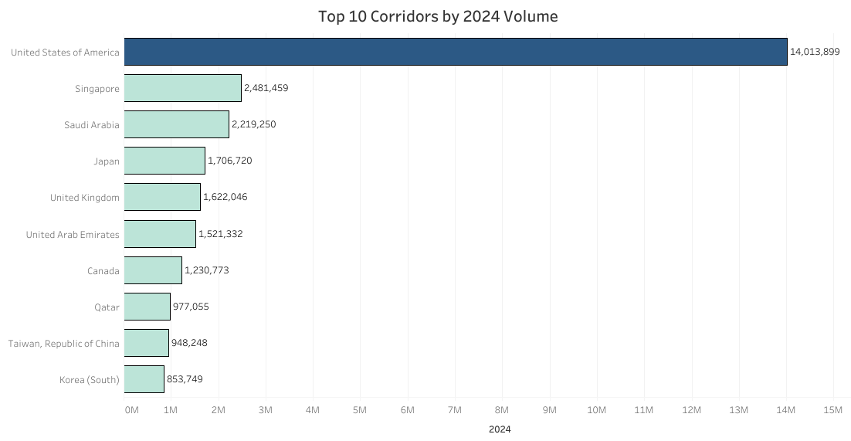
The US Corridor is in a Category of Its Own
3
Unit: USD Thousands · Source: BSP Cash Remittances by Country
5.6×
larger than #2 Singapore
40.6%
of all OFW remittances
Data: BSP Cash Remittances by Country, 2019–2024. Rankings based on 2024 annual totals.
Threshold: Countries with ≥ USD 100M annual total included. 27 corridors met this threshold in 2024.

Slide 4
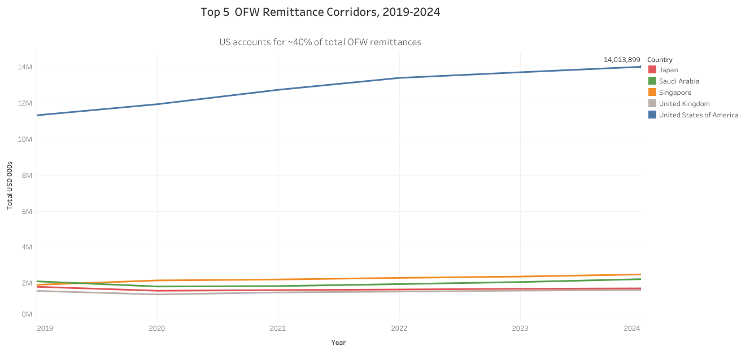
US Dominance Has Grown Consistently Since 2019
4
Unit: USD Thousands · Source: BSP
$77.1B
US 6-yr cumulative
+23.8%
US growth 2019→2024
BSP 2019–2024 annual data. Top 5 corridors by 2024 volume shown.

Slide 5
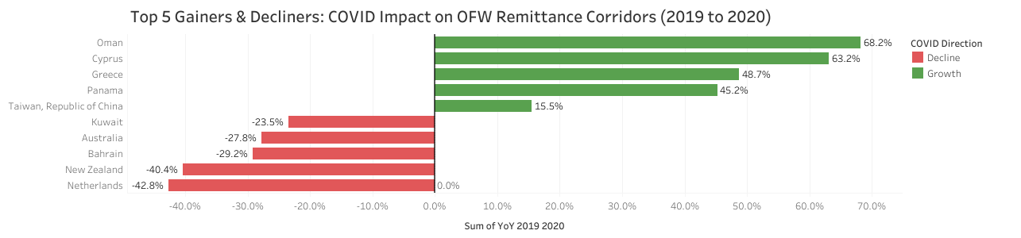
COVID Split OFW Corridors: Western Markets Grew, Gulf Contracted
5
Year-over-year change in remittances, 2019 → 2020
+68.2%
Oman — biggest gainer
vs. –42.8% Netherlands
Filtered to 5 biggest gainers and 5 biggest decliners for clarity. Full corridor data in BSP_OFW_Analysis.xlsx.
Gulf corridor declines reflect OFW job losses and reduced deployment during the pandemic. Western corridor growth reflects continued professional OFW income stability.

Slide 6
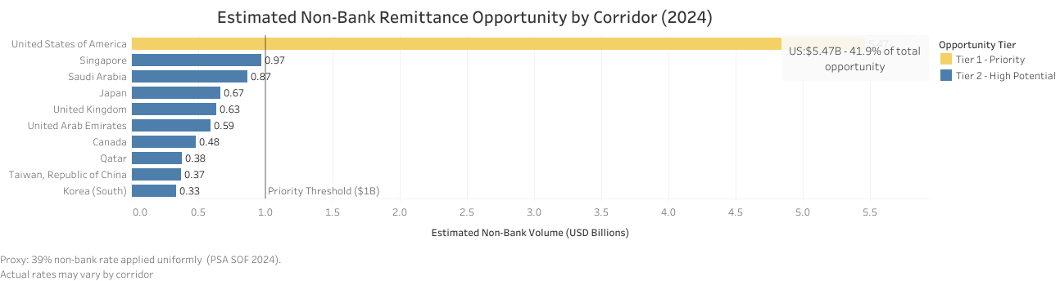
$13.04 Billion Flows Outside Formal Banking Annually
6
$13.04B
total annual opportunity
across 27 corridors
Tier 1 — Priority (≥$1B)
Tier 2 — High Potential

Slide 7
WHAT SHOULD YOUR BANK DO NEXT?
Three data-driven recommendations for digital remittance expansion
01
Prioritize US Corridor Digital Onboarding
$5.47B opportunity
$5.47B flows outside formal banking in the US corridor alone — 41.9% of the total addressable opportunity. This single corridor justifies dedicated digital infrastructure, competitive fee structures, and targeted OFW community partnerships in key US states.
02
Target Gulf Recovery Corridors with Competitive Fees
Saudi · Qatar · UAE · Kuwait
Saudi Arabia (+1.1% CAGR) and Qatar (+5.2% CAGR) have recovered and are growing post-COVID. UAE and Kuwait have not fully recovered — presenting an opening for a competitive bank to capture displaced flows with transparent pricing.
03
Build Early Infrastructure in High-CAGR Emerging Corridors
Cyprus · Taiwan · Malaysia
Cyprus (+14.9%), Taiwan ROC (+9.7%), and Malaysia (+7.2%) are growing 2–3× faster than top-volume corridors. Establishing digital remittance presence now — before volumes peak — gives the bank a cost advantage and first-mover loyalty.
These recommendations are data-driven. Corridor prioritization is based on BSP 2024 volumes and PSA SOF 2024 bank usage proxy.

Slide 8
REFERENCES & DATA SOURCES
All data sourced from Philippine government institutions. Publicly available, no license restrictions.
Bangko Sentral ng Pilipinas (BSP)
OF Cash Remittances by Country — Monthly Excel File
https://www.bsp.gov.ph/SitePages/Statistics/External.aspx?TabId=8
Primary dataset. Annual corridor-level remittances 2019–2024. Used for: corridor ranking, trend analysis, COVID impact, underserved opportunity sizing.
Philippine Statistics Authority (PSA)
Survey on Overseas Filipinos (SOF) — Remittance by Mode of Transfer, Tables 9/6
https://psa.gov.ph/statistics/survey/labor-and-employment/survey-overseas-filipinos
Supplementary dataset. Bank vs. non-bank usage rates 2019–2024. Used for: 39% informal rate proxy applied to BSP corridor volumes.
BSP Department of Economic Statistics
Discussion Paper: Remittances from Overseas Filipinos in the Time of COVID-19 — Spillovers and Policy Imperatives
https://www.bsp.gov.ph
Background literature. Reviewed for context on US corridor inflation via correspondent banking and COVID-era remittance behavioral shifts. Tables not used in analysis.

