Slide 1


EVENT STREAMING PLATFORM
Apache Kafka
An introduction to distributed event streaming, for engineers who haven't met it yet.
Intro to Apache Kafka
Notes:
Welcome slide. Set expectations: this is a conceptual intro, not a hands-on lab. By the end, students should understand what Kafka is, why it exists, and its core vocabulary (topics, partitions, producers, consumers, brokers).

Slide 2
What Is Kafka?
Apache Kafka is a distributed platform for publishing, storing, and processing streams of events in real time.
Distributed
Durable
Real-Time
Scalable
Originally built at LinkedIn in 2011, Kafka is now the de facto standard for moving data between systems at high volume and low latency.
Intro to Apache Kafka
02
Notes:
Define Kafka simply before diving into mechanics. Emphasize three words: distributed, durable, real-time. Mention the LinkedIn origin (2011, later open-sourced as an Apache project) for context.

Slide 3
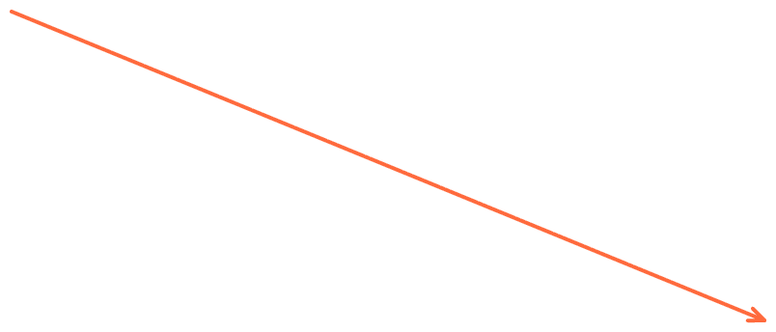
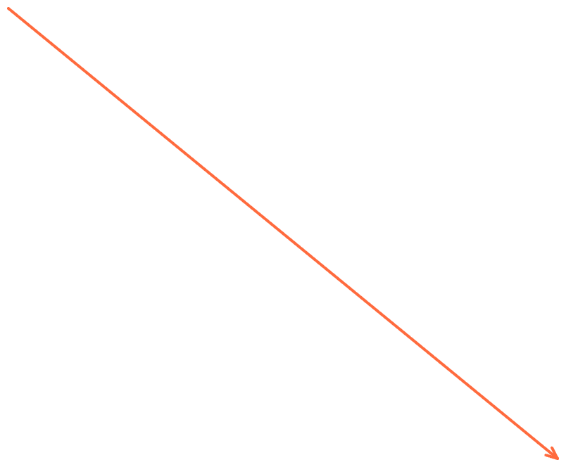
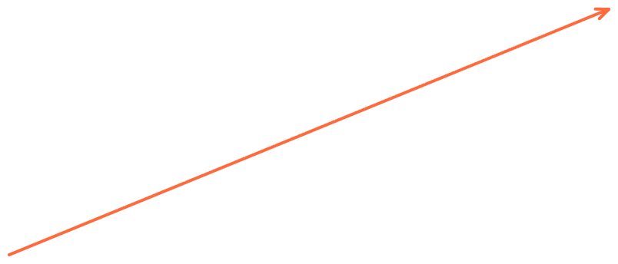
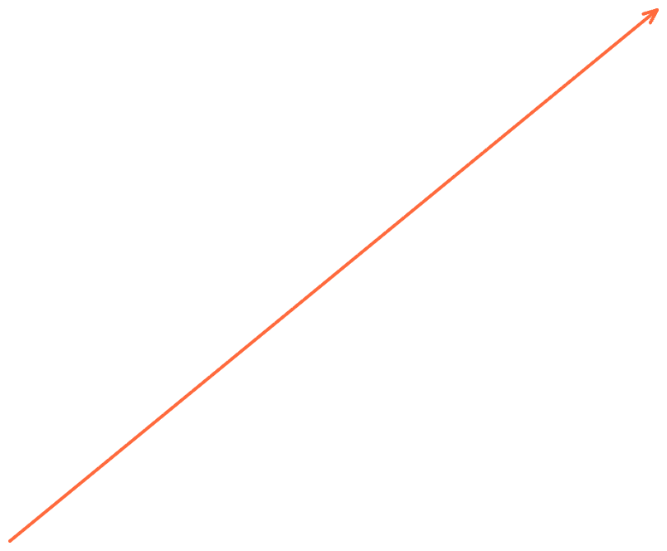
The Problem: Everyone Talks to Everyone
Without Kafka
With Kafka
Orders
Analytics
Orders
Analytics
Payments
Email
Payments
Kafka
Email
Inventory
Search
Inventory
Search
N systems need up to N² point-to-point connections.
Every system just talks to Kafka.
Intro to Apache Kafka
03
Notes:
Classic N-squared integration problem. Before Kafka, every system that needs data from every other system requires a custom point-to-point connection. Kafka acts as a central nervous system: producers write once, any number of consumers read independently.

Slide 4


Publish / Subscribe, Not Point-to-Point
Consumer A
Producer
Topic: orders
Consumer B
3 partitions
One producer writes to a topic once. Any number of consumers can read it independently — at their own pace, without the producer knowing they exist.
Consumer C
Intro to Apache Kafka
04
Notes:
Highlight decoupling: the producer doesn't know who or how many consumers exist. Consumers can be added later without changing the producer. This is the core pub/sub value proposition versus point-to-point messaging or direct API calls.

Slide 5
Topics Are Split Into Partitions
A topic is a named stream of events, e.g. orders. Kafka splits it into partitions — ordered, append-only logs identified by an offset.
Partition 0
0
1
2
3
+
Partition 1
0
1
+
Partition 2
0
1
2
+
Order is only guaranteed within a partition — never across the whole topic.
Intro to Apache Kafka
05
Notes:
Key concept: partitions are the unit of parallelism and ordering. Each partition is an immutable, append-only log; new records get the next offset. Emphasize that ordering is per-partition only, which surprises many students.

Slide 6


Producers Write. Consumers Read.
Producers
Consumers
Applications that publish events to a topic
Can choose (or hash) a key to pick a partition; defaults to round-robin delivery
Don't know or care who reads the data
Applications that subscribe and read events
Track their own position with an offset
Can replay history by resetting that offset
Intro to Apache Kafka
06
Notes:
Producers and consumers are decoupled in time and space. Consumers control their own offset, which is what makes replay possible — a big difference from traditional message queues where messages disappear once consumed.

Slide 7
Brokers Form the Cluster
Broker 1
Broker 2
Broker 3
Partition 0 · Leader
Partition 0 · Follower
Partition 0 · Follower
Partition 1 · Follower
Partition 1 · Leader
Partition 1 · Follower
Partition 2 · Follower
Partition 2 · Follower
Partition 2 · Leader
Each partition has one leader broker that handles reads and writes, and replicas on other brokers for fault tolerance. If a broker fails, a follower takes over.
Intro to Apache Kafka
07
Notes:
A broker is a single Kafka server; a cluster is a group of brokers. Explain leader/follower replication briefly — replication factor is typically 3 in production. Mention that modern Kafka uses its own KRaft consensus for cluster coordination, replacing ZooKeeper, if time allows.

Slide 8
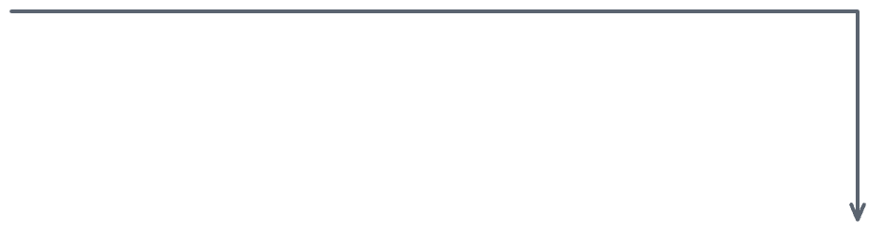
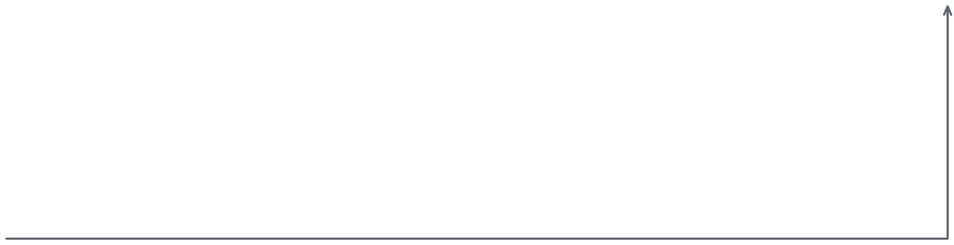
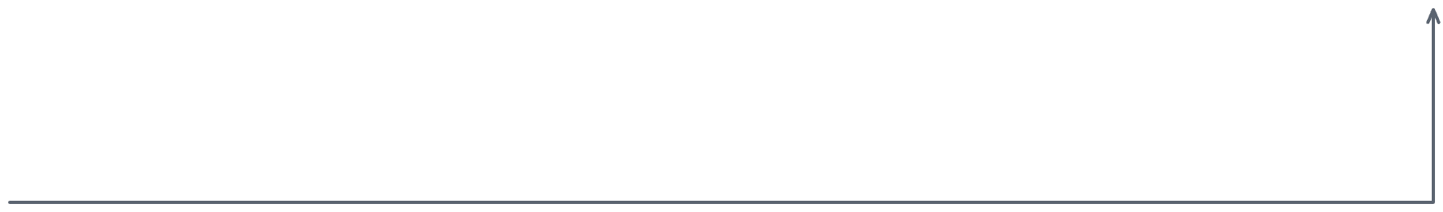
Consumer Groups Scale Reads
Topic: orders
Partition 0
Consumer Group: billing-service
Partition 1
Consumer 1
Consumer 2
reads P0, P1
reads P2, P3
Partition 2
Partition 3
Each partition is read by exactly one consumer in a group — that's how client apps can scale beyond a single consumer
Intro to Apache Kafka
08
Notes:
Consumer groups are how Kafka achieves scalable, parallel consumption while preserving per-partition order. Rule: within a group, each partition is assigned to exactly one consumer. Add a consumer, and Kafka rebalances partitions across the group — up to one consumer per partition (more consumers than partitions sit idle).

Slide 9


Who Deletes the Message, and When?
The biggest difference between Kafka and a traditional queue (RabbitMQ, ActiveMQ, JMS) is how — and when — a message goes away.
Traditional Queue
Kafka
The broker must track every subscriber and what each one has already acknowledged
A message is deleted only once all subscribers have consumed it
Add a subscriber, and the broker takes on more per-message bookkeeping
The broker does not track which consumers have read a message
Every message simply stays until its retention period expires (e.g. 7 days)
Each consumer tracks its own offset — the broker's job never gets more complex
Traditional queues: bookkeeping grows with the number of subscribers. Kafka: one retention clock per topic, no matter how many consumers are reading.
Intro to Apache Kafka
09
Notes:
Focus on message lifecycle and consumption model. A traditional queue broker has to track, per message, which of its subscribers have acknowledged it, and only deletes the message once everyone has -- that per-subscriber bookkeeping is real operational overhead that grows as you add consumers. Kafka sidesteps this entirely: it never tracks per-consumer acknowledgment at the broker level. It just keeps every message until the topic's retention period (time- or size-based) expires, and each consumer independently tracks its own offset. This is why adding a new consumer group to Kafka is "free" for the broker, while adding a subscriber to a traditional queue adds work.

Slide 10
Why Kafka Holds Up at Scale
Property | What it means
Durability | Events are written to disk and replicated across brokers before being acknowledged
Scalability | Add brokers and partitions to handle more throughput, with no downtime
Fault tolerance | Replica brokers take over automatically if a leader fails
Ordering | Guaranteed within a partition, so events for the same key stay in sequence
High throughput | Sequential disk I/O and batching let a single broker handle millions of events/sec
Intro to Apache Kafka
10
Notes:
Five properties worth memorizing. Durability and fault tolerance come from replication; scalability comes from partitioning; ordering is scoped to a partition, not a topic. These properties distinguish Kafka from a simple message queue.

Slide 11






Where Kafka Shows Up
Real-time analytics
Log aggregation
Microservice events
Dashboards and fraud detection on live data
Centralizing logs from thousands of services
Decoupled communication between services
Metrics & monitoring
Data integration
Event sourcing
Streaming system and application metrics
Feeding data lakes, warehouses, and search indexes
The log as the source of truth for state changes
Intro to Apache Kafka
11
Notes:
Ground the abstract concepts in familiar examples. LinkedIn originally built Kafka for activity tracking and metrics. Today, companies like Netflix, Uber, and Airbnb use it for exactly these six patterns.

Slide 12
Beyond the Core: the Ecosystem
Tool | Purpose
Kafka Connect | Prebuilt connectors to import/export data (databases, S3, Elasticsearch...)
Kafka Streams | A Java library for building stream-processing applications
ksqlDB | SQL-like queries over streaming data, no code required
Schema Registry | Enforces and versions the structure of messages over time
Intro to Apache Kafka
12
Notes:
Kafka itself is just the log. The ecosystem is what makes it practical: Connect for integration without custom code, Streams/ksqlDB for processing, Schema Registry for data contracts between teams.

Slide 13




The Full Picture
Kafka Cluster
Producer A
Consumer 1
Producer B
Broker 1
Broker 2
Broker 3
Consumer 2
Topic: orders
Topic: orders
Topic: orders
P0
P1
P2
P0
P1
P2
P0
P1
P2
Producer C
Consumer group
Intro to Apache Kafka
13
Notes:
Bring every concept together: producers write to topics spread across partitions on brokers in a cluster; consumer groups read from those partitions in parallel. This is the mental model students should leave with.

Slide 14

Key Takeaways
Kafka is a distributed event streaming platform, not a traditional message queue
Topics are split into ordered partitions — the unit of parallelism
Producers and consumers are fully decoupled — consumers control their own offset
Consumer groups parallelize reads, each partition to only one consumer
Replication across brokers gives Kafka durability and fault tolerance
Intro to Apache Kafka
14
Notes:
Recap the five core ideas before moving to a hands-on lab or demo. These five points are the minimum a student needs to make sense of any Kafka documentation or tutorial they read next.

Slide 15

THANK YOU
Questions?
Notes:
Open the floor for questions. Suggest a hands-on follow-up: installing Kafka locally (or via Docker) and running the quickstart producer/consumer console scripts.

