Slide 1

Create a Free-Tier PostgreSQL Instance on Amazon RDS
AWS · AMAZON RDS
Default VPC · Port 5432 restricted to your /24 · Connect with pgAdmin
Notes:
Course walkthrough: create a free-tier PostgreSQL RDS instance in the default VPC, restrict access to the student's /24, and connect with pgAdmin. Budget about 30 minutes, most of it waiting for the instance to become Available.

Slide 2



What we are building
OVERVIEW
Default VPC
Your workstation
Internet
Security group
RDS PostgreSQL
pgAdmin
public IP
5432 from your /24
free tier, public
Part 1 Create the database in the console
Part 2 Open port 5432 to your /24 only
Part 3 Connect with pgAdmin
Part 4 Clean up so nothing bills
Notes:
Walk left to right. The instance gets a public IP when Public access = Yes, but the security group is what actually decides who can reach port 5432.

Slide 3


Prerequisites
BEFORE WE START
AWS account
Billing set up. Know whether it is on the credit-based Free plan.
One region
Everyone uses the same one, for example us-east-1.
Default VPC
VPC console, Your VPCs, Default VPC = Yes. Recreate it if deleted.
pgAdmin
Already installed on the workstation. Optional: psql.
Notes:
Have students confirm the default VPC before anything else. If they deleted it: VPC console > Actions > Create default VPC.

Slide 4
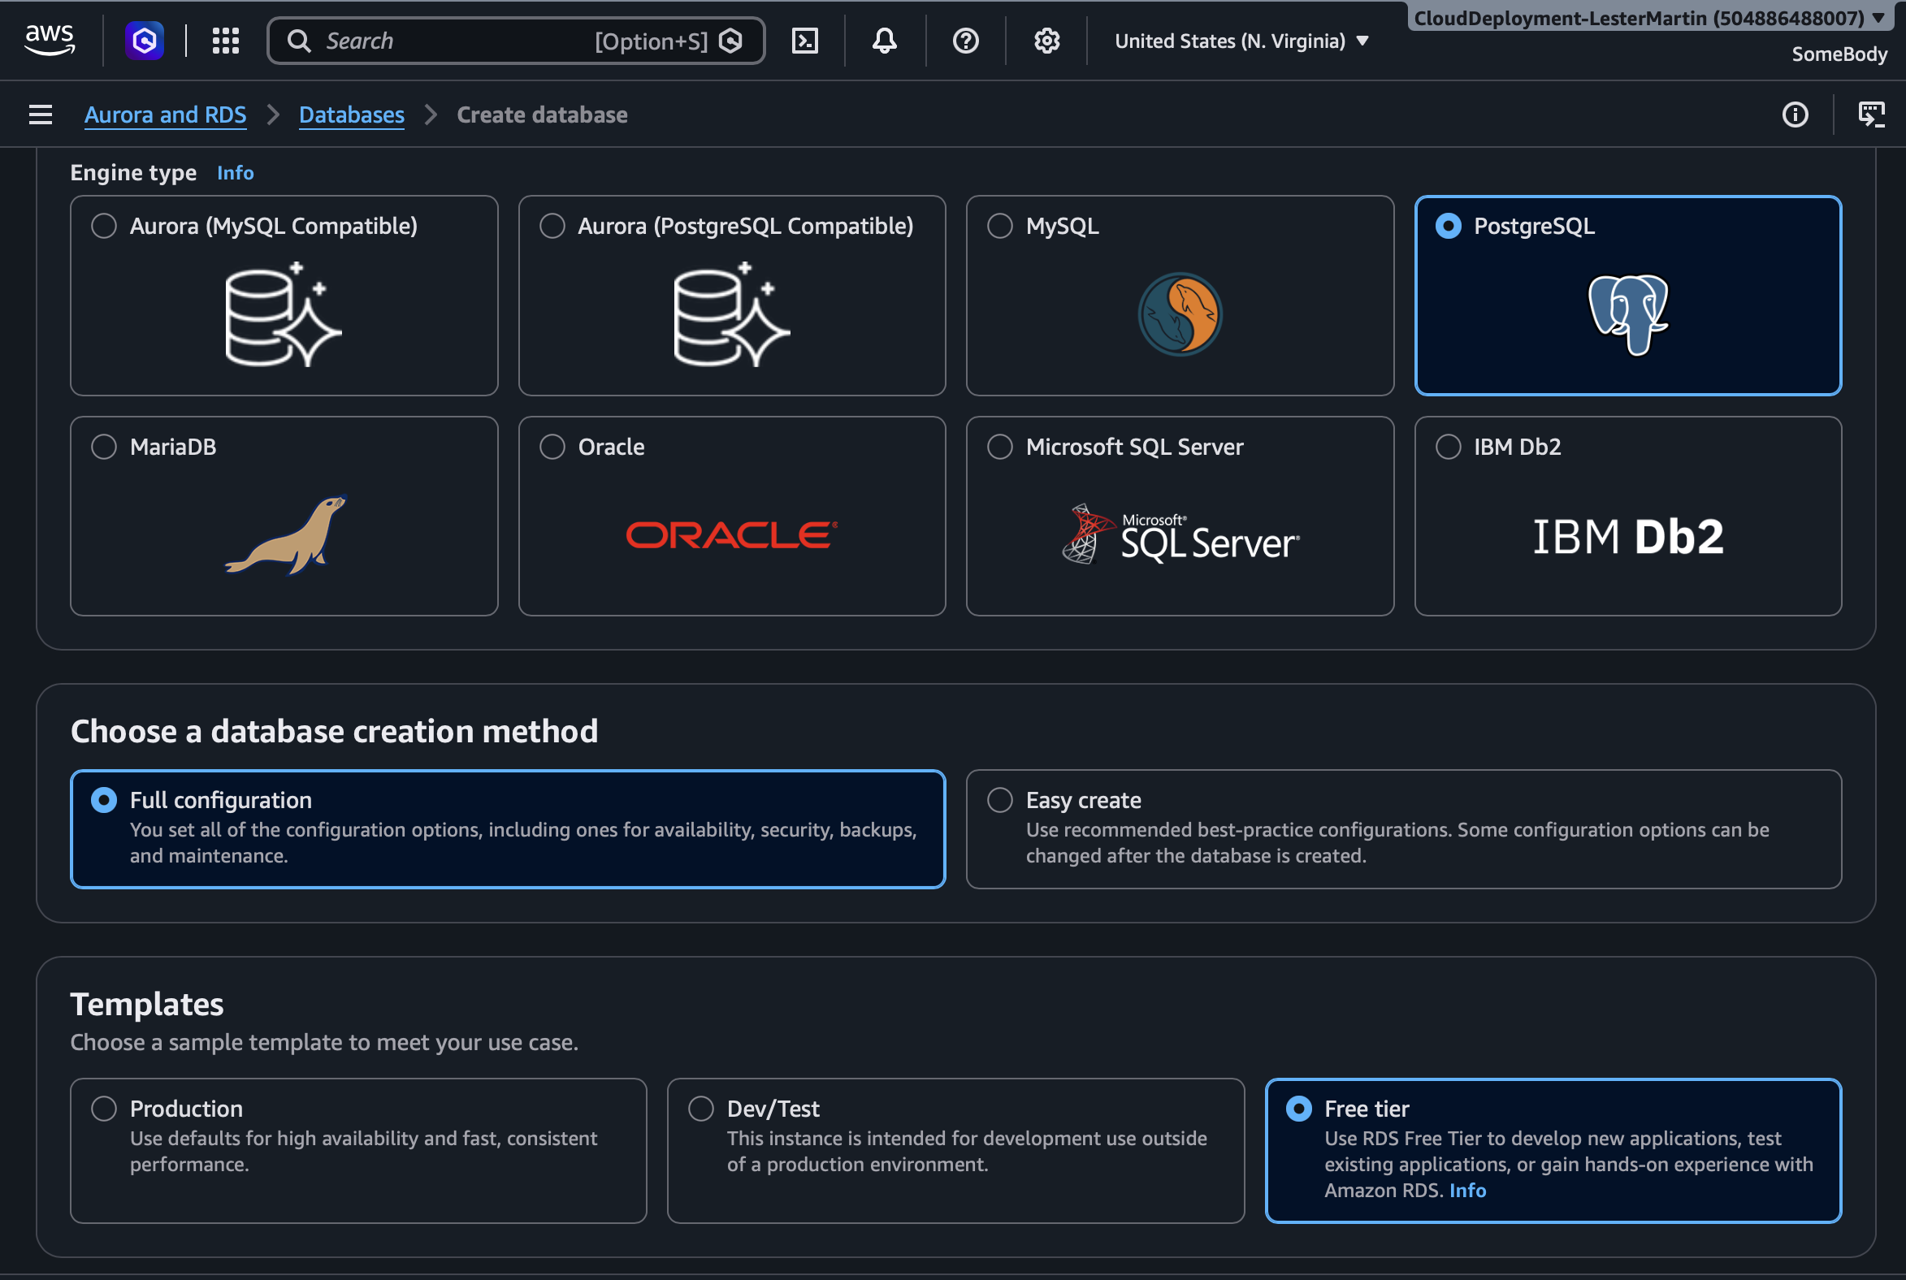
Start the wizard
PART 1 · CREATE THE DATABASE
Sign in to the console and set your region to United States (N. Virginia).
Open RDS and choose Databases, then Create database.
Full configuration. Not Express configuration, which hides the networking options.
Engine: PostgreSQL, not Aurora.
Template: Free tier. It preselects a free-tier instance and single-AZ.
Notes:
Stress Standard create. Easy create hides the VPC and public access choices we need.

Slide 5
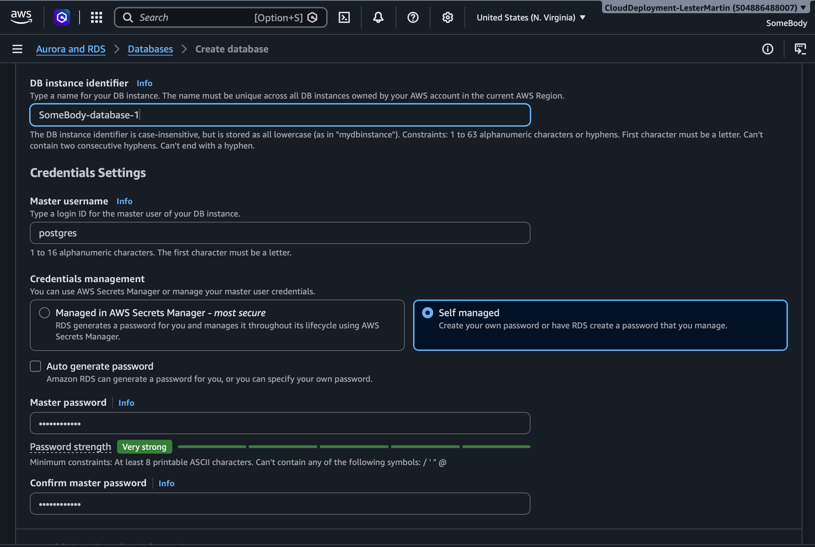
Settings and instance size
PART 1 · CREATE THE DATABASE
Identifier: <YourName>-db-1
Master username: postgres
Credentials: Self managed. Secrets Manager is not free.
Password: strong, entered twice. Write it down.
Additional credentials settings > DB auth options: Password authentication.
Instance class: db.t3.micro or db.t4g.micro (free-tier eligible).
Notes:
The master password is the real protection once the port is reachable from the internet. Insist on something strong.

Slide 6
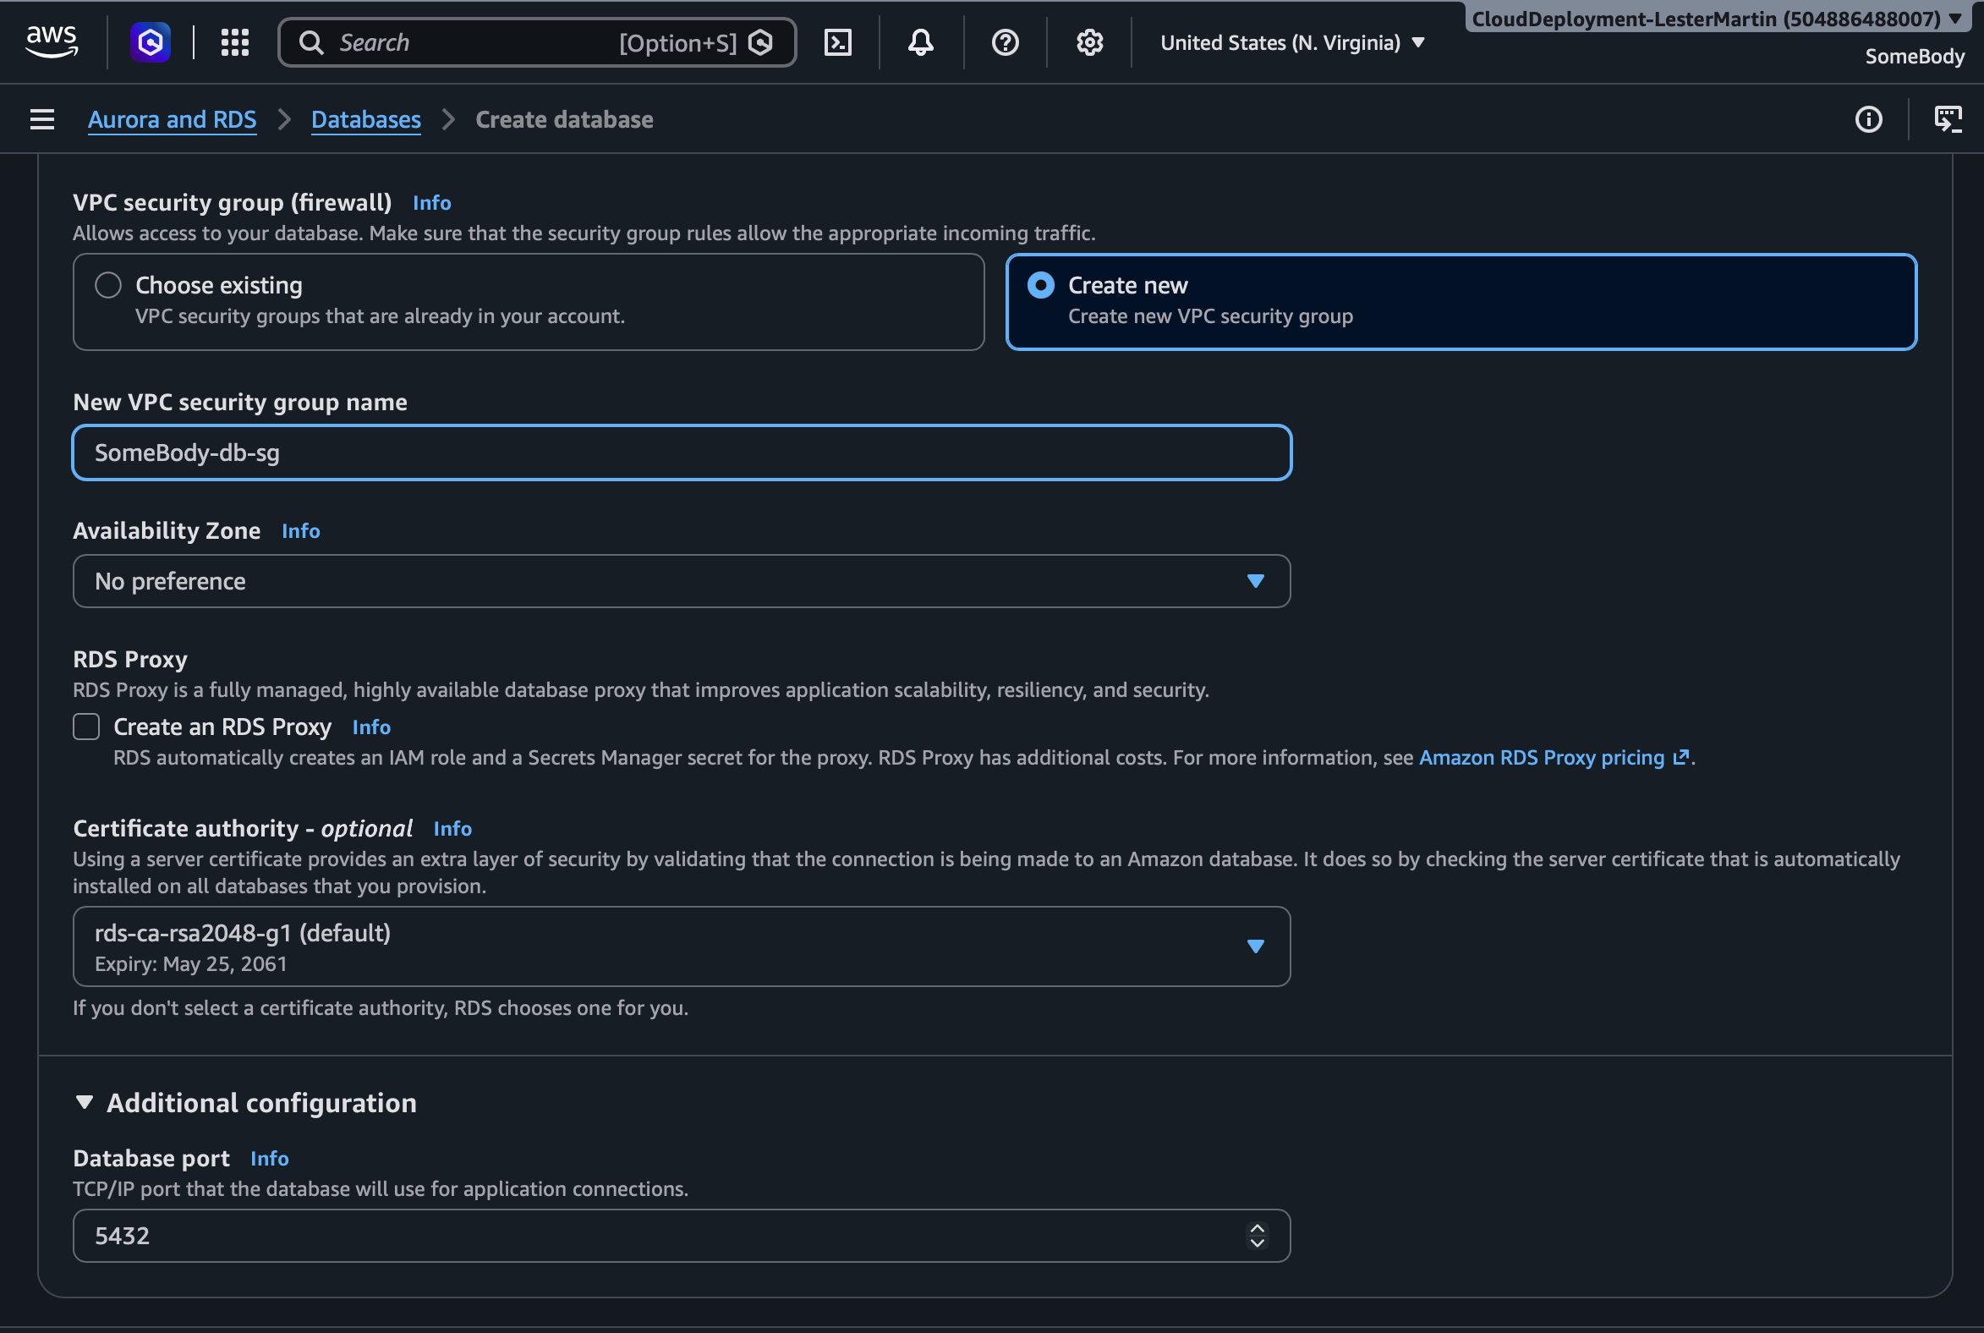
Storage and connectivity
PART 1 · CREATE THE DATABASE
Storage: General Purpose SSD, 20 GiB (the free-tier maximum).
Additional storage config > Storage autoscaling: turn it off.
Compute resource: Don't connect to an EC2 compute resource.
VPC: the default VPC. Subnet group: default.
Public access: Yes.
Create new, named <YourName>-db-sg, Security group. Port 5432 under Additional config.
Notes:
Public access = Yes only assigns a public IP. Nothing can connect until the security group allows it (Part 2).

Slide 7
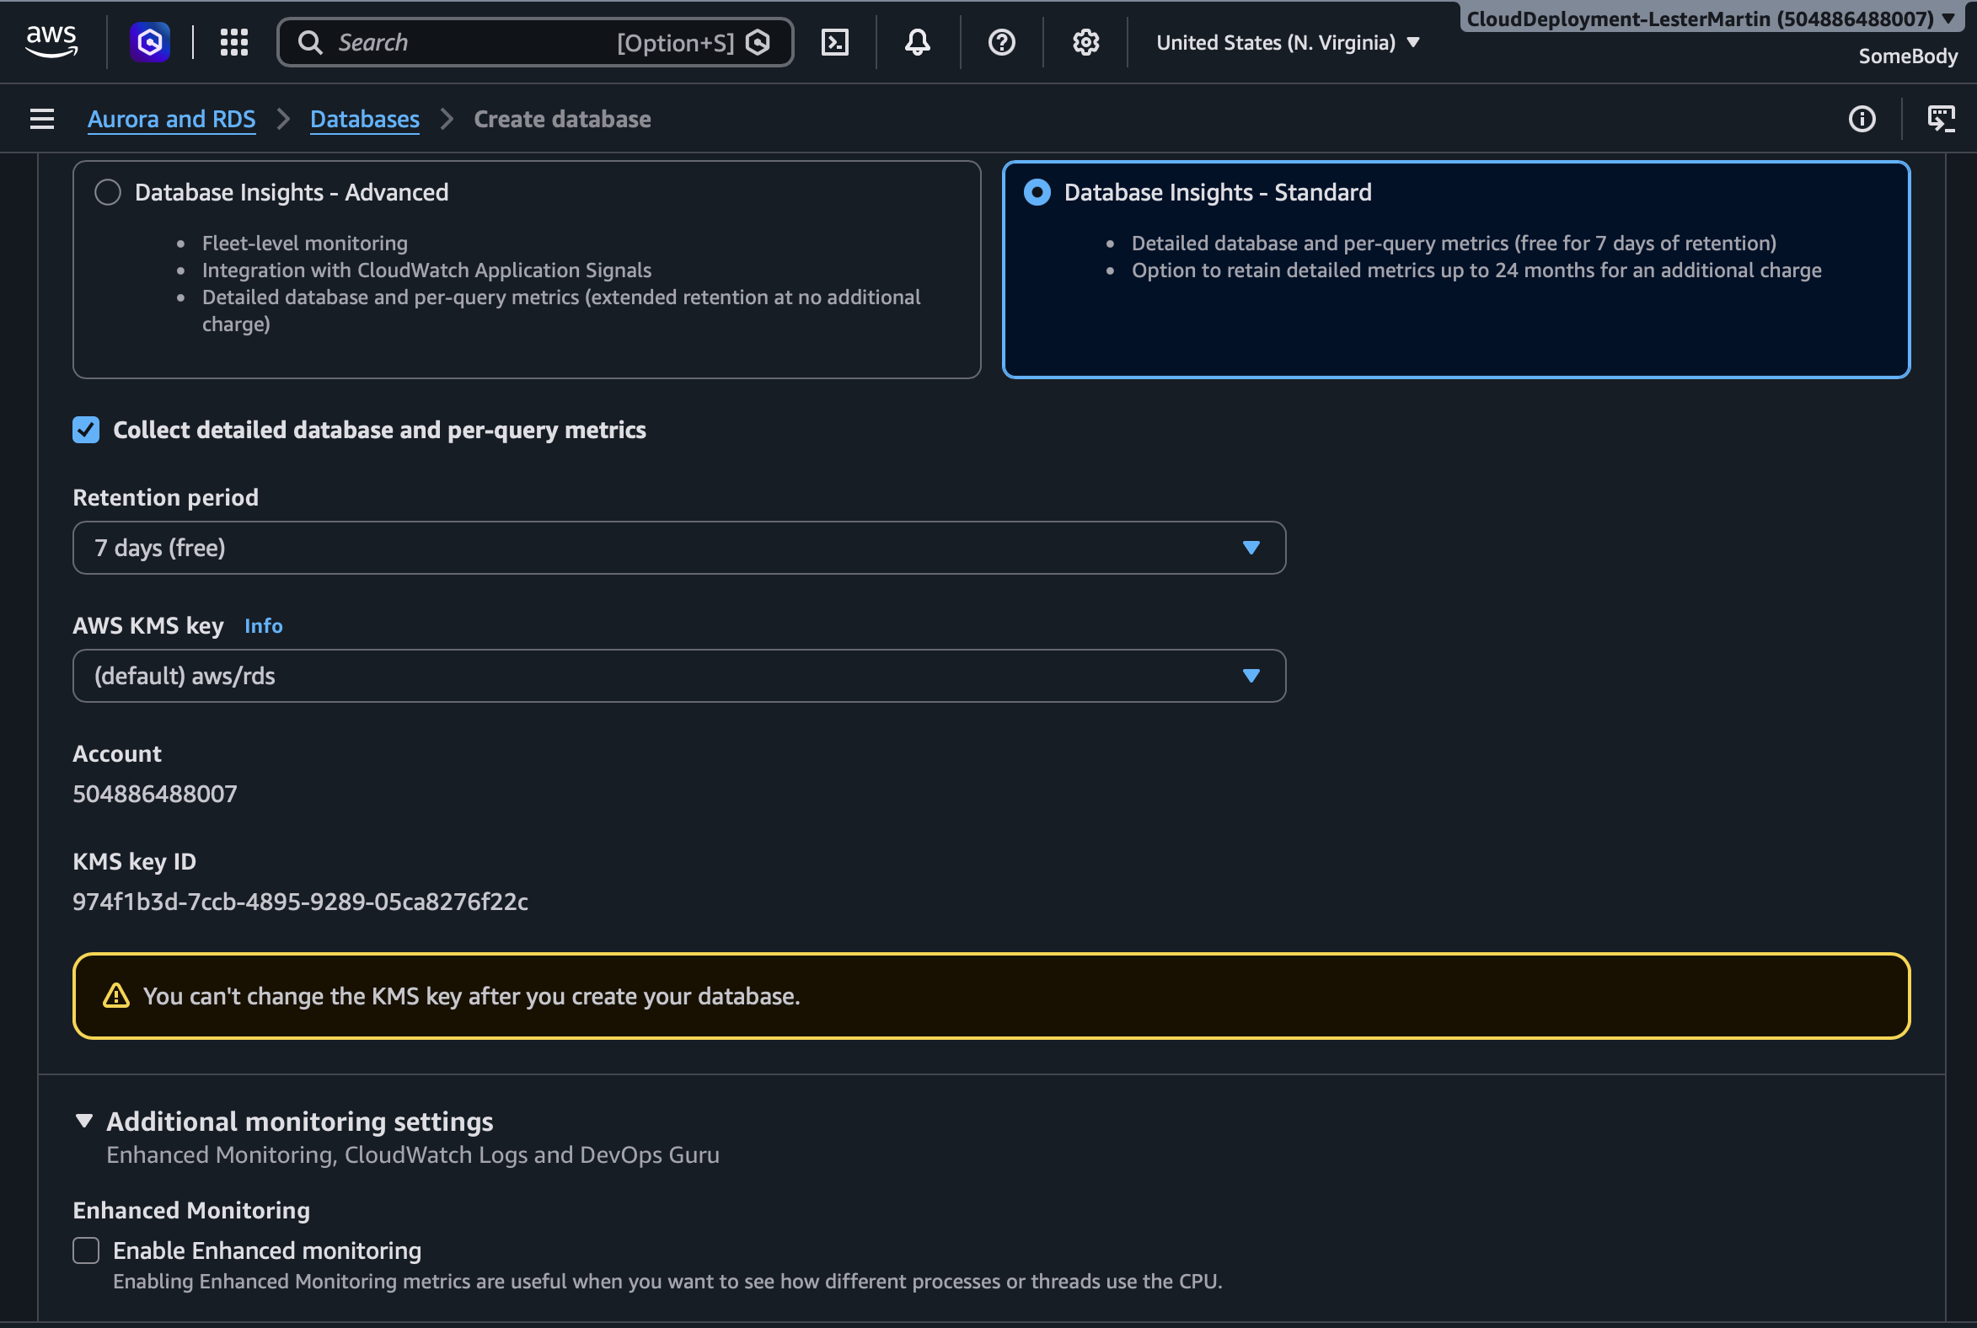
Finish and create
PART 1 · CREATE THE DATABASE
Monitoring: leave Performance Insights and Enhanced Monitoring off.
Additional configuration: initial database name test_db.
Backups and protection: short retention, deletion protection off for easy cleanup.
Check the cost panel, then click Create database.
Notes:
If the initial database name is blank, RDS creates no database besides the default 'postgres'. Students then connect to 'postgres' instead.

Slide 8
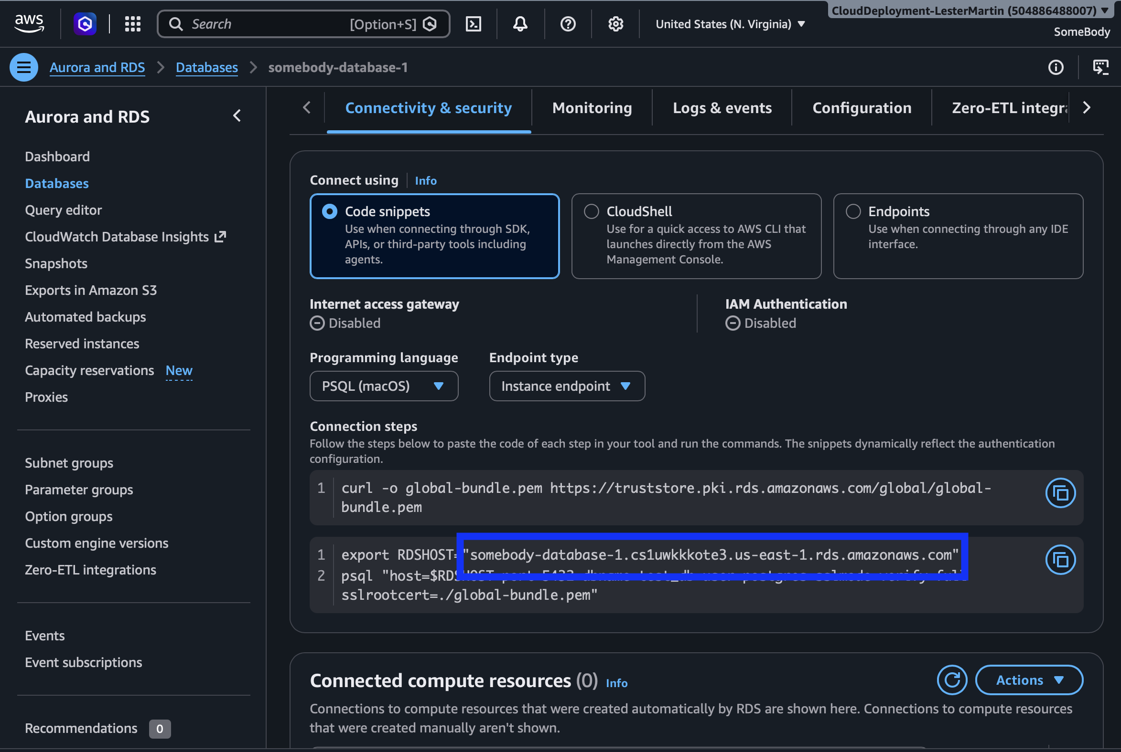
Wait, then copy the endpoint
PART 1 · CREATE THE DATABASE
Wait 5 to 10 minutes until Status = Available.
Open the instance and find the Connectivity & security tab.
Copy the Endpoint. You will paste it into pgAdmin in Part 3.
Example endpoint
name-db-1.abc123xyz.us-east-1.rds.amazonaws.com
Notes:
Use the wait to explain the free tier: 750 instance-hours per month, 20 GB storage, 20 GB backups. Public IPv4 addresses may be billed separately; check current terms.

Slide 9
Step A: find your public IP
PART 2 · RESTRICT ACCESS TO YOUR /24
Use the public address the internet sees, not your private 192.168.x.x address.
curl -s https://checkip.amazonaws.com
Or browse to checkip.amazonaws.com.
Or in the security group editor, set Source to My IP and copy the address (it fills in a /32).
Example result: 203.0.113.57
Notes:
If checkip returns an IPv6 address (colons), use curl -4 to force IPv4, or add a separate IPv6 rule.

Slide 10
Step B: convert it to a /24
PART 2 · RESTRICT ACCESS TO YOUR /24
Keep the first three octets, set the last to 0, add /24.
Public IP | CIDR to use | Addresses covered
203.0.113.57 | 203.0.113.0/24 | 203.0.113.0 – 203.0.113.255 (256)
198.51.100.214 | 198.51.100.0/24 | 198.51.100.0 – 198.51.100.255 (256)
Why 256?
/24 fixes the first 24 bits (3 octets). The last 8 bits are free: 2⁸ = 256 addresses.
curl -s https://checkip.amazonaws.com |
awk -F. '{print $1"."$2"."$3".0/24"}'
Notes:
The one-liner prints the CIDR directly. Good moment to discuss CIDR notation.

Slide 11
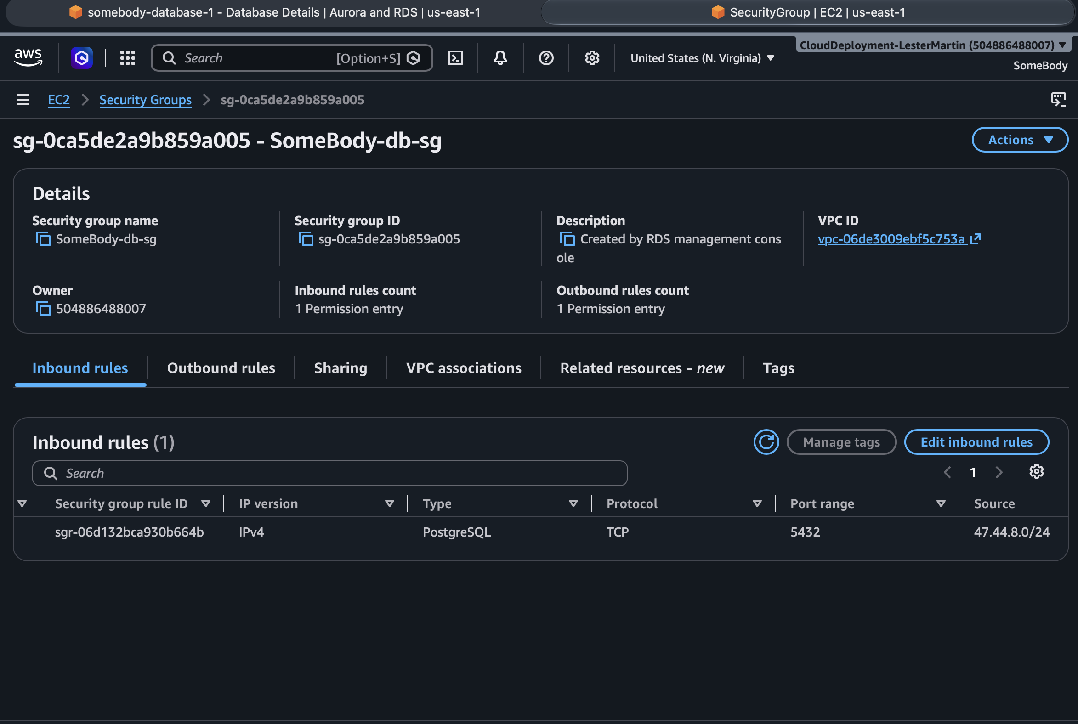
Step C: add the inbound rule
PART 2 · RESTRICT ACCESS TO YOUR /24
Navigate to the Security group rules under the instance’s Connectivity & security tab.
Select <YourName>-db-sg inbound link to edit inbound rules.
Delete any wizard-created 5432 rule.
Add rule: Type PostgreSQL (TCP 5432). Source Custom: your /24, e.g. 203.0.113.0/24.
Description: Course demo, delete after class. Save rules.
Notes:
Deleting the wizard rule matters: otherwise a stale rule may still be admitting traffic.

Slide 12
Step D: verify and know the limits
PART 2 · RESTRICT ACCESS TO YOUR /24
Negative test: try from a phone hotspot. The connection should time out.
Your IP can change. If connections suddenly time out, redo Step A and update the rule.
Shared networks: campus, corporate, or VPN /24s include other people. Run Step A while on the VPN.
Not strong security: the password is the real protection. Production uses private subnets.
IPv6: needs its own rule. Use curl -4 to get an IPv4 address.
Contrast exercise
Try My IP (/32) versus the /24. Discuss the tradeoff.
Bots are fast
Port 5432 open to 0.0.0.0/0 is probed within minutes.
Notes:
This replaces the original open-to-the-internet rule. Optional demo: show 0.0.0.0/0 only as a bad example.

Slide 13
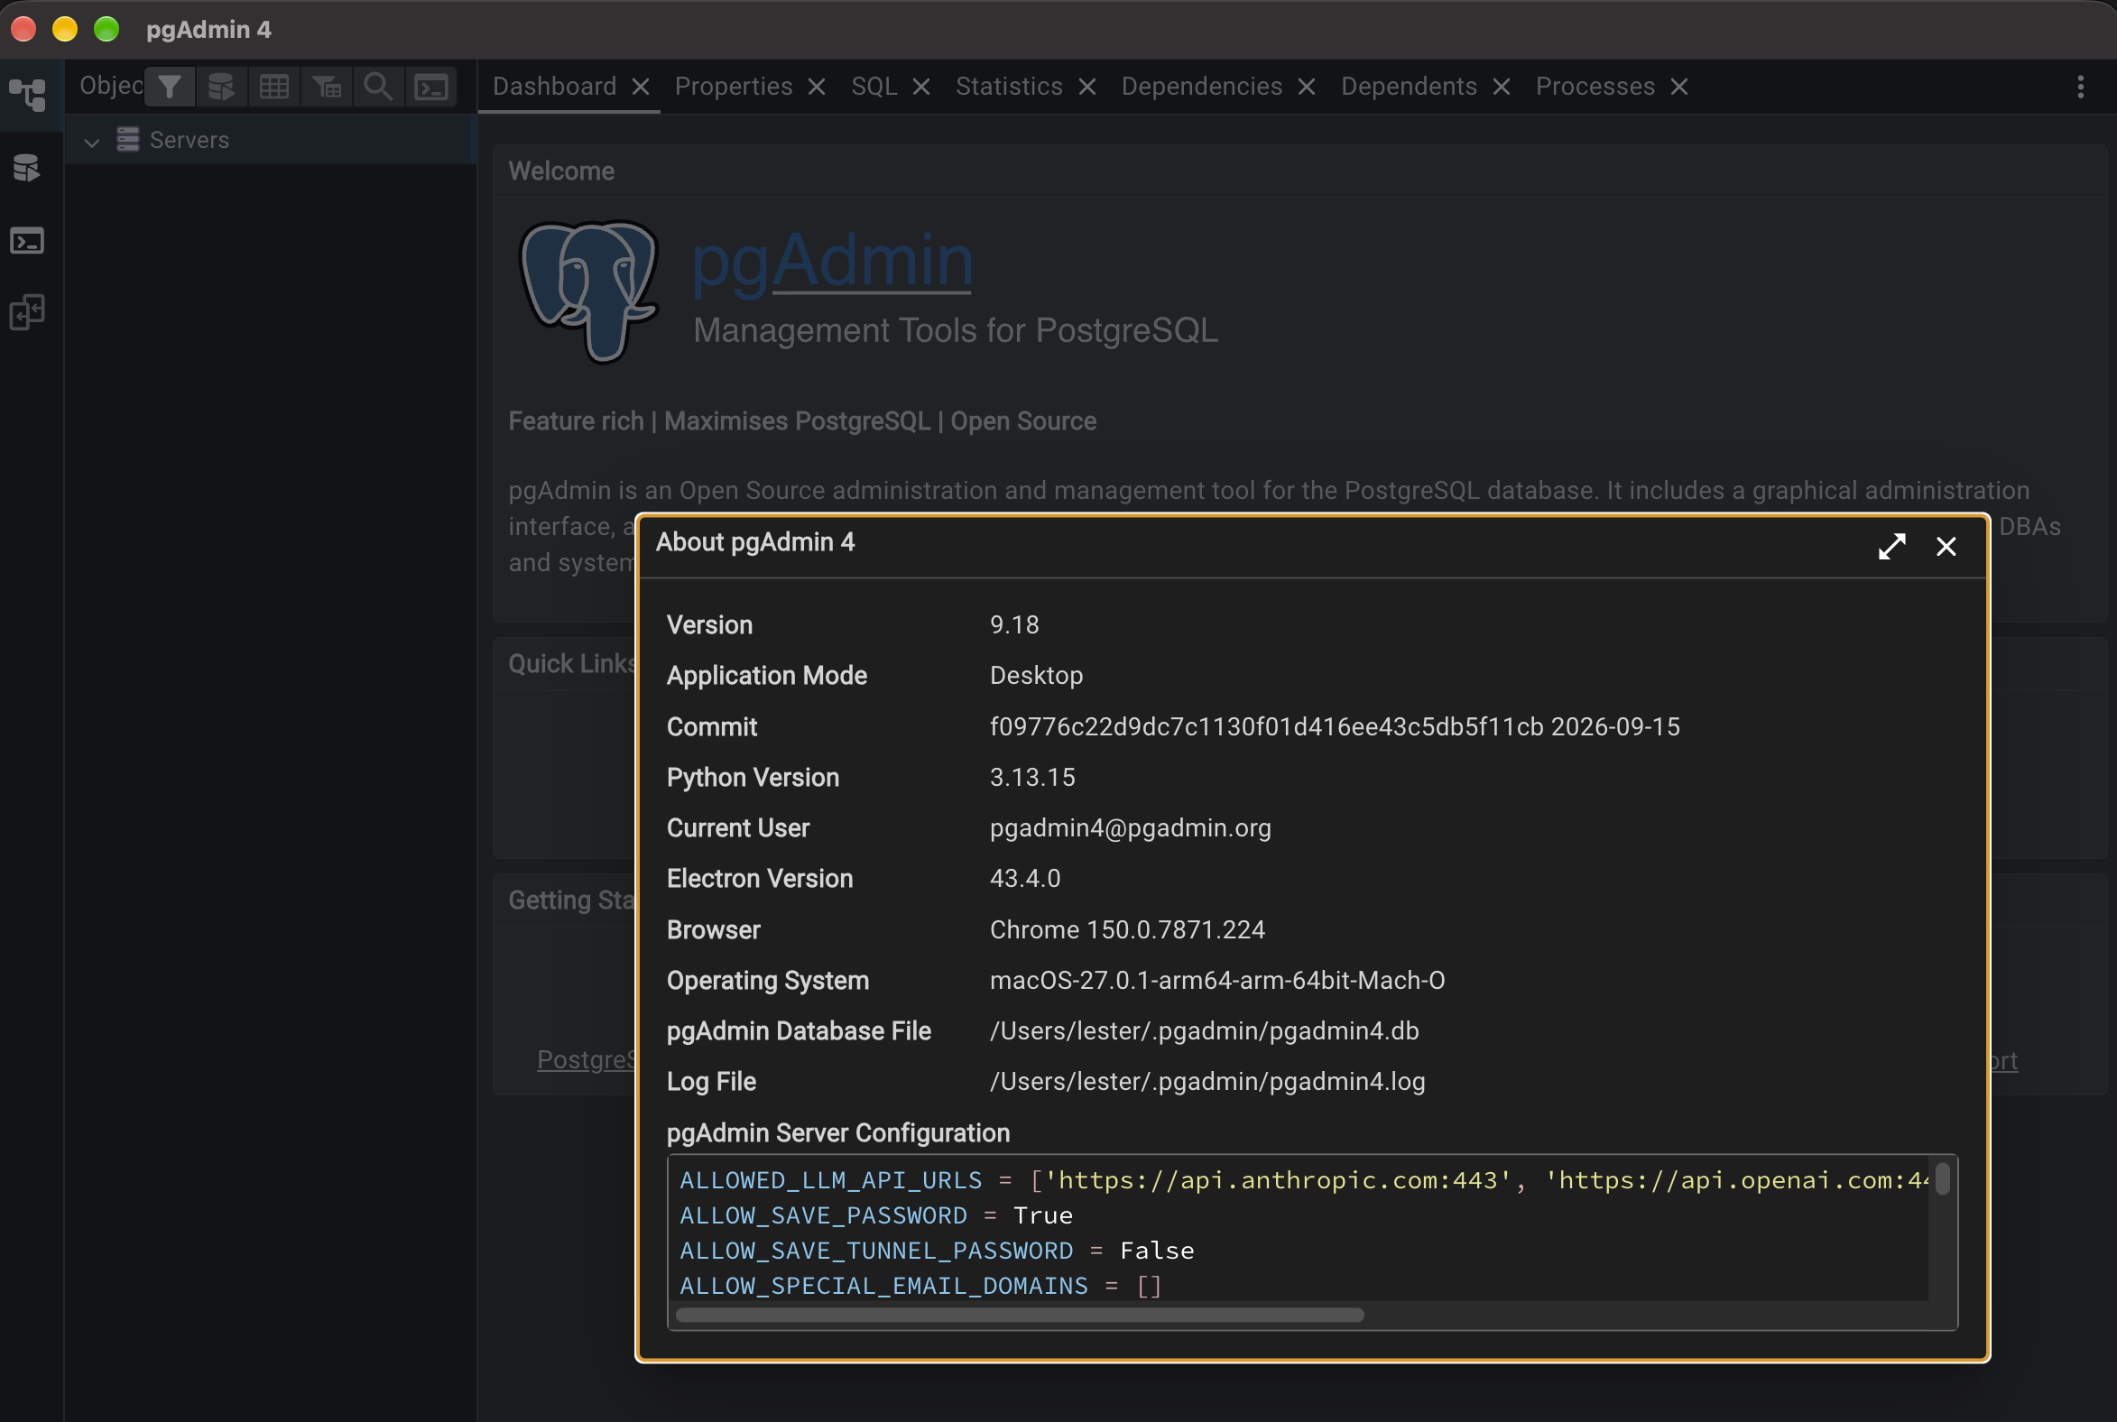
Step A: open your existing pgAdmin
PART 3 · CONNECT WITH PGADMIN
Launch pgAdmin from the Start menu, Applications folder, or app menu.
Enter the master password if prompted. It protects saved credentials only.
Show the Object Explorer (View, Show/Hide Browser Panel) if hidden.
Remove stale entries from earlier classes under Servers.
Check your version under Help, About pgAdmin 4. Steps match 8.x and 9.x.
Notes:
The pgAdmin master password is unrelated to the database password. Remind students not to confuse the two.

Slide 14
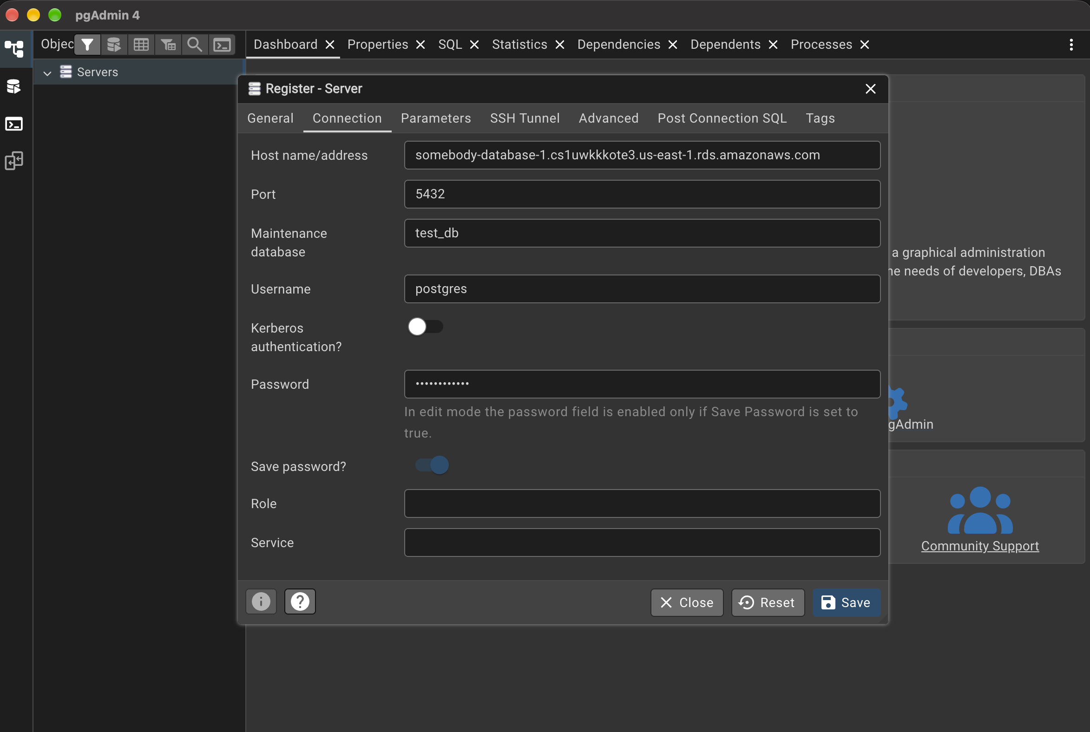
Step B: register the RDS server
PART 3 · CONNECT WITH PGADMIN
Right-click Servers, then Register, Server.
General tab: Name = course-postgres (local label only).
Connection tab: Host = the RDS endpoint. Port = 5432.
Maintenance database: test_db.
Username / password: postgres and the master password.
Notes:
Save password only on a personal machine. Leave it unchecked on shared or lab machines.

Slide 15
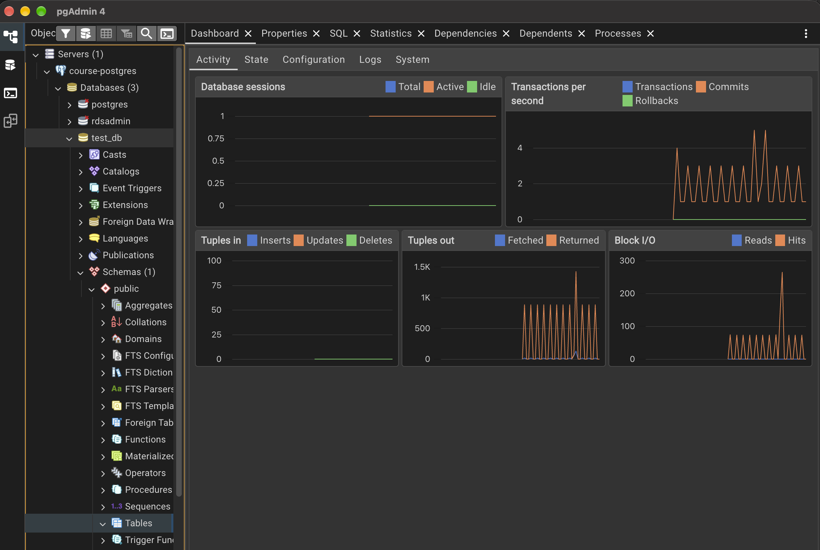
Save and confirm the connection
PART 3 · CONNECT WITH PGADMIN
SSL tab (optional): mode prefer works. Use require to force encryption.
Click Save. pgAdmin connects immediately.
Expand the tree: course-postgres, Databases, coursedb, Schemas, public, Tables.
Error instead? See the troubleshooting slide.
Notes:
RDS supports SSL out of the box, so require works without importing a certificate for this exercise.

Slide 16
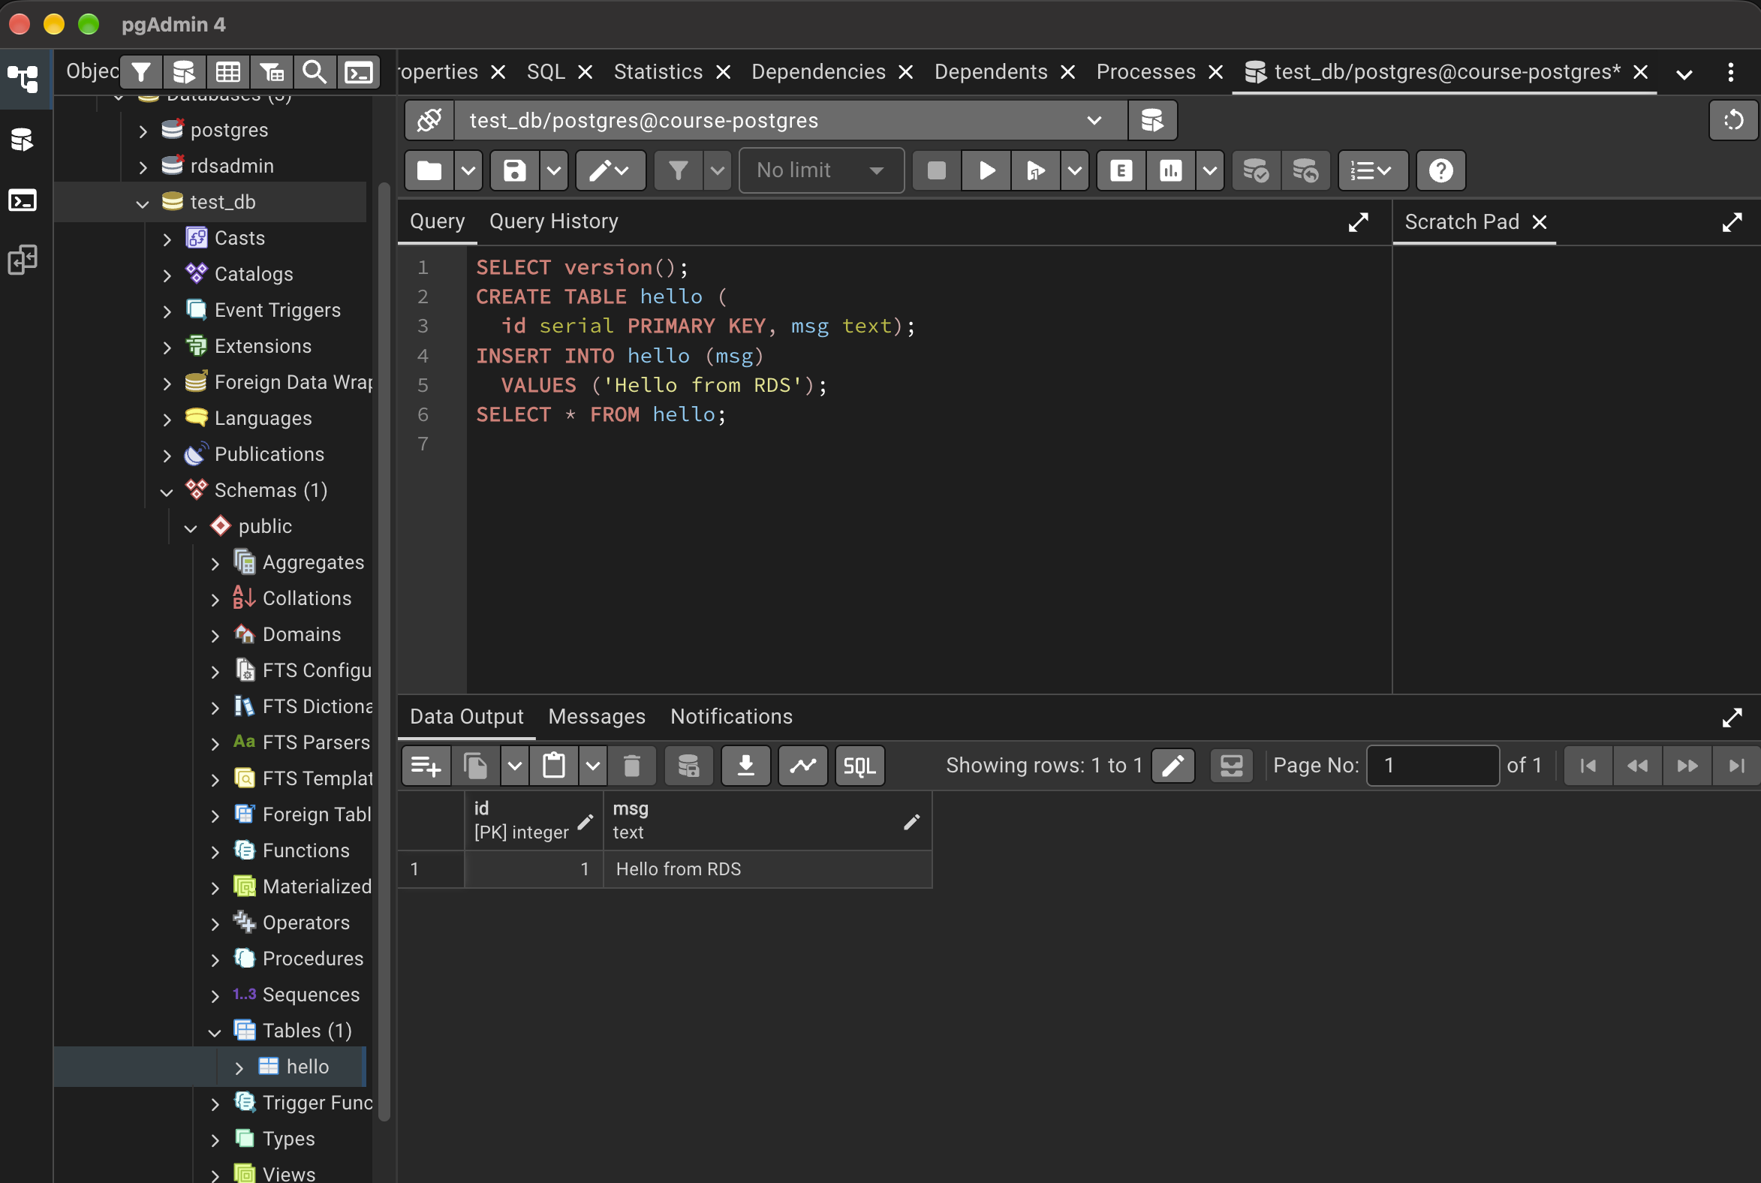
Run your first queries
PART 3 · CONNECT WITH PGADMIN
Right-click test_db, choose Query Tool (Alt+Shift+Q).
Paste the script, click Execute (F5).
Results appear in Data Output; timing in Messages.
SELECT version();
CREATE TABLE hello (
id serial PRIMARY KEY, msg text);
INSERT INTO hello (msg)
VALUES ('Hello from RDS');
SELECT * FROM hello;
Notes:
Optional exploration: right-click the hello table, View/Edit Data, All Rows; show the server Dashboard tab.

Slide 17
Troubleshooting pgAdmin
PART 3 · CONNECT WITH PGADMIN
Symptom | Likely cause
Connection timed out | Rule missing or your current IP is outside the /24; or Public access is No
Password authentication failed | Wrong password. Reset via RDS, Modify, New master password.
Database coursedb does not exist | Initial name left blank. Set Maintenance database to postgres.
SSL error | Set SSL mode to prefer or require, not disable.
Worked yesterday, fails today | Your public IP changed. Redo Part 2 Step A.
Times out on every rule | Campus or corporate firewall blocks outbound 5432. Try a hotspot.
Notes:
Most failures are the security group or a changed IP. Check there first.

Slide 18
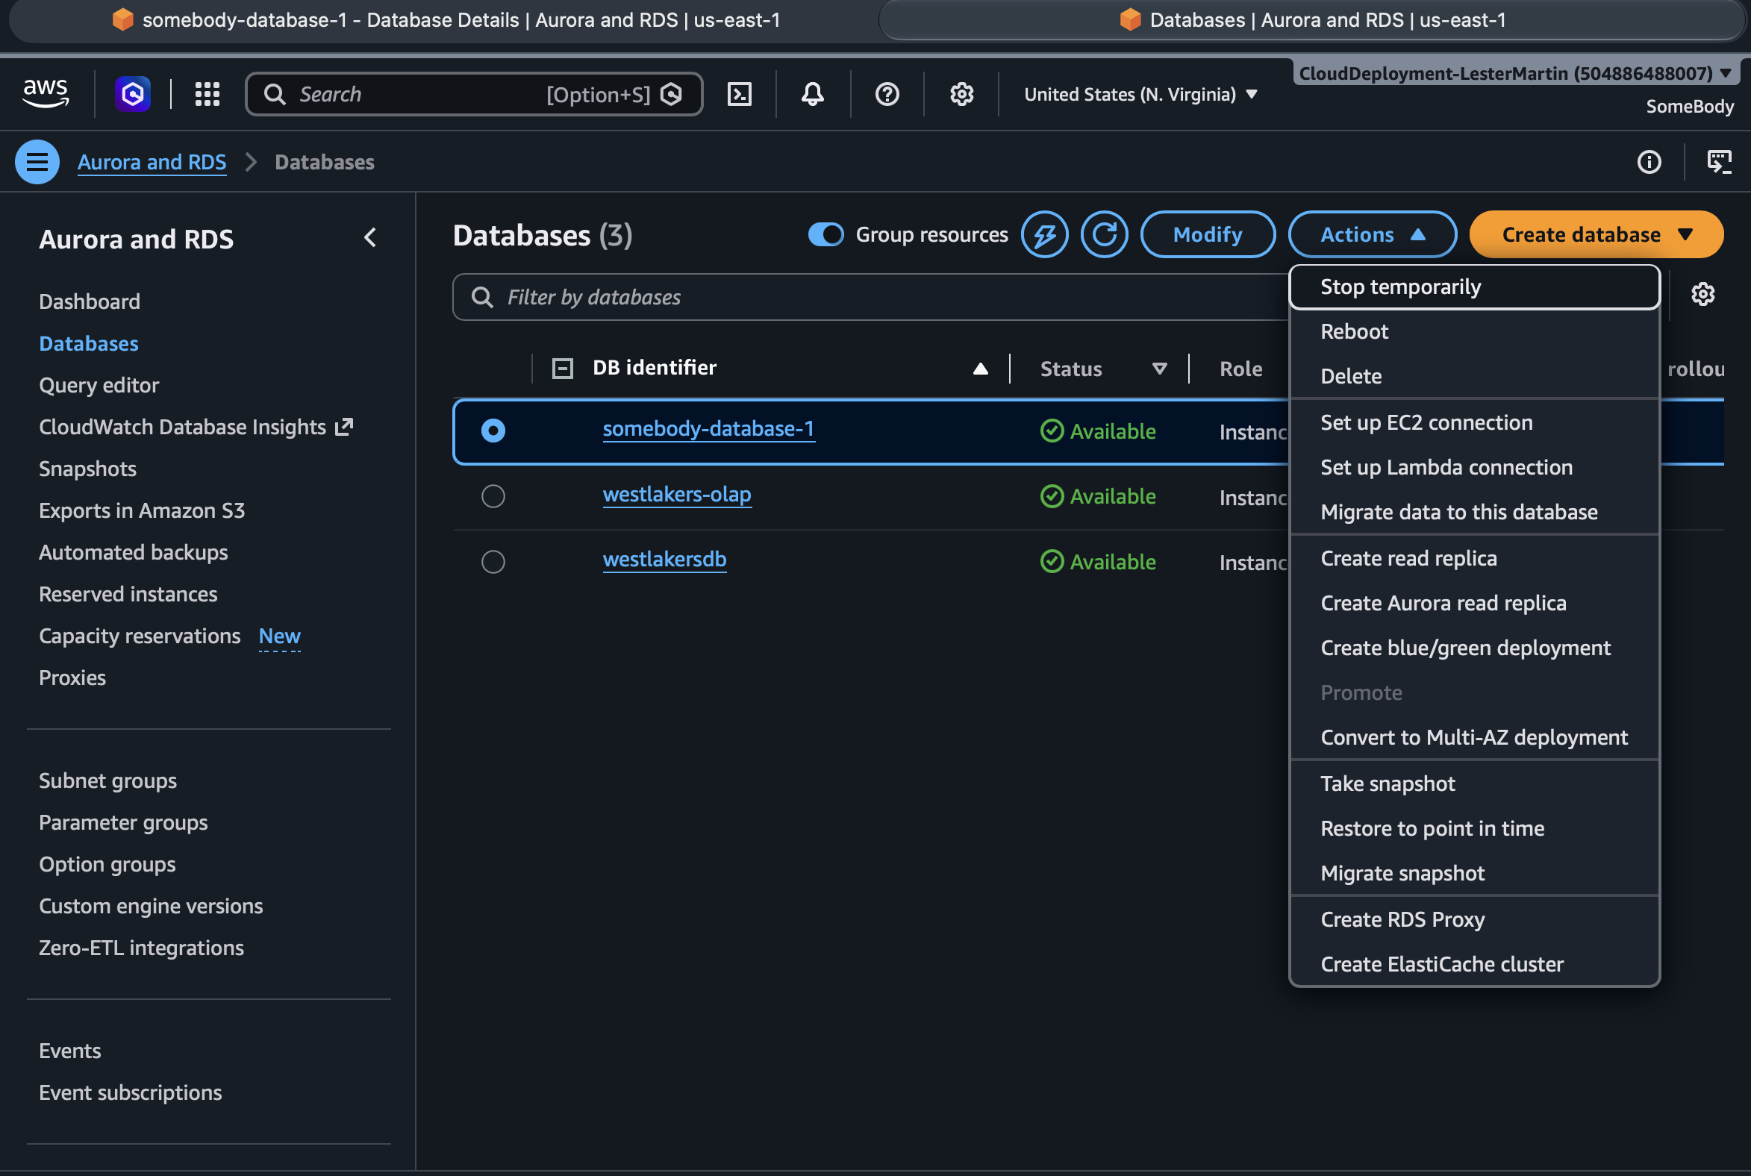
Delete everything OR at least STOP instance
PART 4 · CLEANUP
pgAdmin: right-click the server, Remove Server.
RDS: select the instance, Actions, Delete.
Uncheck Create final snapshot and Retain automated backups.
Confirm: tick the acknowledgment, type delete me.
EC2, Security Groups: delete course-postgres-sg.
Billing, Free Tier: confirm no remaining usage.
Notes:
Forgotten instances are the most common surprise bill. Suggest a billing alarm or AWS Budget before starting.

Slide 19



Key takeaways
Free tier
750 hours a month, 20 GB storage, 20 GB backups. Verify current terms.
Security
A /24 beats 0.0.0.0/0, but the password and private subnets are what protect production.
Cost
Delete the instance. Set a billing alarm or Budget first.
Notes:
Close by asking students which part of the setup they would change for a production database.

