Slide 1
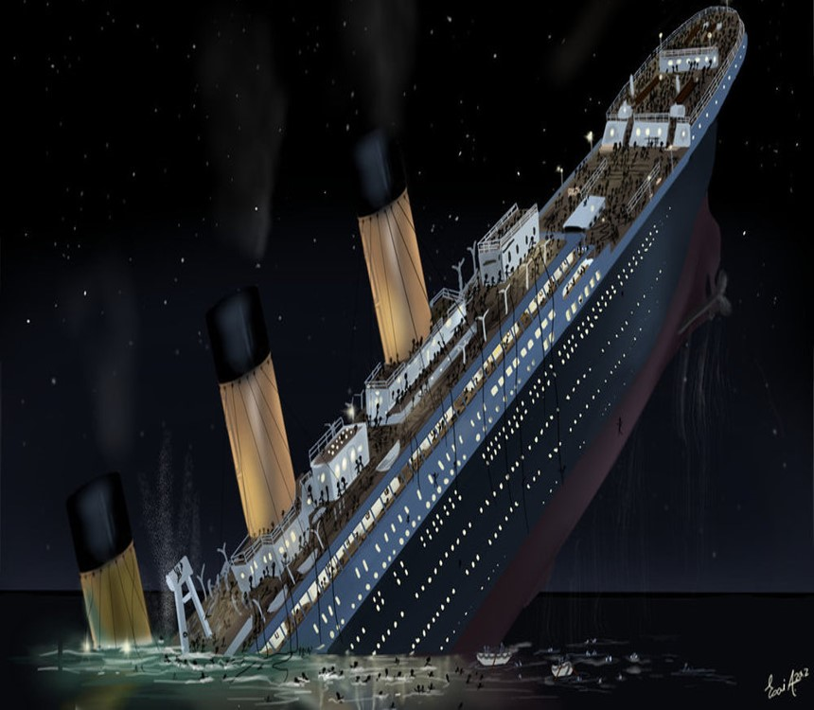
RMS Titanic Prediction on people likely to survive
Team: Lester
Shiny

Slide 2
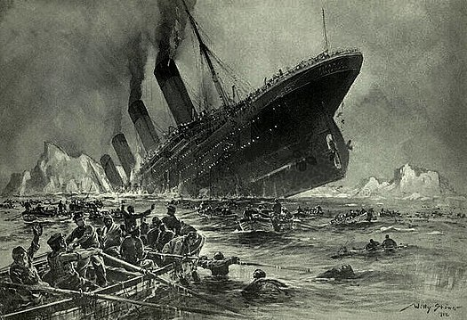
Background
RMS Titanic Collision with Iceberg on 15th April 1912
Total boarded- 2224 Passengers + Crew
Survived- 1502
Most reliable cause for deaths
Lack of Lifeboats
According to Encyclopedia,
712 Survivors
500-Passengers (369- Women & Children + 212- Men)
212 Crew
20- Women
192-Men

Slide 3

HYPOTHESIS
We can predict which passengers survived the tragedy.
Sources claim that women, children and Upper Category people Survived the most
To see if the Factors Contributing to increase the Survival rate of a Particular Passenger is per the mentioned claim

Slide 4
Data Acquisition & Processing
Data Source:
KaaGle- https://www.kaagle.com/c/titanic
Processing Steps
Data Cleaning to remove the Nan and filled in few data points without altering the main data
Converted the data into float and changed few columns into 1 and 0 for easy analysis
Did analysis on different factors, supporting charts were drawn
Correlation analysis to determine significance and relationship
Regression analysis was carried out as a part of conclusion

Slide 5
Titanic – Data Dictionary and Problems
PassengerID— A column added by Kaggle to identify each row and make submissions easier
Survived— Whether the passenger survived or not and the value we are predicting (0=No, 1=Yes)
Pclass— The class of the ticket the passenger purchased (1=1st, 2=2nd, 3=3rd)
Sex— The passenger’s sex
Age— The passenger’s age in years
SibSp— The number of siblings or spouses the passenger had aboard the Titanic
Parch— The number of parents or children the passenger had aboard the Titanic
Ticket— The passenger’s ticket number
Fare— The fare the passenger paid
Cabin— The passenger’s cabin number
Embarked— The port where the passenger embarked (C=Cherbour, Q=Queenstown, S=Southampton)
The Data had missing input in fields:
There were 1309 passengers in total
Cabin was missing in 1015 items
Age was missing in 246 items
Embarked Location in 2 items
Fare in 1 item
Disposition:
Cabin dropped
Age filled with mean for given sex and age
Embarcation and Fare missing recs dropped

Slide 6
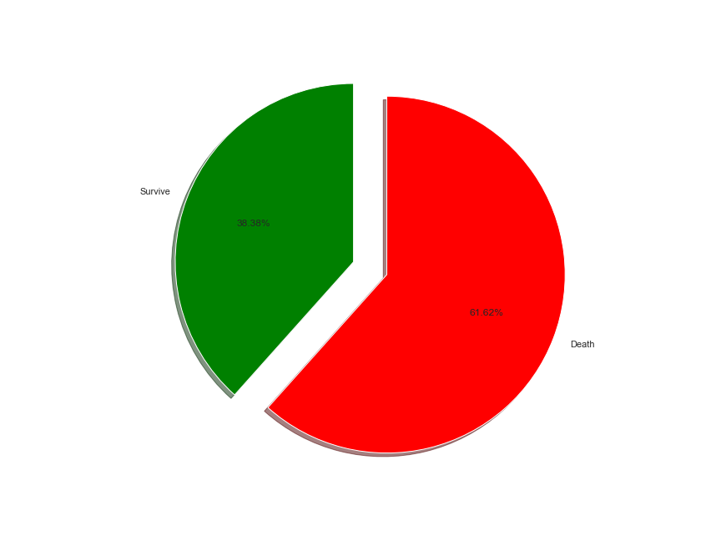
analysis
Overall Survived to Death
Survived- 38.38%
Death- 61.62%

Slide 7
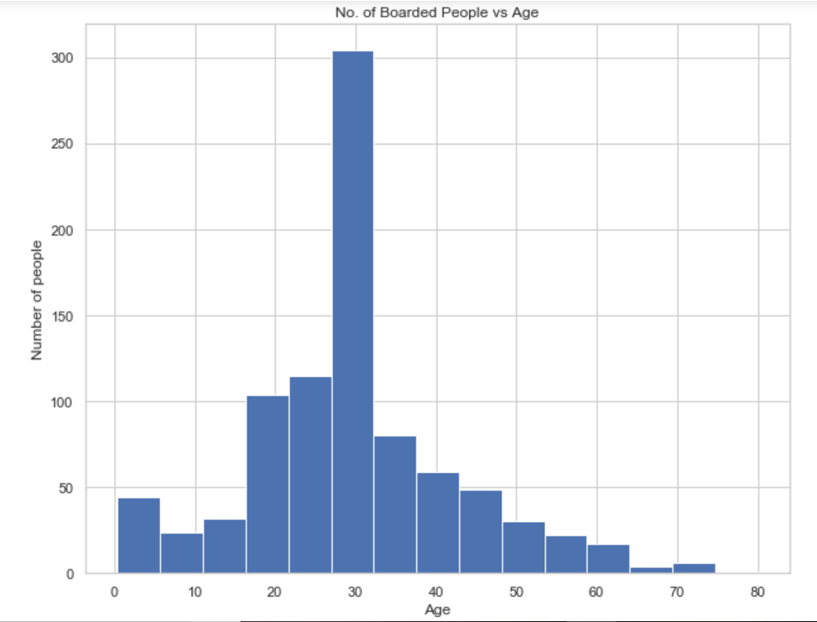
1. Age Analysis -Total Boarded People with respect to age
Age Group between 25 to 35 reaches the peak per the chart

Slide 8
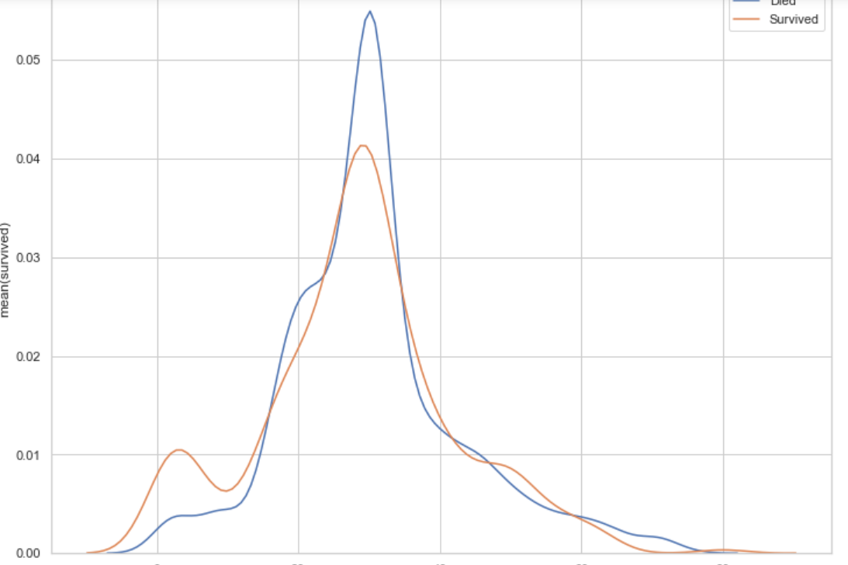
Survival to Death Plot per Age
Significant points
Count of Survival is more for Children and age group between 25 to 35, where death is very much higher so is survival rate

Slide 9
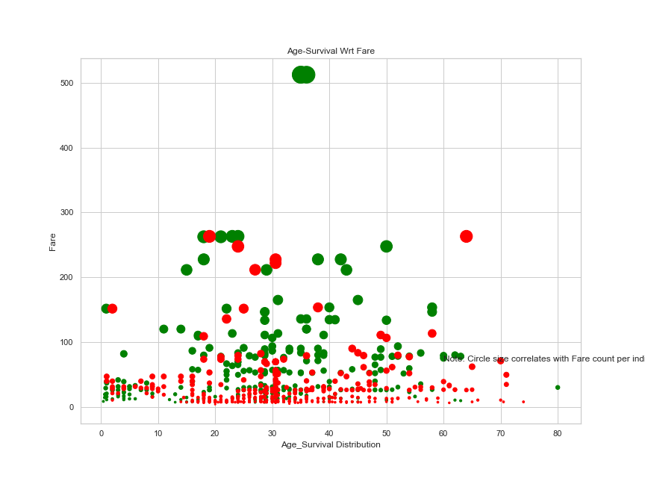
2. Fare Analysis Survival Per Age Group Depending on Fare
Red- Dead
Green- Survived
Bigger Circle- More Price
More Price Better chance of Survival, highest fare group is between 30-40, only 2.

Slide 10
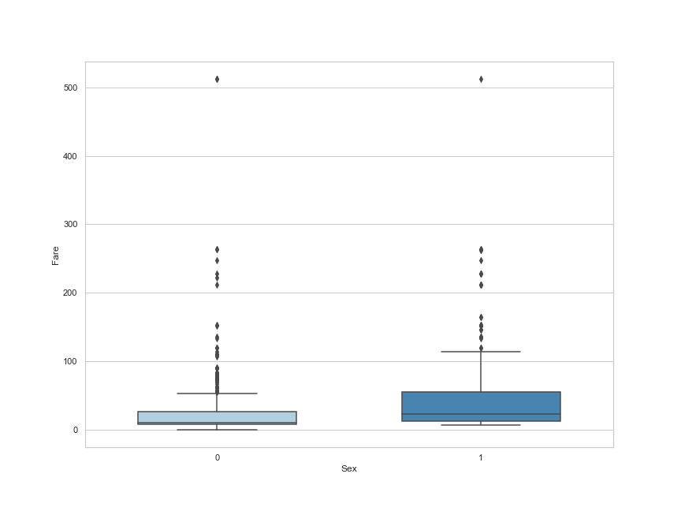
Fare between Male and Female
Male- 0
fEmale- 1
Shows that higher percentage of women have taken higher price compared to men, which explains next graph of survival

Slide 11
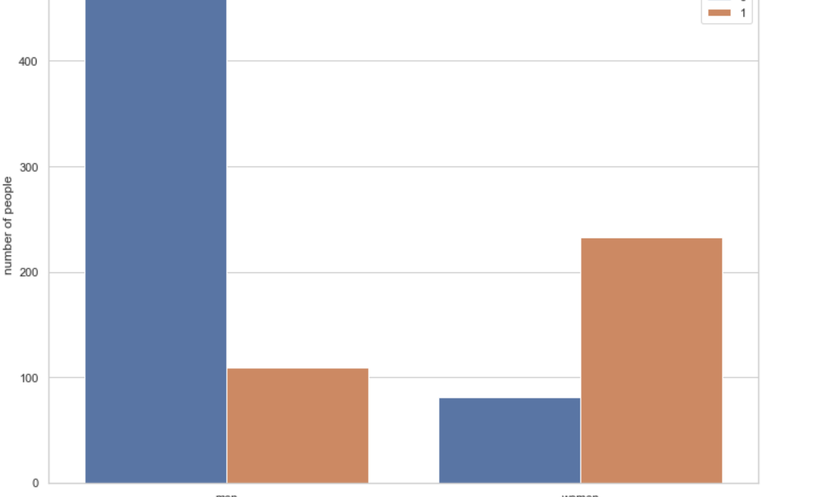
3. Sex Analysis Men to Women, Survival to Death PRediction
Dead=0
Survived=1
Women survived more than men, higher fare may be one of the reason

Slide 12
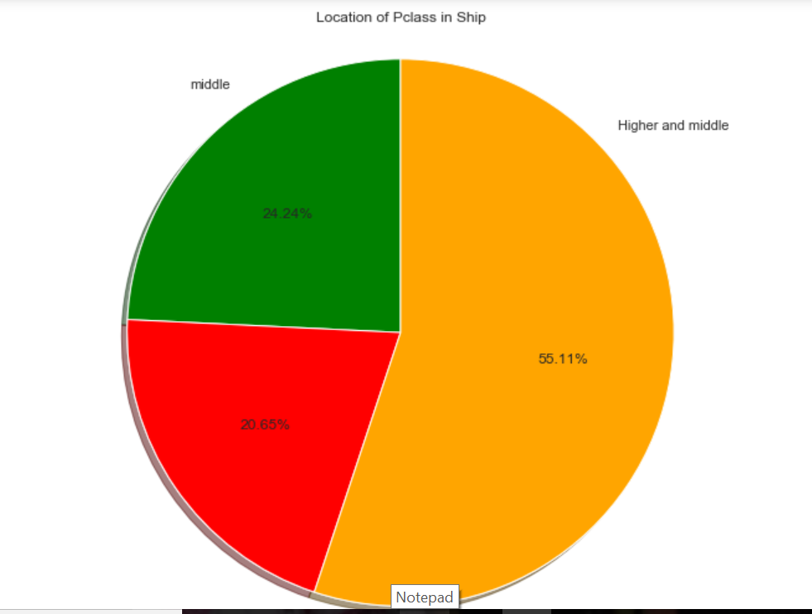
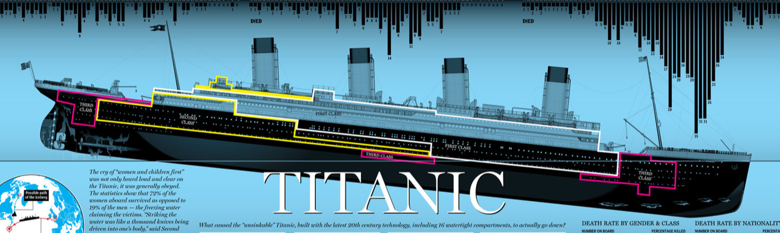
4. Class Analysis Overall Population Distribution in different Passenger classes
Higher and middle- Orange- 55.11%
Middle- green- 24.24%
Deck and Bottom-red- 20.65%

Slide 13
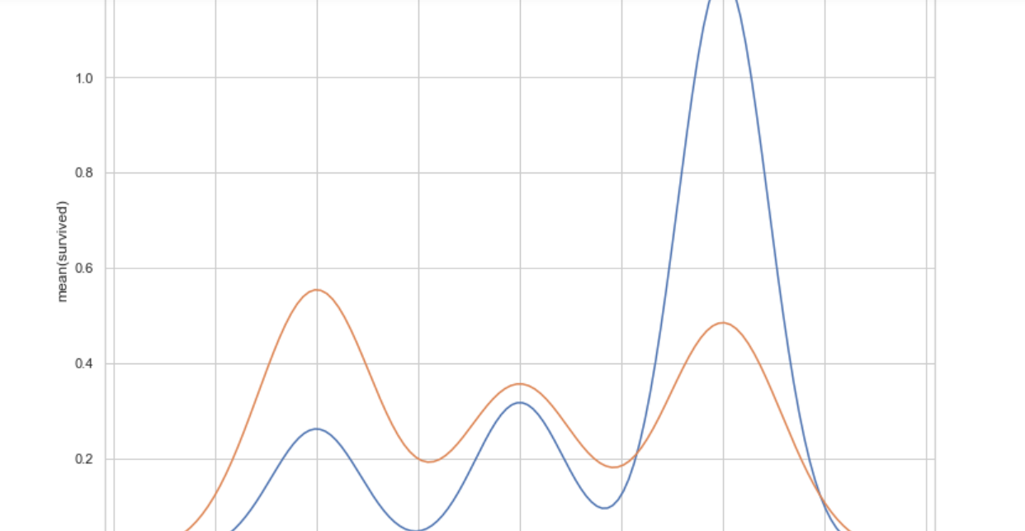
Survival to death based on Passenger Class
Blue- dead
Red- Survived
P1- survived more
P3- Death More

Slide 14
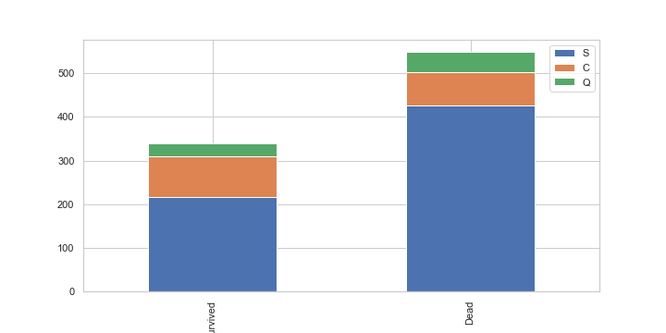
5. Embarked Station Analysis Survived to Death analysis for stations(C = Cherbourg, Q = Queenstown, S = Southampton)
Green-Q
Pink-C
Blue-S- Survived More

Slide 15
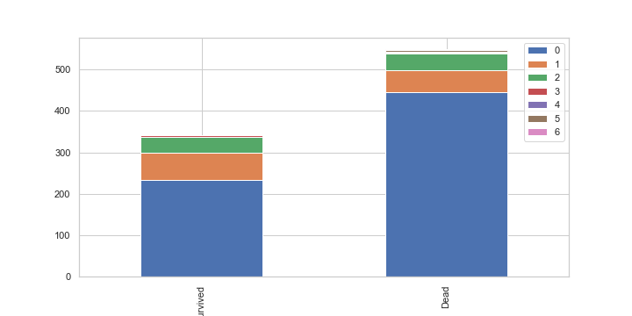
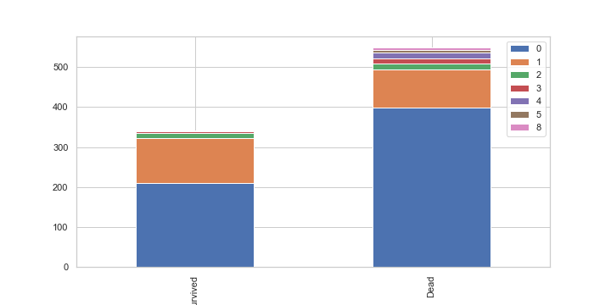
6. Relationship analysis -Survival to Death for SIbSp and Parch
Survival chances less for loners who board in ship
Parch
SibSP

Slide 16
Correlation
Pearsons correlation coefficient
Estimated reliability via p-value
Good correlation with all variables except id
Used cleaned data

Slide 17
Correlations
Correlations:
Out[32]:
 |  | Sex | Fare | Age | Parch | Pclass | SibSp | Embarked
0 | r | 5.415849e-01 | 2.552905e-01 | -0.082446 | 0.083151 | -3.355489e-01 | -0.034040 | 0.108669
1 | p | 6.682012e-69 | 1.079789e-14 | 0.013934 | 0.013137 | 7.776916e-25 | 0.310675 | 0.001174

Slide 18
Logistic regression
We ran a logistic regression on the data using the sklearn library
The accuracy of the regression was. 80.54
We generated a prediction array for the data without survivors – approximately 400 passengers

Slide 19
Conclusion
We can predict survival given the information given!
According to Pearson Correlation and our plots, there is significance in most of the fields that we were given
We can predict the contribution of factors via regression analysis
Due to the fact that our dependent variable is binary, it is necessary to use logistic regression

Slide 20
Future Directions
A great way to Use data for predicting given outcomes is a machine learning model
Different Ways to Evaluate Data – all should be used in order to find the best Model – this can be used to find the best model:
Stochastic Gradient Descent
Random forest
K Nearest neighbor
Gaussian naïve bayes
Decision tree

Slide 21
As a result of our work, we gained valuable experience of building prediction systems and achieved our best score on Kaggle: 80.383% of correct predictions (in Kaggle leaderboard, it corresponds to positions 477 - 881 out of 3911 participants). • We performed featured engineering techniques • Changed alphabetic values to numeric • Calculated family size • Extracted title from name and deck label from ticket number • Used linear regression algorithm to fill in missing ages • We used several prediction algorithms in python • Decision tree • Random forests • Extra trees • We achieved our best score 80.383% correct predictions

Slide 22
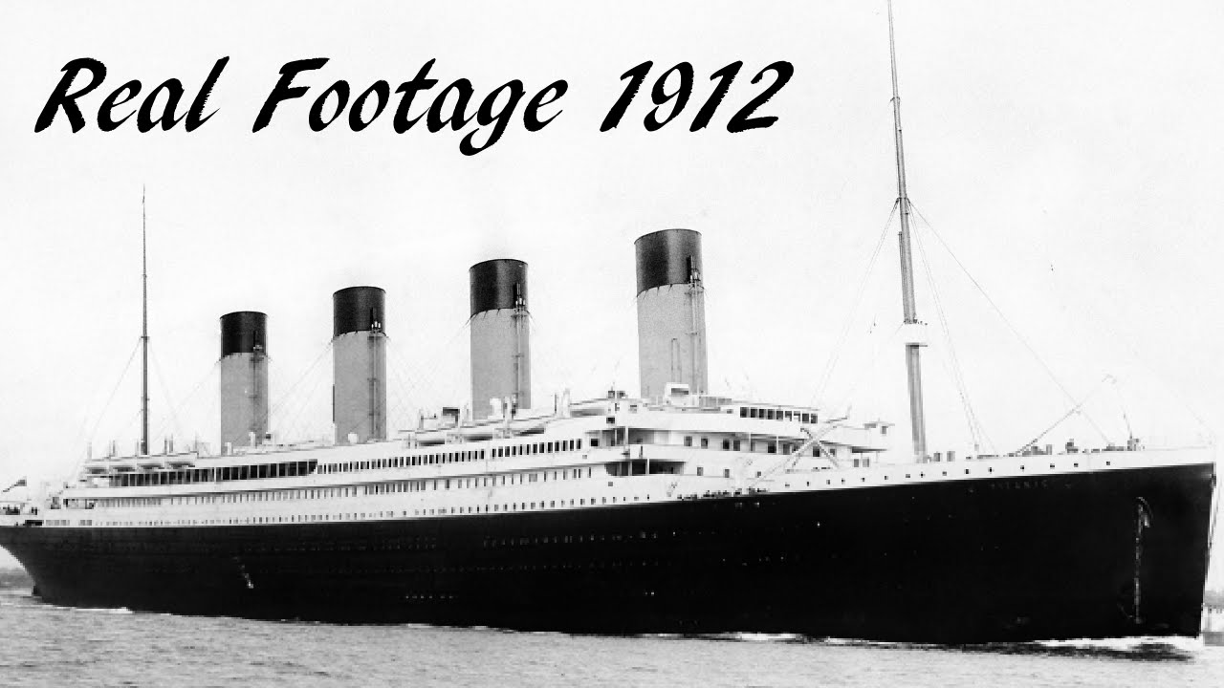
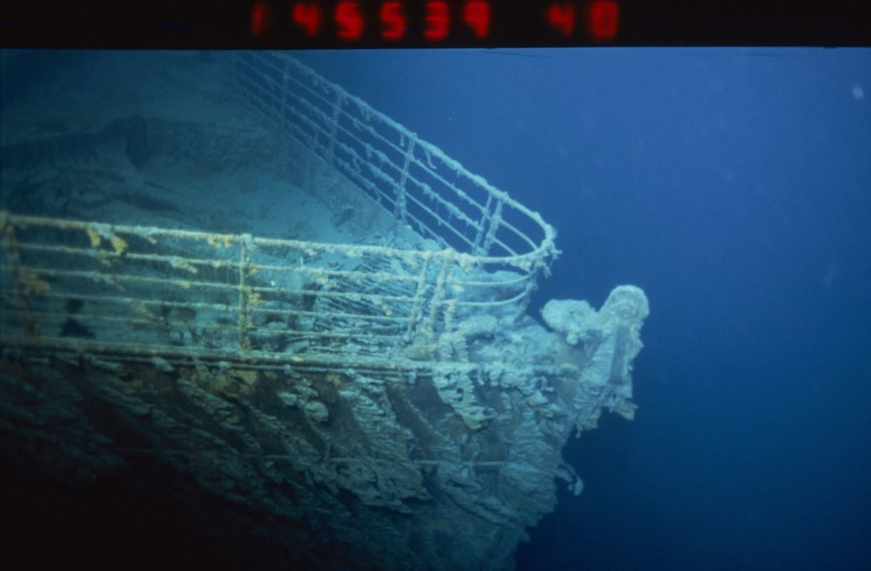
Thank you

