Slide 1
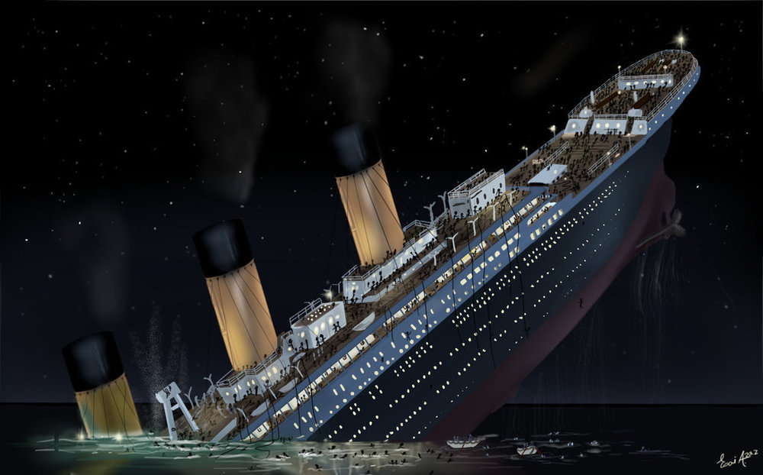
Titanic
Prediction on people likely to survive

Slide 2
RMS Titanic - Background
One of the most infamous shipwrecks in history.
Collision with iceberg, killing 1502 out of 2224 passengers and crew.
What about lifeboats?
More women, children and upper-class survived.

Slide 3
Titanic - Hypothesis
We can predict which passengers survived the tragedy.
Consider which factors will have an effect.

