Slide 1
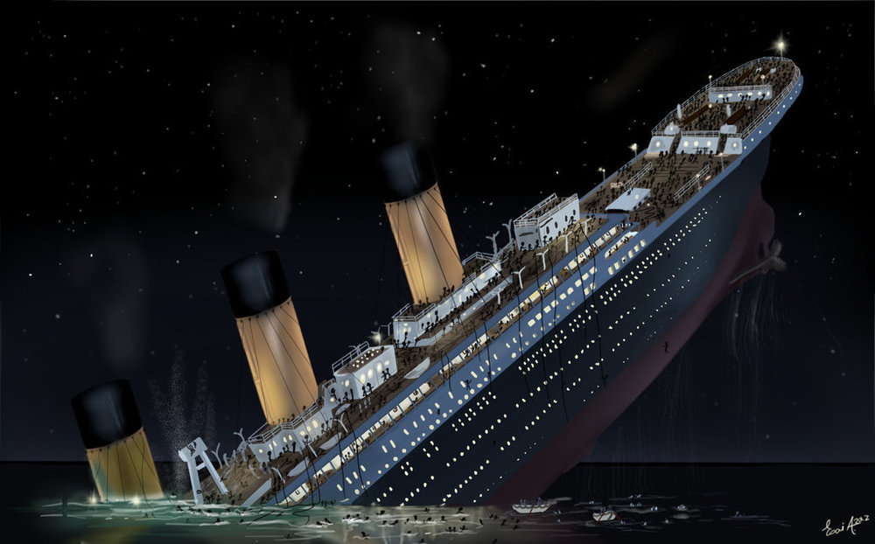
Titanic
Prediction on people likely to survive

Slide 2
RMS Titanic - Background
One of the most infamous shipwrecks in history.
Collision with iceberg, killing 1502 out of 2224 passengers and crew.
What about lifeboats?
More women, children and upper-class survived.

Slide 3
Titanic - Hypothesis
We can predict which passengers survived the tragedy.
Consider which factors will have an effect.

Slide 4
Titanic – Possible Factors in Prediction of Survival
Age
Gender
Passenger Class– 1st vs 2nd vs 3rd
Embarcation Point

Slide 5
Titanic – Data Problems
The Data had missing input in fields:
There were 1309 passengers in total
Cabin was missing in 1015 items
Age was missing in 246 items
Embarked Location in 2 items
Fare in 1 item
Disposition:
Cabin dropped
Age filled with mean for given sex and age
Embarcation and Fare missing recs dropped

Slide 6
Titanic -

