Slide 1
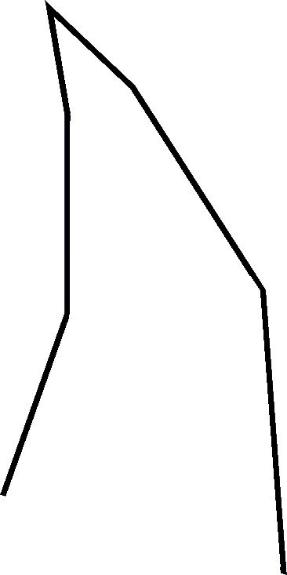
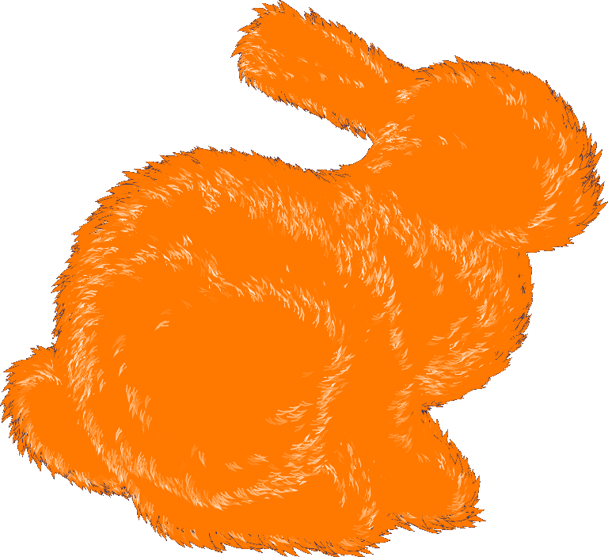
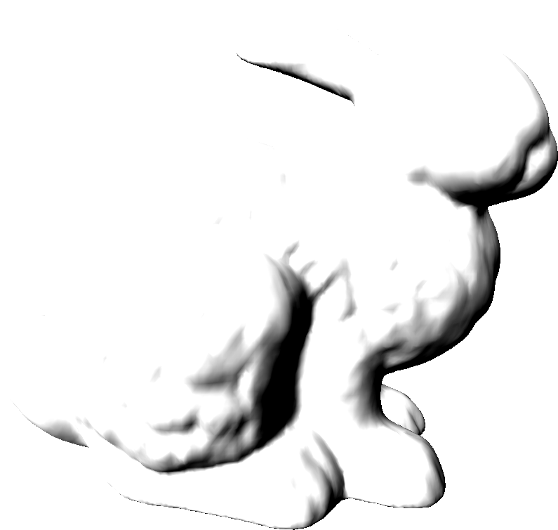
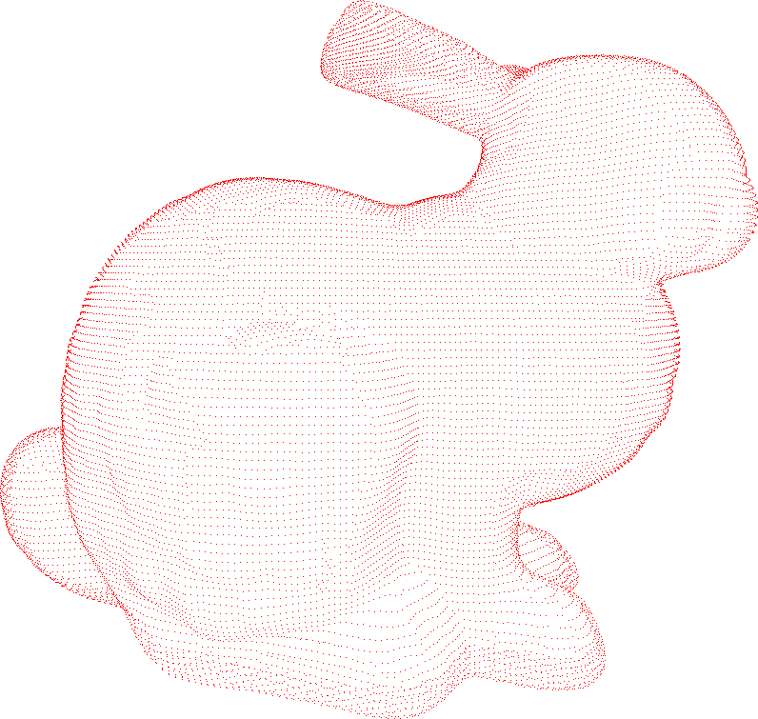
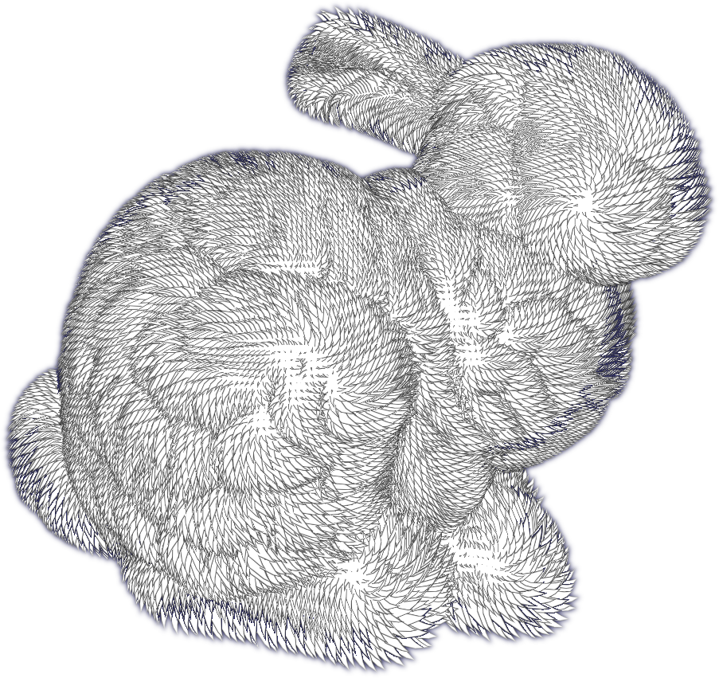
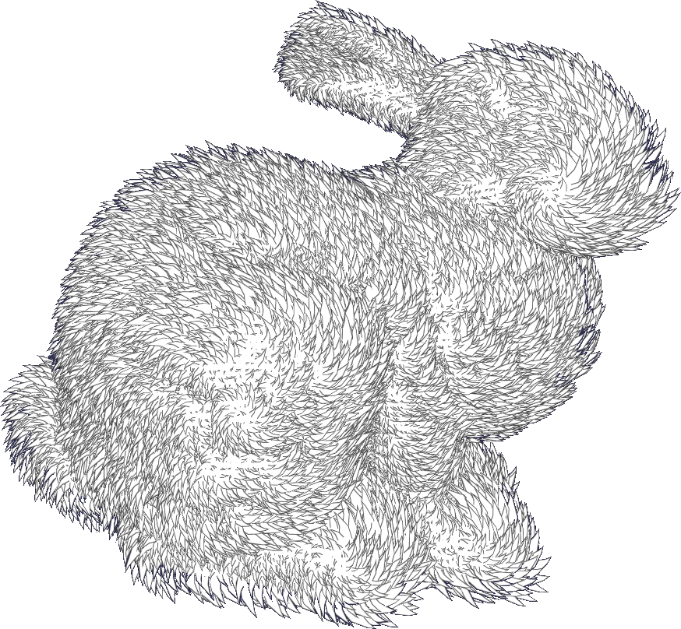
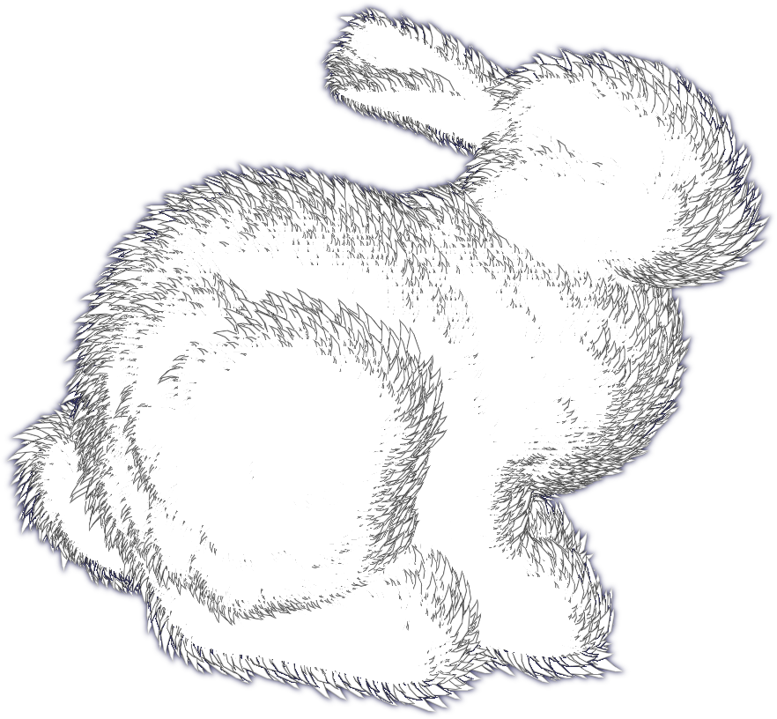
GPU Graftals: A Method for Stylized Rendering of Fur and Grass
Michael Lester, Rose-Hulman Institute of Technology
See more at www.realtimemike.wordpress.com
Introduction
Level-Of-Detail (LOD)
Results
Any art student can draw fur or grass with just a few simple strokes, but this is still a significant obstacle in real-time graphics. This work attempts to adapt the techniques of traditional artists to 3D in order to achieve stylized representations of furry objects at real-time frame rates.
As the graftals travel through the rendering pipeline, they are represented as a cloud of point-vertices (visualize Fig B) with many attributes. These attributes, such as visibility, distance, and orientation, are used to select a discrete Level-Of-Detail (LOD) for the graftal. This allows for different styles, such as the outer and inner graftals seen in Fig F.
In order to save processing time, the cloud is first passed through a culling stage, where graftals that will not be drawn are discarded (such as those near the center of the bunny in Fig F).
Stages | Time (ms) | # Graftals | Time/Graftal
Culling | 0.3 | 70,000 | ~
LOD Sort #1 | 0.1 | 35,000 | ~
LOD Sort #2 | 0.1 | 35,000 | ~
LOD Draw #1 | 4.7 | 10,000 | 470 ns
LOD Draw #2 | 1.3 | 2,700 | 481 ns
Total: | 6.5 ms | 70,000 | 93 ns
What's a Graftal?
A graftal is a small "fin" of geometry that is used to represent a single piece of fur or other complex geometry. Each graftal has individual parameters such as size, orientation, style, etc.
Graftals are represented by a central spine (red) and an array of rib lengths (blue). Each frame, the graftals are expanded by their rib vectors into fins.
This expansion process is more expensive than simply storing static geometry, but it allows for complex animation techniques such as wind and gravity. It also makes it easy to render the graftal in different styles and levels of detail (e.g. only draw the spine)
Temporal Coherence
Individual images often look pleasant, but stylized techniques often break down when viewed in an interactive scene, as the image appears to “pop” between frames. To alleviate this, we scale the size of the graftals based on their distance from the edge of the object. Thus graftals from behind appear to “grow” over the horizon, instead of simply popping in (Fig E).
Timings for Fig F. The results show that the system, given a budget of 16ms (which is robust!), should be able to handle about 170,00 graftals. For reference, a typical video game character will have ~50,000 graftals (1 graftal per vertex).
Future Work
Perturbed graftal positions: Instead of using the object’s vertex positions, which causes grid noise
Grass-style graftals: To showcase flexibility
Speed improvements: There is still much optimization that can be done, especially in the shading and culling stages
Graftal animation: such as wind or gravity
Edge Rendering
Graftal Creation
(A) Edge Distance
(B) Min(Distance)
(C) AA Graftal Edge
Currently, Graftal normals and positions are based on the vertices of the original model (Fig B). This works for models of significant triangulation, but may produce grid-like noise (visible in Fig D). Fig C shows the result of this basic setup.
Artists’ work (and our world) is never perfect, so the uniform graftals method appears unnatural (Fig C). To alleviate this, we perturb several graftal parameters when they are initialized, such as: size, normal, and rib width (Fig D).
When the central spine is expanded to form the graftal geometry, the expansion distance (from each edge) is stored at each new edge vertex (A). In the pixel shader, we threshold this value to determine if we are near an edge (B). If so, we draw an edge line (C). If it is near the outer edge of the geometry, it is blended with the background to anti-alias (AA) the line.
Fig F: Final Result
Fig A: Diffuse Model
Fig B: Graftal Positions
Fig C: Uniform Graftals
Fig D: Perturbed Graftals
Fig E: Distance Scaling

