Slide 1
Problem Statement Worksheet (Hypothesis Formation)
Determine the optimum price and/or pricing strategy relative to competitors to help Big Mountain Resort increase revenue through higher utilization of their facilities, cost reduction and increase operating margins.
H
1
Context
4
Constraints within solution space
Determine the optimal pricing strategy that will encourage two things
1. Increased utilization of the facilities
2. Improvement in the profitability of Big Mountain by increases in
some combination of the following:
Increase revenue
Increase operating margins
Increase utilization
Reduce operating costs
Unwillingness to implement the recommendations of our study because of previous commitments or fear that we may be taking on additional risk by changing our pricing for example or deciding that the lifts recently added should be decommissioned if that is what is recommended by our findings.
Big Mountain is also constrained by existing market environment and its competitors. It has to account for prices available from its competitors for similar offerings.
2
Criteria for success
Increase growth and profit margin by one or both of the following:
1. Maintain or increased ticket pricing.
2. Reduce operating costs
5
Stakeholders to provide key insight
Jimmy Blackburn – Director of Operations
Alesha Eisen– Database Manager
3
Scope of solution space
Reduce the number of lifts to lower cost or increase prices without adversely affecting utilization
6
Key data sources
CSV File available from database manager
Notes:
Hypothesis: Create a Hypothesis with an emphasis on SMART principles. (S – Specific, M – Measurable, A – Achievable, R – Realistic, T – Timebound). If you cannot do this, you do not have a good grasp on the business problem.
Context: With context, we have clearly identified the problem at hand and have elucidated on how our initiative may solve this problem, alongside the commercial implications this will have on the business.
Criteria for Success: Clearly defining the criteria for success ensures that the scope of your work is clearly defined and understood. Otherwise, if this isn’t defined – your work will never end which will result in mismatched expectations.
Scope of Solution Space: Scoping out the solution space ensures that the business initiative is SPECIFIC for a certain segment or area. This prevents solutions that have been developed being scaled and applied for all other business units that the solution may not be responsible or scalable for.
Constraints within Solution Space: Looking forward, what are the foreseeable problems we are likely to encounter? Could this be stakeholder resistance? Could this be we don’t have access to the right data?
Stakeholders to provide key insight: Who are the people I need to speak to, to get the answers I need for my data analysis?
What key data sources are required?
Based off my discussions with the key stakeholders – can we clearly list out all the data sources we need so we can make a highly targeted request as opposed to a scatter-gun approach where we ask for a bit of everything?

Slide 2
Reccommendation and Key Findings
Our model recommends an increase in ticket prices up to a maximum of $94.2.
We suggest incremental price increases up to the maximum while monitoring profitability to determine how it changes with these price changes.
Acquire data on the marginal costs of changing each feature and retraining a model with these cost features.

Slide 3
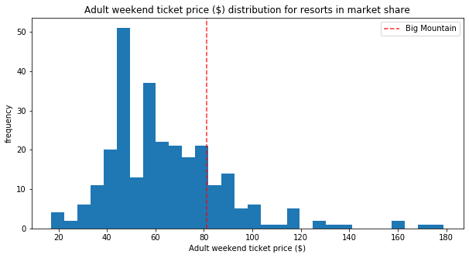
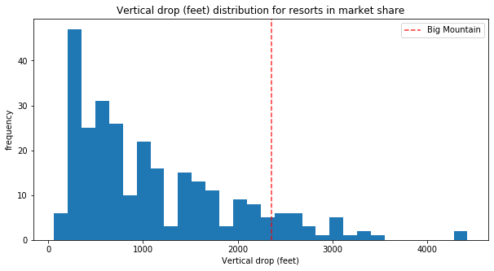
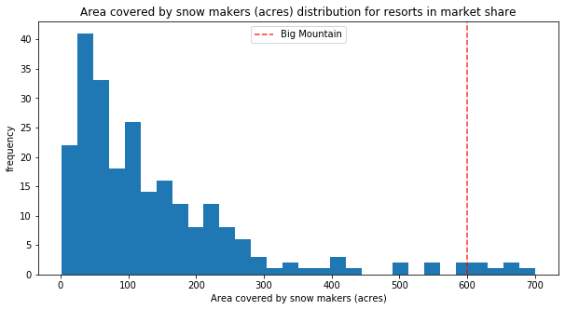
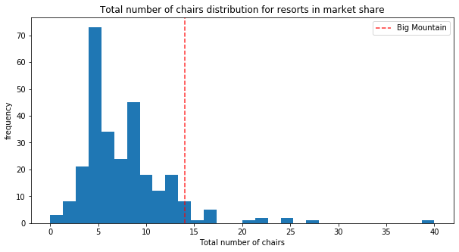
Market Position (1 of 2)
Ticket Prices
Vertical Drop
Snow Making Area
Total Number of Chairs

Slide 4
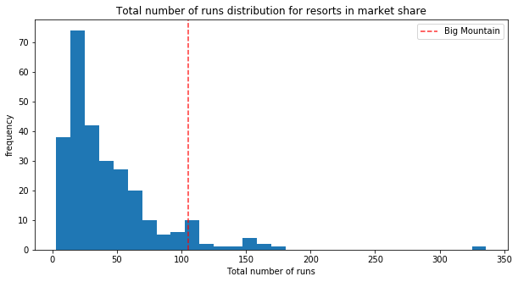
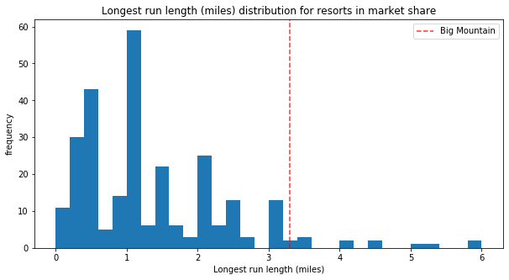
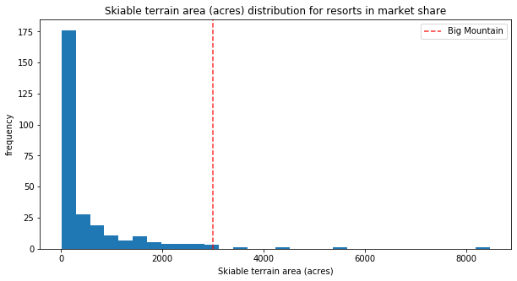
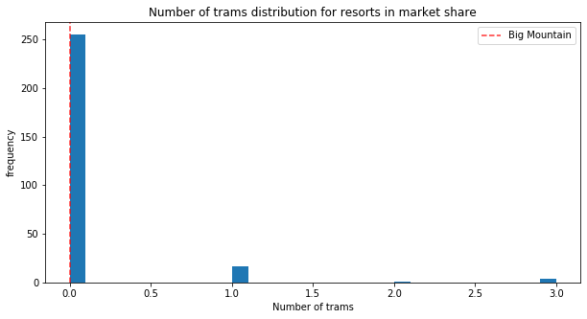
Market Position (2 of 2)
# of Runs
Longest Run
Big Mountain compares well for the number of runs. There are some resorts with more, but not many.
Big Mountain has one of the longest runs. Although it is just over half the length of the longest, the longer ones are rare.
Skiable Terrain Area
Trams
Big Mountain is amongst the resorts with the largest amount of skiable terrain.
The vast majority of resorts, such as Big Mountain, have no trams.

Slide 5
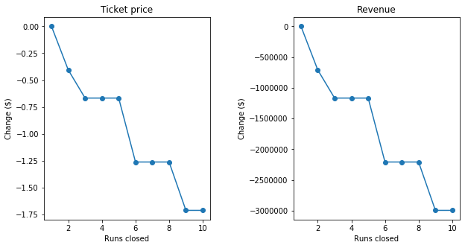
Modeling Scenarios(1 of 2)
Scenario 1: Closing some runs
The model says closing one run makes no difference. Closing 2 and 3 successively reduces support for ticket price and so revenue. If Big Mountain closes down 3 runs, it seems they may as well close down 4 or 5 as there's no further loss in ticket price. Increasing the closures down to 6 or more leads to a large drop.
Scenario 2: Add a run, increase vertical drop by 150, install additional chair lift
This scenario increases support for ticket price by $1.99
Over the season, this could be expected to amount to $3474638
Scenario 3: Scenario 2 + additional 2 acres of snow making
Results same as scenario so no appreciable difference in ticket price or revenue.

Slide 6
Modeling Scenarios (2 of 2)
Scenario 4: Increase longest run by .2 miles and adding 4 acres of snow making capability.
No difference whatsoever. Although the longest run feature was used in the linear model, the random forest model (the one we chose because of its better performance) only has longest run way down in the feature importance list.

Slide 7
Summary and Conclusion
Big Mountain currently charges $81.00 /adult ticket. Our goal is to determine/predict the optimal price for Big Mountain Resort to maximize profit, accordingly we decided to remove Big Mountain current pricing from our data used to train our model and then predict the optimal price for big mountain based on the selected features.
Preliminary analysis with our model indicated/predicted a price of $94.22 which suggests there is room for increasing Big Mountain pricing while improving profitability. There are other factors to consider such as whether other resorts are mispricing or whether we have the necessary features to accurately and reliably predict prices.
On the majority of features Big Mountain’s compares favorably meaning based on the features evaluated it such be pricing in the higher end in comparison to other resorts. We demonstrated this with comparisons on the majority of features using the plot_compare function.
Various modelling scenarios suggests the management of Big Mountain Resort could make decisions about shutting down a certain of runs to recover the operating expenses incurred for those runs. A knowledge of how much each potential closing of a run would recover would help decide the optimal number of runs, if any, to close to maximize profits.
An application user interface such as a web application that provided the ability to input values for specific features and execute the model for those features based on the values input by the user either in absolute terms or by specifying a delta would allow recalculation and prediction of the price and the overall profitability. This is particularly true if we are able to get additional data on how changes or deltas in these features would affect cost.

