Slide 1


Principle Component Analysis (PCA)
Luis Estrada
Info 523

Slide 2
Agenda
What is PCA?
History
How does PCA work?
Example: Image Compression
Conclusion

Slide 3
What is PCA?
An exploratory data analysis technique used to reduce complex data sets into lower dimensional data
Linear algebra Based
Has the ability to reveal simple underlying structure of higher dimensional data
The utility of PCA becomes more apparent for data with 4 or more dimensions
Used for following:
Dimension Reduction
Visualize data of higher dimension
More efficient use of resources
Noise Removal
Applications:
Face Recognition, Image Compression, Gene Expression, AOA estimation etc..
 | Sample 1 | Sample 2 | Sample 3 | Sample 4 | …
Dim 1 | 92 | 15 | 12 | 3 | …
Dim 2 | 55 | 27 | 74 | 8 | …
Dim 3 | 71 | 85 | 77 | 17 | …
Dim 4 | 82 | 23 | 45 | 52 | …
Convert 4D data
to 2D PC(s)
Y
PCA2
PCA1
X
Notes:
Mxn matrix where m are the number of dimensions and n is the number of sampes

Slide 4
History
Invented by Karl Pearson (1901)
Persons was a eugenicist, mathematician and biostatistician
Often accredited with establishing the discipling of mathematical statistics
Pearson is also known for the following contributions to stats:
Correlation coefficient
Pearson distribution
Chi-Squared Test
Contingency Table
Notes:
First applied in ecoloy by Goodall (1954) under the name of factor analysis

Slide 5
How does PCA work? (1/3)
The first step is to generate a covariance matrix from you mxn data set
Where covariance measure the correlation between two dimensions
 | Sample 1 | Sample 2 | Sample 3 | Sample 4 | …
Dim x | 92 | 15 | 12 | 3 | …
Dim y | 55 | 27 | 74 | 8 | …
Dim z | 71 | 85 | 77 | 17 | …
Dim r | 82 | 23 | 45 | 52 | …
cov(x,x)
….
cov(x,r)
C =
….
….
….
cov(r,x)
….
cov(r,r)

Slide 6
How does PCA work? (2/3)
The second step is to calculate the eigenvalues and eigenvectors
Eigenvalues correspond to the variance on each competent
Eigenvectors correspond to individual components in your data set
cov(x,x)
….
cov(x,r)
C =
….
….
….
cov(r,x)
….
cov(r,r)
Cx = λx
nxn
Covariance Matrix
Eigenvalues
Eigenvector

Slide 7
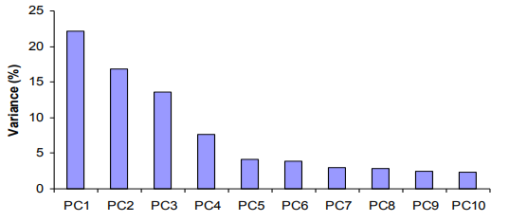
How does PCA work? (3/3)
To derive PCs, you then sort the eigenvalues in decreasing order and keep the eigenvectors that account for most of the variance
You do lose some information, but if the eigenvalues are small, you can still have a meaningful representation of your data

Slide 8

Example: Image Compression
Image compression is a great way to visibly see what PCA can do
Images a primally a gird of pixels or a matrix of rgb values
For this example, I am going to use an image of the perseverance mars rover shown to the right
844x1500 pixels

Slide 9
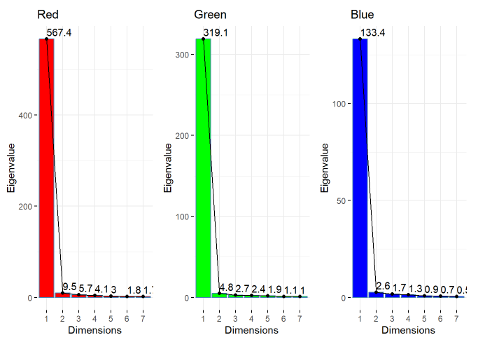
Image Compression: Eigenvalues
First step: Import image into R
R has built in PCA tools, but under the hood, it building a covarianve matrix, and doing eigenvalue eigenvector decomposition
Visualizing the first 7 eigen values of the individual RGB components you can see that there is one dimension that has the largest eigenvalues by a large margin
Next is choosing/reducing the number of components

Slide 10
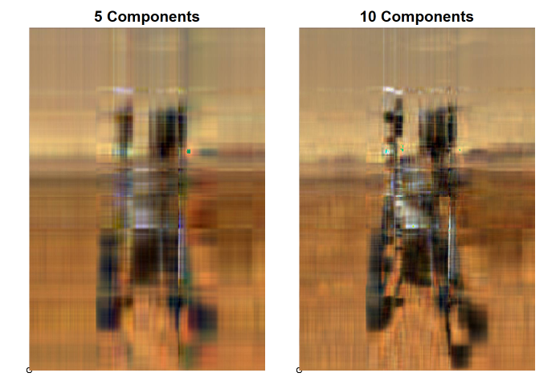
Image Compression: PCs 5 and 10
On the extreme, when reducing to 5 and 10 components you can see that a lot of the details are lost, but the general shapes and outlines are still there

Slide 11
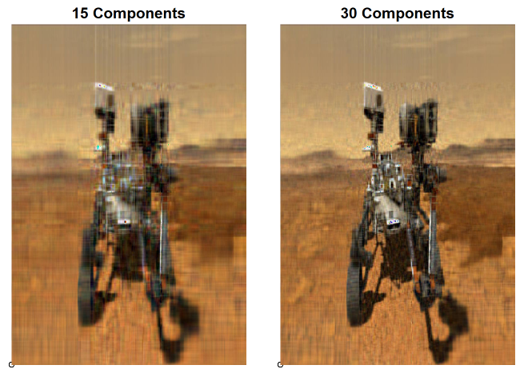
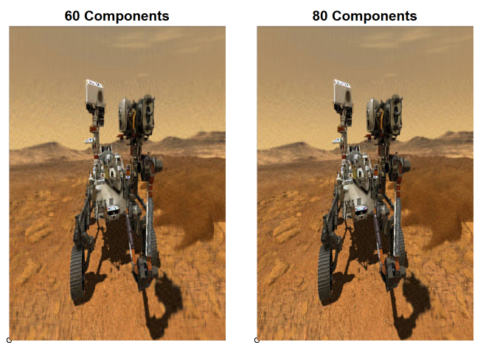
Image Compression: PCs 15-80
With more components you can start to see a large difference in the quality with the picture not longer appearing blured

Slide 12
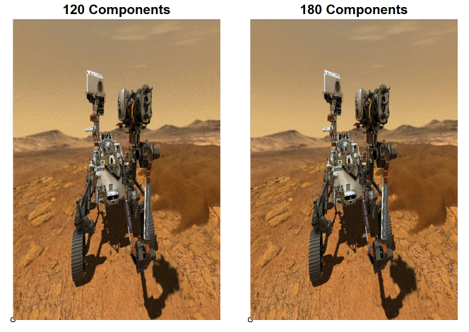

Image Compression: PCs 120-210
By 120-210 you’ve gained back a lot of details, although still a visible difference from the original picture

Slide 13
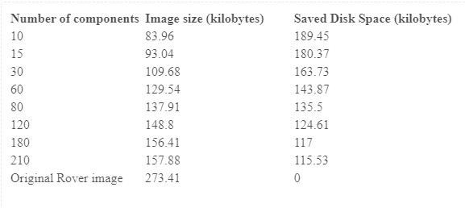
Image Compression: File Size
Depending on application and need, by reducing to 210 components you’ve saved almost half of the storage space
This has various other application in addition to data storage especially with image recognition, and feature extraction
By reducing the number of PC there's less data for these methods to sort through

Slide 14
Conclusion/Considerations
PCA can be a very valuable tool dimensionality reduction, visualizing data of higher dimensions etc..
But it has one key assumption – It assumes linearity
By assuming linearity, the problem reduces to finding the appropriate change of basis
Where a basis a set of vectors that have linear independence and span the whole set
When you do not have linearity, you can use other tools such as Independent Competent Analysis

