Slide 1
CADCloud
Leszek Dubicki
15/12/2015

Slide 2
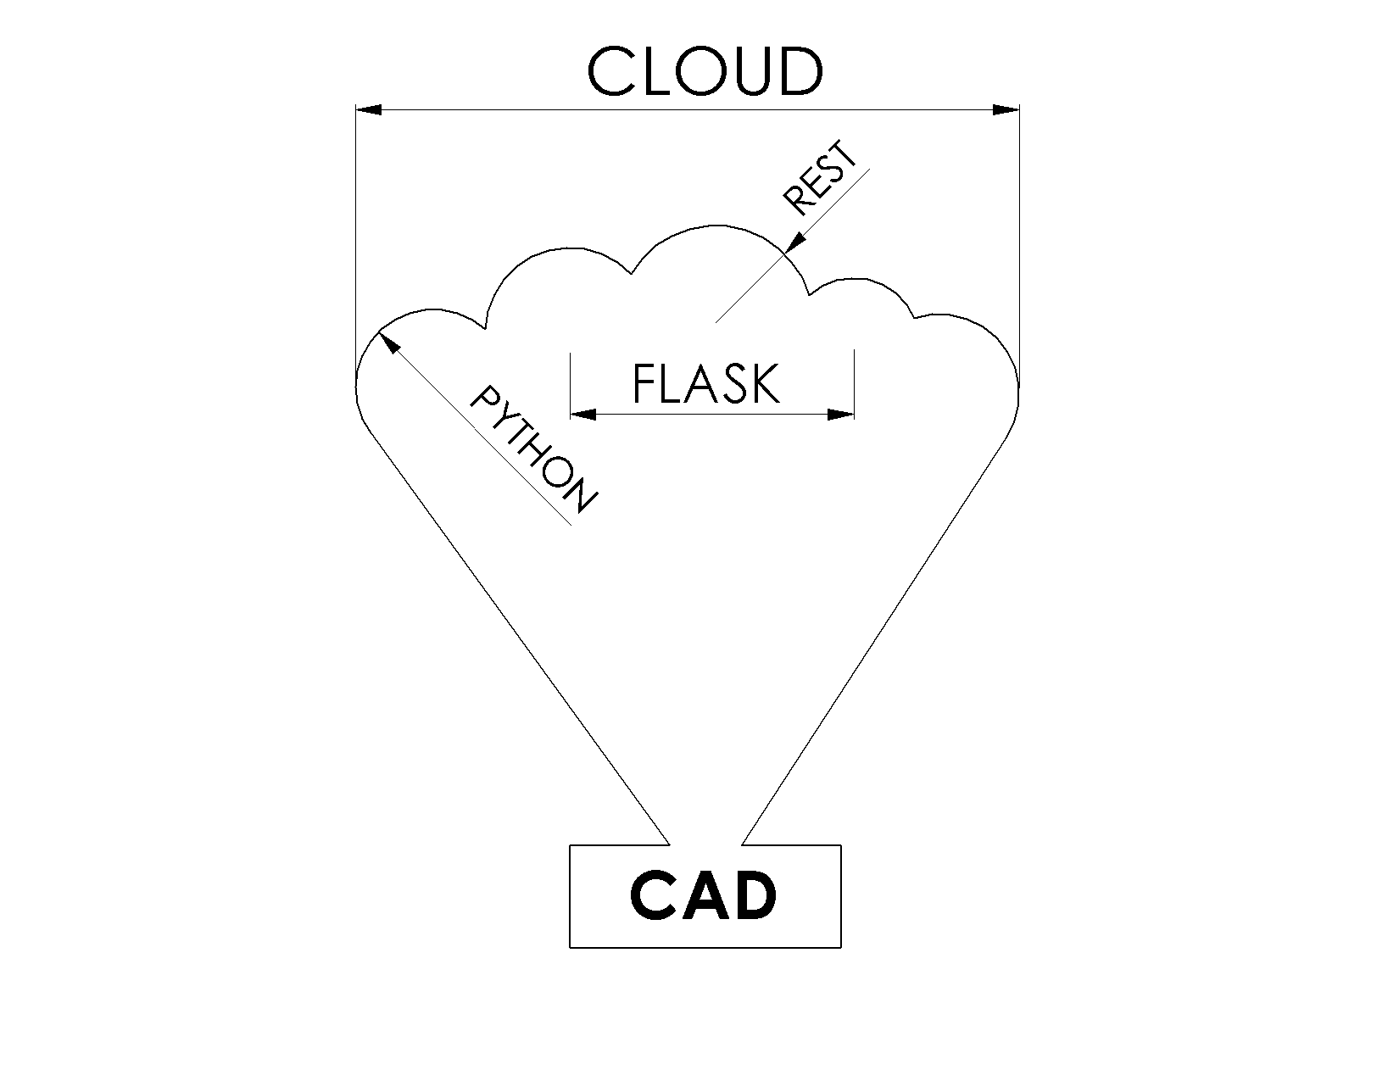
Outline
Introduction
Goals
Solution
Demonstration
Q&A

Slide 3
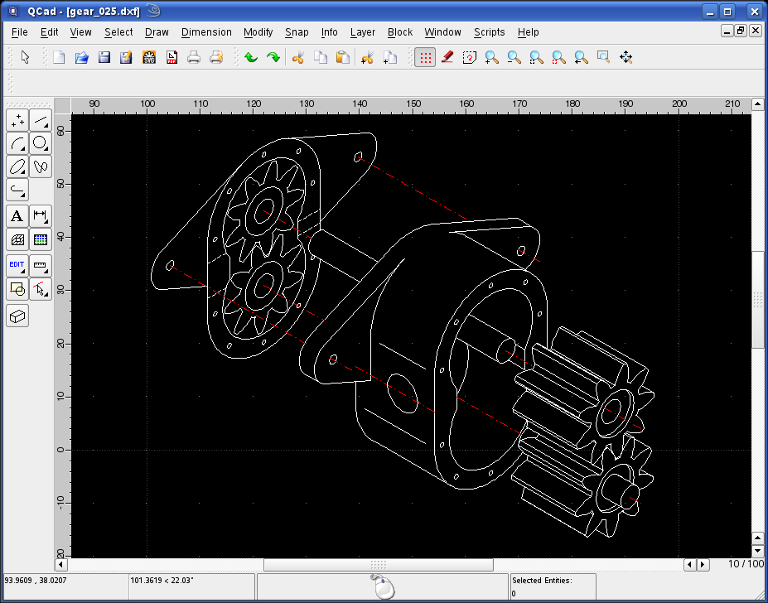
Introduction
CAD – Computer-aided Design
„Computer-aided design (CAD) is the use of computer systems to aid in the creation, modification, analysis, or optimization of a design.^{[1]} CAD software is used to increase the productivity of the designer, improve the quality of design, improve communications through documentation, and to create a database for manufacturing.” (after Wikipedia)
Usually ridiculously expensive
Is it possible to integrate projects in CAD application with external resources?

Slide 4
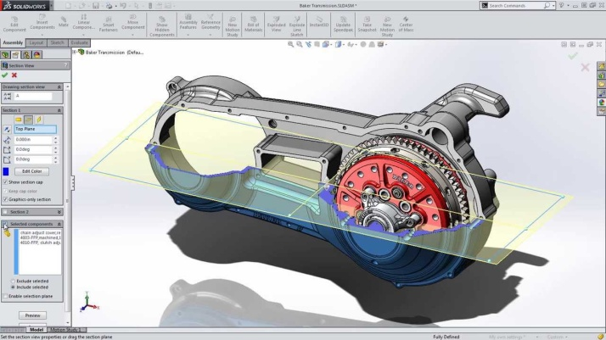


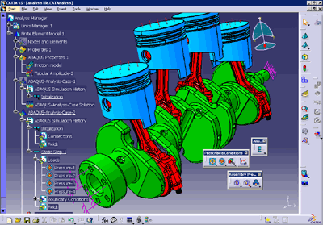
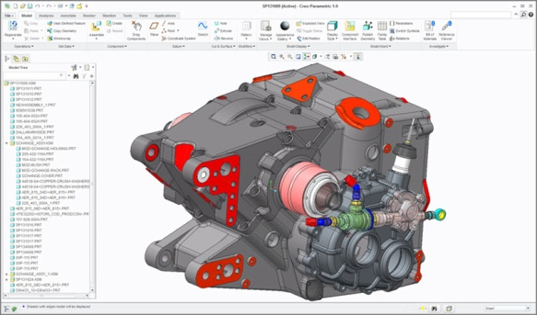

Examples of CAD software
Solidworks
Catia
Creo Parametric

Slide 5
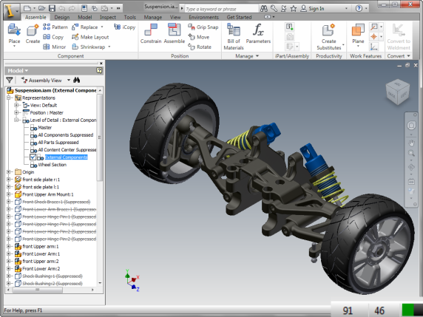

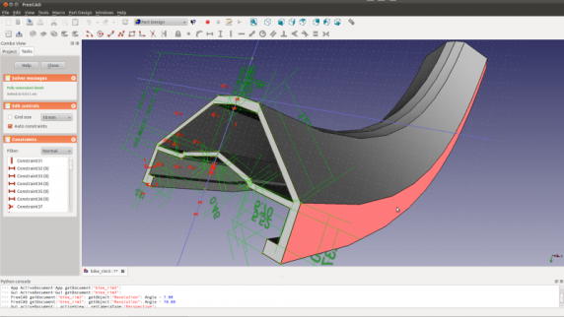

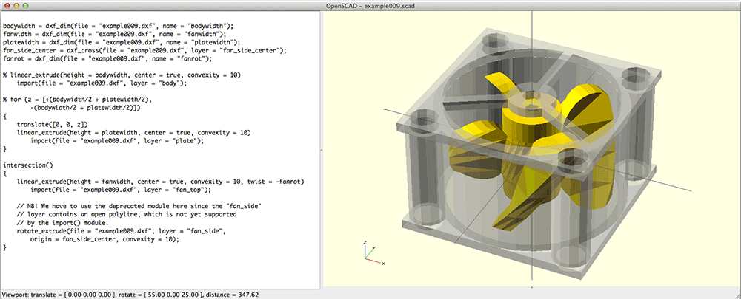
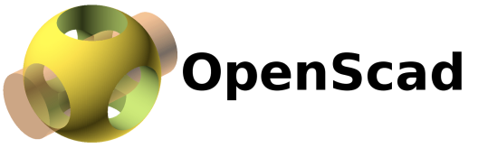
Examples of CAD software
Autodesk Inventor
FreeCAD
OpenSCAD

Slide 6
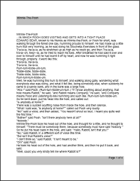
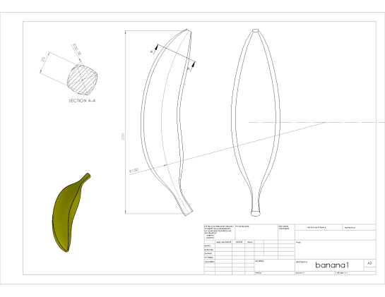
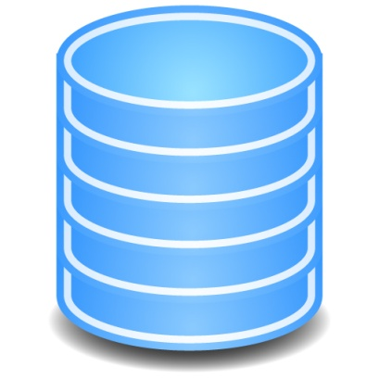

Current situation
Designer uses project documentation to obtain most of the information needed to complete the project
Often designer has to look for the project informaiton in databases
Often designer has to update databases with information from their completed project
Database
CAD

Slide 7

Target
Get the CAD applications to pull some data directly from the Web/Cloud
Get CAD to push some data into the Web/Cloud
Project Documentation
Product spec.
CAD
Database

Slide 8
Solution - CADCloud
Platform where CAD apps and other software can get or set data?
Base for more specialised web applications using / being used by CAD apps

Slide 9
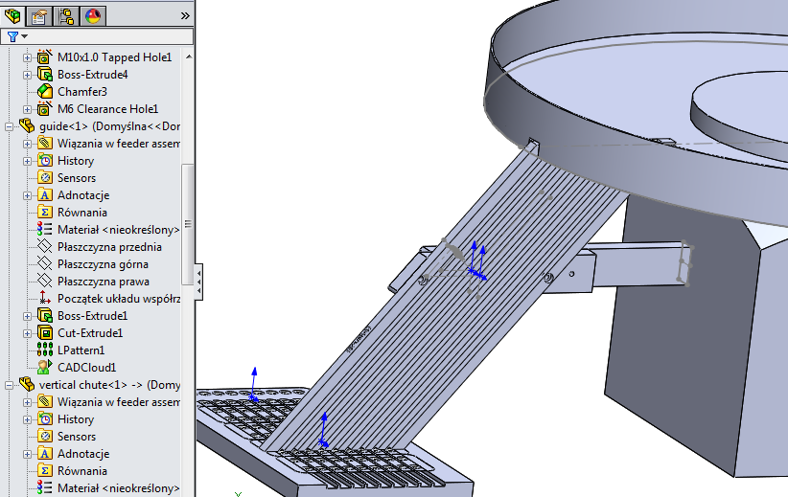
System
Client-Server architecture
CAD clients – each has it’s own plugin
Other clients

Slide 10
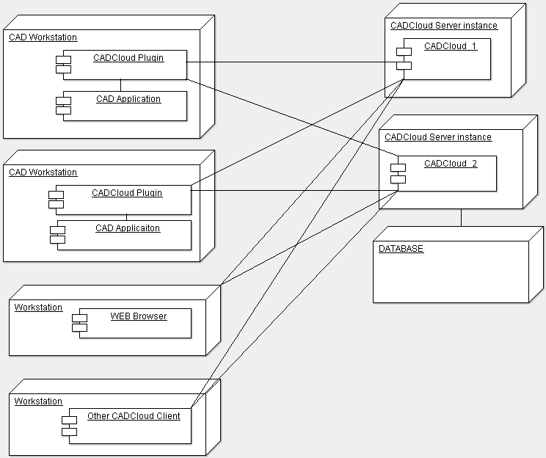

System

Slide 11
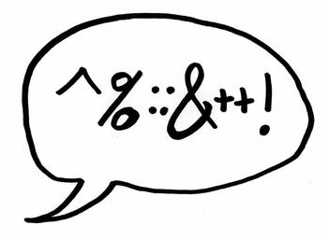
Requirements
Server:
Fast respond
Easy to extend
Client:
Plugins easy to configure
Possible to implement in design templates

Slide 12
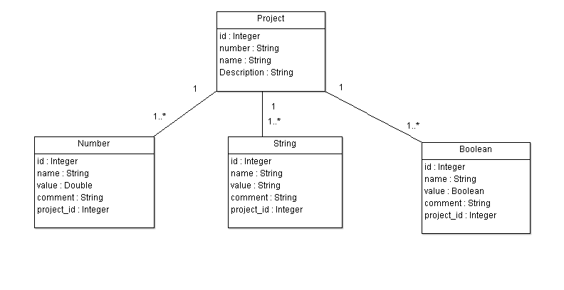
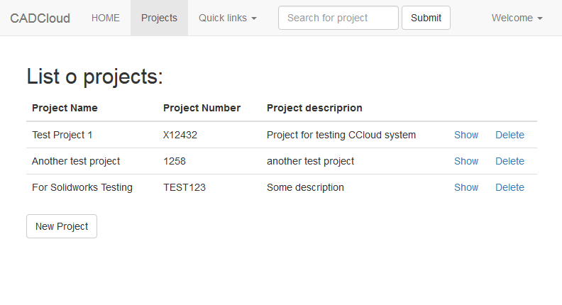
Implementation - server
Python Flask
Python SQLAlchemy
Python WTForms
REST-full API
HTTP/json format
BOOTSTRAP

Slide 13
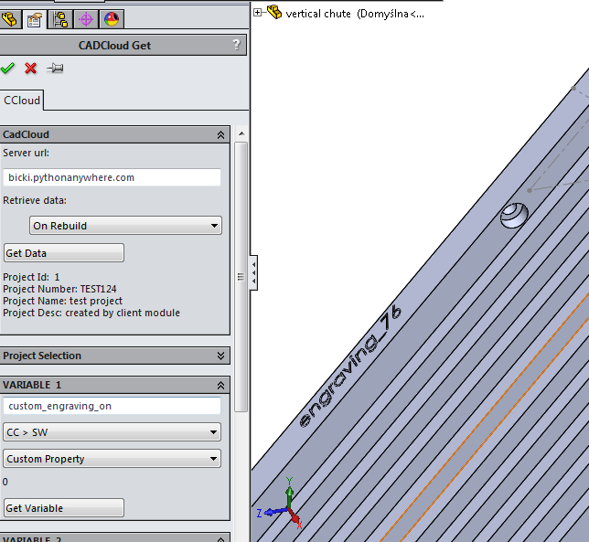
Implementation - client
Python Windows Extensions
VBA
SolidWorks API

Slide 14
Conclusions and Future Work
Works with Solidworks
Add other clients (FreeCAD)
Add sharing of other data
2D Geometry
Lists/Arrays
Logic (functions to use in documents)
3D Geometry
Add revisions
Optimize communication
Project templates/copying
Connect to Configurator/SAT Solver

Slide 15
Testing and Evaluation
Deployed to pythonanywhare.com
http://leszekdubicki.pythonanywhere.com/
Example CAD projects using the CC server features were made?
Testing scripts sending random data to the server and retrieving data from the server App

Slide 16
Demonstration
Web Page
Example Client Script
Example Solidworks Project
Short movie to explain one of the examples: feeding system

Slide 17

Q&A

