Slide 1
Wave function collapse algorithm

Slide 2
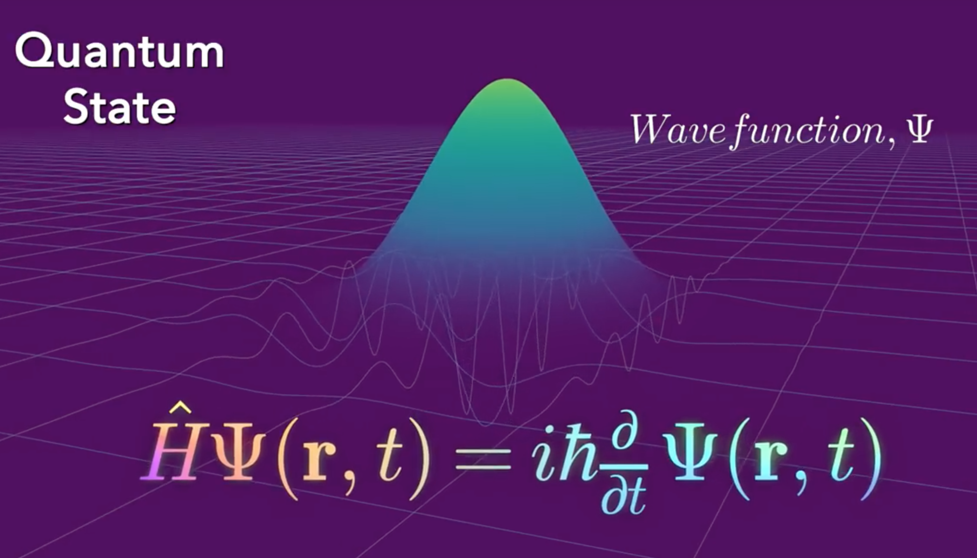

Slide 4




Introduction

Slide 5
Introduction
https://github.com/mxgmn/WaveFunctionCollapse

Slide 6
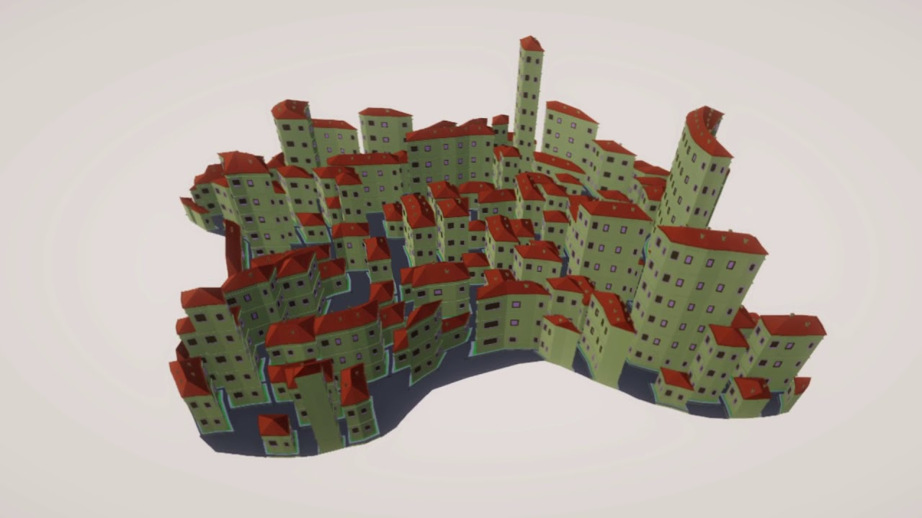
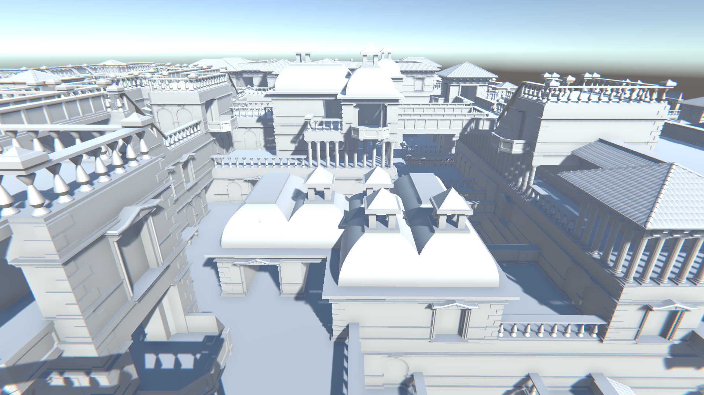
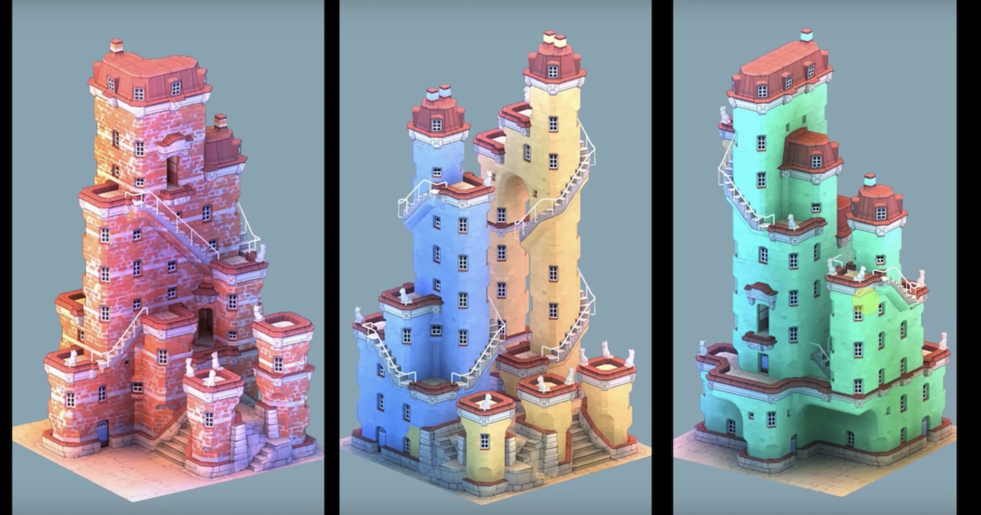
Introduction

Slide 7









How it works?

Slide 8

How it works?

Slide 9

How it works?

Slide 10

How it works?

Slide 11

How it works?

Slide 12
How it works?

Slide 13
How it works?

Slide 14
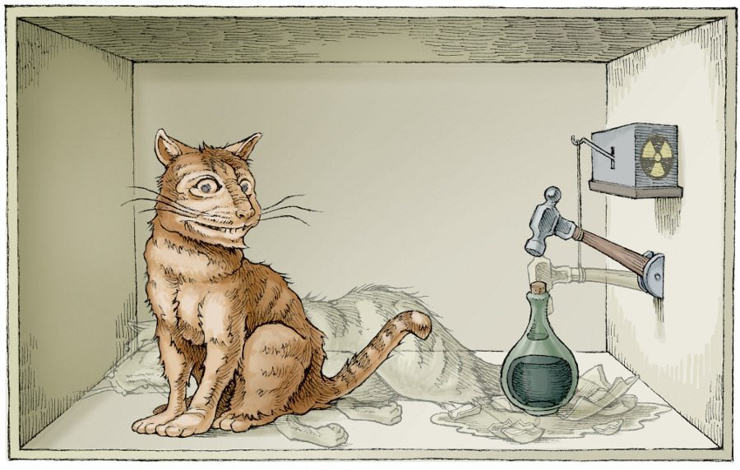
How it works?

Slide 15

How it works?

Slide 16
How it works?

Slide 17
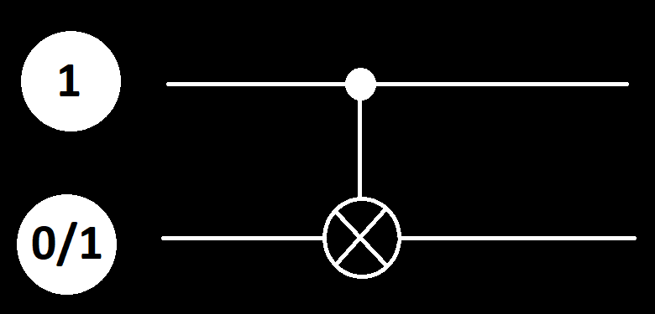
How it works?

Slide 18
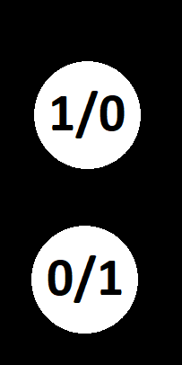
How it works?

Slide 19
How it works?
?

Slide 20
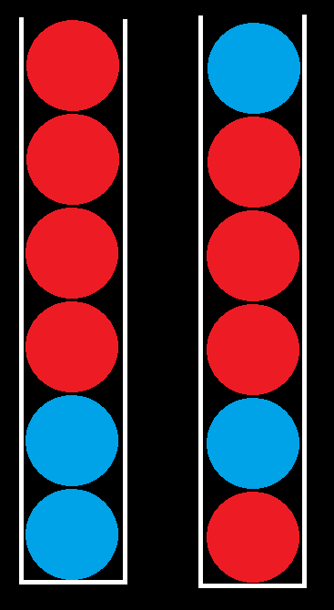
How it works?
1
2

Slide 21
How it works?
2 pieces
1
2

Slide 22




How it works?
1
2
1
2

Slide 23
How it works?

Slide 24
How it works?

Slide 25
How it works?

Slide 26
How it works?

Slide 27
How it works?

Slide 28
How it works?

Slide 29
How it works?

Slide 30
How it works?

Slide 31
How it works?

Slide 32
How it works?

Slide 33
How it works?

Slide 34
How it works?

Slide 35
How it works?

Slide 36
How it works?

Slide 37
How it works?

Slide 38

How it works?

Slide 39
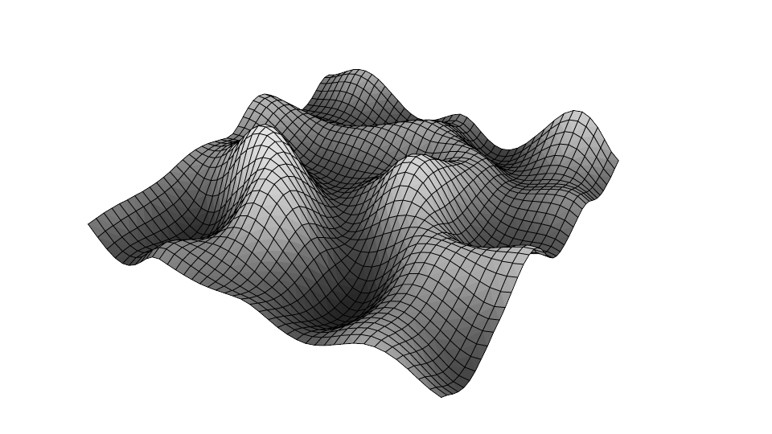

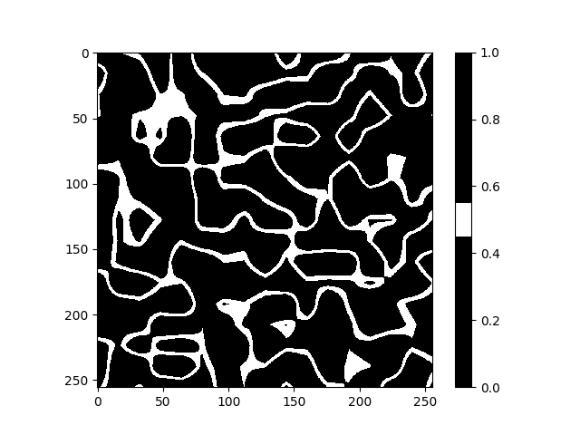
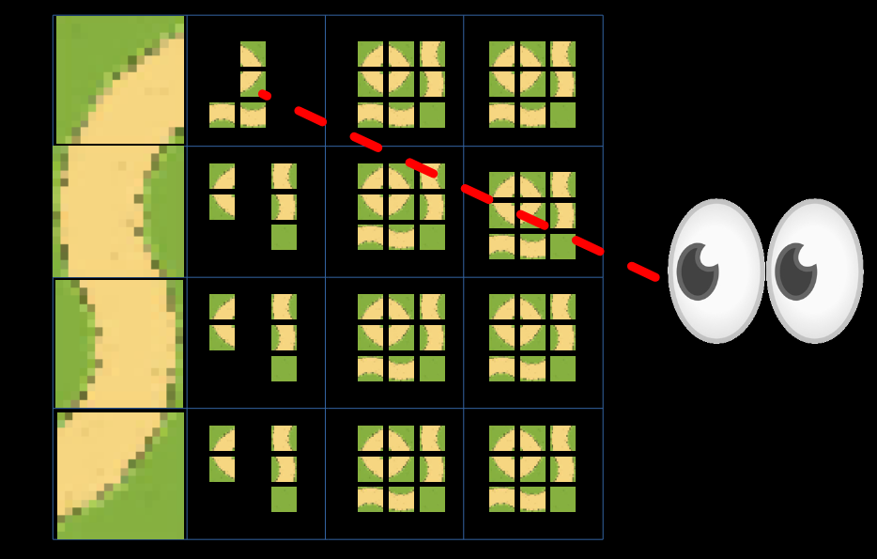
Why is it not perfect?

Slide 40
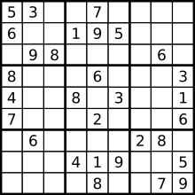
Why is it not perfect?

Slide 41
Why is it not perfect?
NP
COMPLETE

Slide 42
Why is it not perfect?

Slide 43
Why is it not perfect?

Slide 44
Why is it not perfect?
?

Slide 45
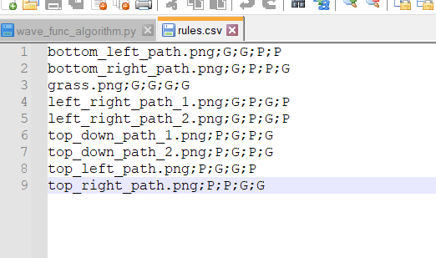
Why is it not perfect?

Slide 46


Why is it not perfect?

Slide 47
( ͡° ͜ʖ ͡°)
https://www.youtube.com/watch?v=bskLi6i946Q
https://www.youtube.com/watch?v=TO0Tx3w5abQ

Slide 48


Slide 49
Sources
https://www.youtube.com/watch?v=rI_y2GAlQFM
https://github.com/mxgmn/WaveFunctionCollapse
https://www.youtube.com/watch?v=bskLi6i946Q
https://www.youtube.com/watch?v=TO0Tx3w5abQ
https://80.lv/articles/using-the-wave-function-collapse-algorithm-for-infinite-procedural-cities/
https://obrazkowo.pl/bbb022ad415c1928ce0459454c8c1290/Po-prezentacji-kt%C3%B3ra-ma-mi-uratowa%C4%87-dupe-na-koniec-roku

