Slide 1
Computer Science Seminar
The Effect of a Market Visualizer on Nigerian Investors
Presentation Focus
Honest charts from named sources
Stocks, crypto, and NGX
Isolation Forest vs 3-sigma
USD to NGN context
Design, Implementation, and Detector-Based Evaluation
[Your Full Name]
[Matric Number] | [Department] | [University]
Supervisor: [Supervisor Name] | Session 2024/2025
1

Slide 2
Problem
Tangible Struggles Nigerian Beginners Face
NGX information is often scattered across broker apps, exchange pages, news sites, WhatsApp groups, and social-media posts.
Many beginners can see prices, but they cannot easily tell whether a move shows trend, volatility, or an unusual day.
Many tools invent a line when history is missing, or claim “AI” without a method you can examine.
Without A Local Visualizer
Analysis becomes fragmented, slow, and easy to misunderstand.
2

Slide 3
Reality
What Happens Without The Tool
Scattered Information
Weak Local Context
Unnamed Methods
A beginner may jump between exchange pages, headlines, broker screens, and social media before understanding one asset.
Many platforms are stronger for US markets than NGX, so Nigerian users get less naira-first interpretation.
Charts appear without tested indicators or a named unusual-day detector, so “unusual” is just a guess.
3

Slide 4
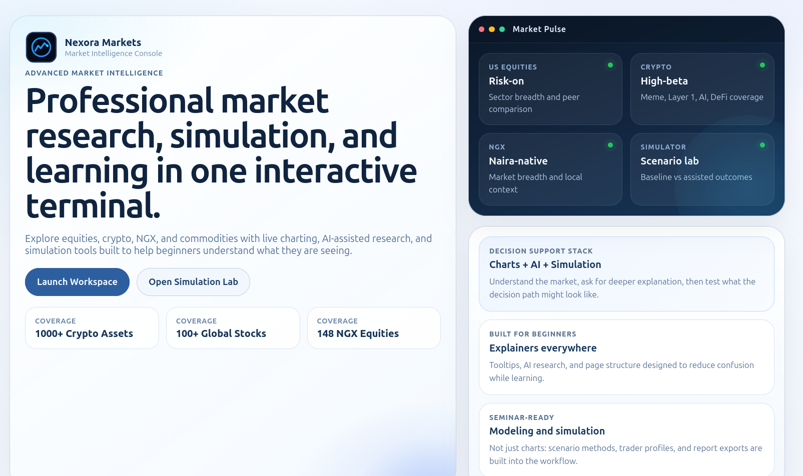
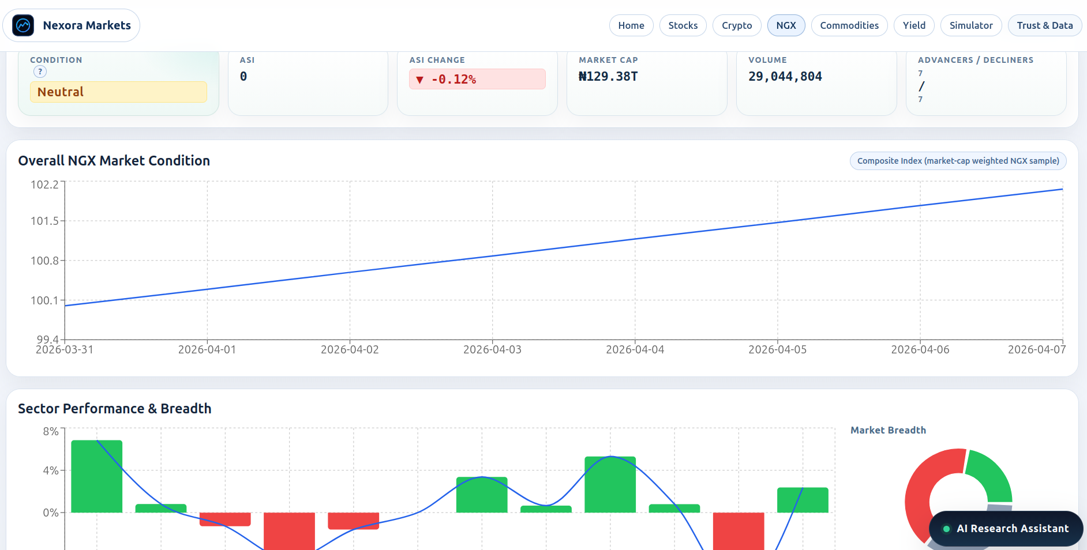
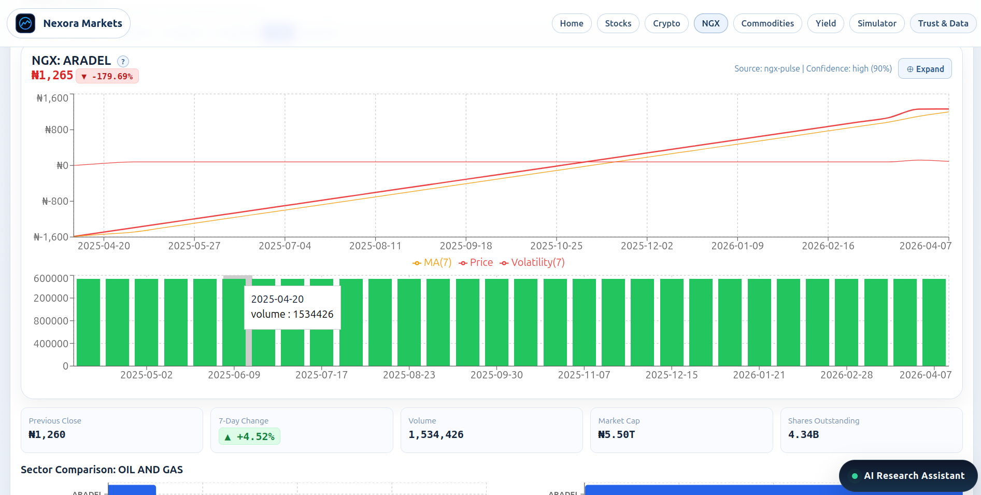
Demo
What The Live App Shows
View 1
View 2
View 3
Home: three markets
NGX in naira
Stocks: indicators and flags
Place screenshots in docs/screenshots/. Routes: /, /ngx, /stocks.
4

Slide 5
Demo
Stocks And Crypto On One Chart Stack
Stocks
Add Screenshot
Crypto
crypto.png
Place this file inside:
/home/m/Desktop/m&s/docs/screenshots
Search, SMA/RSI, compare two names
Crypto: CoinGecko with Yahoo fallback
If a provider has no history, the chart stays empty.
5

Slide 6
Nigeria Lens
Why This Matters In Nigeria
NGX belongs in the same visualizer as US tickers, in naira.
A USD to NGN bar gives FX context without pretending to be a trading desk.
Honest empty charts matter more than a guessed line when Pulse or CoinGecko is down.
Local Need
The platform is designed to reduce confusion, restore local context, and keep methods examinable.
6

Slide 7
Workflow
How A User Moves Through The Tool
1
2
3
4
5
Pick Stocks, Crypto, or NGX
Search a ticker
Plot history or see empty
Overlay tested indicators
Click gold or wine marks
7

Slide 8
Architecture
What We Built
React + Vite
Express API
Indicators
Isolation Forest
Yahoo, CoinGecko, NGX Pulse, and FX APIs. 3-sigma is the statistical baseline next to Isolation Forest.
8

Slide 9
Alpha Points
How The Visualizer Tackles Each Problem
Scattered information -> Home, Stocks, Crypto, and NGX share one chart stack.
Weak NGX support -> naira workspace plus a USD to NGN bar.
Unnamed methods -> SMA, EMA, RSI, MACD, Bollinger with tests.
“Unusual” without a definition -> gold 3-sigma vs wine Isolation Forest.
Tool Value
Detection on the chart in front of you, not a forecast and not a buy or sell signal.
Home
NGX
Flags
9

Slide 10
Evaluation
Unusual Days: Isolation Forest vs 3-sigma
Detector
Same Chart
Gold: return or volume > 3σ
Wine: 4-D Isolation Forest
Top 5% score and floor 0.55
Click a mark to read the day
Not a forecast
Gold ring = 3-sigma. Wine fill = Isolation Forest.
10

Slide 11
Findings
What The Artifact Demonstrates
A working visualizer for stocks, crypto, and NGX.
Named providers; empty chart if history is missing.
Tested indicators computed on the bars that arrived.
Isolation Forest compared with a 3-sigma baseline.
USD to NGN for local FX context.
Takeaway: potential effect is clearer reading of history, not measured trading profit.
Charts
NGX
Crypto
Add Screenshot
crypto.png
Place this file inside:
/home/m/Desktop/m&s/docs/screenshots
11

Slide 12
Limits
Study Boundaries
Not a Brokerage
Not a Forecast
Not a Field Study
The platform does not execute trades or give investment instructions.
Isolation Forest flags unusual bars; it does not predict the next close.
The effect on Nigerians is inferred from design, not measured in a survey.
12

Slide 13
Conclusion
Main Contribution
Bottom Line
A small, examinable visualizer: named data, tested indicators, NGX and FX context, and an unusual-day detector next to a 3-sigma rule.
Most defensible claim: the visualizer may help Nigerian-oriented beginners read market history more clearly.
Present the effect as likely and designed, not as nationally proven.
13

Slide 14
Close
Recommendations
Test the tool with Nigerian students and beginner investors.
Measure confusion and interpretation quality directly.
Strengthen NGX history coverage; keep refusing next-day forecasts.
Thank you
Questions
and discussion
14

