Slide 1
Computer Science Seminar
The Effect of a Market Visualizer on Nigerian Investors
Presentation Focus
Why we built it
What the system does
How we evaluated it
What the simulation suggests
Design, Implementation, and Simulation-Based Evaluation
[Your Full Name]
[Matric Number] | [Department] | [University]
Supervisor: [Supervisor Name] | Session 2024/2025
1

Slide 2
Problem
Why This Project Exists
Many beginner investors can see prices, but they still struggle to understand charts, trends, and risk.
Most tools are more foreign-market focused than NGX-focused, so local users often get less contextual support.
This creates a gap between access to market data and actual understanding of market information.
Core Problem
Effect here means likely improvement in understanding and modeled decision support, not proven nationwide impact.
2

Slide 3
Solution
Platform Overview
Market Visualizer
AI Research Support
Simulation Lab
Clearer charts, market context, and related news across NGX, stocks, crypto, and commodities.
An embedded assistant that may reduce confusion by explaining terms, moves, and page context in simpler language.
A modeling layer that tests the likely effect of the visualizer on baseline versus assisted decision behavior.
3

Slide 4
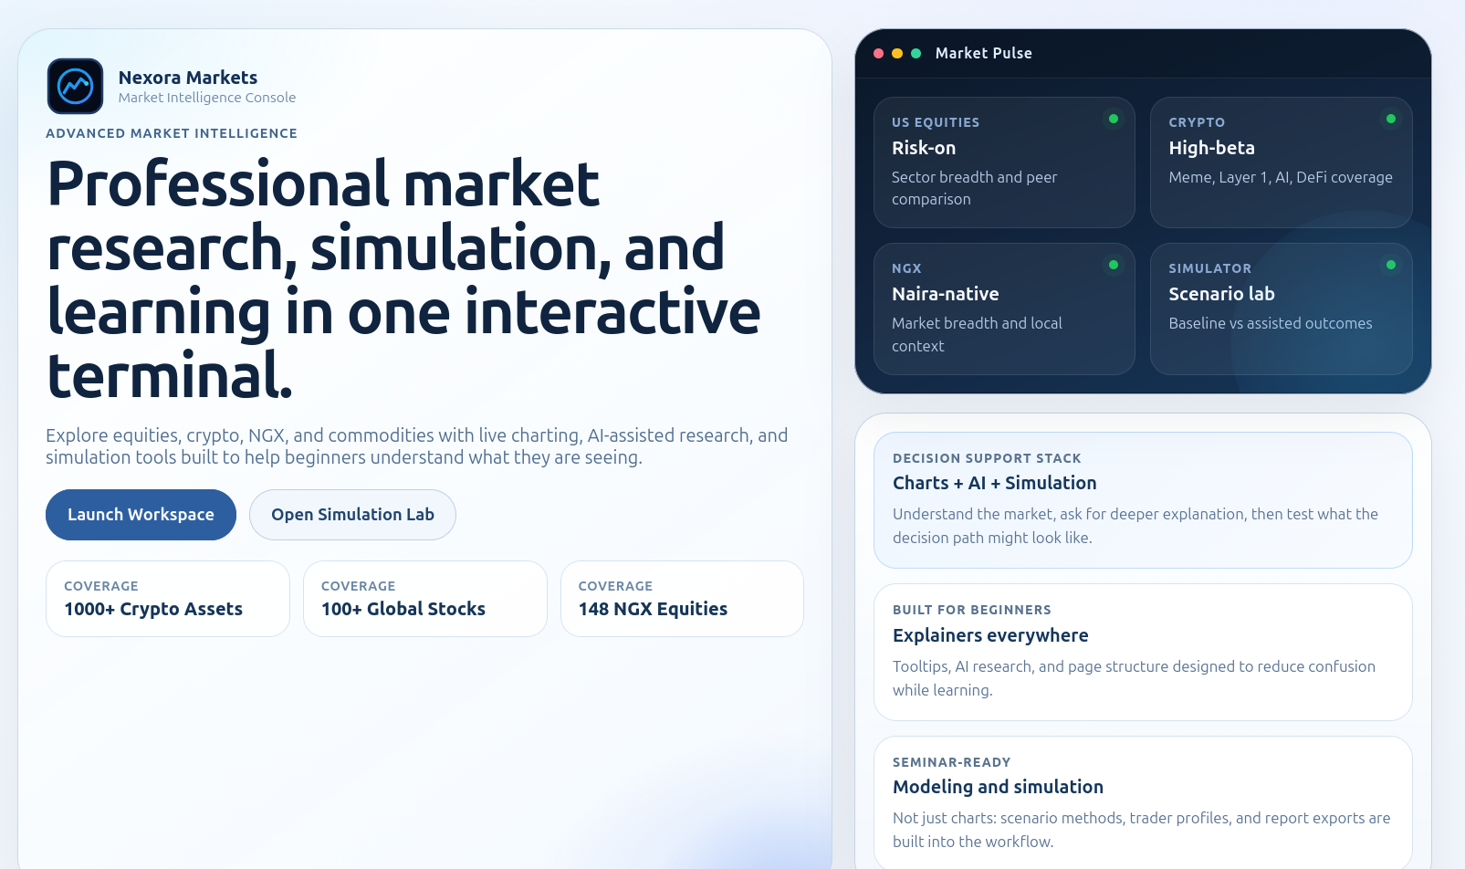
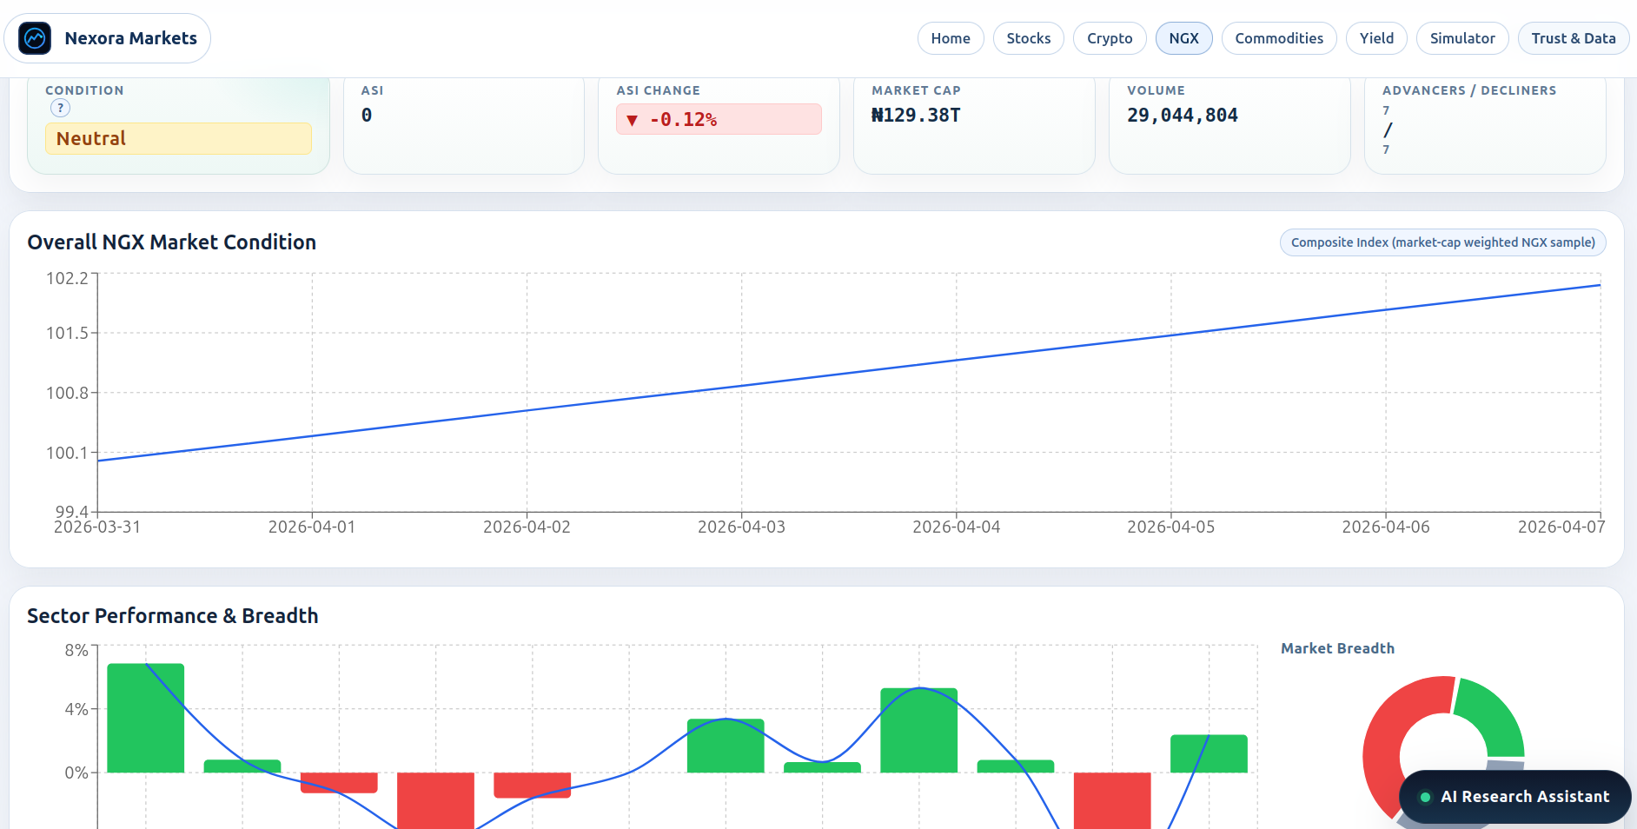
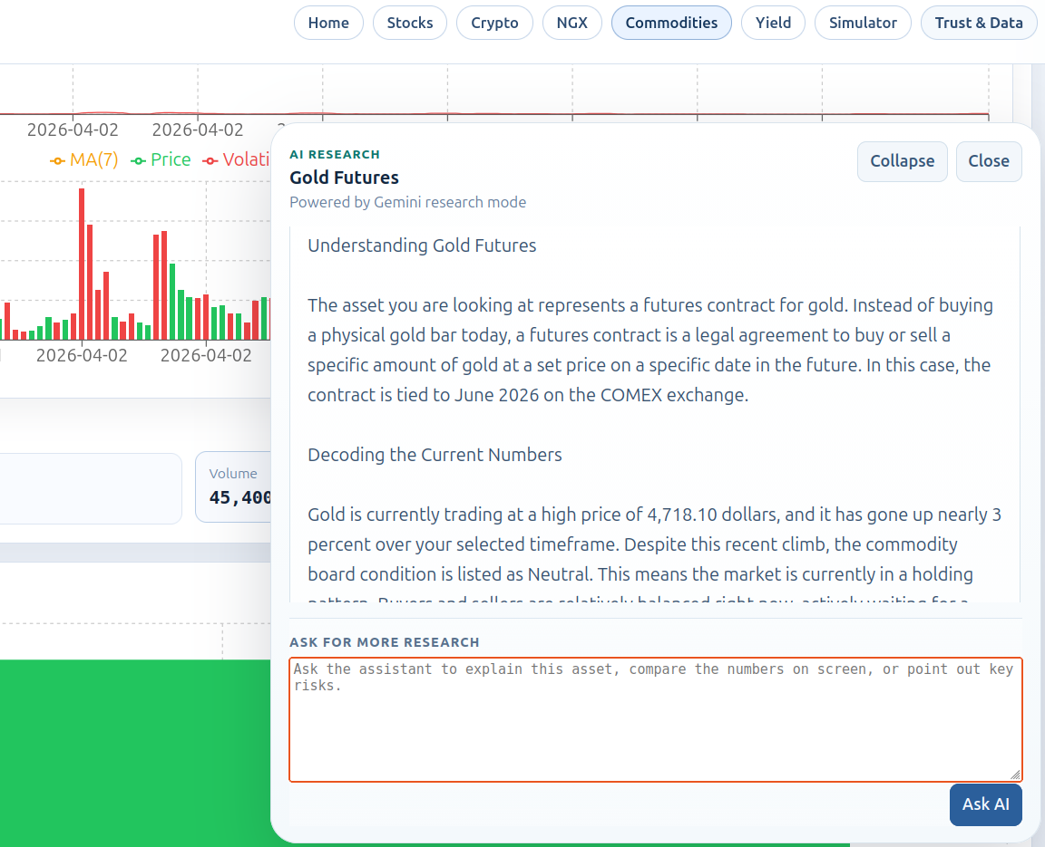
Product Visuals
Live Product Views
View 1
View 2
View 3
Home / product entry
NGX analysis workflow
AI-assisted analysis
These screens show where the likely effect on clarity and explanation begins.
4

Slide 5
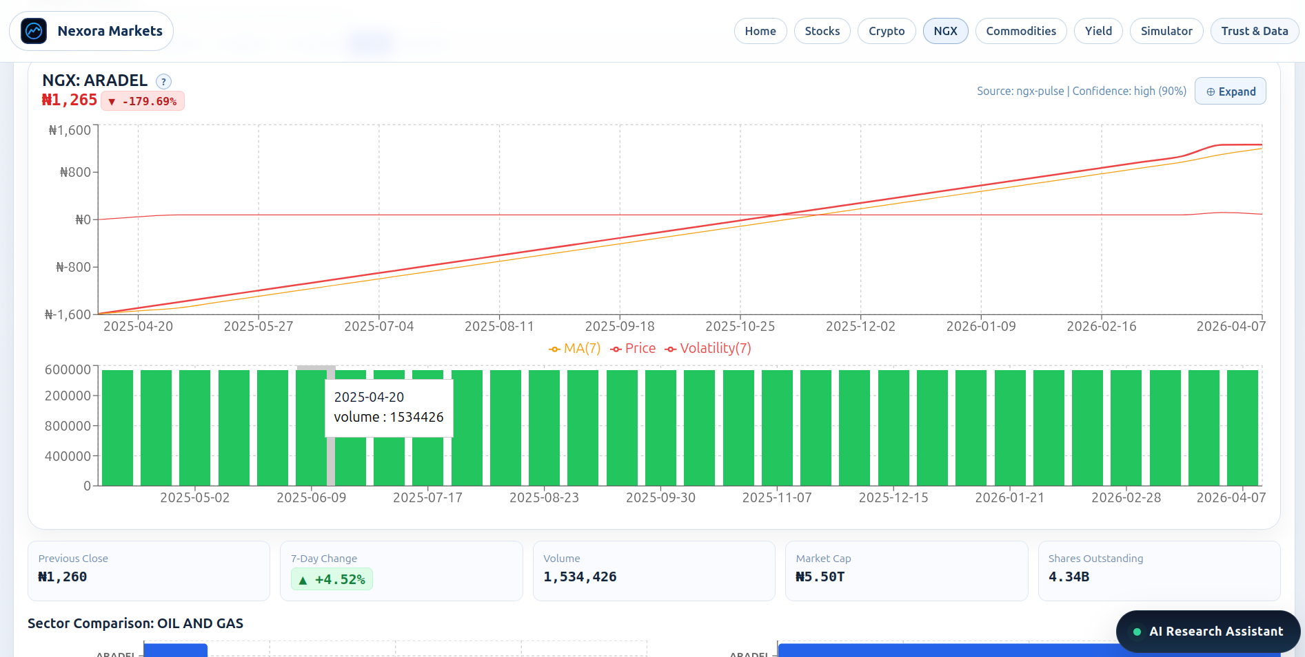
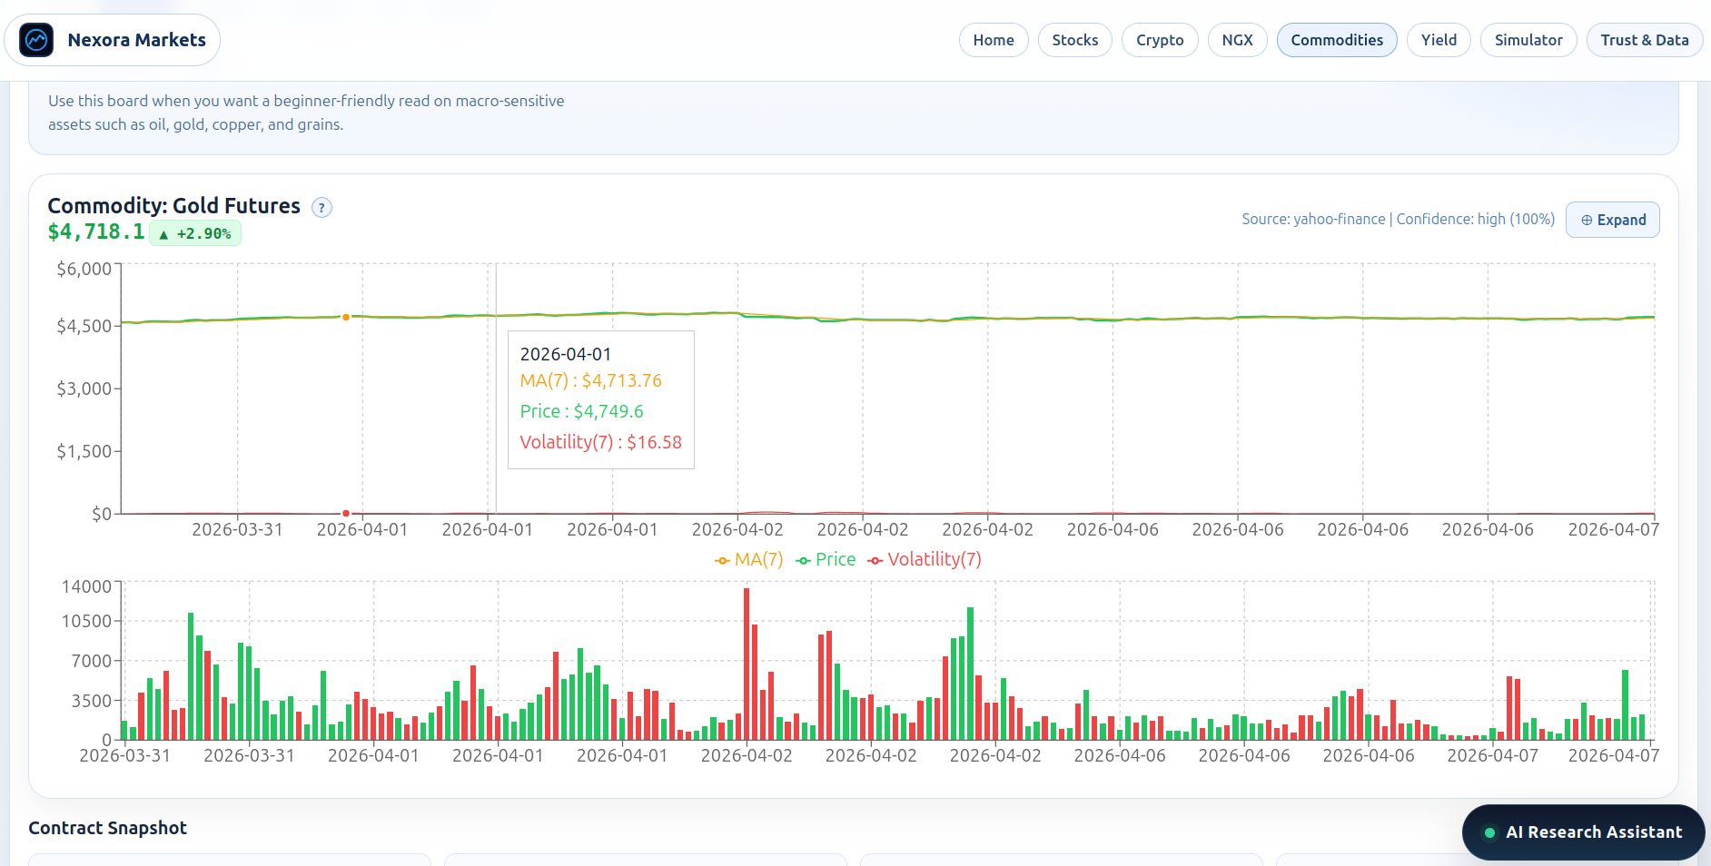
Visual Proof
More Product Views
Stock Visualizer
Market Context
Stock visualization workflow
Broader market/news context
These extra views show the wider workflow that supports the platform's likely effect.
5

Slide 6
Nigeria Lens
Why This Matters in Nigeria
NGX-centered support is often weaker than support for foreign markets.
Many new users need help connecting local news, charts, and market meaning.
A local-market-first design may improve confidence, orientation, and financial understanding.
Effect Pathway
Local relevance, clearer visuals, and explanation support may produce a stronger learning and analysis experience for Nigerian beginners.
6

Slide 7
Workflow
User Journey
1
2
3
4
5
Choose an asset
Read charts and market context
Review page-related news
Ask AI for clarification
Compare baseline vs assisted outcomes
7

Slide 8
Architecture
System Architecture
User Interface
Market Visualizer
AI Research Layer
Simulation Engine
Visualization, explanation, and simulation are connected so the effect can be explored inside one workflow.
8

Slide 9
Method
Build and Evaluation Approach
Implementation
Evaluation
React + Vite frontend
Express backend
Recharts for visualization
Yahoo Finance, CoinGecko, NGX Pulse
Design-science / software engineering
Case-based observation of workflows
Simulation-based comparison of effect
No nationwide field study claim
9

Slide 10
Effect
How The Visualizer Produces Effect
Clearer chart structure reduces interpretive burden for beginners.
NGX-first context improves local meaning and usability.
AI explanation helps users connect numbers, news, and risk.
Mechanism
The expected effect begins with better understanding, then extends to better modeled decision quality under assisted conditions.
10

Slide 11
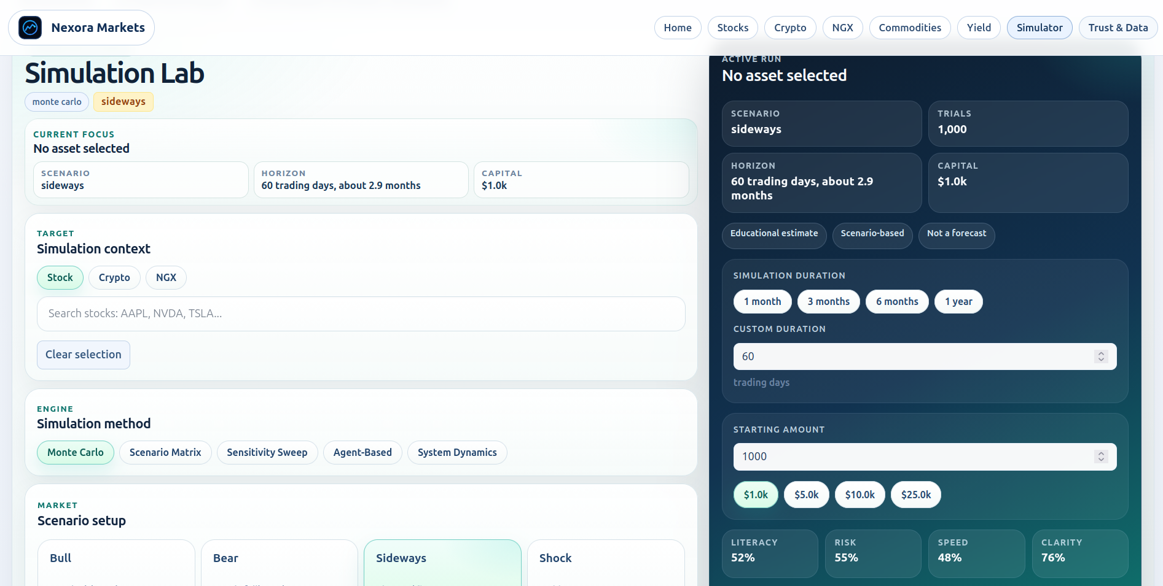
Effect Model
Simulation In Action
Simulation Result
Measured Example
Bull scenario | 400 trials | seed 2026
Accuracy: 56.1% -> 70.3%
Latency: 7.70 -> 6.00
Risk: 0.540 -> 0.420 | Return: 0.065 -> 0.182
Baseline vs visualizer-assisted simulation output
11

Slide 12
Findings
Key Outcomes
The platform successfully combines visualization, explanation, and simulation in one workflow.
The strongest inferred effects are better clarity, stronger local relevance, and better in-flow explanation for Nigerian beginners.
A representative Monte Carlo run showed about +14.2 percentage-point decision accuracy and about -1.70 decision latency under assistance.
Scenario-matrix results kept the direction of effect positive across bull, bear, sideways, and shock settings.
Takeaway: the prototype suggests positive modeled effect, but real-world Nigerian user testing is still future work.
12

Slide 13
Limits
Study Boundaries
Not a Brokerage
Not a Forecast Engine
Not a Field Study
The platform does not execute trades or give direct investment instructions.
The simulator models decision behavior; it does not predict future NGX prices.
The effect on Nigerians is inferred from the system and model, not directly measured nationally.
13

Slide 14
Conclusion
Main Contribution
Bottom Line
A technically complete and academically cautious market-analysis platform with NGX relevance, AI explanation, and simulation-based evidence of likely effect.
Most defensible claim: the prototype may improve how Nigerian-oriented beginners understand market information and may improve modeled decision support.
Effect should be presented as likely and modeled, not as nationally proven.
14

Slide 15
Close
Recommendations
Test the effect directly with Nigerian students and beginner investors.
Add questionnaires and usability measures for stronger evidence.
Strengthen NGX educational support and continue simulation validation.
Thank you
Questions
and discussion
15

