Slide 1
Computer Science Seminar
The Effect of a Market Visualizer on Nigerian Investors
Presentation Focus
Real Nigerian struggles
How the tool tackles them
How it was built and evaluated
What the simulation suggests
Design, Implementation, and Simulation-Based Evaluation
[Your Full Name]
[Matric Number] | [Department] | [University]
Supervisor: [Supervisor Name] | Session 2024/2025
1

Slide 2
Problem
Tangible Struggles Nigerian Beginners Face
NGX information is often scattered across broker apps, exchange pages, news sites, WhatsApp groups, and social-media posts.
Many beginners can see prices, but they cannot easily tell whether a move shows trend, volatility, or rising risk.
Foreign-first tools often give weak NGX context, so Nigerian users must combine several sources by themselves.
Without A Local Visualizer
Analysis becomes fragmented, slow, and easy to misunderstand.
2

Slide 3
Reality
What Happens Without The Tool
Scattered Information
Weak Local Context
Guesswork And Rumor
A beginner may jump between exchange pages, headlines, broker screens, and social media before understanding one asset.
Many platforms are stronger for US markets than NGX, so Nigerian users get less local explanation and less naira-first interpretation.
When charts are not explained clearly, users may depend on hype, informal commentary, or incomplete understanding.
3

Slide 4
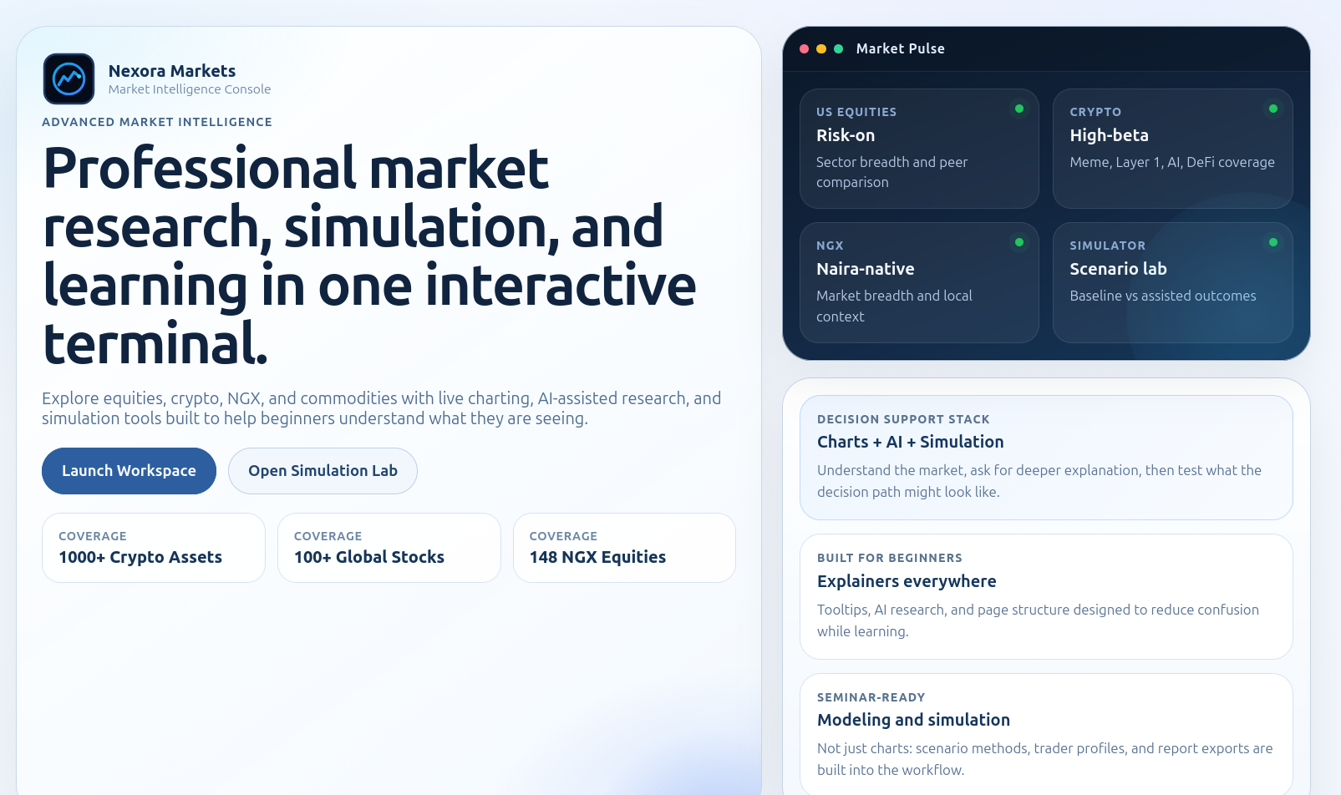
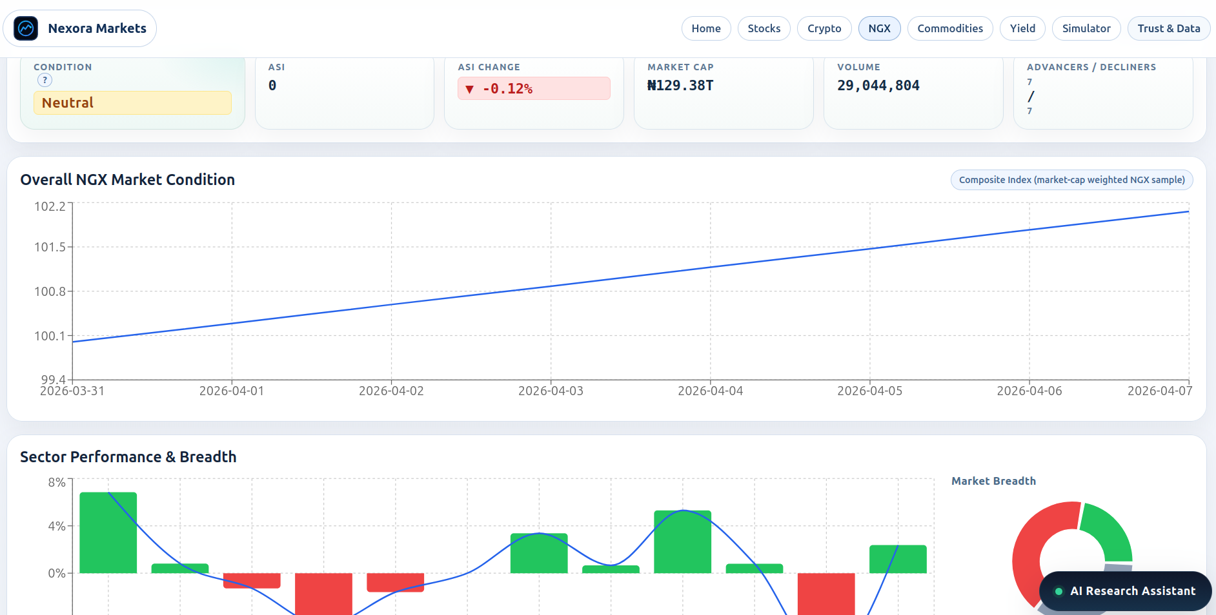
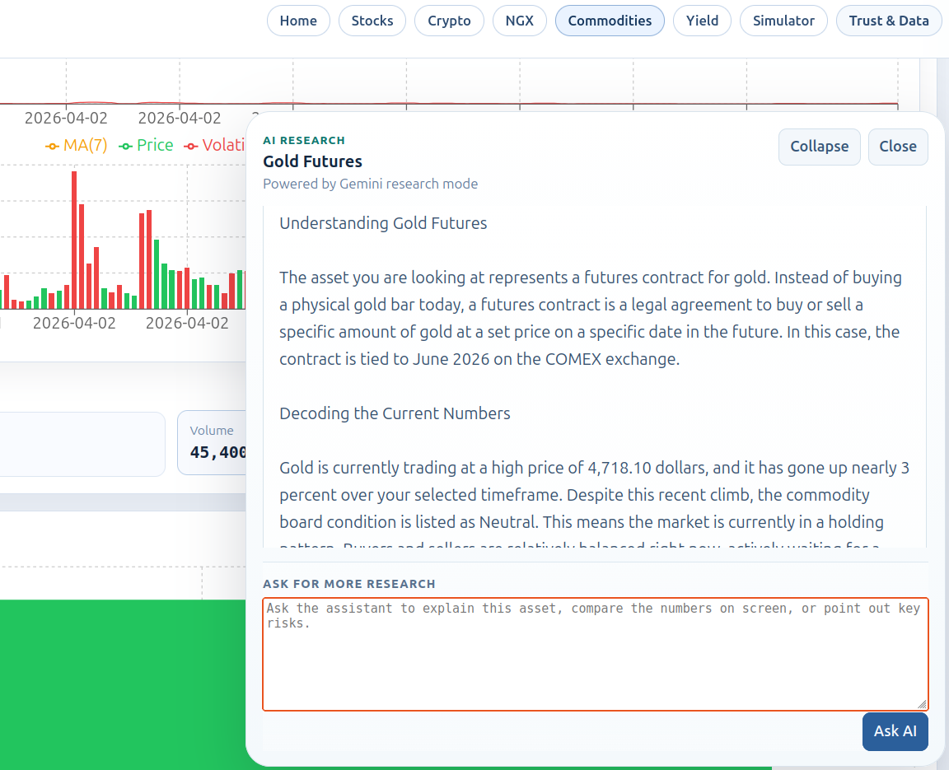
Response
How The Tool Responds To Those Problems
Response 1
Response 2
Response 3
One place to start and navigate
NGX-focused local workflow
AI explains what the user is seeing
The tool responds through centralization, local context, and in-flow explanation.
4

Slide 5
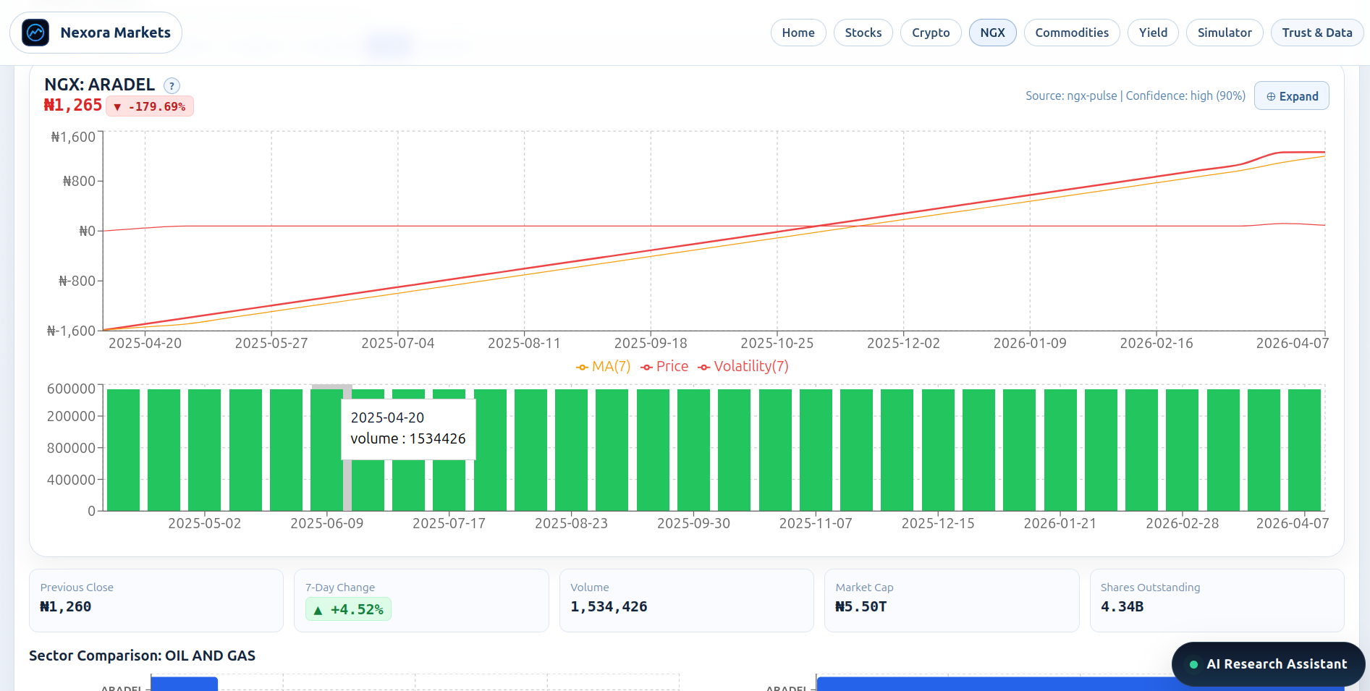
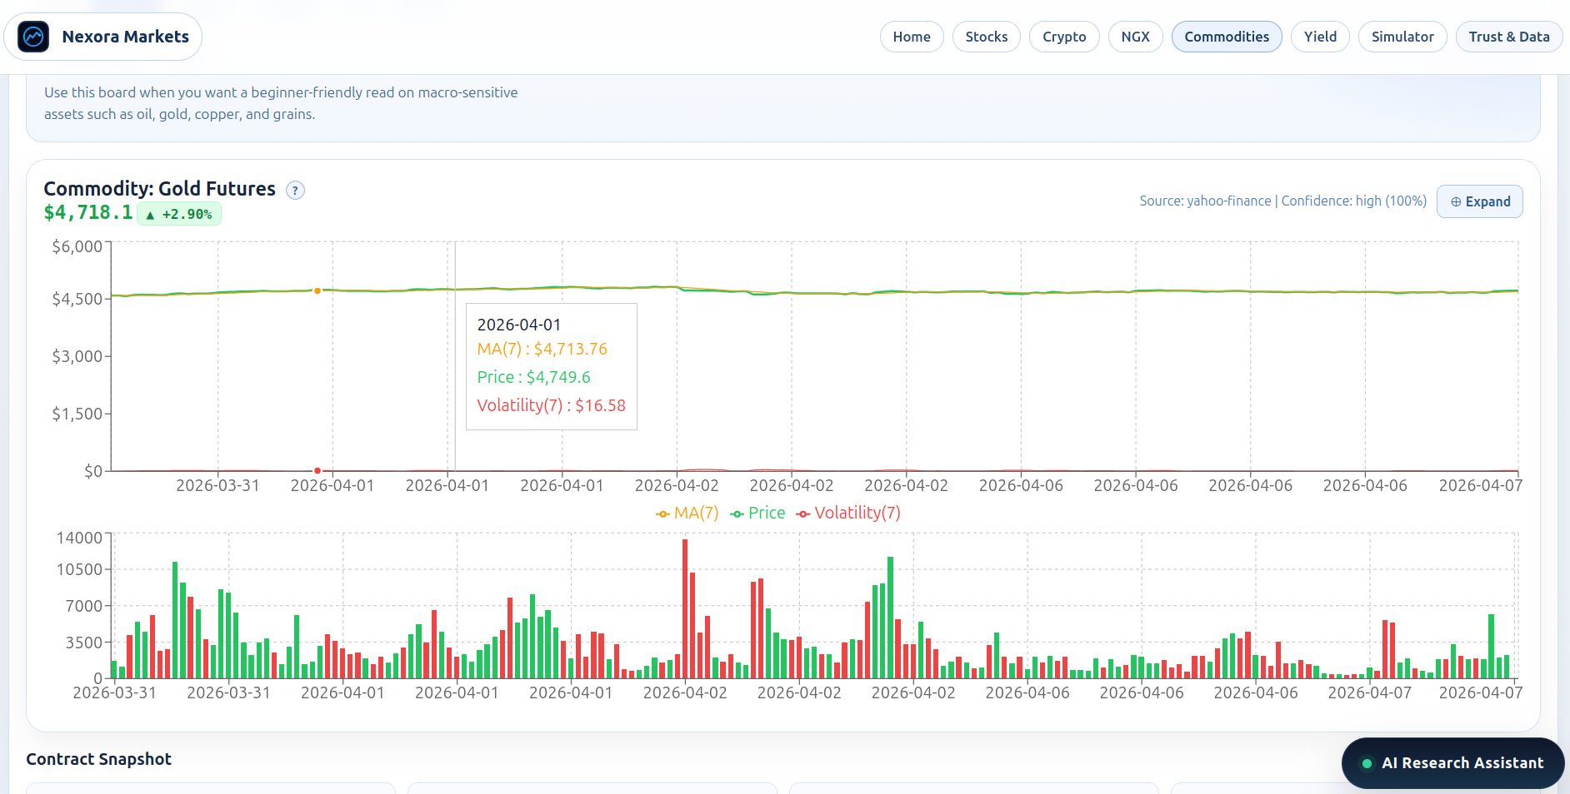
Product Depth
What Was Actually Built
Analysis Workspace
Research Context
Multi-asset analysis workspace
Broader market and news context
These additional screens show the product has depth beyond one page.
5

Slide 6
Nigeria Lens
Why This Matters In Nigeria
Many beginners rely on scattered online commentary when formal market interpretation is weak.
Social-media and rumor-driven information can be fast, but it is often incomplete or noisy.
A clearer NGX-first platform may reduce confusion and support more careful learning.
Local Need
The platform is designed to reduce confusion, restore local context, and make Nigerian market analysis easier to understand.
6

Slide 7
Workflow
How A User Moves Through The Tool
1
2
3
4
5
Choose an asset
Read charts and market context
Review page-related news
Ask AI for clarification
Compare baseline vs assisted outcomes
7

Slide 8
Architecture
What We Built
React Frontend
NGX & Market Views
AI Explanation
Simulation Engine
Built as one connected system so analysis, explanation, and evaluation stay together.
8

Slide 9
Method
How It Was Built And Evaluated
Implementation
Evaluation
React + Vite frontend
Express backend
Recharts for chart visualization
Yahoo Finance, CoinGecko, NGX Pulse APIs
Design-science / software engineering
Case-based observation of workflows
Simulation-based comparison of effect
No nationwide field study claim
9

Slide 10
Problem Mapping
How Our Tool Tackles Each Problem
Scattered information -> one workflow connects charts, context, news, and simulation.
Weak NGX support -> the NGX workspace adds naira-native local analysis.
Poor explanation -> AI support helps users understand terms, moves, and risk.
Tool Response
The tool is designed to turn confusion into clearer analysis, local meaning, and better modeled decision support.
10

Slide 11
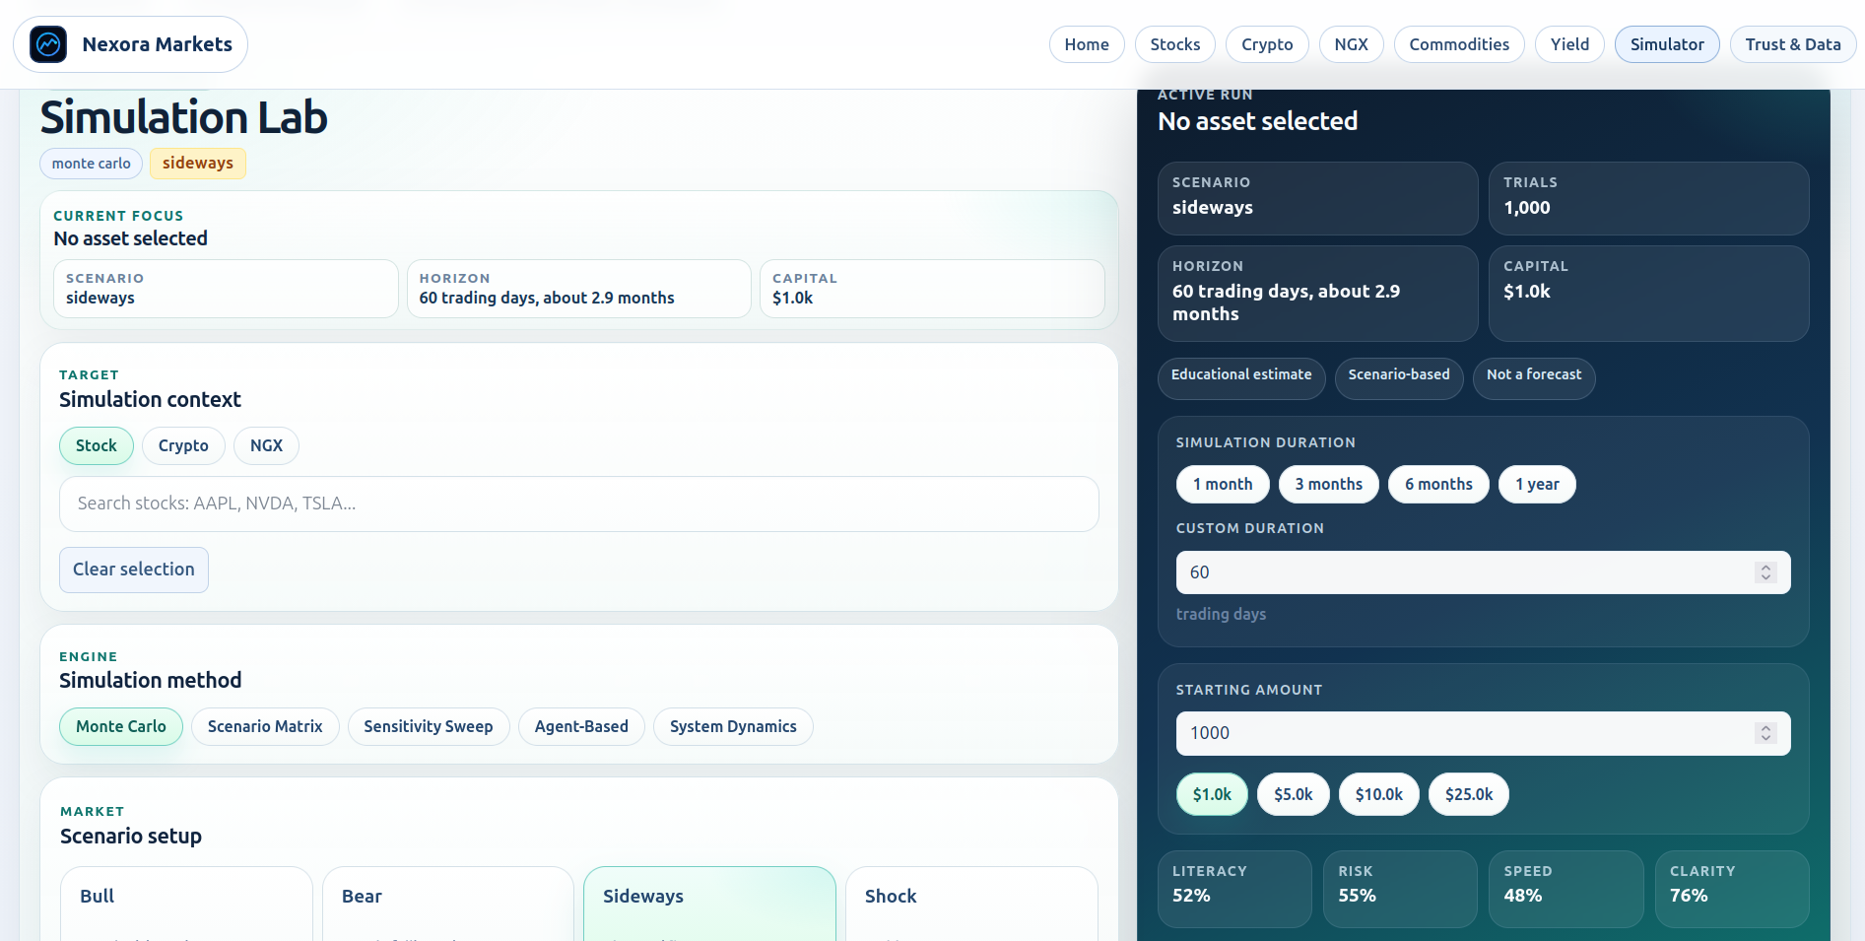
Measured Effect
Simulation In Action
Simulation Result
Measured Example
Bull scenario | 400 trials | seed 2026
Accuracy: 56.1% -> 70.3%
Latency: 7.70 -> 6.00
Risk: 0.540 -> 0.420 | Return: 0.065 -> 0.182
Baseline vs visualizer-assisted simulation output
11

Slide 12
Findings
Tangible Outcomes
The system successfully centralizes charts, context, explanation, and simulation in one workflow.
The NGX workspace addresses a real local-market support gap for Nigerian users.
AI support reduces the need to leave the page for basic interpretation.
Simulation suggests assisted users perform better on the same modeled path.
Takeaway: the strongest visible effects are clarity, continuity, local relevance, and improved modeled decision quality.
12

Slide 13
Limits
Study Boundaries
Not a Brokerage
Not a Forecast Engine
Not a Field Study
The platform does not execute trades or give direct investment instructions.
The simulator models decision behavior; it does not predict future NGX prices.
The effect on Nigerians is inferred from the system and model, not directly measured nationally.
13

Slide 14
Conclusion
Main Contribution
Bottom Line
A technically complete and academically cautious platform that tackles real Nigerian beginner-investor problems through NGX-first visualization, explanation, and simulation.
Most defensible claim: the tool addresses real analysis struggles and may improve how Nigerian-oriented beginners understand market information.
Present the effect as likely and modeled, not as nationally proven.
14

Slide 15
Close
Recommendations
Test the tool with Nigerian students and beginner investors.
Measure confusion, confidence, and interpretation quality directly.
Strengthen NGX educational support and continue simulation validation.
Thank you
Questions
and discussion
15

