Slide 1

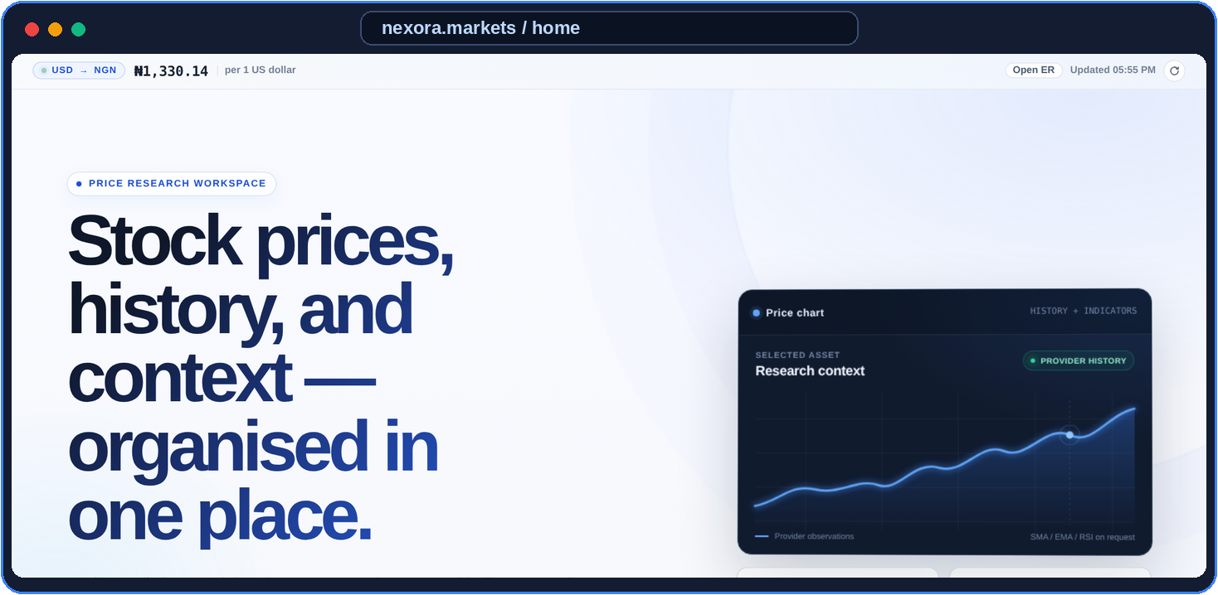
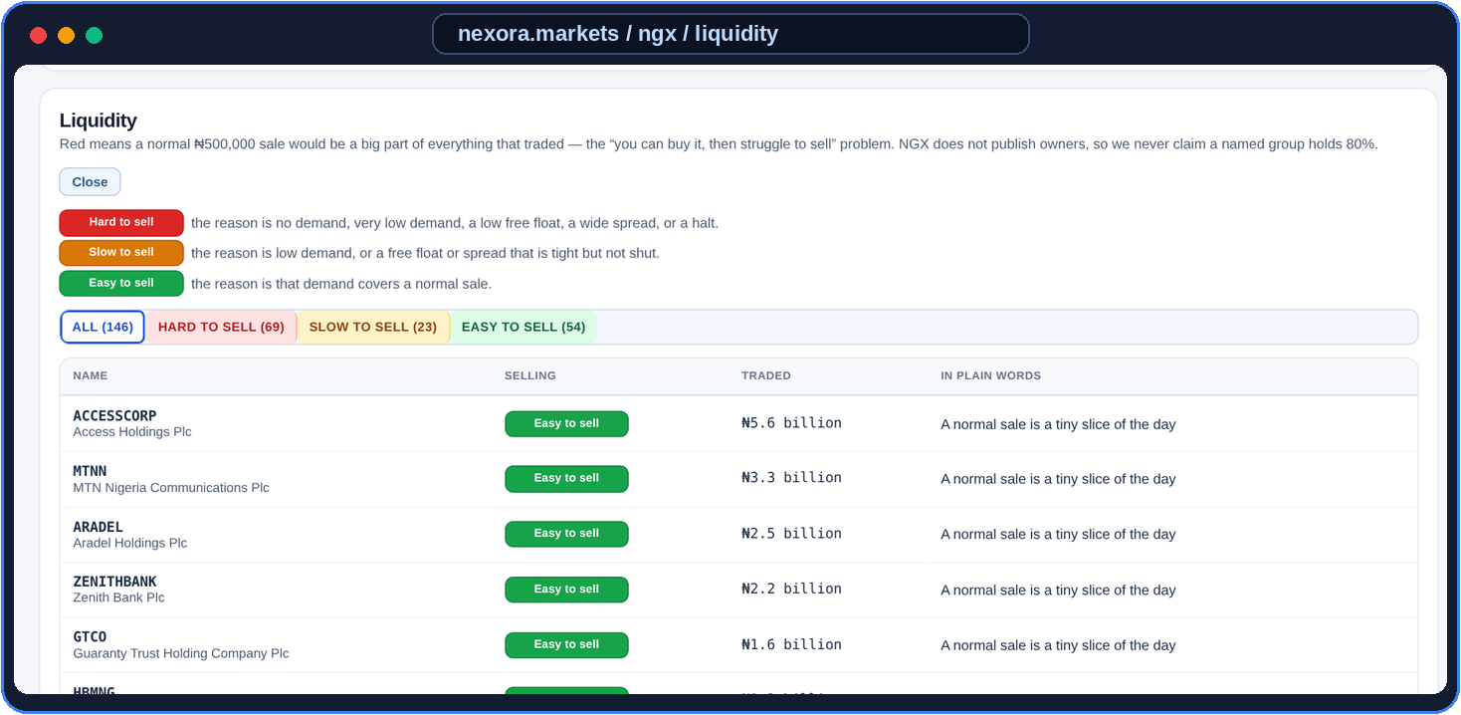
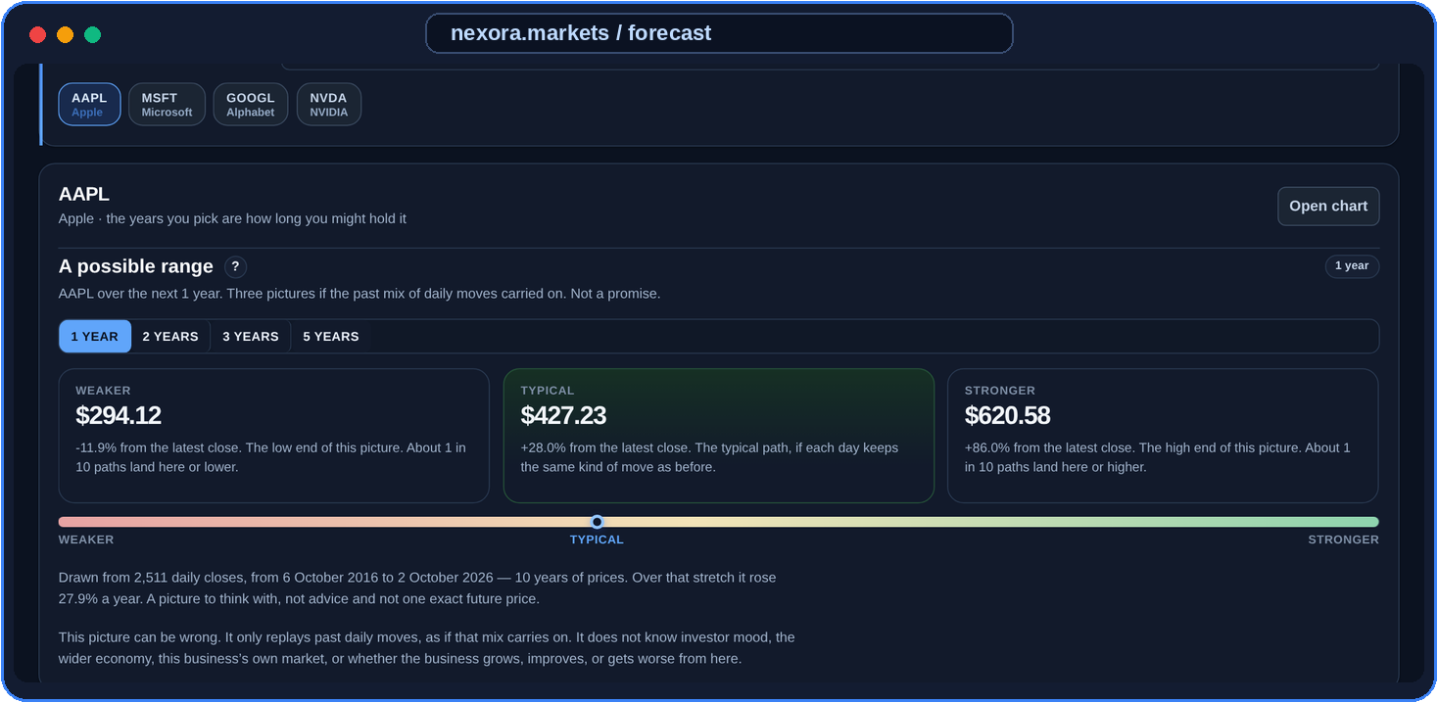
LIVE HOME
NEXORA MARKETS
B.SC. COMPUTER SCIENCE DEFENCE · LEGACY UNIVERSITY OKIJA
The Effect of a Market Visualizer on Nigerian Investors
Design, Implementation, and Simulation-Based Evaluation
Onwurah Ebube Michael
Matriculation No: 2022/CSC/018
Supervisor: Dr Nwachukwu Nwosu
October 2026
NGX LIQUIDITY (₦)
1–5 YEAR RANGE
NGX IN NAIRA (₦)
US STOCKS
57 TESTS PASSED
Notes:
Introduce yourself, Nexora Markets, your title, and Dr Nwachukwu Nwosu. The three screens on the right are the real app: Home, the NGX liquidity board, and the Forecast range.

Slide 2

OUTLINE
N
NEXORA MARKETS
Presentation roadmap
01
02
03
04
05
The Problem
Why beginners misread share prices and get stuck in thin stocks
The Goal
One platform for NGX (in Naira) and US stocks side by side
The System
Six modules built in three layers with React and Node.js
Live Proof
Unusual-day alerts, 1–5 year price ranges and liquidity warnings
Conclusion
57 automated tests, honest limits and future work
Slide 3
Slide 4
Slides 5–6
Slides 7–11
Slides 12–15
NEXORA MARKETS · Onwurah Ebube Michael (2022/CSC/018) · Legacy University Okija
2 / 15
Notes:
Walk the panel through the five stages of the defence.

Slide 3
PROBLEM
N
NEXORA MARKETS
Six real traps facing Nigerian beginners
1
Scattered sources
NGX prices, US stocks, news and FX rates sit on different sites.
2
Foreign-first tools
Popular apps are built in dollars and ignore NGX realities.
3
Unexplained charts
Beginners see moving lines with no plain-English guidance.
4
Share price vs size
Thinking a ₦10 stock is cheaper than a ₦1,000 one, ignoring company size.
5
The liquidity trap
Buying a quiet NGX stock easily, then getting stuck when selling.
6
Single-price hype
Social media sells one target price instead of an honest range.
NEXORA MARKETS · Onwurah Ebube Michael (2022/CSC/018) · Legacy University Okija
3 / 15
Notes:
Emphasise #4 (share price vs company size) and #5 (liquidity trap — buying a stock you cannot easily sell).

Slide 4
AIM & OBJECTIVES
N
NEXORA MARKETS
What Nexora Markets set out to achieve
Build one web platform that helps Nigerian beginners read NGX (in Naira) and US stocks clearly — checked with price-range modelling and 57 automated tests.
MAIN AIM
1
Unify NGX & US stocks
Nigerian shares in Naira beside US stocks and USD/NGN.
2
Flag unusual days
3-Sigma rule plus Machine Learning on every chart.
3
Warn before you get stuck
Tag stocks Easy, Slow or Hard to sell from volume.
4
Show an honest range
Weaker, Typical and Stronger paths over 1–5 years.
5
Teach inside the app
Explain company size (market cap) vs share price.
6
Private watchlists
Secure sign-in so each user saves their own stocks.
NEXORA MARKETS · Onwurah Ebube Michael (2022/CSC/018) · Legacy University Okija
4 / 15
Notes:
Stress that the goal is decision support and education — not a brokerage app that takes people's money.

Slide 5

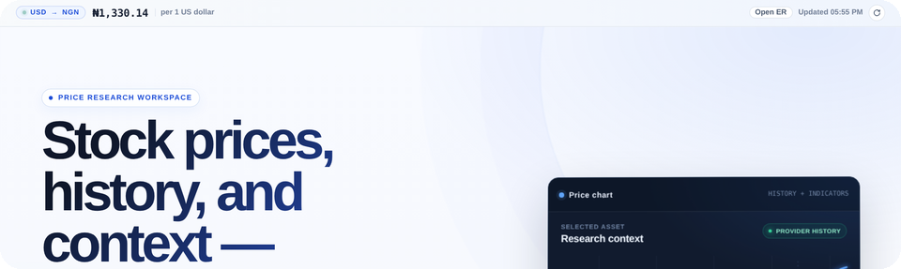
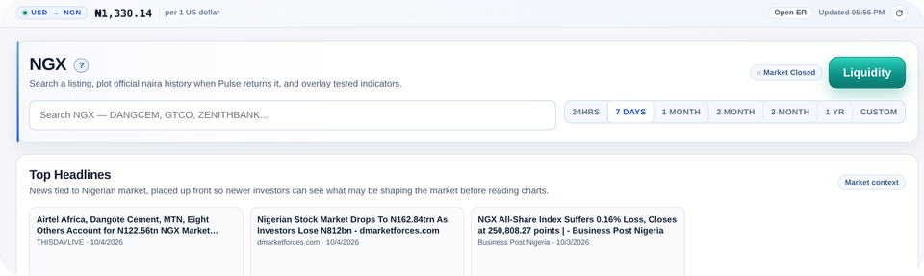
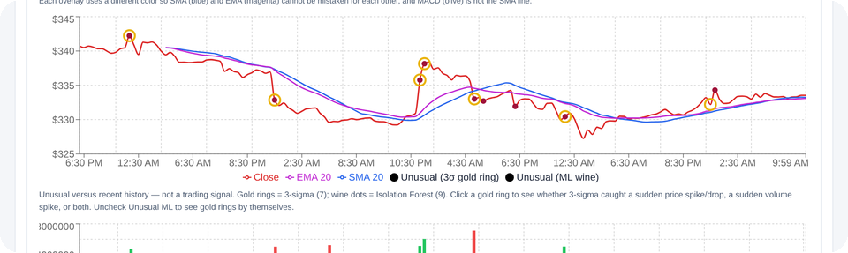
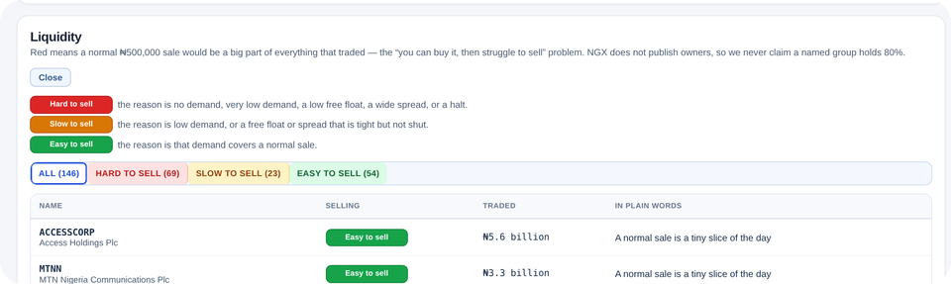
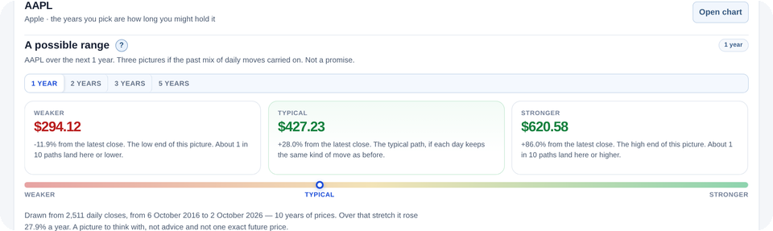
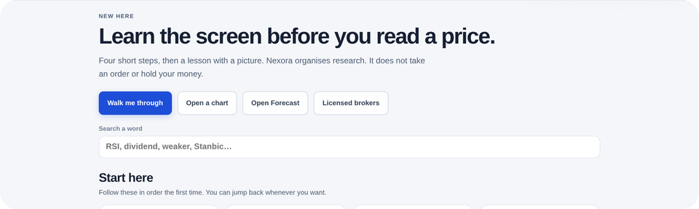
SYSTEM
N
NEXORA MARKETS
Six modules inside Nexora Markets
1
2
3
Home
Live USD/NGN rate, market overview and a guided tour.
NGX (Nigeria)
Nigerian shares in Naira, All-Share Index, company pages.
US Stocks
Charts with unusual-day alerts and side-by-side compare.
4
5
6
Liquidity Board
Ranks listings Easy, Slow or Hard to sell.
Forecast
1, 2, 3 and 5-year Weaker / Typical / Stronger range.
Learn & Watchlist
Plain lessons on company size, plus saved stocks.
NEXORA MARKETS · Onwurah Ebube Michael (2022/CSC/018) · Legacy University Okija
5 / 15
Notes:
Briefly name the six modules — each card shows the real screen — before the architecture and live demos.

Slide 6
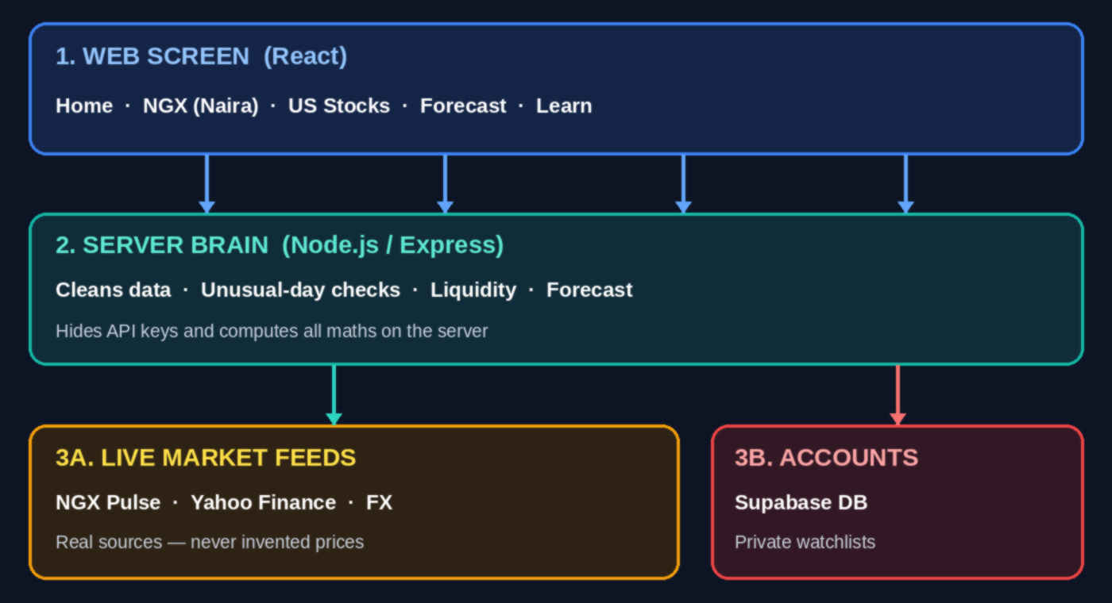
ARCHITECTURE
N
NEXORA MARKETS
How Nexora Markets is built (3-tier design)
1
Server does all maths; browser only draws
2
Live data: NGX Pulse, Yahoo Finance & FX
3
Refuses to invent missing prices or history
4
Each user only sees their own watchlist
5
API keys stay hidden on the server
NEXORA MARKETS · Onwurah Ebube Michael (2022/CSC/018) · Legacy University Okija
6 / 15
Notes:
Explain simply: React in the browser, Node/Express on the server doing the calculations, and Supabase for private watchlists.

Slide 7
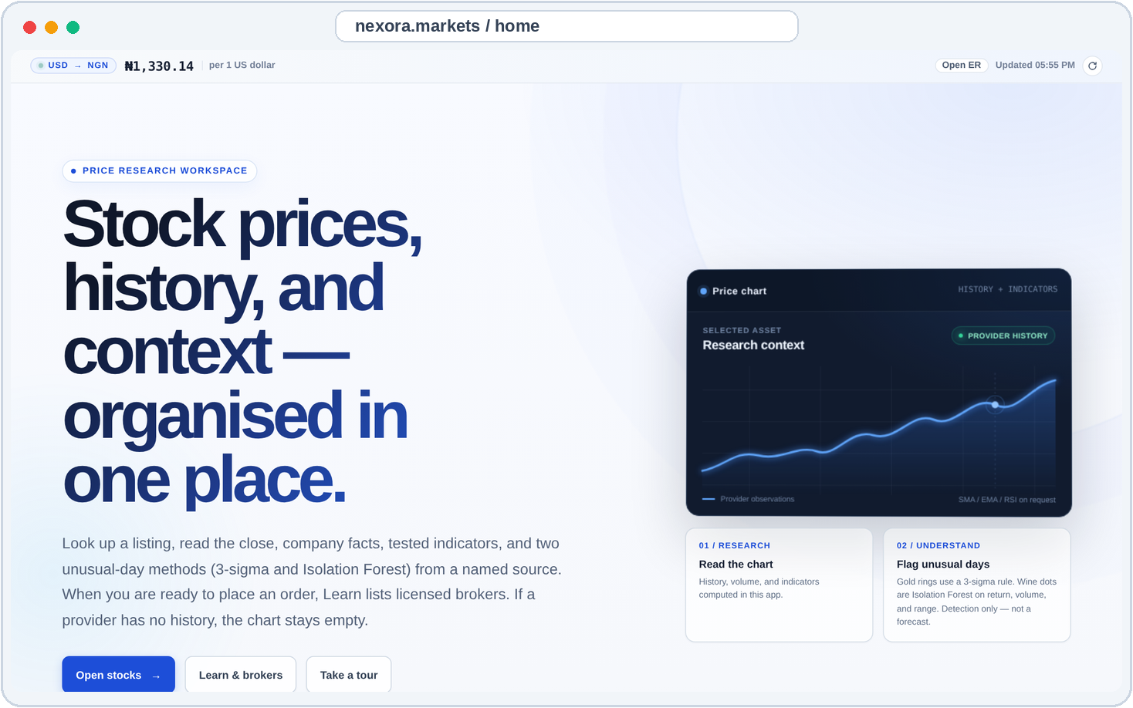
LIVE DEMO 1
N
NEXORA MARKETS
Nexora Markets: NGX, US stocks & Naira rate
NGX & US stocks + Learn in one top menu
1
Live Dollar-to-Naira (₦) rate always visible
2
Guided tour walks a beginner through the page
3
Purely educational — no 'Buy' button traps
4
NEXORA MARKETS · Onwurah Ebube Michael (2022/CSC/018) · Legacy University Okija
7 / 15
Notes:
Point to the top menu and the live USD/NGN bar.

Slide 8
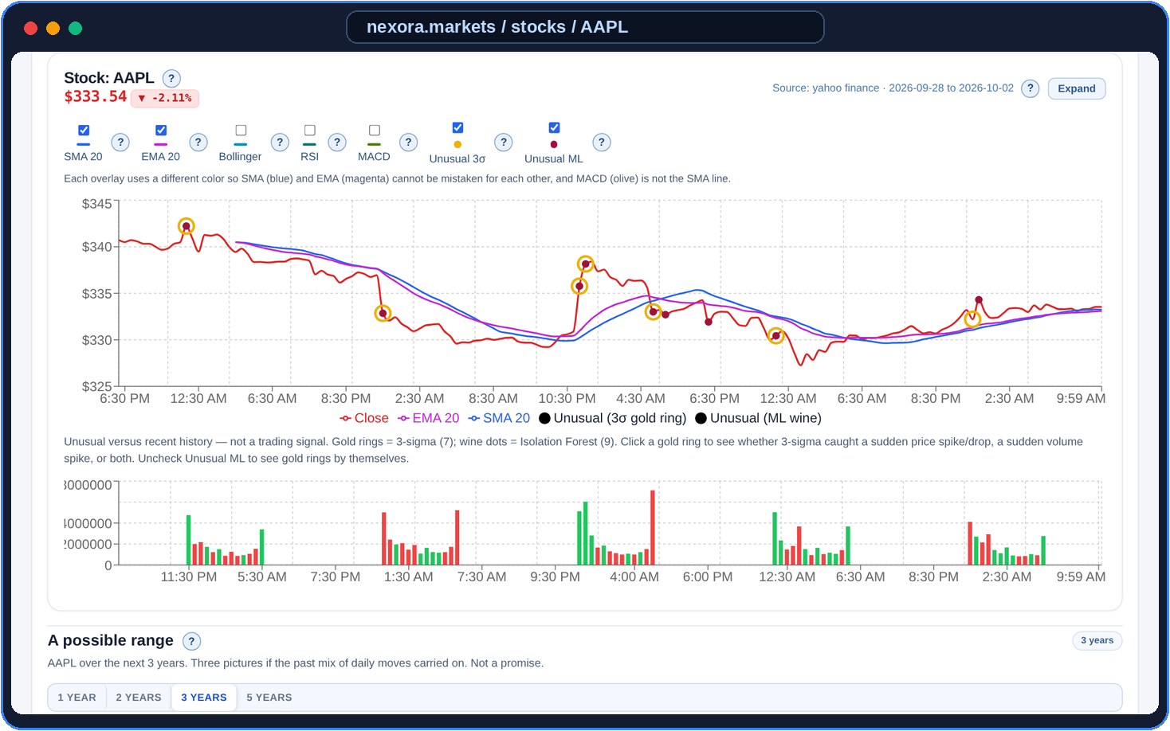
LIVE DEMO 2
N
NEXORA MARKETS
Spotting unusual days on a real chart
Gold ring = 3-Sigma statistical spike
1
Wine dot = Isolation Forest ML detection
2
Clicking any marker explains why it was flagged
3
Alerts the user to investigate — not a trade tip
4
NEXORA MARKETS · Onwurah Ebube Michael (2022/CSC/018) · Legacy University Okija
8 / 15
Notes:
Point to the gold rings and wine dots on the Apple chart.

Slide 9
METHODS
N
NEXORA MARKETS
How the system spots an unusual trading day
1. 3-Sigma Rule (Gold Ring)
2. Isolation Forest (Wine Dot)
Traditional statistical check
Machine-learning anomaly detector
Flags if today's move is 3× larger than normal
Checks price move, volume & high-low spread
Also flags sudden spikes in trading volume
Spots unusual combinations a single rule misses
Simple formula any examiner can check by hand
Flags only the most abnormal 5% of trading days
Warning to read the news — NOT a buy/sell tip
When Gold and Wine agree, that day stands out
NEXORA MARKETS · Onwurah Ebube Michael (2022/CSC/018) · Legacy University Okija
9 / 15
Notes:
Explain why there are two methods: Gold is the textbook statistics rule; Wine is Machine Learning checking several features at once.

Slide 10
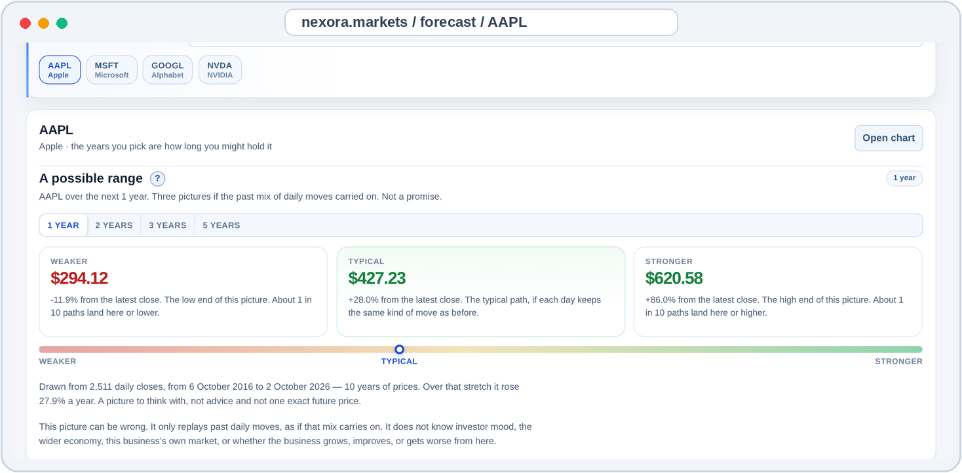
LIVE DEMO 3
N
NEXORA MARKETS
1–5 Year price range: Weaker, Typical & Stronger
Built from 2,511 real daily closes (10 years)
1
Weaker ($294) · Typical ($427) · Stronger ($621)
2
Range widens over 3–5 years as uncertainty grows
3
Clear warning: replays past moves, not a promise
4
NEXORA MARKETS · Onwurah Ebube Michael (2022/CSC/018) · Legacy University Okija
10 / 15
Notes:
Read the three cards clearly: Weaker, Typical, Stronger.

Slide 11
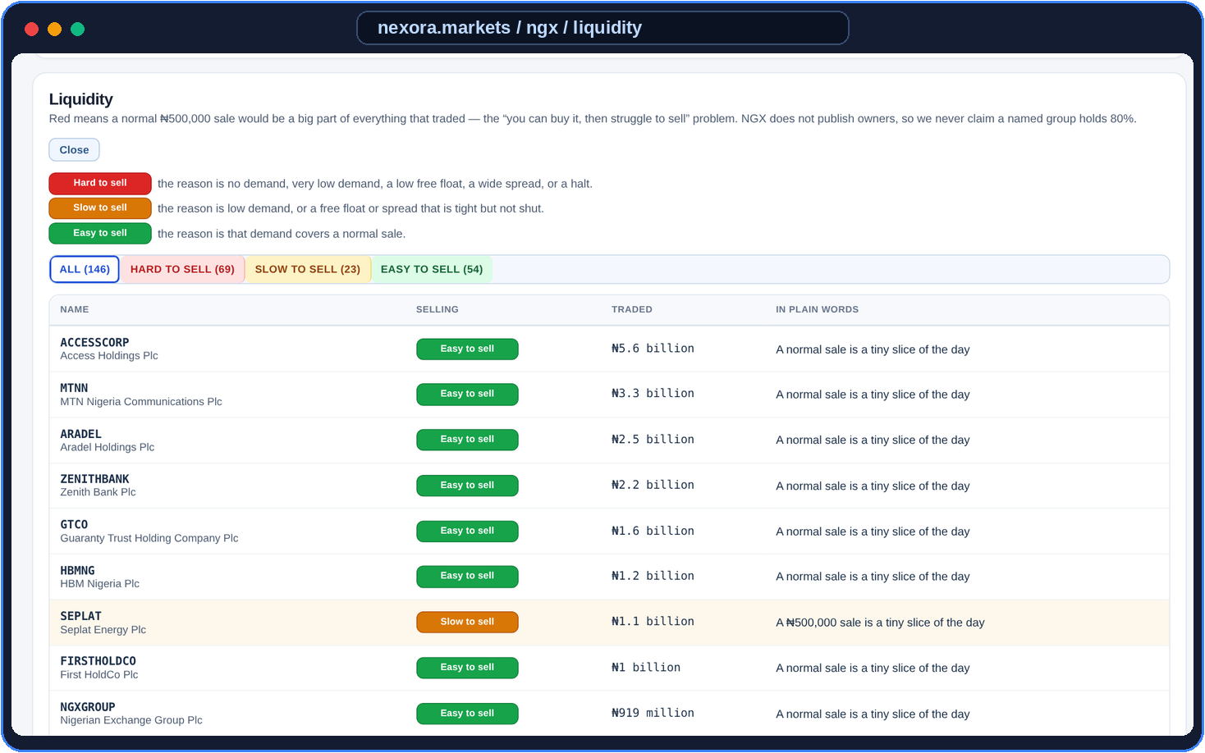
LIVE DEMO 4
N
NEXORA MARKETS
NGX Liquidity Board — avoiding the exit trap
Tests if a normal ₦500,000 sale can exit easily
1
Red = Hard to sell · Amber = Slow · Green = Easy
2
Explains every rating in plain everyday English
3
Missing exchange facts say 'Not stated' — never ₦0
4
NEXORA MARKETS · Onwurah Ebube Michael (2022/CSC/018) · Legacy University Okija
11 / 15
Notes:
Explain the ₦500,000 normal sale test and why Red means you can get stuck.

Slide 12
EVALUATION
N
NEXORA MARKETS
How Nexora Markets was tested and proven
57 Tests
Automated backend checks
2,511 Days
10-year Apple history
2 Detectors
3-Sigma & Isolation Forest
1–5 Years
Simulated price horizons
1-Yr AAPL: $294 (Weaker) · $427 (Typical) · $621 (Stronger)
Simulation = mathematical range from past daily moves
3-Yr range widens ($367 – $1,337) as uncertainty grows
57 unit tests verify every formula before deployment
Short NGX history is rejected honestly — never faked
No human survey claimed — proven via code & live screens
NEXORA MARKETS · Onwurah Ebube Michael (2022/CSC/018) · Legacy University Okija
12 / 15
Notes:
This answers 'Simulation-Based Evaluation': a mathematical price-range model + 57 automated tests + live screens.

Slide 13
LIMITATIONS
N
NEXORA MARKETS
Honest boundaries of this study
1
No human investor survey
Time was limited to one academic session, so evaluation focused on software and mathematical testing.
2
Free NGX data has short history
Free NGX feeds return recent sessions only; the app says 'not enough history' instead of guessing.
3
Past moves do not guarantee the future
The Forecast range replays past daily volatility — it cannot know future news or management changes.
4
Educational tool, not a broker
Nexora Markets does not hold money, execute trades or give personal financial advice.
NEXORA MARKETS · Onwurah Ebube Michael (2022/CSC/018) · Legacy University Okija
13 / 15
Notes:
Examiners respect honesty: state clearly what the system does not claim to do.

Slide 14
CLOSE
N
NEXORA MARKETS
Conclusion and future recommendations
What Nexora Markets Achieved
Recommendations for Future Work
1
Combined NGX (in Naira) & US stocks in one tool
1
Test with a group of Nigerian beginner investors
2
Built Statistical + ML unusual-day alerts
2
Connect paid multi-year NGX historical feeds
3
Created plain-English Liquidity Trap warnings
3
Add Nigerian languages (Igbo, Yoruba, Hausa)
4
Replaced single-price hype with a 1–5yr range
4
Keep refusing to invent missing market data
NEXORA MARKETS · Onwurah Ebube Michael (2022/CSC/018) · Legacy University Okija
14 / 15
Notes:
Summarise your 4 concrete contributions and 4 practical next steps.

Slide 15

NEXORA MARKETS
Thank You
Questions from the panel are welcome.
Onwurah Ebube Michael · 2022/CSC/018 · Supervisor: Dr Nwachukwu Nwosu
Notes:
Thank the panel and wait for questions.

