Slide 2
Content
Introduction
Project Objectives
System Specification
Hardware Design
Implement result
Future improvement
Reference

Slide 3

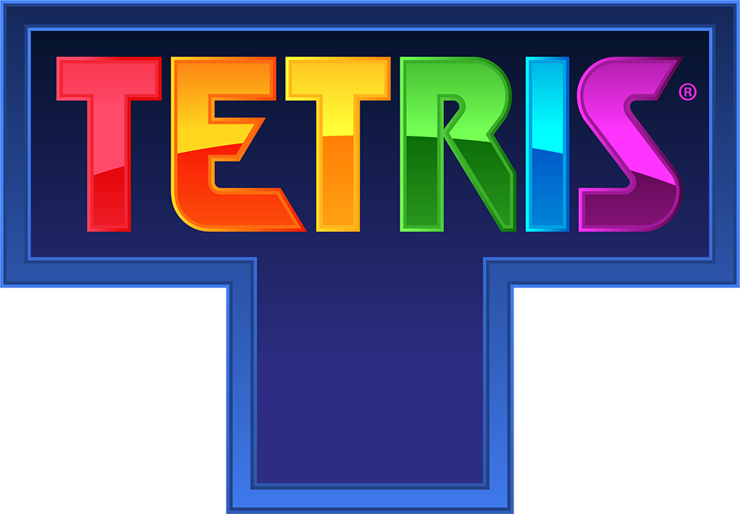
1. Introduction
- Tetris is a classic puzzle game.
- Invented in 1984 by Alexey Pajitnov.
- Popularized worldwide in 1989 on Nintendo Game Boy, became one of the most iconic puzzle games in history.

Slide 4
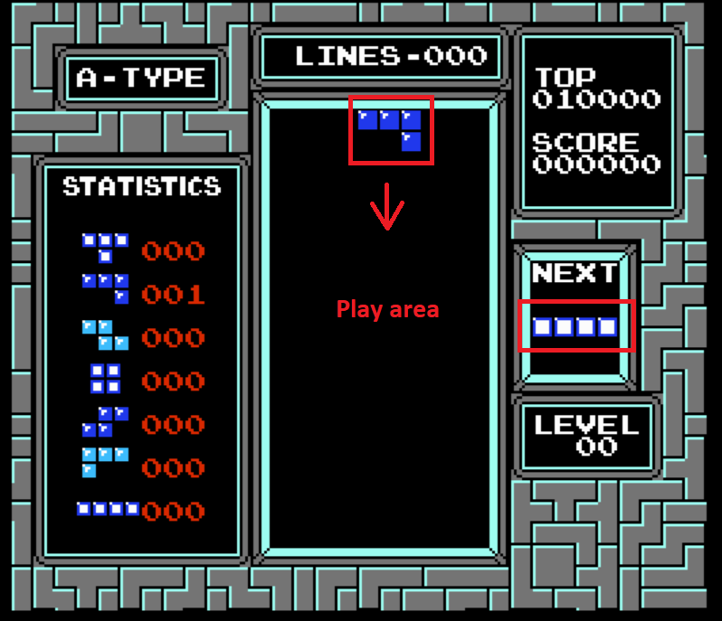
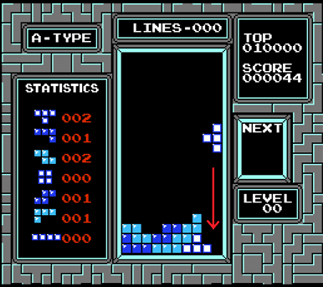
1. Introduction
Player controls falling blocks (Tetrominoes).
Blocks can be moved left, right, or rotated.
Goal: fill horizontal lines without gaps.

Slide 5
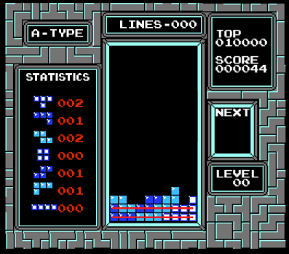
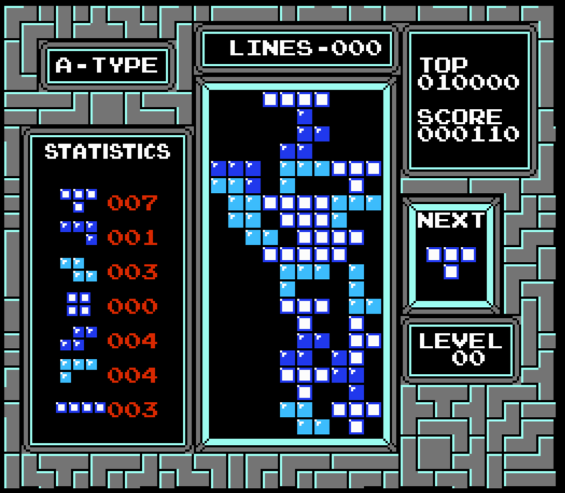
1. Introduction
A full line is cleared → score increases.
Game ends when blocks stack to the top.

Slide 6
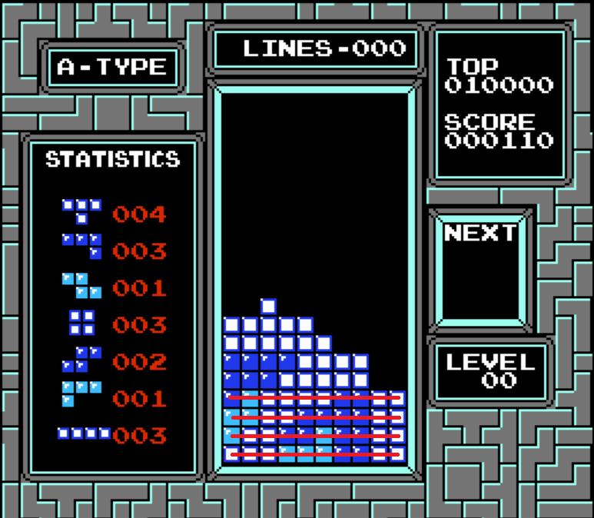
1. Introduction
The more line cleared at the same time the more score you got.

Slide 7
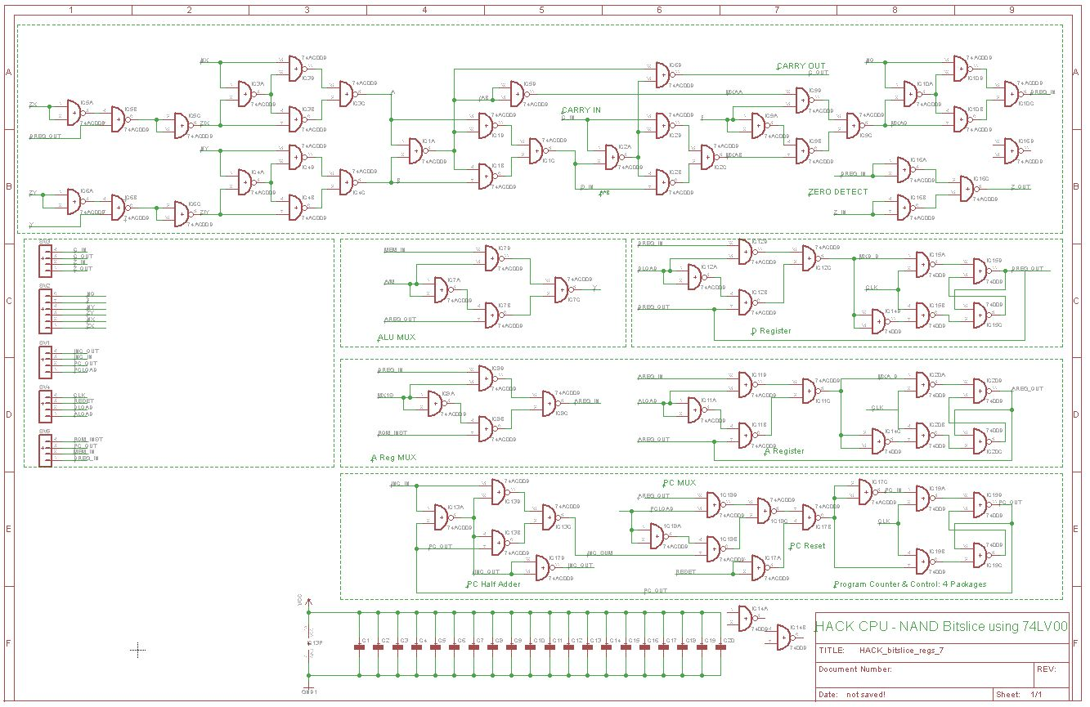

1. Introduction
Simple but challenging: Tetris has clear rules, requires careful design of game logic.
Still alive today with events like the Classic Tetris World Championship (CTWC), attracting international players and streaming audiences.

Slide 8
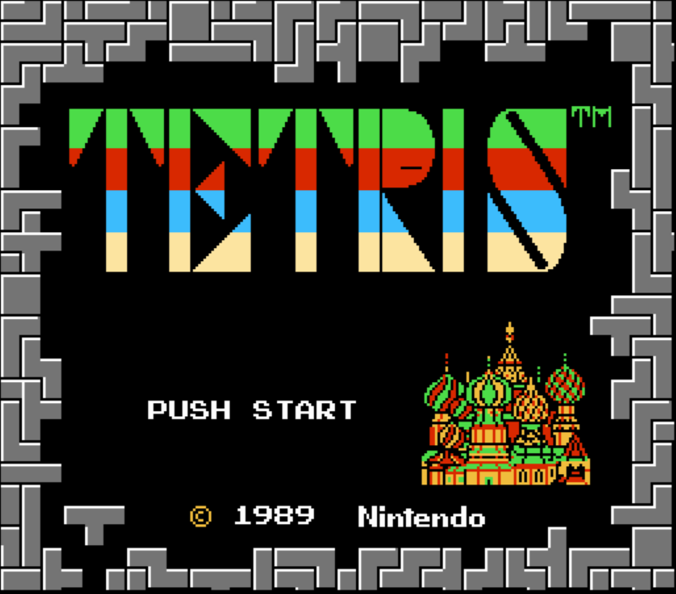
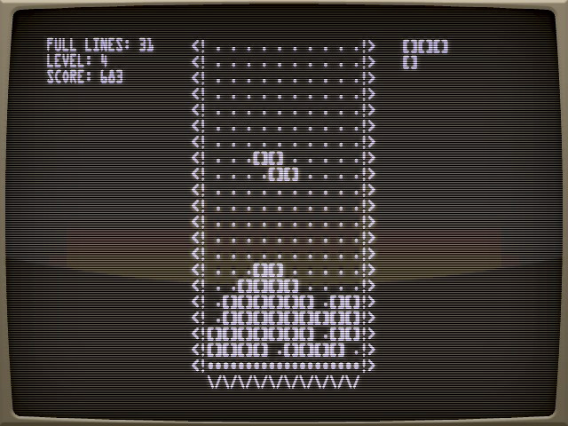
2. Project Objectives
- Implement the classic Tetris game fully on FPGA hardware.
- Design and integrate for VGA display, keyboard input, game logic, and scoring.
- Demonstrate real-time gameplay at 50 MHz with smooth graphics and controls.
- The design can be extended with sound, new features, or more complex graphics.

Slide 9
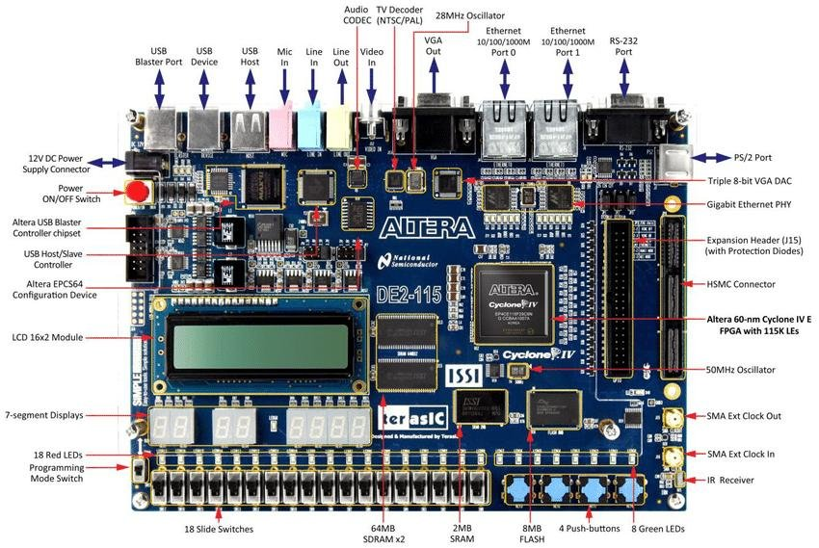
3. System Specification
Target Hardware
FPGA board: Altera DE2-115 (Cyclone IV EP4CE115F29C7)
Base clock: 50 MHz
Display
- VGA output: 640 × 480 resolution @ 60 Hz(8 bits per channel)
- Game grid: 30x32 (8x8 pixel each) cells with 10x20 playable.
Input
- PS/2 keyboard interface
- Controls:Left / Right → move piece, Down → soft drop, Z/X → rotate piece, Enter → start / reset

Slide 10
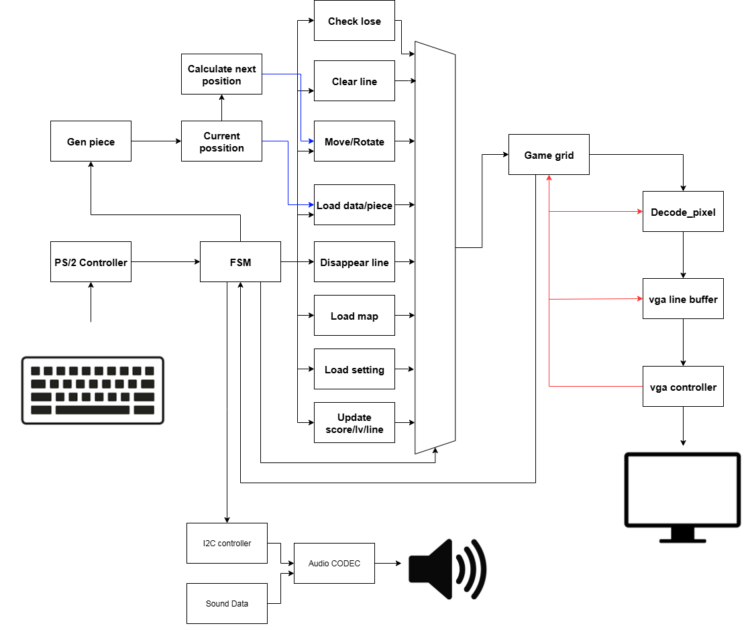
4. Hardware Design

Slide 11
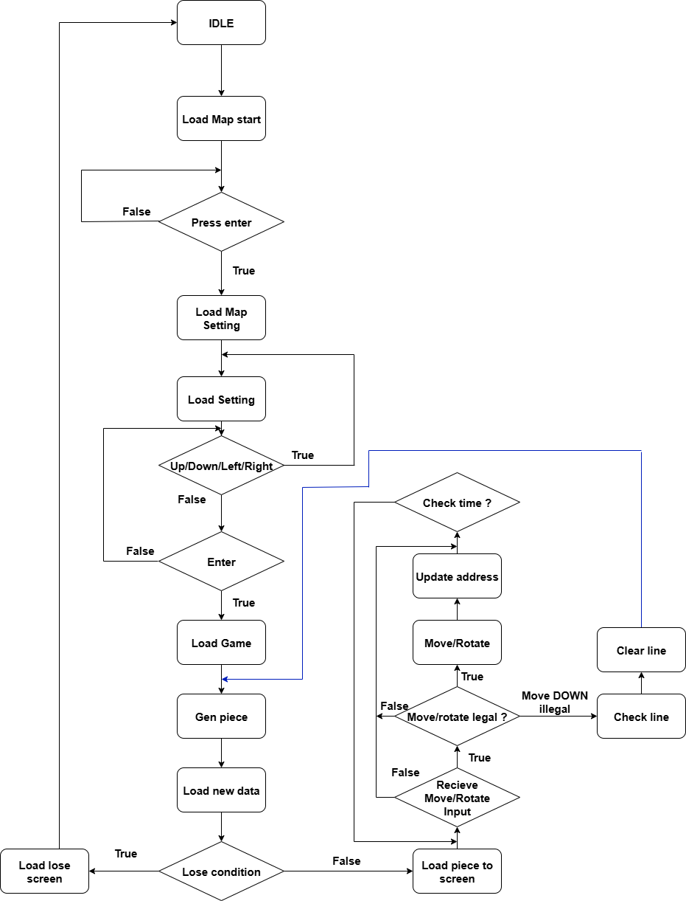
4. Hardware Design
Update score/topscore

Slide 12
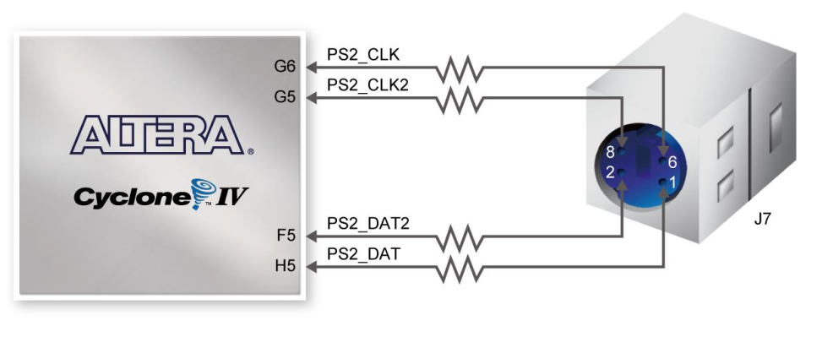
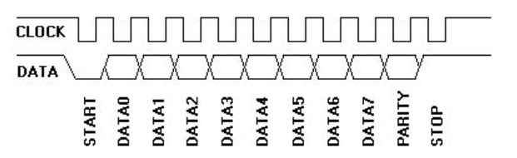
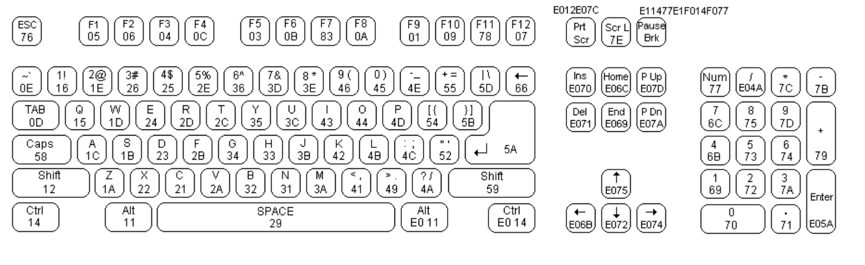
4. Hardware Design
Start bit (1 bit): Always 0 (logic low)
Data bits (8 bits): Sent least significant bit (LSB) first. These represent the scan code from the keyboard.
Parity bit (1 bit): Used for odd parity checking. The total number of logic ‘1’s in the 8 data bits plus the parity bit must be odd.
Stop bit (1 bit): Always 1 (logic high)

Slide 13
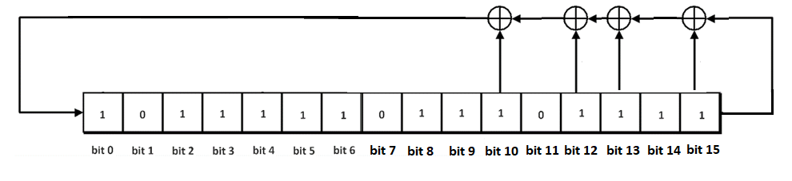
4. Hardware Design
Generate random piece (15,13,12,10 – BEEF)

Slide 14
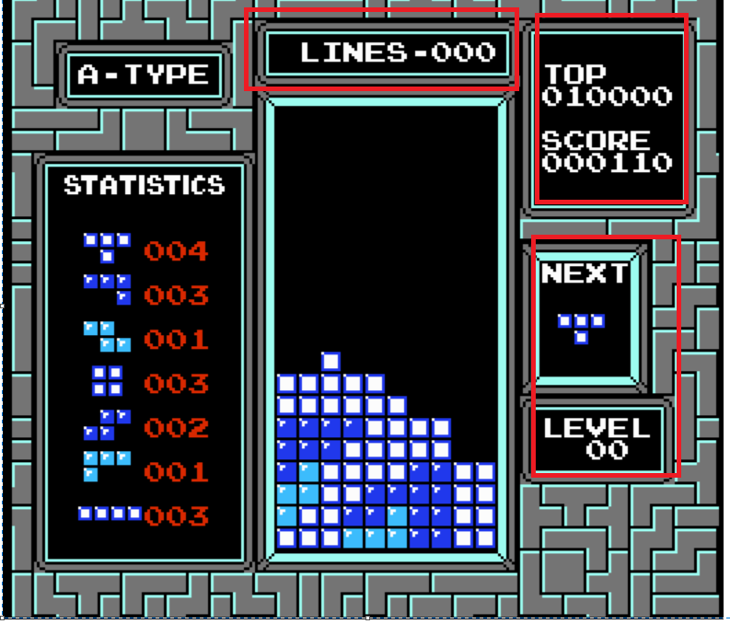
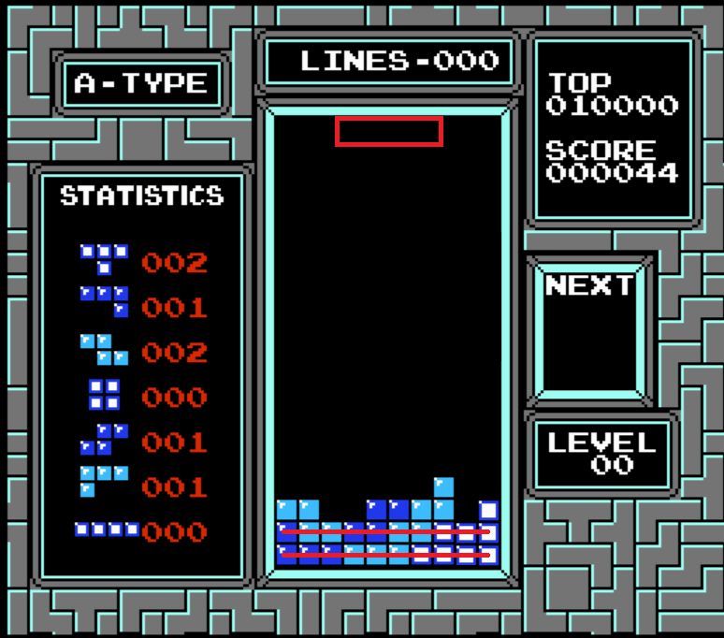
4. Hardware Design
Load data / Lose condition (4 by 1 in the middle)

Slide 15
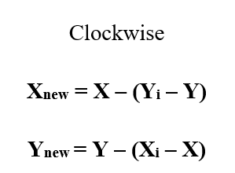
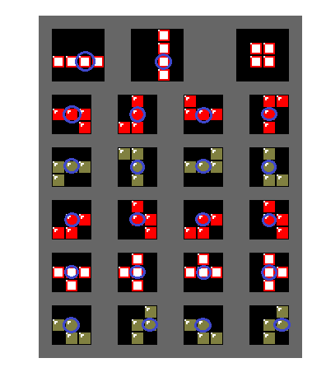
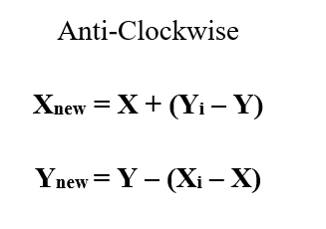
4. Hardware Design
Check rotate
Rotate formula

Slide 16
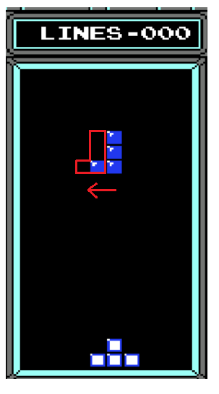
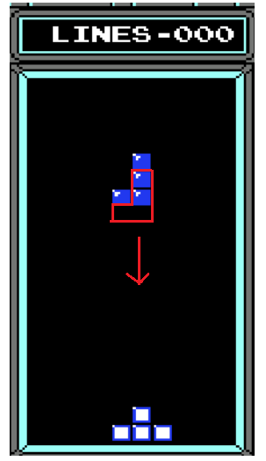
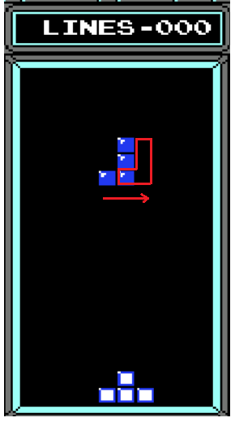
4. Hardware Design
Check illegal move
Left -> -1
Right -> +1
Down -> +32

Slide 17
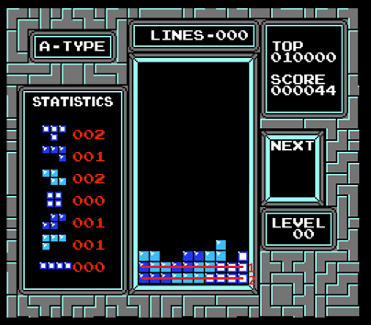
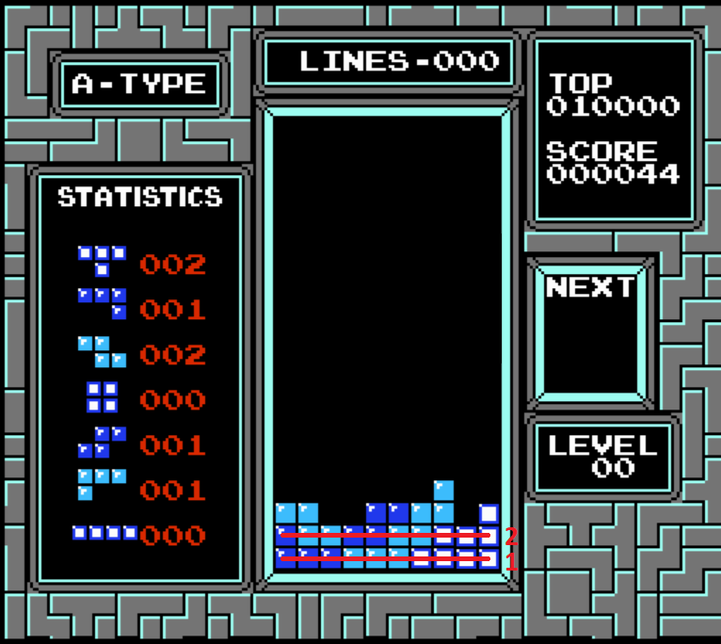
4. Hardware Design
Clear line

Slide 18





4. Hardware Design
Tetris color

Slide 19
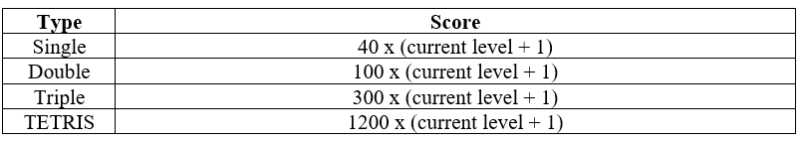
4. Hardware Design
Tetris score

Slide 20
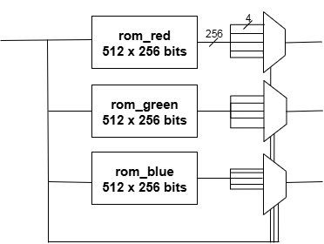
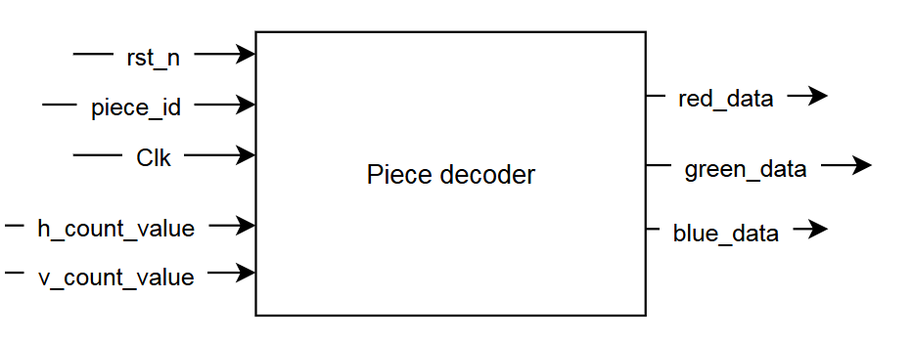
4. Hardware Design
piece_decoder

Slide 21
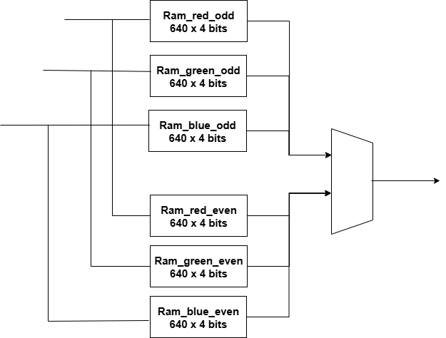
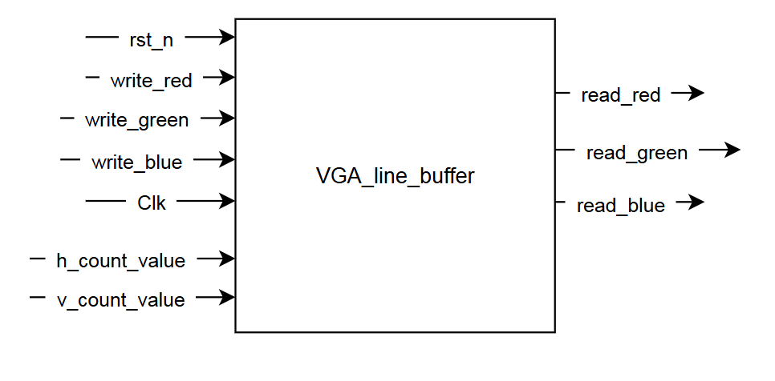
4. Hardware Design
VGA line buffer (Ram 640x8 bits)

Slide 22
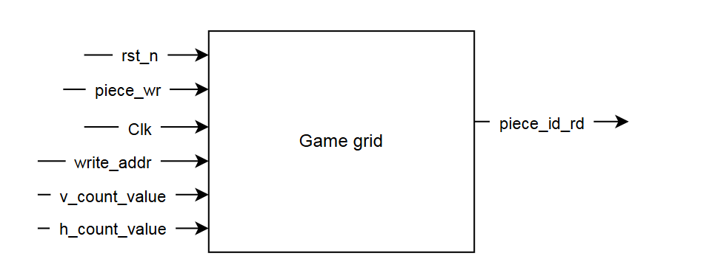
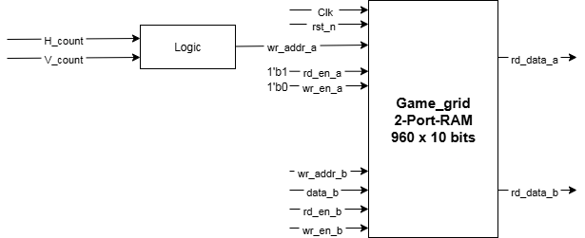
4. Hardware Design
Game grid (Ram 1024x9bits)

Slide 23
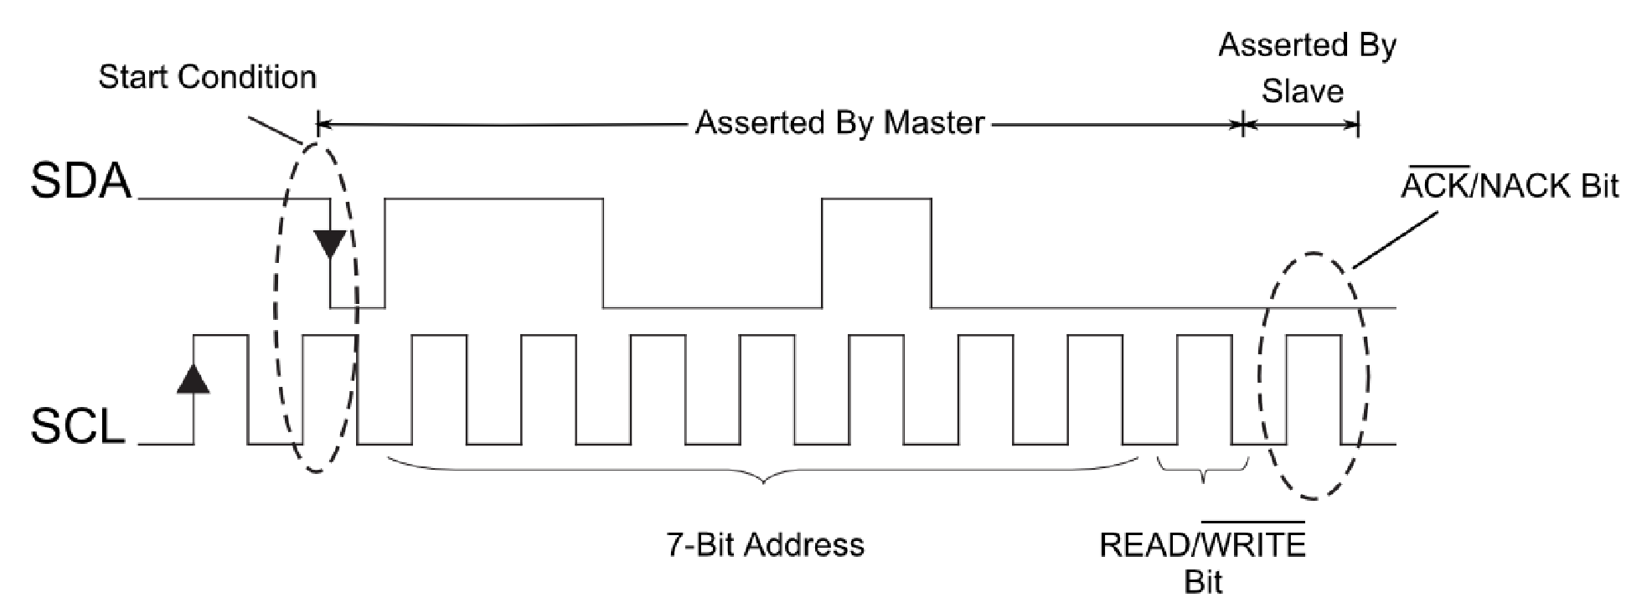
4. Hardware Design
Audio
Using i2c to control the Audio CODEC on DE2 – 115
1201- activate interface 0A00 - Disable soft mute
0460 - left headphone out 102F - sampling control
0C00 - power down control 0660 - right headphone out
0812 - analog audio path control 1E00 - reset device

Slide 24
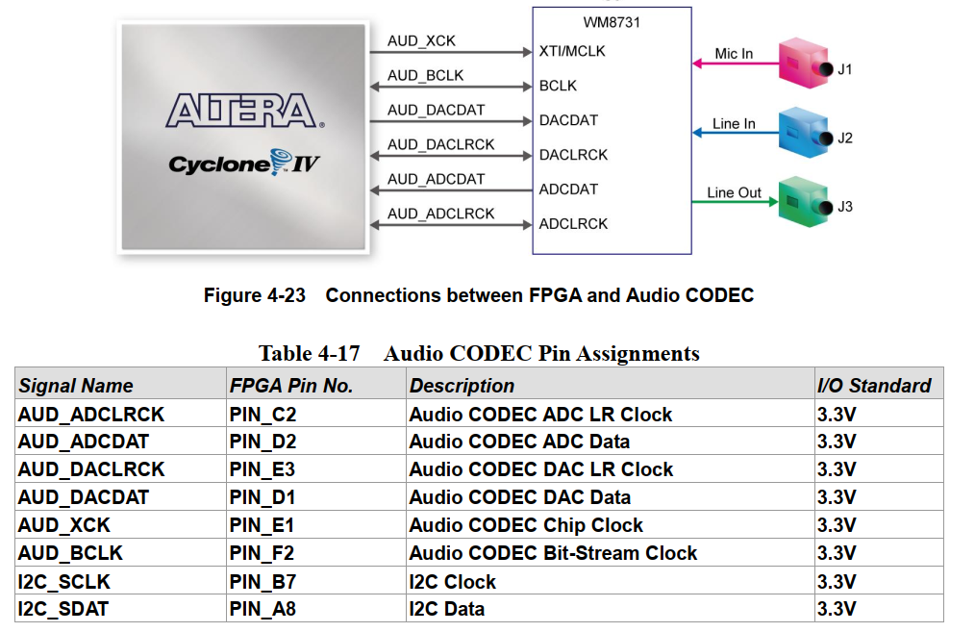
4. Hardware Design
Audio

Slide 25
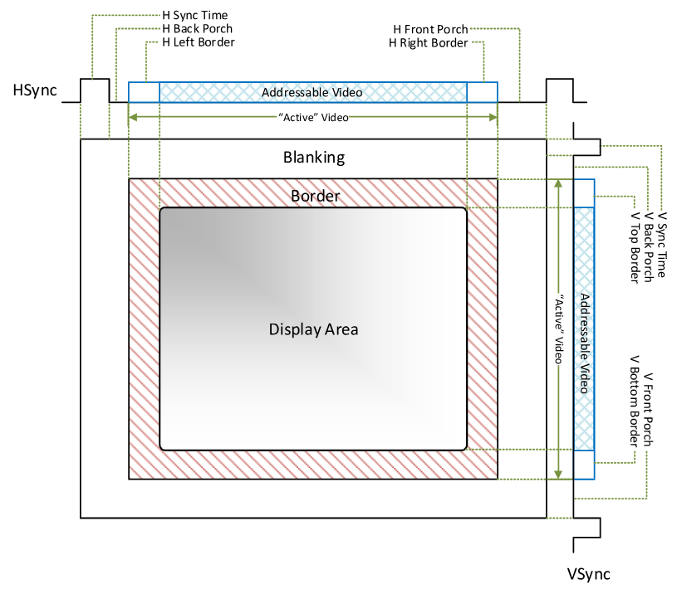
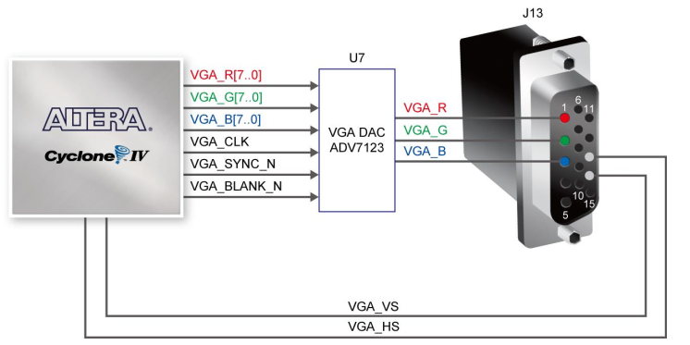
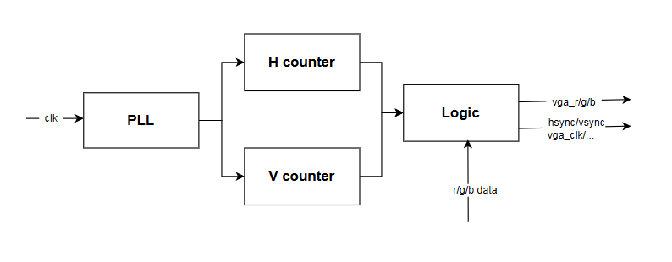
4. Hardware Design
Front Porch: Small interval after visible area, before sync pulse. Acts as a buffer.
Back Porch: Interval after sync pulse, before next visible area. Provides timing margin.
HSYNC: Pulse marking the end of a horizontal line.
VSYNC: Pulse marking the end of a frame.

Slide 26
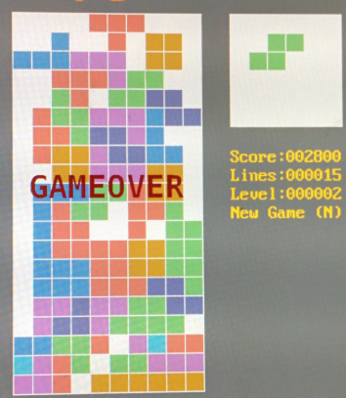
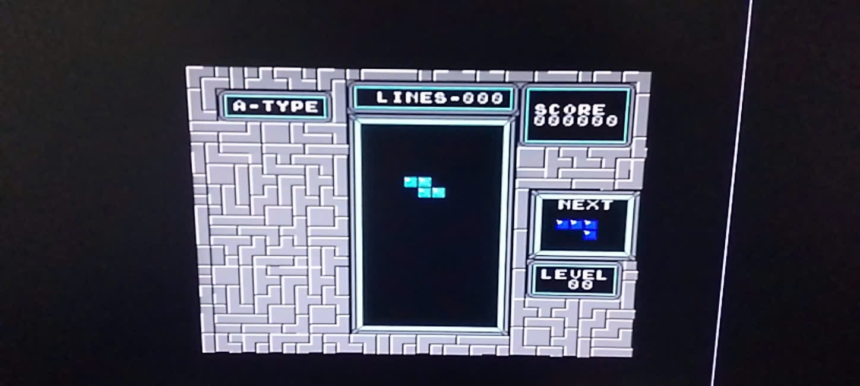
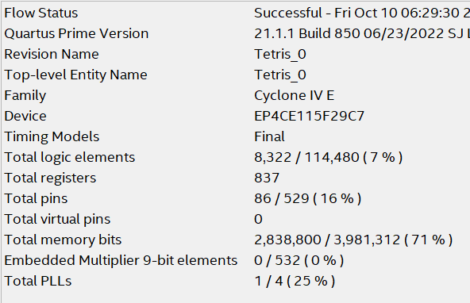
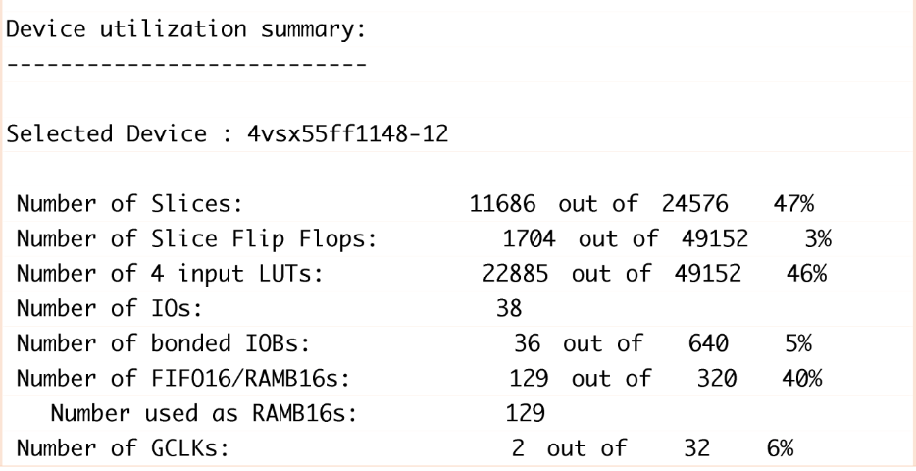
5. Implementation Results

Slide 27
6. Future improvement
Improve visual: To make the FPGA-based Tetris game more engaging, one of the main focuses is to improve the visual experience. Although hardware limitations exist, careful design of VGA output and display elements can significantly enhance gameplay.
PvP/PvE mode: In modern game design, adding multiple gameplay modes helps increase player engagement and replayability. Two popular styles are Player vs Player (PvP) and Player vs Environment (PvE).

Slide 28
Thank you for listening

Slide 29
7. Reference
Tinylic. (n.d.). ASIC-FPGA-Tetris. GitHub repository. Retrieved October 10, 2025, from https://github.com/tinylic/ASIC-FPGA-tetris
Johan92. (n.d.). YaFPGA Tetris. GitHub repository. Retrieved October 10, 2025, from https://github.com/johan92/yafpgatetris
Kerong2002. (n.d.). FPGA Tetris. GitHub repository. Retrieved October 10, 2025, from https://github.com/kerong2002/FPGA_TETRIS
Trenz Electronic. (n.d.). Verilog Tetris. Trenz Electronic Wiki. Retrieved October 10, 2025, from https://wiki.trenz-electronic.de/display/PD/Verilog+Tetris
Nintendo Tetris (NES) – Technical Reference. (n.d.). NES Files Documentation. Retrieved October 10, 2025, from https://www.nesfiles.com/NES/Tetris/Tetris.pdf
Project FPGA. (n.d.). VGA Signal and Timing. Retrieved October 10, 2025, from https://projectfpga.com/vga/
Valcarce, J. (n.d.). VGA Signal Format and Timing Specifications. Retrieved October 10, 2025, from http://javiervalcarce.eu/html/vga-signal-format-timming-specs-en.html
Hard Drop Wiki. (n.d.). Nintendo Rotation System (NRS). Retrieved October 10, 2025, from https://harddrop.com/wiki/Nintendo_Rotation_System
Super Rotation System (SRS). (n.d.). Tetris Wiki. Retrieved October 10, 2025, from https://tetris.fandom.com/wiki/Super_Rotation_System

