Slide 1
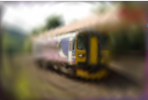
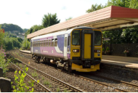
CSF
(SPSA Based Optimization)
GT Answers
Semantic Loss
Predicted Outputs
$∇_{θ}ℒ_{text}$
$y_{gt}$
$y_{pred}$
Inference
Sampled Image
$Î=𝔼_{θ}(I)$
Self and Cross Attention
Bio-inspired
Latent Encoding Layer
Adaptive Sampling
(BASS)
Visual Encoder
Text Encoder
Pixel Budget
$ℒ_{img}$
Möbius
B
Parameters
Perceptual Loss
Frozen VLM
Transformation
Layers
Questions
$<q_{1},q_{2}...q_{n}>$
Forward Pass
Input Image
Backward Pass
MLP Network
I

