Slide 1
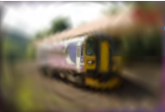
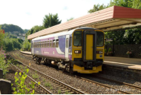
CSF
(SPSA Based Optimization)
GT Answers
Semantic Loss
Predicted Outputs
$∇_{θ}ℒ_{text}$
$y_{gt}$
$y_{pred}$
Inference
Sampled Image
$Î=𝔼_{θ}(I)$
Self and Cross Attention
Latent Encoding Layer
Bio-inspired
Adaptive Sampling
(BASS)
$ℒ_{img}$
Visual Encoder
Text Encoder
Pixel Budget
Möbius
Parameters
B
Frozen VLM
Transformation
Perceptual Loss
Layers
Questions
$<q_{1},q_{2}...q_{n}>$
Forward Pass
Input Image
Backward Pass
MLP Network
I

