Slide 1
Customer info
List of Orders
Order Status
Order details
Order info
Product Category
Order confirmation
Item Stocks/Inventory
Costumer
Seller
Drink Lab
Order Status
Product Info
Payment method
Generate reports

Slide 2
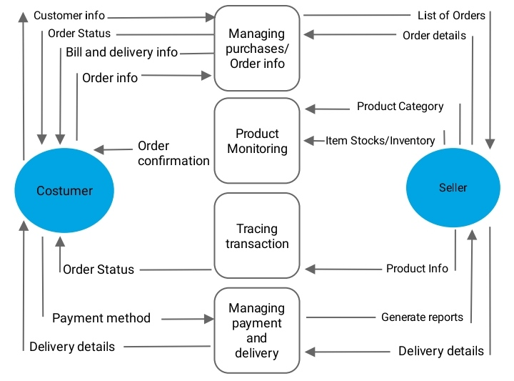
/

Slide 3
Login/Sign Up
Registration
Login/Sign up
Confirmation
Data Retrieval
Confirmation
Inventory
Update stocks
Confirmed stocks
Search/Browse
Data Retrieval
Add to cart
Free Mix
Pre-Mixed
USER
Admin
Home Page
Products
Confirmed
stocks
COD
Gcash,etc.
Update
info
Confirmation
Order_details
Details
(Delivery)
Details
(Order)
Confirmation
(Order)
Confirmation
(Delivery)

