Slide 1


FACOLTÀ DI INGEGNERIA
CORSO DI LAUREA MAGISTRALE IN
INGEGNERIA INFORMATICA
Analysis and evaluation of hard cases in
Probabilistic Argumentation Frameworks
RELATORI
CANDIDATO
Prof. Sergio FLESCA
Luca BRUNO
Matr. 145994
Anno Accademico 2012-2013

Slide 2
Thesis work summary
Introduction to argumentation frameworks and probabilistic argumentation frameworks (PrAFs)
Approximating the semantics evaluation with
an existing Monte Carlo approach
Analysis of tractable cases that are decidable in polynomial time
Optimization of hard cases based on tractable cases
Constructing problem instances and benchmarking
Notes:
Il problema affrontato è quello dell'editing collaborativo in tempo reale di documenti condivisi sul Web tra più utenti. Quello che si propone è usare un modello di consistenza basato sulla tecnica Operational Transformation . Inoltre come caso di studio, l'implementazione completa verrà integrata nel sistema documentale Borè. L'obiettivo finale è quello di evitare completamente i conflitti al momento del salvataggio di un documento.

Slide 3
Summary
Introducing argument systems
  Argumentation Frameworks
  Abstract AFs
  Probabilistic AFs
  Monte Carlo approximation
Tractable cases and optimizations
Implementation and testing

Slide 4
Argumentation Frameworks
Constructing pro and contra arguments
Evaluating how strong a set of argument is against other arguments
Deductive logic has a single path of inference
Argumentation looks at the two sides of an
argument

Slide 5
Abstract argumentation frameworks (AAF)
Arguments are abstract and atomic
Any argument can be attacked (defeated) by
other arguments
Formally it is a graph of arguments and
defeat relations

Slide 6

Example of AAF and justification state
Argument “a” and “c” are justified
Argument “b” is not justified
Decide whether a set of arguments is justified according to some criteria

Slide 7


Conflict-free set of arguments
1.
2.
A set of arguments is conflict-free iff:
there are no defeats between the arguments
But in (2) the argument is not justified!

Slide 8
Admissible set of arguments
A set of arguments is admissible iff:
every argument is defended by other arguments in the set
1.
2.

Slide 9
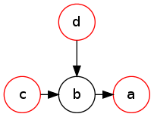
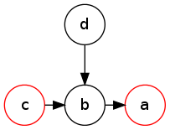
Complete and grounded semantics
1.
2.
A set of arguments is complete iff:
every argument defensible by the set
is in the set
A set of arguments is grounded iff:
it's the minimal complete set

Slide 10
Probabilistic argumentation frameworks (PrAF)
Introduce uncertainty on arguments and defeats
Independence assumption
GOAL: compute the probability of arguments being justified under some semantics

Slide 11




Inducing AAFs from a PrAF
Problem: the number of AAFs that can be induced grows exponentially with arguments and defeats

Slide 12
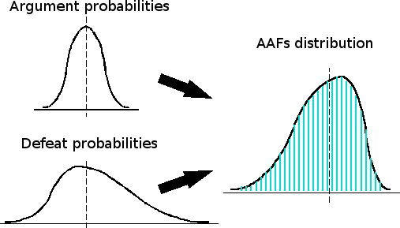
Approximating with Monte Carlo
Input: PrAF, set of arguments and semantics
Sample the space of induced AAFs
Decide whether the given set is an extension
Output: successes / trials

Slide 13
Summary
Introducing argument systems
Tractable cases and optimizations
  Conflict-free property
  Admissible property
  Optimization of hard cases
Implementation and testing

Slide 14

Optimization of hard cases based on tractable cases
Probability of a set being conflict-free:
no defeats
between arguments
Probability of a set being an extension:
P(extension) = P(extension|CF)*P(CF)
OPTIMIZATION IDEA:
the space of conflict-free AAFs is smaller!

Slide 15
Other tractable cases
The probability of a set to be admissible is computable in a similar way
Optimizations based on this case should
theoretically be more efficient
Problem: sampling the space of admissible
AAFs without bias is not trivial

Slide 16
Summary
Introducing argument systems
Tractable cases and optimizations
Implementation and testing
  Generating PrAFs
  Choosing a set of arguments
  Benchmark results

Slide 17
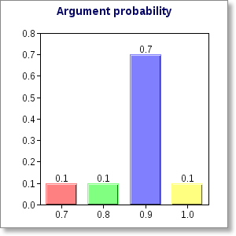
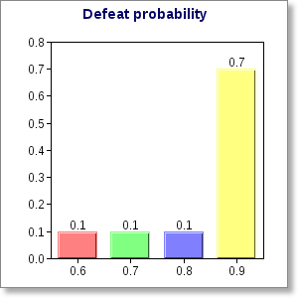
Generating PrAFs
Goal: benchmark P(complete) of a set on a PrAF
Problem: we need a PrAF

Slide 18
A good set of arguments for tests
Goal: benchmark P(complete) of a set on a PrAF
Problem: we need a set of arguments
We search for a set to satisfy the following:
0.6 < P(conflict-free) < 1.0
P(complete) > 0.2

Slide 19
Choosing a set of arguments
Given a PrAF, we find an initial set that maximizes P(conflict-free) and P(complete) using linear programming
We run hill climbing to improve the set
We manually adjust the PrAF probabilities to satisfy the constraints

Slide 20
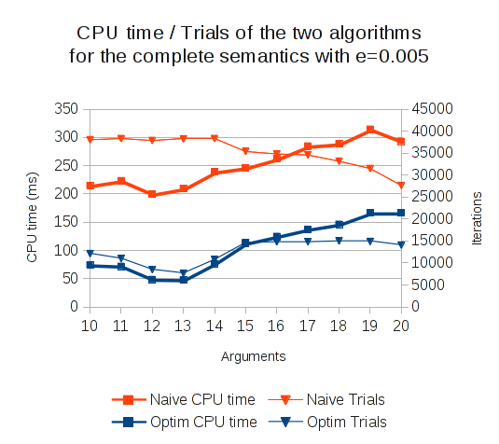
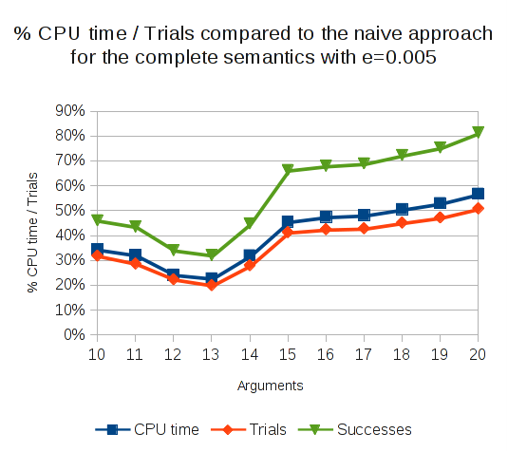
Results for complete semantics
Result: P(conflict-free) is an upper bound on the running time compared to the naïve algorithm!

Slide 21
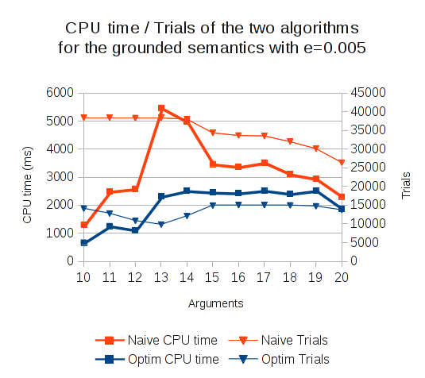
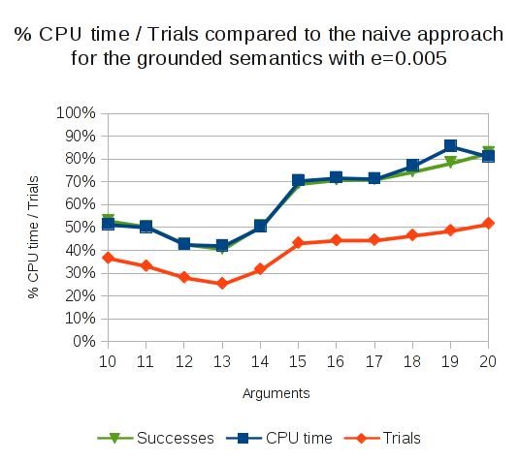
Results for grounded semantics
Result: generally faster but no obvious upper bound :-(

Slide 22
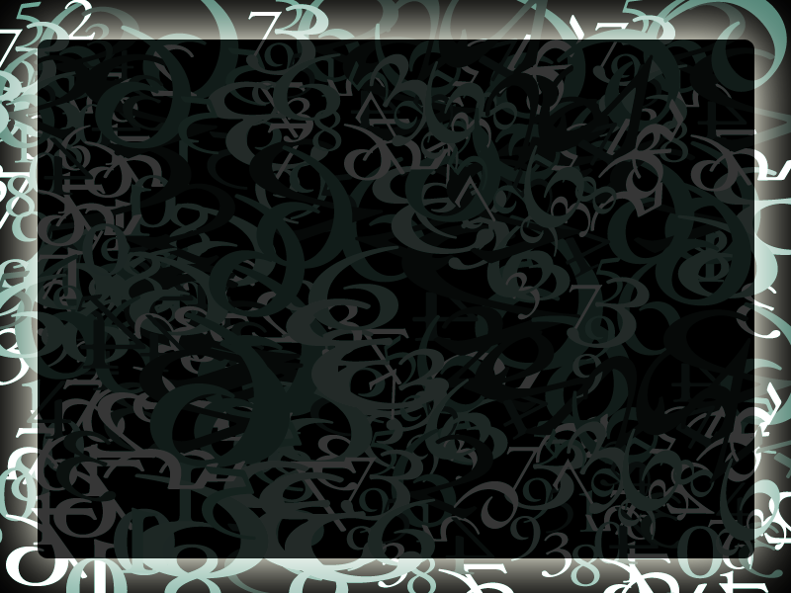
THE END
THANKS FOR YOUR
ATTENTION

