Slide 1

TRAINING PROCESS
Python – Network – Testing
Indicator: Le Thanh Hai
Instructor: Le Tri Cuong

Slide 2
Agenda
PYTHON
Basic Python Syntax
Collections and Loops
Working with IO, Functions
Classes
NETWORK
OSI; TCP/IP model
VLAN (IEEE802.1Q)
SNMP, DHCP, TCP/UDP, ARP
Telnet/SSH
FTP/SCP
TESTING

Slide 3
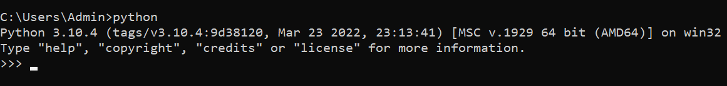
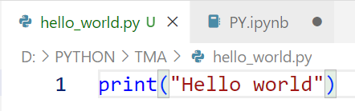
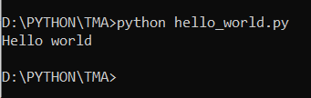
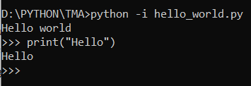
1. PYTHON
Basic Syntax
Interactive Mode Programming
Script Mode Programming

Slide 4
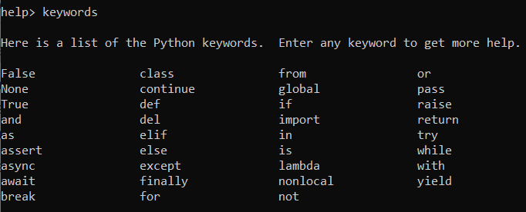
1. PYTHON
Python Identifiers
Name used to identify a variable, function, class, module or other object. Start with a letter A to Z or a to z or an underscore (_) followed by zero or more letters, underscores and digits (0 to 9).
Reserved Words

Slide 5
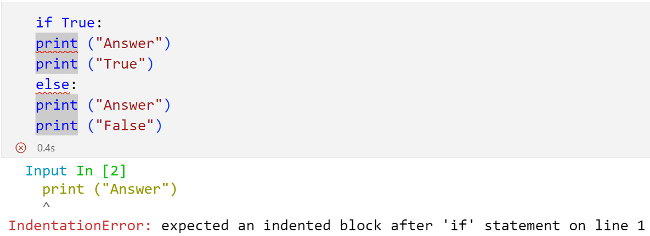
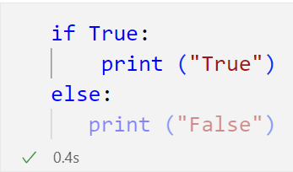
1. PYTHON
Lines and Indentation

Slide 6
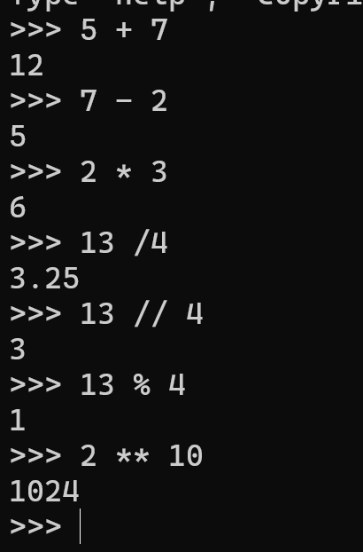
1. PYTHON
Python Operator
Python Arithmetic Operators
Addition: +
Subtraction: -
Multiplication: *
Division: /
Floor Division: //
Modulo: %
Power: **

Slide 7
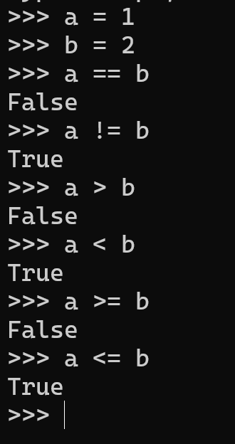
1. PYTHON
Python Operator
Python Comparison Operators
Equal: ==
Not Equal: !=
Greater than: >
Less than: <
Greater than or Equal: >=
Less than or Equal: <=

Slide 8
1. PYTHON
Variable Types
Python has five standard data types: Numbers, Strings, Lists, Tuples, Dictionary
Python Numbers | Example
int | print(type(10)) >>> <class 'int'>
float | print(type(1.5)) >>> <class 'float'>
complex | print(type(12j)) >>> <class 'complex'>

Slide 9
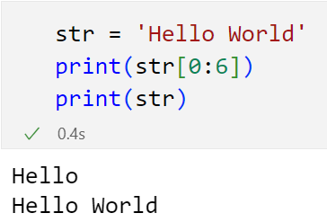
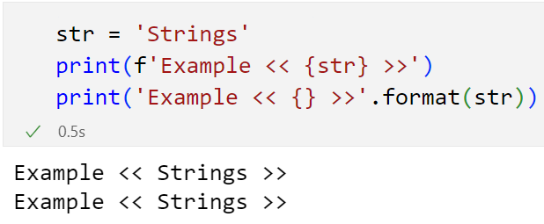
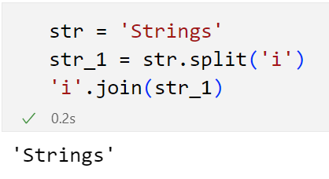
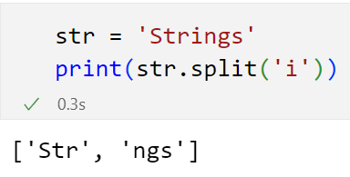
1. PYTHON
Python Strings
Can use ‘ ’; “ ”; “““ ”””

Slide 10
1. PYTHON
Python Lists, Tuple, Dictionary
Name type() | Notes | Example
list | Ordered list of items Items can be different data types Can contain duplicate items Mutable (can be changed after created) | [‘a’, 1, 18.2, 1]
tuple | Just like a list; except: Immutable (cannot be changed) | (‘a’, 1, 18.2)
dictionary dict | Unordered key-value pairs Keys are unique; must be immutable Keys don’t have to be the same data type Values may be any data type | {“apples”: 5, “pears”: 2, “oranges”: 9}
set | A set is a collection which is unordered, unchangeable*, and unindexed. Set items are unchangeable, but you can remove items and add new items. | {"apple", "banana", "cherry"}

Slide 11
1. PYTHON
Python Lists, Tuple, Dictionary
Name type() | Creating | Accessing Indexing | Updating
list | l = [‘a’, 1, 18.2] | >>> l[2] 18.2 | >>> l[2] = 20.4 >>> l [‘a’, 1, 20.4]
tuple | t = (‘a’, 1, 18.2) | >>> t[0] ‘a’ | You cannot update tuples after they have been created.
dict | d = {“apples”: 5, “pears”: 2, “oranges”: 9} | >>> d[“pears”] 2 | >>> d[“pears”] = 6 >>> d {“apples”: 5, “pears”: 6, “oranges”: 9}

Slide 12
1. PYTHON
Python Conditions and If statements
Syntax:
if expression1: statements…
elif expression2: statements…
else:
statements…
Indentation is important!
4 spaces indent recommended
You can nest if statements
Less than <
Greater than >
Less than or equal to <=
Greater than or equal to >=
Equal ==
Not Equal !=
Contains element in
Combine expressions with: and, or
Negate with: not

Slide 13
1. PYTHON
Python While Loop
Syntax:
for : statements…
elif expression2: statements…
else:
statements…
Indentation is important!
4 spaces indent recommended
You can nest if statements
Less than <
Greater than >
Less than or equal to <=
Greater than or equal to >=
Equal ==
Not Equal !=
Contains element in
Combine expressions with: and, or
Negate with: not

Slide 14
1. PYTHON
Python For Loop
Syntax:
if expression1: statements…
elif expression2: statements…
else:
statements…
Indentation is important!
4 spaces indent recommended
You can nest if statements
Less than <
Greater than >
Less than or equal to <=
Greater than or equal to >=
Equal ==
Not Equal !=
Contains element in
Combine expressions with: and, or
Negate with: not

Slide 15
2. NETWORK

Slide 16
3. TESTING
Unit testing
Regression testing
System testing
Feature testing
Negative testing
Performance testing
Automation testing

