Slide 1
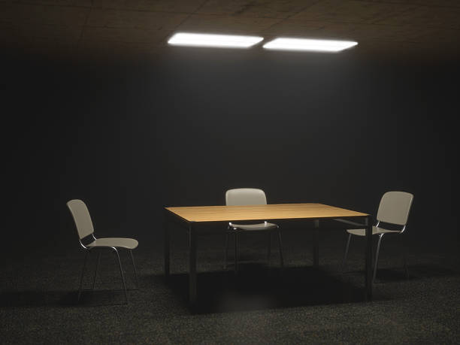
Forensic techniques
Subject interviews

Slide 2
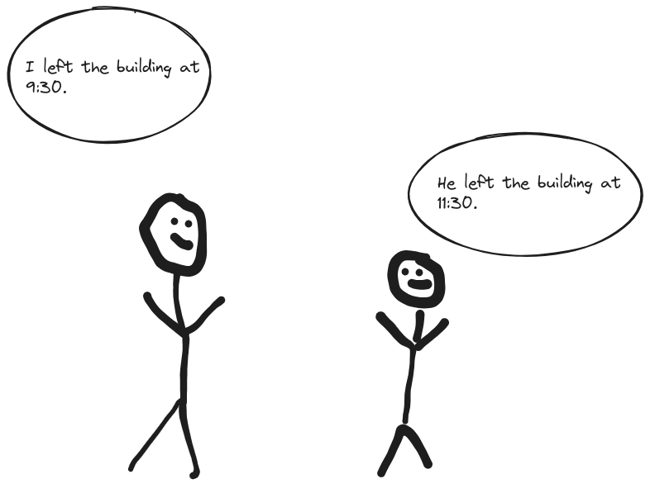
Alibis

