Slide 1
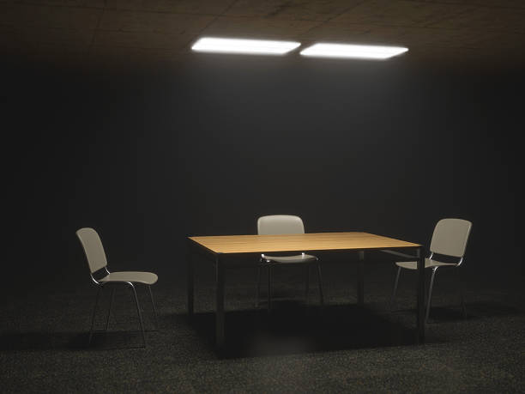
Forensic technic
Subject interviews

Slide 2
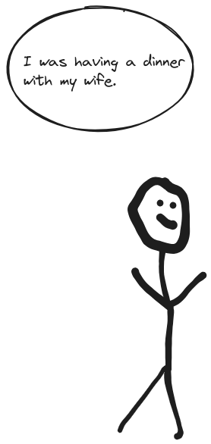
Alibis

