Slide 1
Chapter 6: Functions
Starting Out with C++
Early Objects
by Tony Gaddis, Judy Walters,
and Godfrey Muganda

Slide 2
Topics
6.1 Modular Programming
6.2 Defining and Calling Functions
6.3 Function Prototypes
6.4 Sending Data into a Function
6.5 Passing Data by Value
6.6 The return Statement
6.7 Returning a Value from a Function
6.8 Returning a Boolean Value
6-<number>

Slide 3
Topics (continued)
6.9 Using Functions in a Menu-Driven Program
6.10 Local and Global Variables
6.11 Static Local Variables
6.12 Default Arguments
6.13 Using Reference Variables as Parameters
6.14 Overloading Functions
6.15 The exit() Function
6.16 Stubs and Drivers
6-<number>

Slide 4
6.1 Modular Programming
Modular programming: breaking a program up into smaller, manageable functions or modules. It supports the divide-and-conquer approach to solving a problem.
Function: a collection of statements to perform a specific task
Motivation for modular programming
  Simplifies the process of writing programs
  Improves the maintainability of programs
6-<number>

Slide 5
6.2 Defining and Calling Functions
Function call: a statement that causes a function to execute
Function definition: the statements that make up a function
6-<number>

Slide 6
Function Definition
A definition includes
  name: the name of the function. Function names follow same rules as variable names
  parameter list: the variables that hold the values that are passed to the function when it is called
  body: the statements that perform the function’s task
  return type: data type of the value the function returns to the part of the program that called it
6-<number>

Slide 7
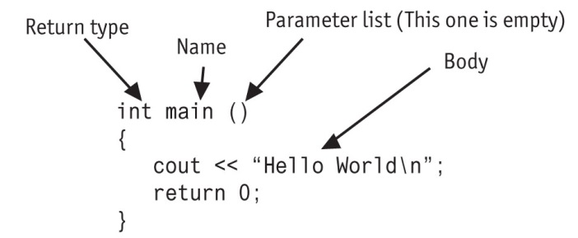
Function Definition
6-<number>

Slide 8
Function Header
The function header consists of
  the function return type
  the function name
  the function parameter list
Example:
int main()
Note: There is no ; at the end of the header
6-<number>

Slide 9
Function Return Type
If a function returns a value, the type of the value must be indicated
  int main()
If a function does not return a value, its return type is void
  void printHeading()
  {
  cout << "\tMonthly Sales\n";
  }
6-<number>

Slide 10
Calling a Function
To call a function, use the function name followed by () and ;
  printHeading();
When a function is called, the program executes the body of the function
After the function terminates, execution resumes in the calling module at the point of call
6-<number>
Notes:
See pr6-01.cpp and pr6-02.cpp

Slide 11
Calling a Function
main is automatically called when the program starts
main can call any number of functions
Functions can call other functions
_{See pr6-03.cpp and pr6-04.cpp}
6-<number>
Notes:
See pr6-03.cpp and pr6-04.cpp

Slide 12
6.3 Function Prototypes
The compiler must know the following about a function before it is called
  its name
  the return type
  the number of parameters
  the data type of each parameter
6-<number>

Slide 13
Function Prototypes
There are multiple ways to notify the compiler about a function before making a call to the function:
  Place the function definition before the calling function’s definition
  Use a function prototype (similar to the header of the function)
    Header: void printHeading()
    Prototype: void printHeading();
_{See pr6-05.cpp}
6-<number>
Notes:
See pr6-05.cpp

Slide 14
Prototype Notes
Place prototypes near the top of the program
A program must include either a prototype or full function definition before any call to the function, otherwise a compiler error occurs
When using prototypes, the function definitions can be placed in any order in the source file. Traditionally, main is placed first.
6-<number>

Slide 15
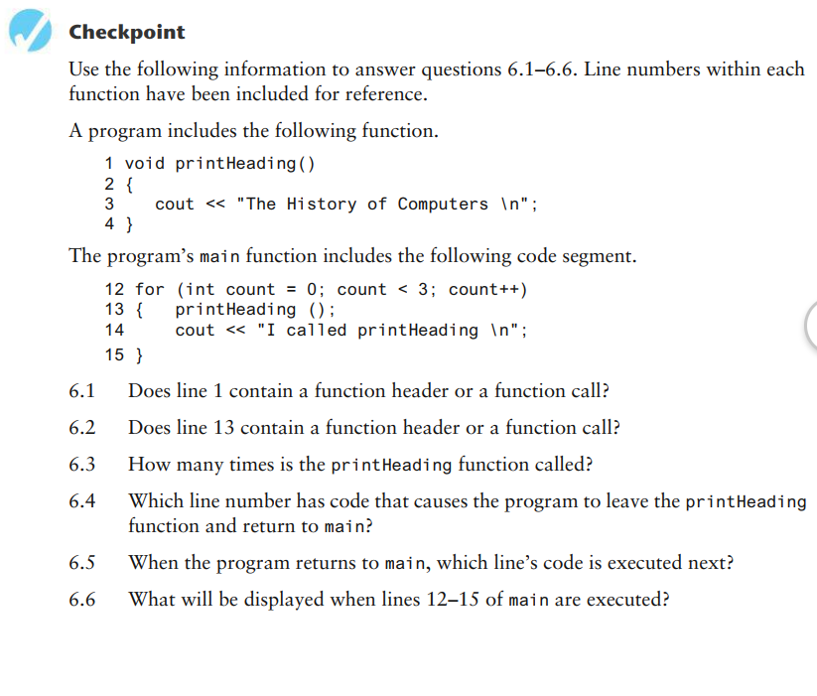
1-<number>

Slide 16
6.4 Sending Data into a Function
You can pass values into a function at time of a call
  c = sqrt(a*a + b*b);
Values passed to a function are arguments
Variables in a function that hold values passed as arguments are parameters
Alternate names:
  argument: actual argument, actual parameter
  parameter: formal argument, formal parameter
6-<number>

Slide 17
Parameters, Prototypes, and Function Headings
For each function argument,
  the prototype must include the data type of each parameter in its (). It may also include the parameter name:
  void evenOrOdd(int); or
  void evenOrOdd(int num); // prototype
  the header must include a declaration, with variable type and name, for each parameter in its ()
  void evenOrOdd(int num) //header
The call for the above function could look like this: evenOrOdd(val); //call
Note: no data type on argument in call
_{See pr6-06.cpp and pr6-07.cpp}
6-<number>
Notes:
See pr6-06.cpp and pr6-07.cpp

Slide 18
Function Call Notes
The value of the argument is copied into the parameter when the function is called
A function can have > 1 parameter
There must be a data type listed in the prototype () and an argument declaration in the function heading () for each parameter
Arguments will be promoted/demoted as necessary to match parameters. Be careful!
6-<number>
Notes:
See pr6-08.cpp

Slide 19
Calling Functions with Multiple Arguments
When calling a function with multiple arguments
  the number of arguments in the call must match the function prototype and definition
  the value of the first argument will be copied into the first parameter, the value of the second argument into the second parameter, etc.
6-<number>

Slide 20
Calling Functions with
Multiple Arguments Illustration
displayData(height, weight); // call
void displayData(int h, int w)// header
{
cout << "Height = " << h << endl;
cout << "Weight = " << w << endl;
}
6-<number>

Slide 21
6.5 Passing Data by Value
Pass by value: when an argument is passed to a function, a copy of its value is placed in the parameter
The function cannot access the original argument
Changes made to the parameter in the function do not affect the value of the argument in the calling function
6-<number>

Slide 22
Passing Data to Parameters by Value
Example: int val = 5;
  evenOrOdd(val);
evenOrOdd may change the variable num, but it will have no effect on variable val
val
num
5
5
argument in
calling function
parameter in
evenOrOdd function
_{See pr6-09.cpp}
6-<number>
Notes:
See pr6-09.cpp

Slide 23
6.6 The return Statement
Is used to end execution of a function
It can be placed anywhere in a function
  Statements that follow the return statement will not be executed
It can be used to prevent abnormal termination of program
Without a return statement, the function ends at its last }
6-<number>
Notes:
See pr6-10.cpp

Slide 24
6.7 Returning a Value from a Function
The return statement can be used to return a value from a function to the module that made the function call
The prototype and function header must indicate the data type of return value (not void)
The calling function should use the returned value, e.g.,
  assign it to a variable
  send it to cout
  use it in an arithmetic computation
  use it in a relational expression
6-<number>
Notes:
See pr6-11.cpp and pr6-12.cpp

Slide 25
Returning a Value – the return Statement
Format: return expression;
expression may be a variable, a literal value, or an expression.
expression should be of the same data type as the declared return type of the function (it will be converted if not)
6-<number>

Slide 26
6.8 Returning a Boolean Value
A function can return true or false
You can declare the return type in the function prototype and header as bool
The function body must contain return statement(s) that return true, false, or bool variables or expressions.
The calling function can use the return value in a relational expression
6-<number>

Slide 27
Boolean return Example
bool isValid(int); // prototype
bool isValid(int val) // header
{
int min = 0, max = 100;
if (val >= min && val <= max)
return true;
else
return false;
}
if (isValid(score)) // call
…
6-<number>
Notes:
See pr6-13.cpp

Slide 28
Programming Style and return statements
A programming style may calculate a return value and use a single return statement. The previous example could be written as:
bool isValid(int val) // header
{
bool result;
int min = 0, max = 100;
if (val >= min && val <= max)
result = true;
else
result = false;
return result;
}
6-<number>
Notes:
See pr6-13.cpp

Slide 29
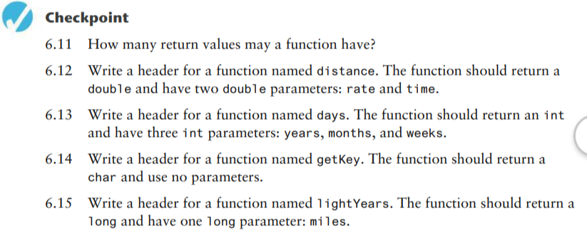
1-<number>

Slide 30
In-Class Assignment Ch. 6 part 1
Markup – Write a program that asks the user to enter an item’s wholesale price and markup %. For example:
  If an item’s wholesale cost is 5.00 and its markup percentage is 50%, then the item’s retail price is $7.50
The program should have a function named calculateRetail that receives the wholesale cost and the markup percentage as arguments and returns the retail price of the item.
The retail price should be displayed in the main function.
Use a function prototype for the function calculateRetail
Write the C++ code, test, print and turn in source code when you are done
1-<number>

Slide 31
6.9 Using Functions in a Menu-Driven Program
Functions can be used
to implement user choices from menu
to implement general-purpose tasks
    Higher-level functions can call general-purpose functions
    This minimizes the total number of functions and speeds program development time
6-<number>
Notes:
See pr6-14.cpp

Slide 32
Screen Management in a
Menu-Driven Program
You can clear the screen to remove prior output while a program is running:
  Windows: system("cls");
  Linux and Mac OS: system("clear");
To allow the user enough time to read output before the screen clears, use code like:
cout << "Press the Enter key to continue.";
cin.get(); // clear the input buffer
cin.get(); // get the Enter key
_{See pr6-14.cpp}
6-<number>
Notes:
See pr6-14.cpp

Slide 33
6.10 Local and Global Variables
local variable: is defined within a function or a block; accessible only within the function or the block. Parameters are also local variables.
Other functions and blocks can define variables with the same name
When a function is called, local variables in the calling function are not accessible from within the called function
_{See pr6-15.cpp}
6-<number>
Notes:
See pr6-15.cpp

Slide 34
Local Variable Lifetime
A local variable only exists while its defining function is executing
Local variables created when a function begins and are destroyed when the function terminates
Data cannot be retained in local variables between calls to the function in which they are defined
6-<number>

Slide 35
Local and Global Variables
global variable: a variable defined outside all functions; it is accessible to all functions within its scope
Easy way to share large amounts of data between functions
Scope of a global variable is from its point of definition to the program end
Use sparingly
6-<number>

Slide 36
Initializing Local and Global Variables
Local variables must be initialized by the programmer
Global variables are initialized to 0 (numeric) or NULL (character) when the variable is defined. These can be overridden with explicit initial values.
_{See pr6-16.cpp and pr6-17.cpp}
6-<number>
Notes:
See pr6-16.cpp and pr6-17.cpp

Slide 37
Global Variables – Why ‘Use Sparingly’?
Global variables make:
Programs that are difficult to debug
Functions that cannot easily be re-used in other programs
Programs that are hard to understand
6-<number>

Slide 38
Global Constants
A global constant is a named constant that can be used by every function in a program
It is useful if there are unchanging values that are used throughout the program
They are safer to use than global variables, since the value of a constant cannot be modified during program execution
6-<number>
Notes:
See pr6-18.cpp

Slide 39
Local and Global Variable Names
Local variables can have same names as global variables
When a function contains a local variable that has the same name as a global variable, the global variable is unavailable from within the function. The local definition "hides" or "shadows" the global definition.
_{See pr6-19.cpp}
6-<number>
Notes:
See pr6-19.cpp

Slide 40
6.11 Static Local Variables
Local variables
  Only exist while the function is executing
  Are redefined each time function is called
  Lose their contents when function terminates
static local variables
  Are defined with key word static
  static int counter;
  Are defined and initialized only the first time the function is executed
  Retain their values between function calls
_{See pr6-20.cpp and pr6-21.cpp}
6-<number>
Notes:
See pr6-20.cpp and pr6-21.cpp

Slide 41
6.12 Default Arguments
Values that are passed automatically if arguments are missing from a function call
Must be a constant or literal declared in the prototype or header (whichever occurs first)
  void evenOrOdd(int x = 0);
Multi-parameter functions may have default arguments for some or all parameters
  int getSum(int, int=0, int=0);
6-<number>
Notes:
See pr6-22.cpp

Slide 42
Default Arguments
If not all parameters to a function have default values, the ones without defaults must be declared first in the parameter list
int getSum(int, int=0, int=0);// OK
int getSum(int, int=0, int); // wrong!
When an argument is omitted from a function call, all arguments after it must also be omitted
sum = getSum(num1, num2); // OK
sum = getSum(num1, , num3); // wrong!
6-<number>

Slide 43
6.13 Using Reference Variables as Parameters
This is a mechanism that allows a function to work with the original argument from the function call, not a copy of the argument
It allows the function to modify values stored in the calling environment
It provides a way for the function to ‘return’ more than 1 value
6-<number>

Slide 44
Reference Variables
A reference variable is an alias for another variable
It is defined with an ampersand (&) in the prototype and in the header
  void getDimensions(int&, int&);
Changes made to a reference variable are made to the variable it refers to
Use reference variables to implement passing parameters by reference
6-<number>

Slide 45
Pass by Reference Example
void squareIt(int &); //prototype
void squareIt(int &num)
{
num *= num;
}
int localVar = 5;
squareIt(localVar); // localVar now
// contains 25
_{See pr6-23.cpp and pr6-24.cpp}
6-<number>
Notes:
See pr6-23.cpp and pr6-24.cpp

Slide 46
Reference Variable Notes
Each reference parameter must contain &
An argument passed to a reference parameter must be a variable. It cannot be an expression or a constant.
Use only when it is appropriate, such as when the function must input or change the value of the argument passed to it.
Files (i.e., file stream objects) should be passed by reference.
6-<number>
Notes:
See pr6-25.cpp, pr6-26.cpp, and pr6-27.cpp

Slide 47
When to Pass by Reference and When to Pass by Value
When an argument is a constant it must be passed by value
When a variable being passed should not have its value changed – pass by value
When only one variable needs to be returned from a function it should be returned using the return statement
When two or more variables need to have their value changed by a function – pass by reference
When copy of an argument can’t reasonably be made, such as a file stream object – pass by reference
See pr6-25.cpp, pr6-26.cpp, and pr6-27.cpp
1-<number>

Slide 48
In-Class Assignment Ch. 6 part 2
Reference Variables:
Write a program that has a function called getNumber.
The main function should:
  Define an integer variable called value which is initialized to 5
  Display the contents of value
  Call getNumber, passing it value as a parameter.
  Display the contents of value again
getNumber should be a void function that is passed one integer reference variable. The function should prompt the user to enter a number in the range of 1 through 100. The input should be validated and assigned to the reference variable.
1-<number>

Slide 49
6.14 Overloading Functions
The signature of a function is the function name and the data types of the parameters, in order.
Overloaded functions are two or more functions that have the same name but different signatures
This can be used to create functions that perform the same task but take different parameter types or a different number of parameters
The compiler will determine which version of the function to call by the argument and parameter lists
6-<number>

Slide 50
Overloaded Functions Example
If a program has these overloaded functions,
  void getDimensions(int); // 1
  void getDimensions(int, int); // 2
  void getDimensions(int, float); // 3
  void getDimensions(double, double);// 4
then the compiler will use them as follows:
  int length, width;
  double base, height;
  getDimensions(length); // 1
  getDimensions(length, width); // 2
  getDimensions(length, height); // 3
  getDimensions(height, base); // 4
_{See pr6-28.cpp and pr6-29.cpp}
6-<number>
Notes:
See pr6-28.cpp and pr6-29.cpp

Slide 51
6.15 The exit() Function
Terminates the execution of a program
Can be called from any function
Can pass a value to operating system to indicate status of program execution
Usually used for abnormal termination of program
Requires cstdlib header file
Use with care
6-<number>
Notes:
See pr6-30.cpp

Slide 52
exit() – Passing Values to Operating System
Use an integer value to indicate program status
Often, 0 means successful completion, non-zero indicates a failure condition
Can use named constants defined in cstdlib:
  EXIT_SUCCESS and
  EXIT_FAILURE
6-<number>

Slide 53
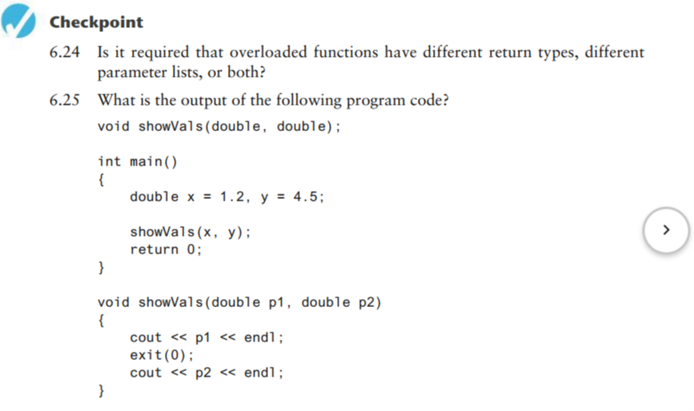
1-<number>

Slide 54
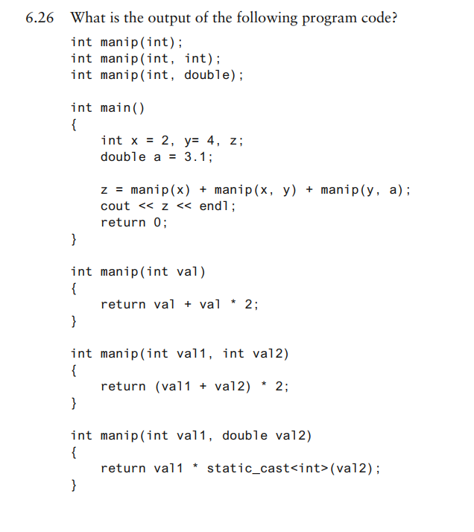
1-<number>

Slide 55
6.16 Stubs and Drivers
Stub: dummy function in place of an actual function
It usually displays a message indicating it was called. May also display parameters
Driver: function that tests a function by calling it
Stubs and drivers are useful for testing and debugging program logic and design
_{See pr6-31.cpp}
6-<number>
Notes:
See pr6-31.cpp

Slide 56
In-Class Assignment Ch. 6 part 3
Write a program that, in addition to main, contains three versions of an overloaded function called max. Each version receives two parameters of the same type, and returns the larger of the two values. Define one of these functions to apply to type double, another to type int and a third to type char. Note: If the values are equal, return -1 from the function.
In your main function:
  Create 2 variables of each type, and ask the user to enter data.
  Call max three times, each time using a different data type.
  Display the greater of each value for each function
  If the values are equal, display a message such as “The integers are equal”
1-<number>

