Slide 1
Chapter 8: Arrays
Starting Out with C++
Early Objects
by Tony Gaddis, Judy Walters,
and Godfrey Muganda

Slide 2
Topics
8.1 Arrays Hold Multiple Values
8.2 Accessing Array Elements
8.3 Inputting and Displaying Array Contents
8.4 Array Initialization
8.5 The Range-Based for loop
8.6 Processing Array Contents
8.7 Using Parallel Arrays
8-<number>

Slide 3
Topics (continued)
8.8 The typedef Statement
8.9 Arrays as Function Arguments
8.10 Two-Dimensional Arrays
8.11 Arrays with Three or More Dimensions
8.12 Vectors
8.13 Arrays of Objects
8-<number>

Slide 4
8.1 Arrays Hold Multiple Values
Array: a variable that can store multiple values of the same type
The values are stored in consecutive memory locations
It is declared using [] operator
  const int ISIZE = 5;
  int tests[ISIZE];
8-<number>

Slide 5
Array Storage in Memory
The definition
  int tests[ISIZE]; // ISIZE is 5
allocates the following memory
Element 0 | Element 1 | Element 2 | Element 3 | Element 4
8-<number>

Slide 6
Array Terminology
In the definition int tests[ISIZE];
  int is the data type of the array elements
  tests is the name of the array
  ISIZE, in [ISIZE], is the size declarator. It shows the number of elements in the array.
  The size of an array is the number of bytes allocated for it
(number of elements) * (bytes needed for each element)
8-<number>

Slide 7
Array Terminology Examples
Examples:
Assumes int uses 4 bytes and double uses 8 bytes
  const int ISIZE = 5, DSIZE = 10;
  int tests[ISIZE]; // holds 5 ints, array
  // occupies 20 bytes
double volumes[DSIZE];// holds 10 doubles,
// array occupies
// 80 bytes
8-<number>

Slide 8
8.2 Accessing Array Elements
Each array element has a subscript, used to access the element.
Subscripts start at 0
subscripts
0 1 2 3 4
8-<number>

Slide 9
Accessing Array Elements
Array elements (accessed by array name and subscript) can be used as regular variables
  tests[0] = 79;
  cout << tests[0];
  cin >> tests[1];
  tests[4] = tests[0] + tests[1];
  cout << tests; // illegal due to
  // missing subscript
tests
0 1 2 3 4
8-<number>

Slide 10
8.3 Inputting and Displaying
Array Contents
cout and cin can be used to display values from and store values into an array
  const int ISIZE = 5;
  int tests[ISIZE]; // Define 5-elt. array
  cout << "Enter first test score ";
  cin >> tests[0];
_{See pr8-01.cpp}
8-<number>
Notes:
See pr8-01.cpp

Slide 11
Array Subscripts
Array subscript can be an integer constant, integer variable, or integer expression
Examples: Subscript is
    cin >> tests[3]; int constant
    cout << tests[i]; int variable
    cout << tests[i+j]; int expression
8-<number>

Slide 12
Accessing All Array Elements
To access each element of an array
  Use a loop
  Let the loop control variable be the array subscript
  A different array element will be referenced each time through the loop
for (i = 0; i < 5; i++)
  cout << tests[i] << endl;
8-<number>
Notes:
See pr8-02.cpp

Slide 13
Getting Array Data from a File
const int ISIZE = 5;
int sales[ISIZE];
ifstream dataFile;
dataFile.open("sales.dat");
if (!dataFile)
cout << "Error opening data file\n";
else // Input daily sales
{ for (int day = 0; day < ISIZE; day++)
dataFile >> sales[day];
dataFile.close();
}
_{See pr8-03.cpp}
8-<number>
Notes:
See pr8-03.cpp

Slide 14
Writing Data to a File
To write data in an array to a file
  Open the output file pointed to by ofstream object
  Use a loop to step through each element in the array
  Direct the output to the file instead of the computer screen
outputFile.open (“demofile.txt”);
for (i = 0; i < 5; i++)
  outputFile << tests[i];
8-<number>
Notes:
See pr8-03.cpp

Slide 15
No Bounds Checking
There are no checks in C++ that an array subscript is in range
An invalid array subscript can cause the program to overwrite other memory
Example:
  const int ISIZE = 3;
  int i = 4;
  int num[ISIZE];
  num[i] = 25;
num
25
[0] [1] [2]
_{See pr8-04.cpp}
8-<number>
Notes:
See pr8-04.cpp

Slide 16
Off-By-One Errors
These most often occur when a program accesses data one position beyond the end of an array or misses the first or last element of an array.
Don’t confuse the ordinal number of an array element (first, second, third) with its subscript (0, 1, 2)
If an array has size n, then the subscripts range from 0 to n-1
8-<number>

Slide 17
Off-By-One Errors
const inst SIZE = 100;
int numbers [SIZE];
for int (count = 1; count <= SIZE;count ++)
numbers [count] = 0;
The intent of this code is to create an array of size 100 and initialize the value of all elements to 0. The subscript goes from 1-100 instead of 0-99.
8-<number>

Slide 18
Review
What is wrong with the following array definitions?
1) int readings [-1];
2) double measurements[4.5];
3) int size;
string name [size];
1-<number>

Slide 19
Review
What is the output of the following code?
int values [5], count;
for (count = 0; count < 5; count++)
values [count] = count + 1;
for (count = 0; count < 5; count ++)
cout << values[count] << endl;
1-<number>

Slide 20
8.4 Array Initialization
An array can be initialized during program execution with assignment statements
  tests[0] = 79;
  tests[1] = 82; // etc.
It can be initialized at array definition with an initialization list
  const int ISIZE = 5;
  int tests[ISIZE] = {79,82,91,77,84};
8-<number>
Notes:
See pr8-05.cpp, pr8-06.cpp, and pr8-07.cpp

Slide 21
Start at element 0 or 1?
You may choose to declare arrays to be one larger than needed. This allows you to use the element with subscript 1 as the ‘first’ element, etc., and may minimize off-by-one errors.
The element with subscript 0 is not used.
This is most often done when working with ordered data, e.g., months of the year or days of the week
8-<number>
Notes:
See pr8-05B.cpp, pr8-06B.cpp, and pr8-07B.cpp

Slide 22
Partial Array Initialization
If array is initialized at definition with fewer values than the size declarator of the array, the remaining elements will be set to 0 or the empty string
  int tests[ISIZE] = {79, 82};
Initial values are used in order; you cannot skip over elements to initialize a noncontiguous range
You cannot have more values in the initialization list than the declared size of the array
79 | 82 | 0 | 0 | 0
8-<number>
Notes:
See pr8-08.cpp

Slide 23
Implicit Array Sizing
C++ can determine the array size by the size of the initialization list
  short quizzes[]={12,17,15,11};
You must use either array size declarator or an initialization list when the array is defined
12 | 17 | 15 | 11
8-<number>

Slide 24
Alternate Ways to Initialize Variables
You can initialize a variable at definition time using a functional notation
  int length(12); // same result as
  // int length = 12;
  In C++ 11 and higher, you can also do this:
  int length{12};
  The second approach checks the argument to ensure that it matches the data type of the variable, and will generate a compiler error if not
1-<number>

Slide 25
8.5 The Range-Based for Loop
NOTE: This is a C++ 11 feature
This is a loop that can simplify array processing.
It uses a variable that will hold a different array element for each iteration
Format:
    for (data_type var : array)
    statement;
data_type : the type of the variable
var: the variable
statement; : the loop body
1-<number>

Slide 26
Range-Based for Loop - Details
data_type must be the type of the array elements, or a type that the array elements can be automatically converted to
var will hold the value of successive array elements as the loop iterates. Each array element is processed in the loop
statement; can be a single statement or a block of statements enclosed in { }
1-<number>

Slide 27
Range-Based for Loop - Example
    // sum the elements of an array
    int [] grades = {68,84,75};
    int sum = 0;
    for (int score : grades)
    sum += score;
_{See pr8-09.cpp and pr8.10.cpp}
1-<number>
Notes:
See pr8-09.cpp and pr8.10.cpp

Slide 28
Range-Based for Loop - Example
    // modify the contents of an array
  const int ISIZE = 3;
    int [ISIZE] grades;
    for (int &score : grades)
    {
    cout << "Enter a score: ";
    cin >> score;
    }
1-<number>

Slide 29
Comparison: Range-Based for Loop vs. Regular for Loop
The range-based for loop provides a simple notation to use to process all of the elements of an array.
However, it does not give you access to the subscripts of the array elements.
If you need to know the element locations as well as the element values, then use a regular for loop.
1-<number>

Slide 30
8.6 Processing Array Contents
Array elements can be
  treated as ordinary variables of the same type as the array
  used in arithmetic operations, in relational expressions, etc.
Example:
if (principalAmt[3] >= 10000)
interest = principalAmt[3] * intRate1;
else
interest = principalAmt[3] * intRate2;
_{See pr8-11.cpp}
8-<number>
Notes:
See pr8-11.cpp

Slide 31
Using Increment and Decrement Operators with Array Elements
When using ++ and -- operators, don’t
confuse the element with the subscript
tests[i]++; // adds 1 to tests[i]
tests[i++]; // increments i, but has
  // no effect on tests
8-<number>

Slide 32
Copying One Array to Another
You cannot copy with an assignment statement:
    tests2 = tests; //won’t work
You must instead use a loop to copy element-by-element:
    for (int indx=0; indx < ISIZE; indx++)
    tests2[indx] = tests[indx];
_{See ArrayCopy.cpp}
8-<number>
Notes:
See ArrayCopy.cpp

Slide 33
Are Two Arrays Equal?
Like copying, you cannot compare two arrays in a single expression:
    if (tests2 == tests)
You can use a while loop with a bool variable:
    bool areEqual=true;
    int indx=0;
    while (areEqual && indx < ISIZE)
    {
    if(tests[indx] != tests2[indx]
    areEqual = false;
    indx++;
    }
_{See ArrayCompare.cpp}
8-<number>
Notes:
See ArrayCompare.cpp

Slide 34
Find the Sum, Average of
Array Elements
Use a simple loop to add together array elements
  float average, sum = 0;
  for (int tnum=0; tnum< ISIZE; tnum++)
  sum += tests[tnum];
Or use C++ 11 range-based for loop:
  for (int num : tests)
  sum += num;
Once summed, average can be computed
  average = sum/ISIZE;
8-<number>

Slide 35
Find the Largest Array Element
Use a loop to examine each element and find the largest element (i.e., one with the largest value)
int largest = tests[0];
for (int tnum = 1; tnum < ISIZE; tnum++)
{ if (tests[tnum] > largest)
largest = tests[tnum];
}
cout << "Highest score is " << largest;
A similar algorithm exists to find the smallest element
_{See pr8-12.cpp}
8-<number>
Notes:
See pr8-12.cpp

Slide 36
Using Arrays vs. Using Simple Variables
An array is probably not needed if the input data is only processed once:
  Find the sum or average of a set of numbers
  Find the largest or smallest of a set of values
If the input data must be processed more than once, an array is probably a good idea:
  Calculate the average, then determine and display which values are above the average, at the average, and below the average
8-<number>

Slide 37
Partially-Filled Arrays
The exact amount of data (and, therefore, the array size) may not be known when a program is written.
The programmer makes a best estimate for the maximum amount of data, then sizes arrays accordingly. A sentinel value can be used to indicate end-of-data.
The programmer must also keep track of how many array elements are actually used
8-<number>
Notes:
See pr8-13.cpp

Slide 38
C-Strings and string Objects
They can be processed using the array name
  Entire string at once, or
  One element at a time by using a subscript
  string city;
  cout << "Enter city name: ";
  cin >> city;
'S' | 'a' | 'l' | 'e' | 'm'
city[0] | city[1] | city[2] | city[3] | city[4]
_{See pr8-14.cpp}
8-<number>
Notes:
See pr8-14.cpp

Slide 39
In Class Ch. 8 Part 1
Write a program that allows the user to enter MAX_NUM integer test scores in the range of 0 to 100 (do input validation) and stores them in an array. Use a traditional for loop to gather the data.
The program should then, using the C++11 range based for loop :
  Count number of scores greater than or equal to 80
Display number of scores greater than 80
Display average score
1-<number>

Slide 40
8.7 Using Parallel Arrays
Parallel arrays: two or more arrays that contain related data
The subscript is used to relate arrays
  elements at same subscript are related
The arrays do not have to hold data of the same type
8-<number>

Slide 41
Parallel Array Example
const int ISIZE = 5;
string name[ISIZE]; // student name
float average[ISIZE]; // course average
char grade[ISIZE]; // course grade
name average grade
0
1
2
3
4
0
1
2
3
4
0
1
2
3
4
8-<number>

Slide 42
Parallel Array Processing
const int ISIZE = 5;
string name[ISIZE]; // student name
float average[ISIZE]; // course average
char grade[ISIZE]; // course grade
...
for (int i = 0; i < ISIZE; i++)
cout << " Student: " << name[i]
<< " Average: " << average[i]
<< " Grade: " << grade[i]
<< endl;
_{See pr8-15.cpp}
8-<number>
Notes:
See pr8-15.cpp

Slide 43
8.8 The typedef Statement
Creates an alias for a simple or structured data type
Format:
  typedef existingType newName;
Example:
  typedef unsigned int Uint;
  Uint tests[ISIZE]; // array of
  // unsigned ints
8-<number>

Slide 44
Uses of typedef
It can be used to make code more readable
Can be used to create an alias for an array of a particular type
  // Define yearArray as a data type
  // that is an array of 12 ints
  typedef int yearArray[MONTHS];
  // Create two of these arrays
  yearArray highTemps, lowTemps;
8-<number>

Slide 45
8.9 Arrays as Function Arguments
Passing a single array element to a function is no different than passing a regular variable of that data type
The function does not need to know that the value it receives is coming from an array
displayValue(score[i]); // call
void displayValue(int item) // header
{ cout << item << endl;
}
_{See pr8-16.cpp}
8-<number>
Notes:
See pr8-16.cpp

Slide 46
Passing an Entire Array
To define a function that has an array parameter, use empty [] to indicate the array in the prototype and header
To pass an array to a function, just use the array name
// Function prototype
  void showScores(int []);
  // Function header
  void showScores(int tests[])
  // Function call
  showScores(tests);
8-<number>

Slide 47
Passing an Entire Array
Use the array name, without any brackets, as the argument
You can also pass the array size as a separate parameter so the function knows how many elements to process
showScores(tests, 5); // call
void showScores(int[], int); // prototype
void showScores(int A[],
int size) // header
_{See pr8-17.cpp and pr8-19.cpp}
8-<number>
Notes:
See pr8-17.cpp and pr8-19.cpp

Slide 48
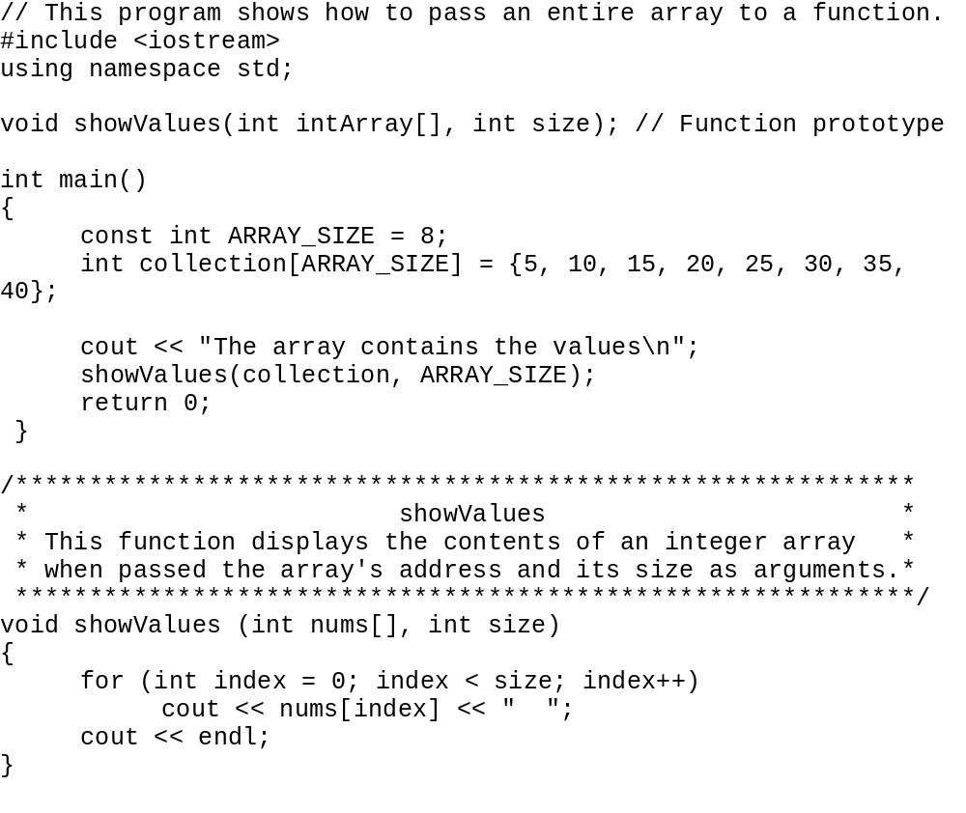
Shows that function accepts address of array and size
Actually passing the beginning address of array and size
nums is the beginning address of the array
Although nums is not a reference variable it acts like one
1-<number>

Slide 49
Using typedef with a Passed Array
You can use typedef to simplify function prototype and header
  // Make intArray an integer array
  // of unspecified size
  typedef int intArray[];
  // Function prototype
  void showScores(intArray, int);
  // Function header
  void showScores(intArray tests,
  int size)
_{See pr8-18.cpp}
8-<number>
Notes:
See pr8-18.cpp

Slide 50
Modifying Arrays in Functions
Array parameters in functions are similar to reference variables
Changes made to array passed to a function are made to the actual array in the calling function
The programmer must be careful that an array is not inadvertently changed by a function
The const keyword can be used in prototype and header to prevent changes
_{See pr8-19.cpp and pr8-20.cpp}
8-<number>
Notes:
See pr8-19.cpp and pr8-20.cpp

Slide 51
Passing Array by With const
const int NUM_DAYS = 5; // Number of days
double sales[NUM_DAYS];
// Function prototype
double sumArray (const double[], int);
// Function call
total = sumArray(sales, NUM_DAYS);
//Function header
double sumArray(const double array[], int size)
1-<number>

Slide 52
8.10 Two-Dimensional Arrays
You can define one array for multiple sets of data
It is like a table in a spreadsheet
Use two size declarators in definition
  int exams[4][3];
Number of rows
Number of columns
8-<number>

Slide 53
Two-Dimensional Array Representation
int exams[4][3];
Use two subscripts to access element
  exams[2][1] = 86;
columns
exams[0][0] | exams[0][1] | exams[0][2]
exams[1][0] | exams[1][1] | exams[1][2]
exams[2][0] | exams[2][1] | exams[2][2]
exams[3][0] | exams[3][1] | exams[3][2]
r
o
w
s
_{See pr8-21.cpp}
8-<number>
Notes:
See pr8-21.cpp

Slide 54
Two-Dimensional Array Access
When you use access an element of a two-dimensional array
  exams[2][1] = 86;
The first subscript, [2], indicates the row in the array
The second subscript, [1], indicates the column in the array
8-<number>

Slide 55
Initialization at Definition
Two-dimensional arrays are initialized row-by-row
  int exams[2][2] = { {84, 78},
  {92, 97} };
Can omit inner { }
84 | 78
92 | 97
8-<number>

Slide 56
Passing a Two-Dimensional Array to a Function
Use the array name and the number of columns as arguments in the function call
  getExams(exams, 2);
Use empty [] for row and a size declarator for the number of columns in the prototype and header
// Prototype, where NUM_COLS is 2
void getExams(int[][NUM_COLS], int);
// Header
void getExams
(int exams[][NUM_COLS], int rows)
8-<number>
Notes:
See pr8-22.cpp

Slide 57
Using typedef with a
Two-Dimensional Array
Can use typedef for simpler notation
typedef int intExams[][2];
  ...
// Function prototype
void getExams(intExams, int);
// Function header
void getExams(intExams exams, int rows)
8-<number>

Slide 58
Two-Dimensional Array Traversal
Use nested loops, one for the row and one for the column, to visit each array element.
Accumulators can be used to calculate the sum the elements row-by-row, column-by-column, or over the entire array.
8-<number>

Slide 59
8.11 Arrays with Three or More Dimensions
You can define arrays that have any number of dimensions
  short rectSolid(2,3,5);
  double timeGrid(3,4,3,4);
When this type of array is used as a parameter, specify the size of all but the 1st dimension
  void getRectSolid(short [][3][5]);
_{See pr8-23.cpp}
8-<number>
Notes:
See pr8-23.cpp

Slide 60
Multidimensional Arrays – Theater Seats
₀
₁
₂
₃
₄
₂
₁
0 1 2 3 4 5 6
₀
_{Row}
_{Seat in Row}
_{Section}
_{Look at Theater}
_{example}
_{See pr8-21.cpp}
1-<number>

Slide 61
8.12 Vectors
A vector holds a set of elements, like a one-dimensional array
It has a flexible number of elements. It can grow and shrink
  There is no need to specify the size when defined
  Space is automatically added as needed
Defined in the Standard Template Library (STL)
  Covered in a later chapter
Must include vector header file to use vectors
#include <vector>
8-<number>

Slide 62
Vectors
It can hold values of any data type, specified when the vector is defined
  vector<int> scores;
  vector<double> volumes;
You can specify initial size if desired
  vector<int> scores(24);
Use [] to access individual elements
8-<number>

Slide 63
Defining Vectors
Define a vector of integers (starts with 0 elements)
  vector<int> scores;
Define int vector with initial size 30 elements
  vector<int> scores(30);
Define 20-element int vector and initialize all elements to 0
  vector<int> scores(20, 0);
Define int vector initialized to size and contents of vector finals
  vector<int> scores(finals);
8-<number>
Notes:
See pr8-24.cpp

Slide 64
C++ 11 Features for Vectors
C++ 11 supports vector definitions that use an initialization list
  vector<int> scores {88, 67, 79, 84};
Note: no = operator between the vector name and the initialization list
A range-based for loop can be used to access the elements of a vector
  for (int test : scores)
  cout << test << " ";
8-<number>
Notes:
See pr8-25.cpp

Slide 65
Growing a Vector’s Size
Use the push_back member function to add an element to a full vector or to a vector that had no defined size
  // Add a new element holding a 75
  scores.push_back(75);
Use the size member function to determine the number of elements currently in a vector
  howbig = scores.size();
8-<number>
Notes:
See pr8-26.cpp and pr8-27.cpp

Slide 66
Removing Vector Elements
Use the pop_back member function to remove the last element from a vector
  scores.pop_back();
Note: pop_back removes the last element but does not return it
To remove all of the elements from a vector, use the clear member function
  scores.clear();
To determine if a vector is empty, use empty member function
  while (!scores.empty()) ...
8-<number>
Notes:
See pr8-28.cpp, pr8-29.cpp, and pr8-30.cpp

Slide 67
8.13 Arrays of Objects
Objects can be used as array elements
  class Square
  { private:
  int side;
  public:
  Square(int s = 1)
  { side = s; }
  int getSide()
  { return side; }
  };
  Square shapes[10]; // Create array of 10
  // Square objects
8-<number>

Slide 68
Arrays of Objects
Use the array subscript to access a specific object in the array
Then use dot operator to access the member methods of that object
for (i = 0; i < 10; i++)
  cout << shapes[i].getSide() << endl;
8-<number>
Notes:
See Circle.h and pr8-31.cpp

Slide 69
Initializing Arrays of Objects
You can use the default constructor to perform the same initialization for all objects
You can use an initialization list to supply specific initial values for each object
  Square shapes[5] = {1,2,3,4,5};
The default constructor is used for the remaining objects if initialization list is too short
Square boxes[5] = {1,2,3};
8-<number>
Notes:
See Circle.h, pr8-31B.cpp, and pr8-32.cpp

Slide 70
Initializing Arrays of Objects
If an object is initialized with a constructor that takes > 1 argument, the initialization list must include a call to the constructor for that object
Rectangle spaces[3]={ Rectangle(2,5),
  Rectangle(1,3),
  Rectangle(7,7)
  };
The same constructor does not have to be used for every object that is being initialized
8-<number>

Slide 71
Arrays of Structures
Structures can be used as array elements
  struct Student
  {
  int studentID;
  string name;
  short year;
  double gpa;
  };
  const int CSIZE = 30;
  Student class[CSIZE]; // Holds 30
  // Student structures
An array of structures can be used as an alternative to parallel arrays
8-<number>

Slide 72
Arrays of Structures
Use the array subscript to access a specific structure in the array
Then use the dot operator to access members of that structure
  cin >> class[25].studentID;
  cout << class[i].name << " has GPA "
  << class[i].gpa << endl;
_{See pr8-33.cpp}
8-<number>
Notes:
See pr8-33.cpp

Slide 73
In Class Assignment Ch. 8 Part 2
Write a C++ program that keeps track of chips and salsa sales for five types of salsa: mild, medium, sweet, hot, and zesty.
The program should:
  Use two parallel arrays. One for the salsa type and one for number of jars of this type sold this month.
  The salsa type array should be initialized using an initialization list at the beginning of the program.
  Using 2 loop(s), the program should:
    prompt the user to enter number of jars sold per salsa type.
    display salsa type and number of jars sold per type on one line.
  The program should display the total number of jars of all types sold for the month.
1-<number>

Slide 74
Chapter 8 – In Class Assignment Part 3 – Extra Credit
Chips and Salsa Part 2
Revise your program from In Class Assignment Part 2 to use an array of Product objects instead of two parallel arrays.
Use a structure to hold product name and quantity.
1-<number>

