Slide 1
From source to the package
Marco Strigl
Build Service Engineer
Using the openSUSE Commander (osc)
lethliel@gmx.de
lethliel on Freenode.net

Slide 2








What is Open Build Service (OBS)?
Online
Repository
Source Package Image
OBS
OBS user submits source
to OBS and gets a “product”

Slide 3



What is Open Build Service (OBS)?
Other tools
WebUI
osc
Mirrors
AMQP
Message bus
API
Frontend
Job-Queue, memcached, ...
Database
Backend
Scheduler, Publisher, Dispatcher, Repserver, Warden, Signer, Cache
Storage
Build Host
(Worker)
Build Host
(Worker)
Build Host
(Worker)
Build Host
(Worker)
Build Host
(Worker)
Build Host
(Worker)

Slide 4
Why packaging?

Slide 5
Critically important!
Delivery of software to customers and users
Reproducibility and Consistency
Upgradeability and Uninstallability
Tracking / Auditing / Monitoring

Slide 6
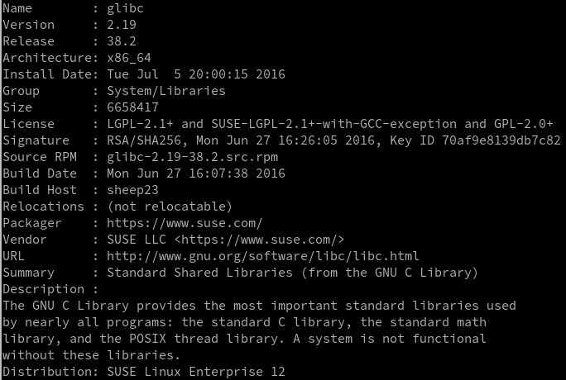
RPM Metadata
Version tracking
Manifest of files
Descriptive data
Rules for:
  Installing
  Updating
  Uninstalling
Dependencies

Slide 7
RPM Packaging Fundamentals
“package”
  Normal .rpm file (that contains the payload of software and metadata)
  The set of files necessary to build the software
RPM Database
rpm
rpmbuild
  Builds software from sources
  Builds for a specific architecture
  Creates a versioned binary package for installation/upgrade
  cpio archive of files + scriptlets

Slide 8
Anatomy of a spec file
Name | The name of the package. This will be used as a label later on.
Version | Version of the software
Release | Version of the package (think of how many times has the software been packaged
License | Software license (https://spdx.org/licenses/)
Summary | Short description (displayed by rpm)
Url | Points to the documentation
Group | Group of the package
Source | Points to the source
BuildRoot | The build directory of the package

Slide 9
Anatomy of a spec file
%description | Detailed description of the software. More than one line
%prep | Is used to prepare the build environment, including: cleaning the old environment, setting up a new one, expanding the source archive.
%build | Here the build is performed. This can be very complex. But also very simple. In our case: make
%install | This section is used to “install” the application.
%files | List of files in the package
%changelog | Changes to the package

Slide 10
Examples for the workshop

Slide 11
Examples
https://github.com/lethliel/osc_packaging_workshop/blob/master/sources/helloSUSE-1.0.tar.gz
https://github.com/lethliel/osc_packaging_workshop/blob/master/sources/nonsense-0.2.tar.gz
https://github.com/lethliel/hellooSC
https://github.com/lethliel/helloSUSE
https://build.opensuse.org/project/show/home:mstrigl:workshop

Slide 12
Examples
Download the examples sources of helloSUSE and nonsense
Install them the classical way (./configure && make && make install)
Investigate what they are doing

Slide 13
Get the hands dirty!

Slide 14
Creating the package
We are using helloSUSE-1.0.tar.gz for this

Slide 15
Creating the package
osc meta -e pkg <name>
osc mkpac <name>
Difference?

Slide 16
Creating the package
copy the sources
write a spec file

Slide 17
Local build
osc repos
osc build <repo> <arch> <recipe>
The last lines of the output are interesting

Slide 18
Success?
osc vc
  add a meaningful change log entry.
osc status
osc add *
osc ci

Slide 19
More commands
osc blame
osc info
osc log
osc buildhistory <repo> <arch>
osc jobhistory <repo> <arch>

Slide 20
Even more commands
osc results (-v)
osc rbl (remotebuildlog) <proj> <pkg> <repo> <arch>
osc getbinaries <repo> <arch>
osc chroot
osc diff

Slide 21
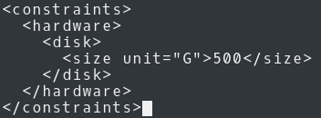
More Topics: _constraints
_constraints files are used to use workers with special features or minimum system requirements.
Basic anatomy:
osc checkconstraints [<repo> <arch>]

Slide 22
More Topics: _constraints
hostlabel |  | Label of the worker. Can be used for reproducible builds
sandbox |  | chroot/Xen/KVM/secure
linux |  | Kernel specific part
 | version | Specific kernel version
 | min | Minimal kernel version
 | max | Maximal kernel version
flavor |  | Specific kernel flavor (default / smp)

Slide 23
More Topics: _constraints
hardware |  |  | Hardware features
 | cpu |  | Cpu related
 |  | flag | Features provided (like mmx). Can be used multiple times
 |  | processors | Minimal amount of processors
 | Disk | size | Minimal size of disk
 | memory | size | Minimal size of memory (including swap)
 | Physicalmemory | size | Minimal site of memory (swap excluded)

Slide 24
Play around with constraints

Slide 25
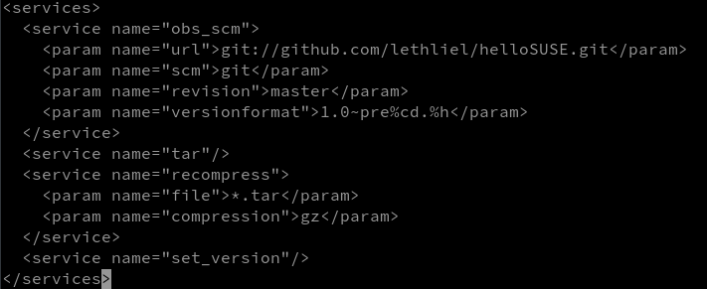
More Topics: _service

Slide 26
More topics: _service
obs-service-download_file | download a file
obs-service-tar_scm | create a tar ball from svn/git/hg
obs-service-set_version | update spec file version string
obs-service_recompress | recompress files
obs-service-format_spec_file | reformats a specfile to SUSE standard

Slide 27
More topics: _service
default | Run after each commit on the server and locally before every build
trylocal | Just locally. Results are not saved with _service: prefix and will be skipped if they are the same
localonly | Just run locally. Results are prefixed with _service:
serveronly | Just run on the server
buildtime | Runs during the build. This means the service package becomes a BuildRequires. Service with mode=”buildtime” do not have network access
disabled | Disable the service

Slide 28
Try to build hellooSC from git with a scm source service

Slide 29
Proper changelog
Describe what you have done and WHY
Include version changes or point to a versioned changelog
Mention bug references
Do not delete bug references
Mention added, deleted or changed patches

Slide 30
It is your turn: Create the package nonsense

Slide 31
More and more topics: meta
Example: Use pkg meta to control the build

Slide 32
So. Let’s do a few packages :-)

