Slide 1
EliteQuant

Slide 2










Bar Event
Order Event
Fill Event
Data Feed
Event Engine
Backtest Brokerage
Event
Portfolio Manager
Order Manager
Strategy Manager
Performance Manager
Data Board

Slide 3



SWIG
VBA
Excel-DNA

Slide 4

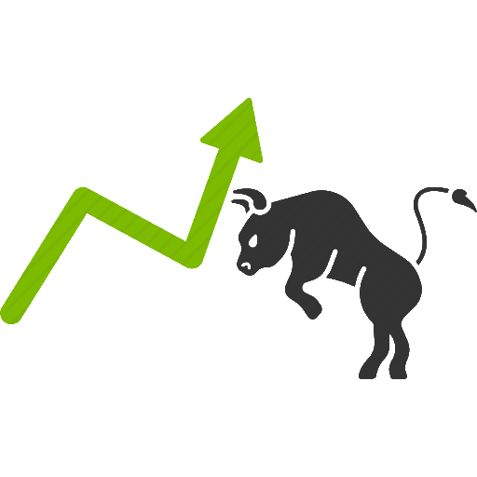
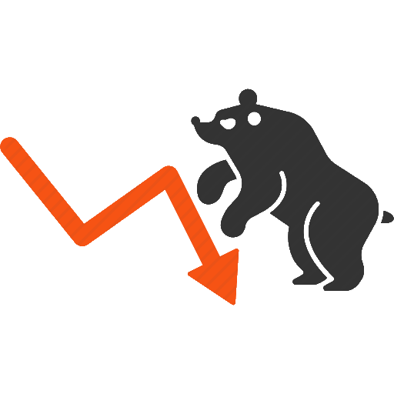
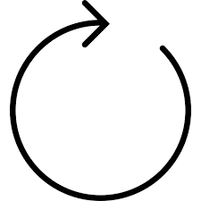
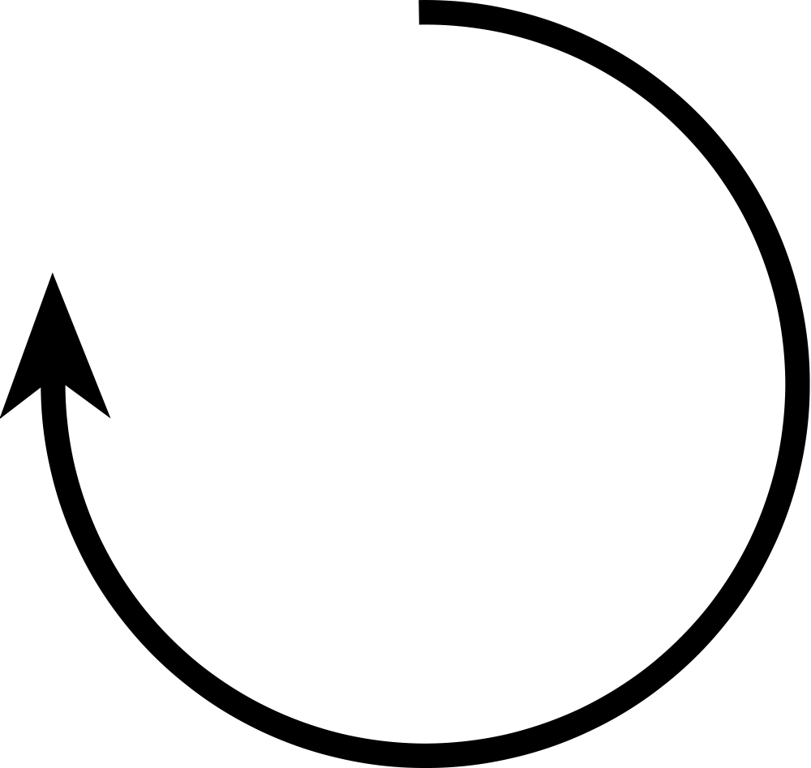


How to know the market from the trader’s mood?
0.5
0.5
0.2
Hidden State
0.8
0.7
0.3
0.1
0.4
0.9
0.6
Observation/Emission

