Slide 1

Intro To Python
Thanos Gentimis

Slide 2

Origins
Released in 1991 Guido Van Rossum (Dutch Programmer)
Two Versions
Python 2. (introduced in 2000, discontinued in 2020)
Python 3. (introduced in 2008, still going strong

Slide 3
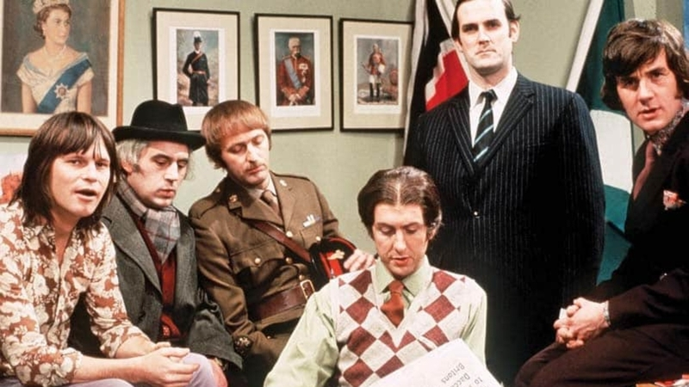
Naming
Python's name is derived from the British comedy group Monty Python

Slide 4
Multi-paradigm programming language
Object-oriented programming
Structured programming
Functional programming
Aspect-oriented programming

Slide 5
Basic Properties
Easily readable language
English keywords instead of punctuation
Few syntactic exceptions
Almost no special cases
Uses whitespace indentation (recommended 4 spaces)

Slide 6
Popularity
Consistently ranked in the top ten most popular programming languages since 2003
It is the most popular language (ahead of Java, and C) since October 2021
Programming Language of the Year in 2007, 2010, 2018, and 2020

Slide 7
Extensions
Python, like R, can be extended through packages/libraries
Since it is open source, anyone can contribute
Extensive support groups and dedicated programmers
Maintained by the Python Enhancement Proposal (PEP)

Slide 8
Companies Using Python
Wikipedia,
Google
Yahoo!
CERN
NASA
Facebook
Amazon
Instagram
Spotify

Slide 9
Anaconda
Distribution of Python (and R) for scientific computing
Simplifies packages, environments
GUI (Anaconda Navigator)
Coda Install Manager

Slide 10
Anaconda Navigator
Jupyter Notebook
Spyder
RStudio
Visual Studio
More …

