Slide 1

Rental Housing in Portugal
Everyone needs a roof over their head
How affordable is rental in Portugal for specific groups?
Influence of short-term rental to long term rental
Data (2021)
Kaggle
Enrichment
Dataset (Kaggle)
Dataset (Airbnb; Kaggle)
Leticia🏦Ferreira | Alexandre👾Garanhão | Aris🧪Goulas

Slide 2
Trends
Room | [%]
T0 | 8
T1 | 18
T2 | 32
T3 | 26
T4 | 10
T5 | 4
T5+ | 2
 | [€/m²]
2017 | 4.39
2018 | 4.80
2019 | 5.32
2020 | 5.61
2021 | 6.04
2022 | 6.55
Source: INE
😮
+36%
Budget requirements?
Quartiles: Q1 (25%) at 820 € | Q2 at 1,300 €
House types (room) rather equally distributed
T1 – T2 –T3 | T0 limited
Average €/m²
12.1 vs. 8.1
(biased)

Slide 3
Spatial analysis
💶
💶
💶
💶
Cheap | [€/m²]
Setúbal | 2.8
Braga | 5.6
Santarém | 6.5
Expensive | [€/m²]
Loulé | 41.0
Cascais | 20.0
Lisboa | 17.9
Popular | Properties
Lisboa | 761
Porto | 266
Cascais | 245
Top20
Overall high: 12.1
Big | [m²]
Setúbal | 879
Faro | 275
Santarém | 224
Small | [m²]
Tavira | 78
Loulé | 88
Portimão | 92
60 m² / 1070 €
Overall large: 176 (biased)

Slide 4
Short-term rental (Airbnb)
Intention: compare long-term to short-term housing
Q: how to relate prices (/day, /month)
Q: go from spatial analysis to localization (heat-maps) and see if it matches pattern with long-term
What went wrong?
Data cleaning and time-crunch

Slide 5
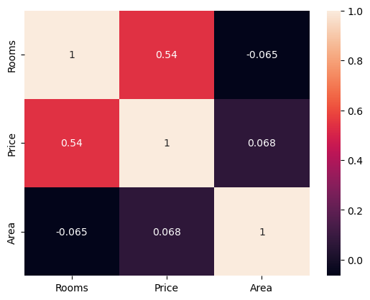
Correlations
Rooms increase the price stronger than house area
Complex relationships
Housestock age (condition)
Location IN location

Slide 6
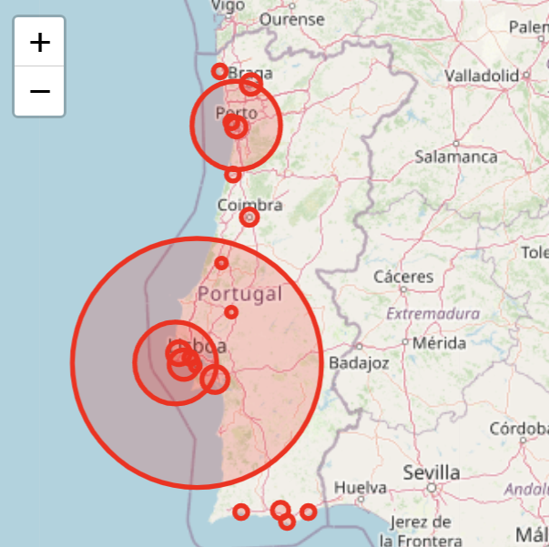
Visualizations
Captures the offer (counts)
Worked toward showing price (heat map)

Slide 7
Conclusions & follow-up
From cleaning to filtering
Geo-localization for connection with Airbnb
Time-dependence
Cross-check imperative (bias)
Didn’t go into actual question
What does the dataset capture?

