Slide 1
Display Time: In-class
Write a program that obtains hours, minutes and remaining seconds from seconds.
Get the time as seconds from the user and convert it to hours, minutes and seconds

Slide 2
3.2
Mathematical Expressions

Slide 3
Mathematical Expressions
Can create complex expressions using multiple mathematical operators
An expression can be a literal, a variable, or a mathematical combination of constants and variables
Can be used in assignment, cout, other statements:
area = 2 * PI * radius;
cout << "border is: " << 2*(l+w);

Slide 4

Algebraic Expressions
Multiplication requires an operator:
Area=lw is written as Area = l * w;
There is no exponentiation operator:
Area=s² is written as Area = pow(s, 2);
Parentheses may be needed to maintain order of operations:
is written as
m = (y2-y1) /(x2-x1);
$$m=\frac{y2−y1}{x2−x1}$$

Slide 5
Algebraic Expressions
Table 3-5 Algebraic and C++ Multiplication Expressions
Algebraic Expression | Operation | C++ Equivalent
6B | 6 times B | 6 * B
(3)(12) | 3 times 12 | 3 * 12
4xy | 4 times x times y | 4 * x * y

Slide 6
Exponent Operations
Need to include cmath library for this operation
cout << pow(2.0, 3) << endl; // Display 8.0
cout << pow(4.0, 0.5) << endl; // Display 2.0
cout << pow(2.5, 2) << endl; // Display 6.25
cout << pow(2.5, -2) << endl; // Display 0.16
3.5.cpp

Slide 7
X ** Y
Write a program that reads the values of x and y from the keyboard, and implement the following formula:
𝑉𝑎𝑙𝑢𝑒=𝑥^𝑦
Liang, Introduction to Java Programming, 11th Edition, (c) 2018 Pearson Education, Inc. All rights reserved.

Slide 8
Operator Precedence
Mathematical expressions can be very complex.
There is a set order in which arithmetic operations will be carried out.
Operator | Associativity | Example | Result
- (unary negation) | Right to left | x = -4 + 3; | -1
* / % | Left to right | x = -4 + 4 % 3 * 13 + 2; | 11
+ - | Left to right | x = 6 + 3 – 4 + 6 * 3; | 23
Higher
Priority
Lower
Priority

Slide 9
Precedence rules for arithmetic operators.
Operator/Convention | Description | Explanation
( ) | Items within parentheses are evaluated first | In 2 * (x + 1), the x + 1 is evaluated first, with the result then multiplied by 2.
unary - | - used for negation (unary minus) is next | In 2 * -x, the -x is computed first, with the result then multiplied by 2.
* / % | Next to be evaluated are *, /, and %, having equal precedence. | In y = 3 + 14%3, 14%3 is evaluated first, with the result then added to 3, because % has higher precedence than +.
+ - | Finally come + and - with equal precedence. | In y = 3 + 2 * x, the 2 * x is evaluated first, with the result then added to 3, because * has higher precedence than +. Spacing doesn't matter: y = 3+2 * x would still evaluate 2 * x first.
left-to-right | If more than one operator of equal precedence could be evaluated, evaluation occurs left to right. | In y = x * 2 / 3, the x * 2 is first evaluated, with the result then divided by 3.

Slide 10
Associativity of Operators
- (unary negation) associates right to left
*, /, %, +, - associate right to left
parentheses ( ) can be used to override the order of operations:
2 + 2 * 2 – 2 = 4
(2 + 2) * 2 – 2 = 6
2 + 2 * (2 – 2) = 2
(2 + 2) * (2 – 2) = 0

Slide 11
Order of Operations
In an expression with more than one operator, evaluate in this order:
- (unary negation), in order, left to right
* / %, in order, left to right
+ -, in order, left to right
In the expression 2 + 2 * 2 – 2
evaluate
second
evaluate
first
evaluate
third

Slide 12
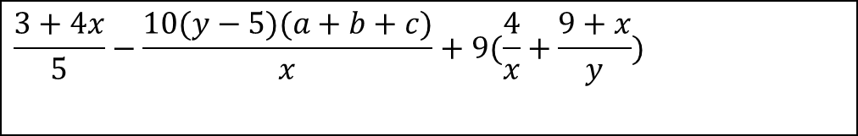
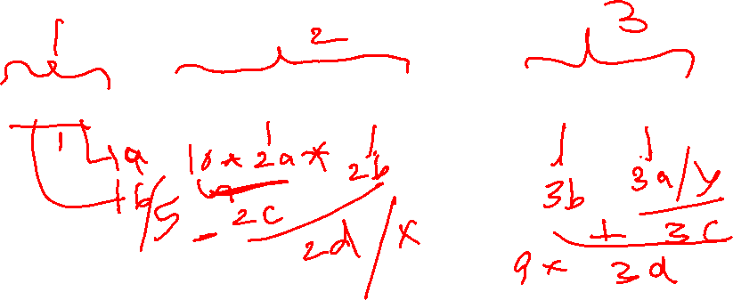
Arithmetic Expressions
$$\frac{3+4x}{5}−\frac{10(y−5)(a+b+c)}{x}+9(\frac{4}{x}+\frac{9+x}{y})$$
is translated to
(3+4*x)/5 – (10*(y-5)*(a+b+c))/x + 9*(4/x + (9+x)/y)

Slide 13
Grouping with Parenthesis
When parenthesis are used in an expression, the inner most parenthesis are processed first.
If two sets of parenthesis are at the same level, they are processed left to right.
x = ((4*5) / (5-2) ) – 25; // result = -19
3
1
2
4

Slide 14
How to Evaluate an Expression
Though C++ has its own way to evaluate an expression behind the scene, the result of a C++ expression and its corresponding arithmetic expression are the same. Therefore, you can safely apply the arithmetic rule for evaluating a C++ expression.

Slide 15
Grouping with Parentheses
Table 3-4 More Simple Expressions and Their Values
Expression | Value
(5 + 2) * 4 | 28
10 / (5 − 3) | 5
8 + 12 * (6 − 2) | 56
(4 + 17) % 2 − 1 | 0
(6 − 3) * (2 + 7) / 3 | 9

Slide 16
Grouping with Parentheses
Example:
How would we encode the following formula in C?

Slide 17
Grouping with Parentheses
Example:
How would we encode the following formula in C?
We could do it as follows:
y = (4 * a * c – d) / (2 – b);

Slide 18

Grouping with Parentheses
Example:
How would we encode the following formula in C?
We could do it as follows:
y = (4 * a * c – d) / (2 – b);
If we remove the parentheses from the statement above, the implemented equation is:

Slide 19
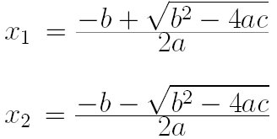
Simple Equations
A quadratic (second order polynomial) equation
ax² + bx + c = 0
can be solved by the formulas
Note: The square root of a negative value is a complex number. In this case, VC++ throws an error like: -1.#IND
Write a program to solve for x in equation x² – 5x + 6 = 0.

Slide 20
Simple Equations
Program1: Solve for x² – 5x + 6 = 0
/* File: secondorder1.c */
#include <iostream>
#include <math.h> int main() { double a = 1.0, b = -5.0, c = 6.0, x1, x2; x1 = (-b +sqrt(b*b-4*a*c))/(2*a); x2 = (-b -sqrt(b*b-4*a*c))/(2*a); cout << "x1 = " << x1 << endl;
cout << "x2 = " << x2 << endl; return 0;
}
Output:
x1 = 3.000000
x2 = 2.000000

Slide 21
Simple Equations quadratic.cpp
x₁ = ( - b + sqrt( b * b – 4 * a * c )) / ( 2 * a)
1
2
8
6
_
*
*
2.0
*
5.0
25.0
4.0
3
*
24.0
a = 1.0
b = -5.0
c = 6.0
4
_
1.0
5
sqrt
7
1.0
+
6.0
9
3.0
/
x₁

Slide 22
3.3
When You Mix Apples with Oranges: Type Conversion

Slide 23
When You Mix Apples with Oranges: Type Conversion
Operations are performed between operands of the same type.
If not of the same type, C++ will convert one to be the type of the other
This can impact the results of calculations.

Slide 24
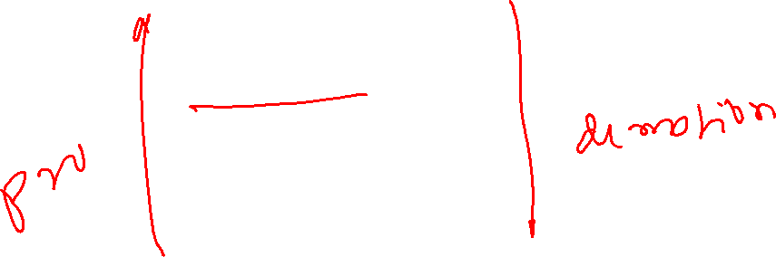
Hierarchy of Types
Highest:
Lowest:
Ranked by largest number they can hold
long double
double
float
unsigned long
long
unsigned int
int

Slide 25
Type Coercion
Type Coercion: automatic conversion of an operand to another data type
Promotion: convert to a higher type
Demotion: convert to a lower type

Slide 26
Coercion Rules
char, short, unsigned short automatically promoted to int
2) When operating on values of different data types, the lower one is promoted to the type of the higher one.
3) When using the = operator, the type of expression on right will be converted to type of variable on left
Coercion.cpp

Slide 27
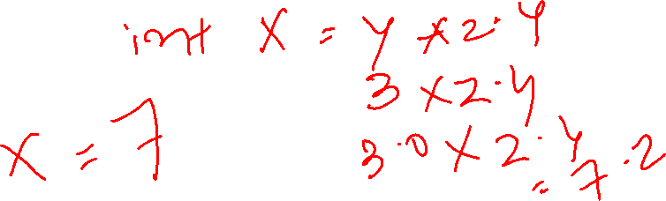
Coercion Rules
char, short, unsigned short automatically promoted to int
2) When operating on values of different data types, the lower one is promoted to the type of the higher one.
3) When using the = operator, the type of expression on right will be converted to type of variable on left
Coercion.cpp

Slide 28
3.4
Overflow and Underflow

Slide 29
Overflow and Underflow
Occurs when assigning a value that is too large (overflow) or too small (underflow) to be held in a variable
Variable contains value that is ‘wrapped around’ set of possible values
Different systems may display a warning/error message, stop the program, or continue execution using the incorrect value
3.7.cpp, overUnderFlow.cpp

Slide 30
3.5
Type Casting

Slide 31
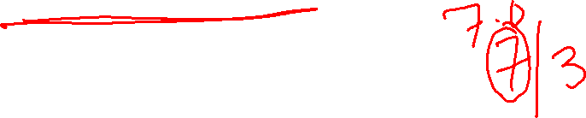
Type Casting
Used for manual data type conversion
Useful for floating point division using ints: double m; m = static_cast<double>(y2-y1)
/(x2-x1);
Useful to see int value of a char variable:
char ch = 'C';
cout << ch << " is "
<< static_cast<int>(ch);

Slide 32
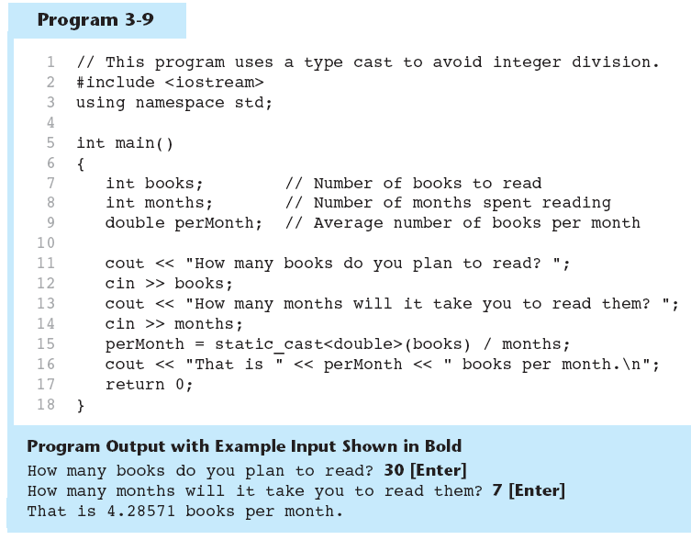
Type Casting in Program 3-9

Slide 34
C-Style and Prestandard Type Cast Expressions
C-Style cast: data type name in ()
cout << ch << " is " << (int)ch;
Prestandard C++ cast: value in ()
cout << ch << " is " << int(ch);
Both are still supported in C++, although
static_cast is preferred
prodAddDiffStatic.cpp
Notes:
https://stackoverflow.com/questions/10438249/in-c-what-are-the-differences-between-static-castdoublea-and-doublea

Slide 35
Numeric Type Conversion
Consider the following statements:
short i = 100;
long k = i * 3 + 4;
double d = i * 3.1 + k / 2;

Slide 36
Type Casting
Implicit casting
double d = 3; (type widening)
Explicit casting
int i = static_cast<int>(3.0); (type narrowing)
int i = (int)3.9; (Fraction part is truncated)

Slide 37
Promotion (Implicit Conversion)
The algorithms and resultant data types of operations depend on the data types of the operands.
A data type that occupies less memory can be converted to a data type that occupies more memory space without loss of any information.
For binary operations, such as addition, subtraction, multiplication, and division, the resultant data type will take the higher order data type of two operands.
For example, the addition of two float numbers will result in a float, while the addition of a float and a double will result in a double.
This is called implicit conversion (i.e., performed by C++ automatically).

Slide 38
Promotion (Implicit Conversion)
The type of each value in a mixed-type expression is automatically promoted to the “highest” type in the expression (actually a temporary version of each value is created and used for the expression—the original values remain unchanged). .
Converting values to lower types (demotion) can result in an incorrect value under certain conditions. Many compilers, therefore, will throw a warning if this is attempted.
In spite of that, C++ will generally perform demotions (e.g., in assignments and function calls) without having to use a cast, although a cast (explicit conversion) can always be used.

Slide 39
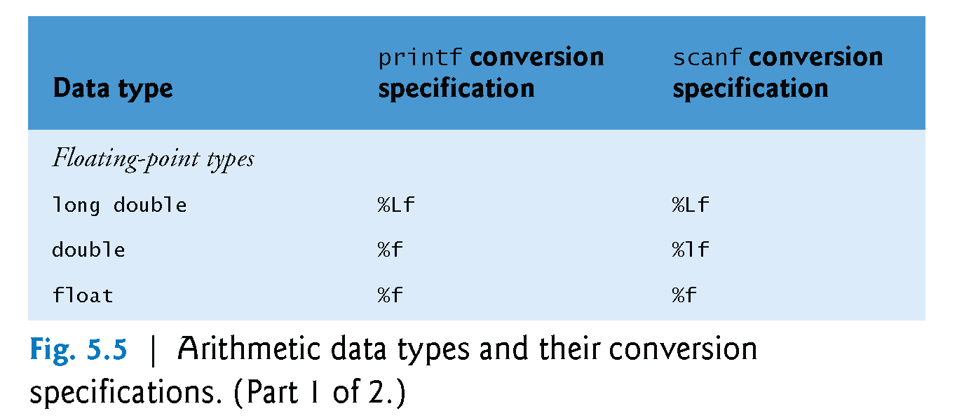
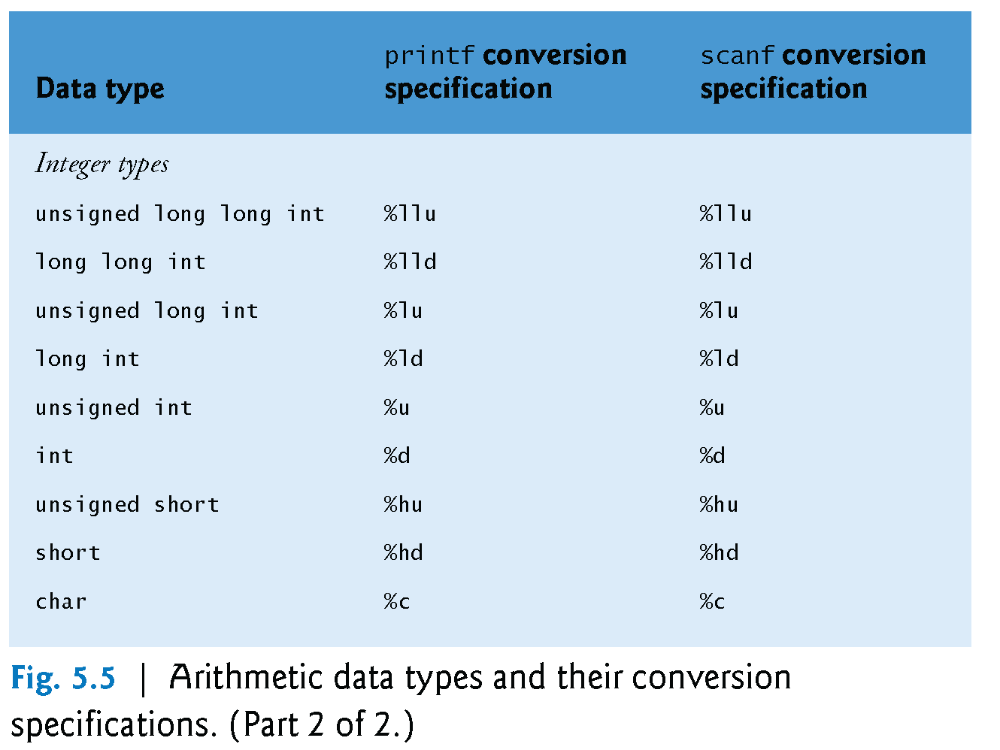
Promotion (Implicit Conversion)

Slide 40
NOTE
Casting does not change the variable being cast. For example, d is not changed after casting in the following code:
double d = 4.5;
int i = static_cast<int>(d); // d is not changed
staticCast.cpp

Slide 42
Casting (Explicit Conversion)
Cast operators are available for most data types.
The cast operator is formed by placing parentheses around a data type name.
average = ( double ) total / counter;
The cast operator is a unary operator, i.e., an operator that takes only one operand.
Cast operators associate from right to left and have the same precedence as other unary operators such as unary + and unary -.
This precedence is one level higher than that of the multiplicative operators *, / and %.

Slide 43
Casting (Explicit Conversion)
Casting can be used to force non-integer division when integer variables are used.
Example: int x = 22, y = 8;
double g;
g = (double) x / y;
g will contain 2.75, since one of the operands, x, was converted to a double. Therefore, the division was not integer division.
Be careful, however. If the cast operator is applied to the entire expression, the result will be different: g = (double) (x / y);
Now g contains 2.0. The division was performed as an integer division (result = 2), that result was converted to a double (result = 2.0), and then assigned to “g”.

Slide 44
Compute Average
Reading multiple inputs in one statement
Calculate average of three numbers by taking in the input from the users.

Slide 45

Example: Converting Temperatures
Write a program that converts a Fahrenheit degree to Celsius using the formula:
$$celsius=\frac{5}{9} ∗ fahrenheit−32$$

Slide 46

Example: Converting Temperatures
Write a program that converts a Fahrenheit degree to Celsius using the formula:
$$celsius=(\frac{5}{9})(fahrenheit−32)$$

Slide 47
Example: Keeping Two Digits After Decimal Points
The sales tax is 6% for any product purchased. Write a program that displays the sales tax with two digits after the decimal point.
SalesTaxDecimalPoint.cpp

Slide 48
Problem: Monetary Units
Calculate the number of $5 notes and $1 notes that a person can have if the user enters a value. Your program should report maximum number of five dollars followed by one dollar
computingChange.cpp

Slide 49
Problem: Monetary Units
This program lets the user enter the amount in decimal representing dollars and cents and output a report listing the monetary equivalent in single dollars, quarters, dimes, nickels, and pennies. Your program should report maximum number of dollars, then the maximum number of quarters, and so on, in this order.
computeChange.cpp

Slide 50
Trace ComputeChange
Suppose amount is 11.56
remainingAmount
1156
int remainingAmount = (int)(amount * 100);
// Find the number of one dollars
int numberOfOneDollars = remainingAmount / 100;
remainingAmount = remainingAmount % 100;
// Find the number of quarters in the remaining amount
int numberOfQuarters = remainingAmount / 25;
remainingAmount = remainingAmount % 25;
// Find the number of dimes in the remaining amount
int numberOfDimes = remainingAmount / 10;
remainingAmount = remainingAmount % 10;
// Find the number of nickels in the remaining amount
int numberOfNickels = remainingAmount / 5;
remainingAmount = remainingAmount % 5;
// Find the number of pennies in the remaining amount
int numberOfPennies = remainingAmount;
remainingAmount initialized

Slide 51
Trace ComputeChange
animation
Suppose amount is 11.56
remainingAmount
1156
int remainingAmount = (int)(amount * 100);
// Find the number of one dollars
int numberOfOneDollars = remainingAmount / 100;
remainingAmount = remainingAmount % 100;
// Find the number of quarters in the remaining amount
int numberOfQuarters = remainingAmount / 25;
remainingAmount = remainingAmount % 25;
// Find the number of dimes in the remaining amount
int numberOfDimes = remainingAmount / 10;
remainingAmount = remainingAmount % 10;
// Find the number of nickels in the remaining amount
int numberOfNickels = remainingAmount / 5;
remainingAmount = remainingAmount % 5;
// Find the number of pennies in the remaining amount
int numberOfPennies = remainingAmount;
11
numberOfOneDollars
numberOfOneDollars assigned

Slide 52
Trace ComputeChange
animation
Suppose amount is 11.56
remainingAmount
56
int remainingAmount = (int)(amount * 100);
// Find the number of one dollars
int numberOfOneDollars = remainingAmount / 100;
remainingAmount = remainingAmount % 100;
// Find the number of quarters in the remaining amount
int numberOfQuarters = remainingAmount / 25;
remainingAmount = remainingAmount % 25;
// Find the number of dimes in the remaining amount
int numberOfDimes = remainingAmount / 10;
remainingAmount = remainingAmount % 10;
// Find the number of nickels in the remaining amount
int numberOfNickels = remainingAmount / 5;
remainingAmount = remainingAmount % 5;
// Find the number of pennies in the remaining amount
int numberOfPennies = remainingAmount;
numberOfOneDollars
11
remainingAmount updated

Slide 53
Trace ComputeChange
animation
Suppose amount is 11.56
int remainingAmount = (int)(amount * 100);
// Find the number of one dollars
int numberOfOneDollars = remainingAmount / 100;
remainingAmount = remainingAmount % 100;
// Find the number of quarters in the remaining amount
int numberOfQuarters = remainingAmount / 25;
remainingAmount = remainingAmount % 25;
// Find the number of dimes in the remaining amount
int numberOfDimes = remainingAmount / 10;
remainingAmount = remainingAmount % 10;
// Find the number of nickels in the remaining amount
int numberOfNickels = remainingAmount / 5;
remainingAmount = remainingAmount % 5;
// Find the number of pennies in the remaining amount
int numberOfPennies = remainingAmount;
remainingAmount
56
numberOfOneDollars
11
numberOfOneQuarters
2
numberOfOneQuarters assigned

Slide 54
Trace ComputeChange
animation
Suppose amount is 11.56
int remainingAmount = (int)(amount * 100);
// Find the number of one dollars
int numberOfOneDollars = remainingAmount / 100;
remainingAmount = remainingAmount % 100;
// Find the number of quarters in the remaining amount
int numberOfQuarters = remainingAmount / 25;
remainingAmount = remainingAmount % 25;
// Find the number of dimes in the remaining amount
int numberOfDimes = remainingAmount / 10;
remainingAmount = remainingAmount % 10;
// Find the number of nickels in the remaining amount
int numberOfNickels = remainingAmount / 5;
remainingAmount = remainingAmount % 5;
// Find the number of pennies in the remaining amount
int numberOfPennies = remainingAmount;
remainingAmount
6
numberOfOneDollars
11
numberOfQuarters
2
remainingAmount updated

