Slide 1
Random Number Generation

Slide 2
RANDOM NUMBER GENERATION
The element of chance can be introduced into computer applications by using the C Standard Library function rand() from the <cstdlib> header.
The rand function generates a pseudo-random integer between 0 and RAND_MAX (a symbolic constant defined in the <cstdlib> header).
It can be used as follows:
i = rand();

Slide 3
RANDOM NUMBER GENERATION
Standard C states that the value of RAND_MAX must be at least 32767, which is the maximum value for a two-byte (i.e., 16-bit) integer.
If rand truly produces integers at random, every number between 0 and RAND_MAX has an equal chance (or probability) of being chosen each time rand is called.
The range of values produced directly by rand is often different from what is needed in a specific application.
For example, a program that simulates coin tossing might require only 0 for “heads” and 1 for “tails.”
A dice-rolling program that simulates a six-sided die would require random integers from 1 to 6.
Dice.cpp

Slide 4
RANDOM NUMBER GENERATION
If we need our random numbers to be generated within a specific range, we can do that by using scaling and shifting.
Scaling limits (i.e., “scales”) the maximum value produced by rand() to whatever we specify.
Shifting shifts the range (generally to the right) on the number line.

Slide 5
Scaling
To perform scaling on the value produced by the rand() function, we use the modulus operator: int x = rand() % 6; Produces a random number between 0 and 5.
In general, a scaling factor of “n” produces random numbers between 0 and n-1. int x = rand() % n;

Slide 6
Shifting
To perform shifting on the value produced by the rand() function, we add an integer value to it: int x = rand() + 5; Produces a random number between 5 and RAND_MAX + 5.

Slide 7
Scaling and Shifting
These two operations can be combined to produce a random integer value in almost any range we want.
For example: x = 1 + rand() % 6; will produce random numbers between 1 and 6 (which might be useful if simulating a roll of the dice).

Slide 8
Scaling and Shifting
To summarize: The values produced directly by rand are always in the range:
0 ≤ rand() ≤ RAND_MAX
As you know, the following statement simulates rolling a six-sided die:
face = 1 + rand() % 6;
The width of this range (i.e., the number of consecutive integers in the range) is 6 and the starting number in the range is 1.
We can generalize this result as follows
n = a + rand() % b;
where a is the shifting value (which is equal to the first number in the desired range of consecutive integers) and b is the scaling factor (which is equal to the width of the desired range of consecutive integers).

Slide 9
Scaling and Shifting
As we mentioned, the general formula for calculating random integers values within a specified range is:
n = a + rand() % b;
where a is the shifting value and b is the scaling factor.
Creating such a range is therefore a two-step process:
Determine the number of numbers in the desired range. Let that value = b.
Note that if a <= x <= b, the number of numbers = (b - a) + 1.
Determine the starting value of the range. Let that value = a.
The resulting expression will generate random integer values over a range of size b and starting at a.

Slide 10
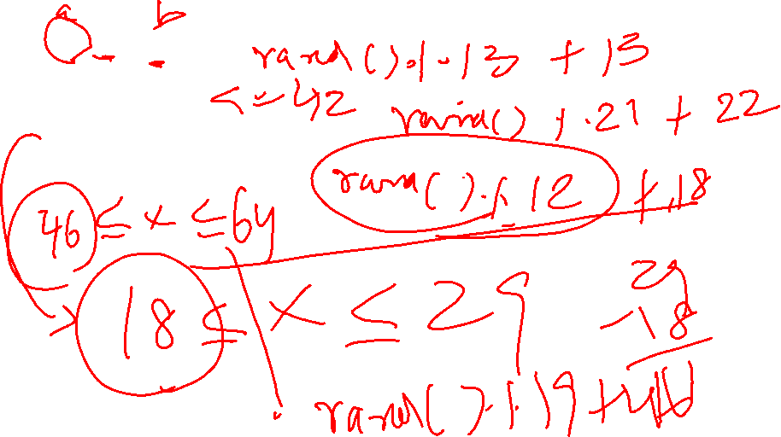
Scaling and Shifting
Let’s work some examples.... What C statements will produce random (integer) numbers in the following ranges?
13 <= x <= 25
22 <= x < 43
17 < x <= 29
45 < x < 65

Slide 11

Scaling and Shifting
Let’s work some examples.... What C statements will produce random (integer) numbers in the following ranges?
13 <= x <= 25
13 + rand() % 13
22 <= x < 43
22 + rand() % 21
17 < x <= 29
18 + rand() % 12
45 < x < 65
46 + rand() % 19

Slide 12
RANDOM NUMBER GENERATION
Note that we get the exact same sequence of values each time we execute this program.
How can these be random numbers? Ironically, this repeatability is an important characteristic of function rand().
When debugging a program, this repeatability is essential for proving that corrections to a program work properly.

Slide 13
RANDOM NUMBER GENERATION
In truth, function rand() doesn’t generate true random numbers. It actually generates what are called pseudorandom numbers.
These are numbers that appear to be random, but which actually repeat themselves each time the program is executed.
As mentioned, this is useful for debugging purposes.
But after a program has been thoroughly debugged, we may want it to produce a different sequence of pseudorandom numbers each time (rather than the same sequence each time).
randTestWithoutSeed.cpp
randSeed.cpp

Slide 14
RANDOM NUMBER GENERATION
So, how do we make our programs produce a different sequence of random numbers each time?
This is called randomizing and is accomplished with the standard library function srand.
Function srand takes an unsigned integer argument and seeds function rand to produce a different sequence of random numbers for each execution of the program.
srand is demonstrated in the following program.
Note that the function prototype for srand is found in <stdlib.h>.

Slide 15
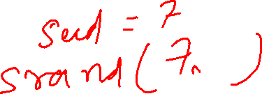

Slide 16
RANDOM NUMBER GENERATION
To randomize without entering a seed each time, we can use a statement like:
srand( time( NULL ) );
This causes the computer to read its clock to obtain the value for the seed automatically.
Function time() returns the number of seconds that have passed since midnight on January 1, 1970.
This value is converted to an unsigned integer and used as the seed to the random number generator.

Slide 17
RANDOM NUMBER GENERATION
“time_t” is a system dependent data type representing time (generally an unsigned integer).
The function prototype for time() is in <ctime>.
Rand_test1.cpp

Slide 18
Add 2 Random numbers – Inclass activity
Generate two random numbers. One number must be between 43 and 87. The second number must be between 35 and 93. Display the sum of two numbers

