Slide 1
3.6
Multiple Assignment and Combined Assignment

Slide 2
Multiple Assignment and Combined Assignment
The = can be used to assign a value to multiple variables:
x = y = z = 5;
Value of = is the value that is assigned
Associates right to left:
x = (y = (z = 5));
value
is 5
value
is 5
value
is 5

Slide 3
Combined Assignment
Look at the following statement:
sum = sum + 1;
This adds 1 to the variable sum.

Slide 4
Other Similar Statements
Table 3-8 (Assume x = 6)
Statement | What It Does | Value of x After the Statement
x = x + 4; | Adds 4 to x | 10
x = x − 3; | Subtracts 3 from x | 3
x = x * 10; | Multiplies x by 10 | 60
x = x / 2; | Divides x by 2 | 3
x = x % 4 | Makes x the remainder of x / 4 | 2

Slide 5
Combined Assignment
The combined assignment operators provide a shorthand for these types of statements.
The statement
sum = sum + 1;
is equivalent to
sum += 1;

Slide 6
Combined Assignment Operators (1 of 2)
C++ has some combined assignment operators.
These operators allow the programmer to perform an arithmetic operation and assignment with a single operator.
Although not required, these operators are popular since they shorten simple equations.

Slide 7
Combined Assignment Operators (2 of 2)
Operator | Example | Equivalent | Value of variable after operation
+= | x += 5; | x = x + 5; | The old value of x plus 5.
-= | y -= 2; | y = y – 2; | The old value of y minus 2
*= | z *= 10; | z = z * 10; | The old value of z times 10
/= | a /= b; | a = a / b; | The old value of a divided by b.
%= | c %= 3; | c = c % 3; | The remainder of the division of the old value of c divided by 3.

Slide 8
3.11

Slide 9
3.7
Formatting Output

Slide 10
Formatting Output
Can control how output displays for numeric, string data:
size
position
number of digits
Requires iomanip header file

Slide 11
Stream Manipulators
Used to control how an output field is displayed
Some affect just the next value displayed:
setw(x): print in a field at least x spaces wide. Use more spaces if field is not wide enough
3.12

Slide 12
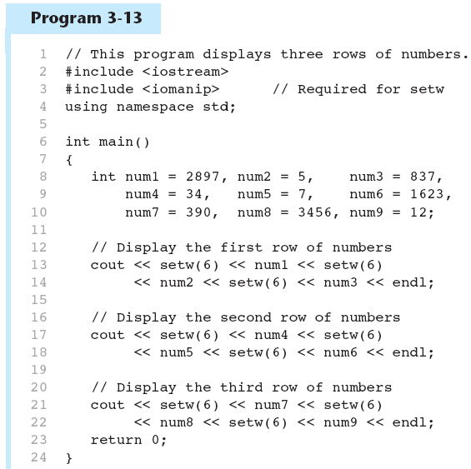
The setw Stream Manipulator in 3-13
Continued…

Slide 13
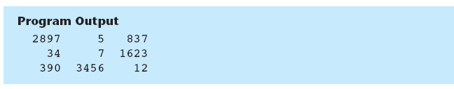
The setw Stream Manipulator in 3-13

Slide 14
Stream Manipulators
Some affect values until changed again:
fixed: use decimal notation for floating-point values
setprecision(x): when used with fixed, print floating-point value using x digits after the decimal. Without fixed, print floating-point value using x significant digits
showpoint: always print decimal for floating-point values
3.15

Slide 15
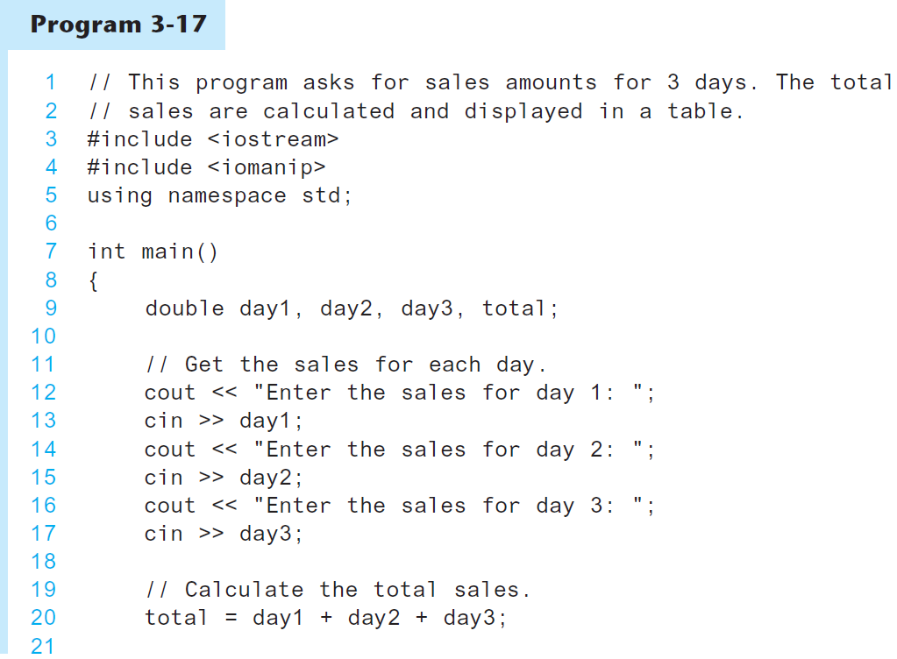
More Stream Manipulators in 3-17

Slide 16
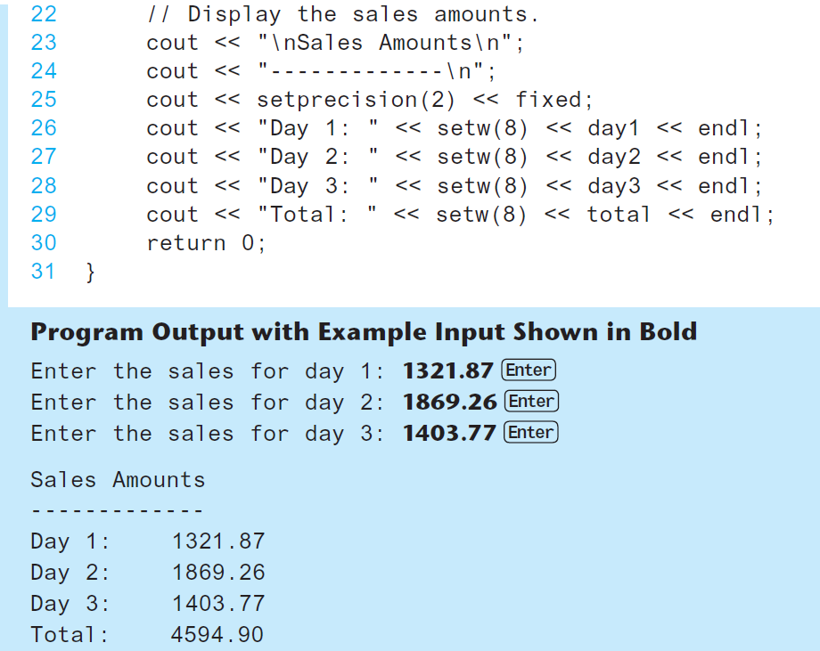
More Stream Manipulators in 3-17

Slide 17
Stream Manipulators
Table 3-12 Stream Manipulators
Stream Manipulator | Description
setw(n) | Establishes a print field of n spaces.
fixed | Displays floating-point numbers in fixed-point notation.
showpoint | Causes a decimal point and trailing zeros to be displayed, even if there is no fractional part.
setprecision(n) | Sets the precision of floating-point numbers.
left | Causes subsequent output to be left-justified.
right | Causes subsequent output to be right-justified.

Slide 18
Precision Demo
fixedResetFixed.cpp
Precision.cpp In class ass 5(PrecisionStudent.cpp)
PrettyPrinting In class ass 6 (PrettyPrintingStudent.cpp)

Slide 19
3.8
Working with Characters and string Objects

Slide 20
Working with Characters and string Objects
Using cin with the >> operator to input strings can cause problems:
It passes over and ignores any leading whitespace characters (spaces, tabs, or line breaks)
To work around this problem, you can use a C++ function named getline.
3.18

Slide 21
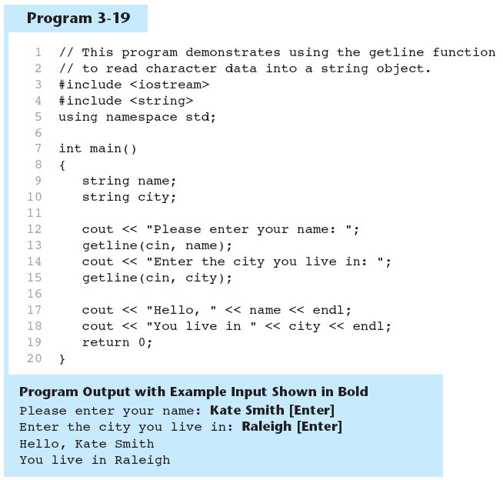
Using getline in Program 3-19

Slide 22
Working with Characters and string Objects
To read a single character:
Use cin:
char ch;
cout << "Strike any key to continue";
cin >> ch;
Problem: will skip over blanks, tabs, <CR>
Use cin.get():
cin.get(ch);
Will read the next character entered, even whitespace
3.20

Slide 23
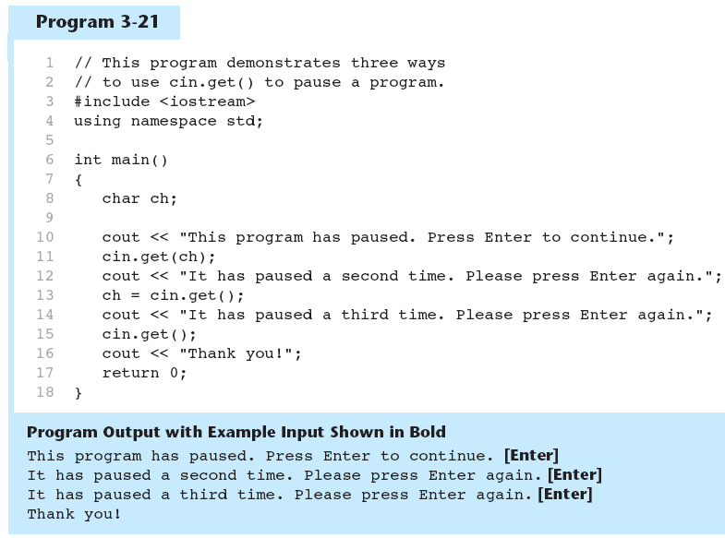
Using cin.get() in Program 3-21

Slide 24
Working with Characters and string Objects
Mixing cin >> and cin.get() in the same program can cause input errors that are hard to detect 3.22
To skip over unneeded characters that are still in the keyboard buffer, use cin.ignore():
cin.ignore(); // skip next char
cin.ignore(10, '\n'); // skip the next
// 10 char. or until a '\n’ 3.23

Slide 25
string Member Functions and Operators
To find the length of a string:
To concatenate (join) multiple strings:
stringDemo.cpp
string state = "Texas";
int size = state.length();
greeting2 = greeting1 + name1;
greeting1 = greeting1 + name2;
Or using the += combined assignment operator:
greeting1 += name2;

Slide 26
3.9
More Mathematical Library Functions

Slide 27
More Mathematical Library Functions
Require cmath header file 3.24
Take double as input, return a double
Commonly used functions:
mathsFunctions.cpp
sin | Sine
cos | Cosine
tan | Tangent
sqrt | Square root
log | Natural (e) log
abs | Absolute value (takes and returns an int)

Slide 28
Go to Random numbers chapter.

Slide 29
More Mathematical Library Functions
These require cstdlib header file
rand(): returns a random number (int) between 0 and the largest int the compute holds. Yields same sequence of numbers each time program is run.
srand(x): initializes random number generator with unsigned int x
3.25

Slide 30
Generate Random numbers within a range
Get one end of the range and store -> end1
Get the other end and store -> end2
Range = end2 – end1 + 1
Seed the random number generator with current time
Output = end1 + random() % range
Rand_test1.cpp

Slide 31
3.10
Hand Tracing a Program

Slide 32
Hand Tracing a Program
Hand trace a program: act as if you are the computer, executing a program:
step through and ‘execute’ each statement, one-by-one
record the contents of variables after statement execution, using a hand trace chart (table)
Useful to locate logic or mathematical errors

Slide 33
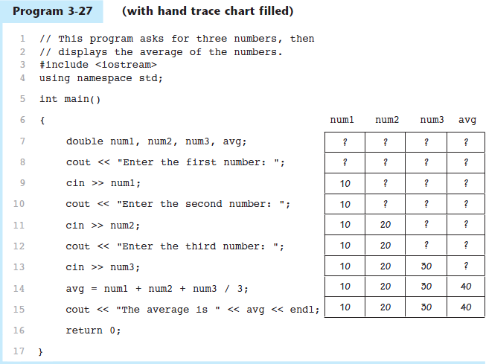
Program 3-27 with Hand Trace Chart

Slide 34
3.11
A Case Study

Slide 35
A Case Study
General Crates, Inc. builds custom-designed wooden crates.
You have been asked to write a program that calculates the:
Volume (in cubic feet)
Cost
Customer price
Profit of any crate GCI builds

Slide 36
Variables
Table 3-14 Named Constants and Variables
Constant or Variable | Description
COST_PER_CUBIC_FOOT | A named constant, declared as a double and initialized with the value 0.23. This represents the cost to build a crate, per cubic foot.
CHARGE_PER_CUBIC_FOOT | A named constant, declared as a double and initialized with the value 0.5. This represents the amount charged for a crate, per cubic foot.
length | A double variable to hold the length of the crate, which is input by the user.
width | A double variable to hold the width of the crate, which is input by the user.
height | A double variable to hold the height of the crate, which is input by the user.
volume | A double variable to hold the volume of the crate. The value stored in this variable is calculated.
cost | A double variable to hold the cost of building the crate. The value stored in this variable is calculated.
charge | A double variable to hold the amount charged to the customer for the crate. The value stored in this variable is calculated.
profit | A double variable to hold the profit GCI makes from the crate. The value stored in this variable is calculated.

Slide 37
Program Design
The program must perform the following general steps:
Step 1:
Ask the user to enter the dimensions of the crate
Step 2:
Calculate:
the crate’s volume
the cost of building the crate
the customer’s charge
the profit made
Step 3:
Display the data calculated in Step 2.

Slide 38
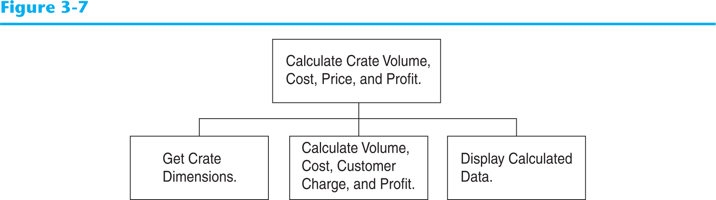
General Hierarchy Chart

Slide 39
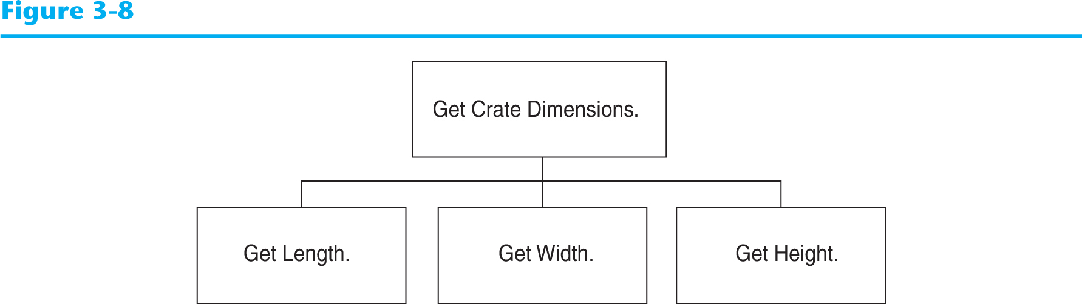
Get Crate Dimensions

Slide 40
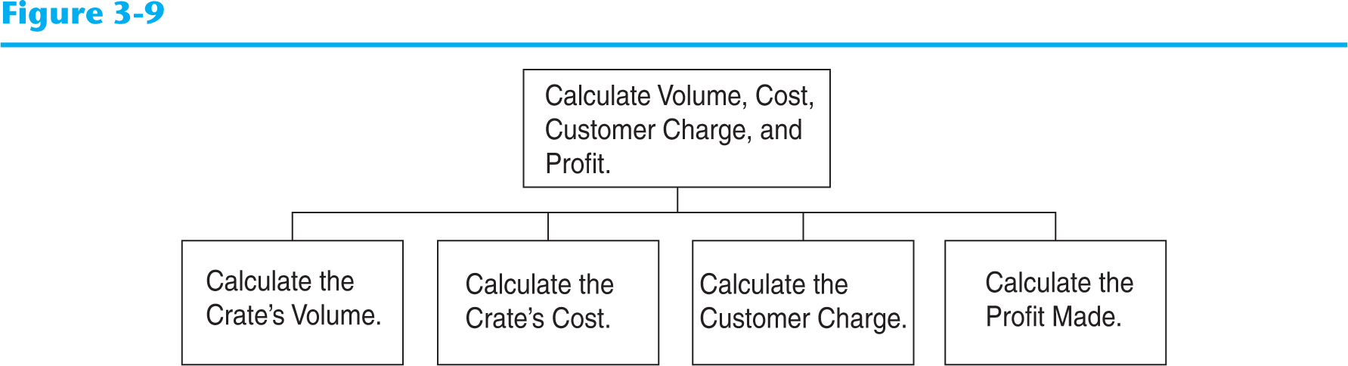
Calculate Volume, Cost, Customer Charge, and Profit

Slide 41
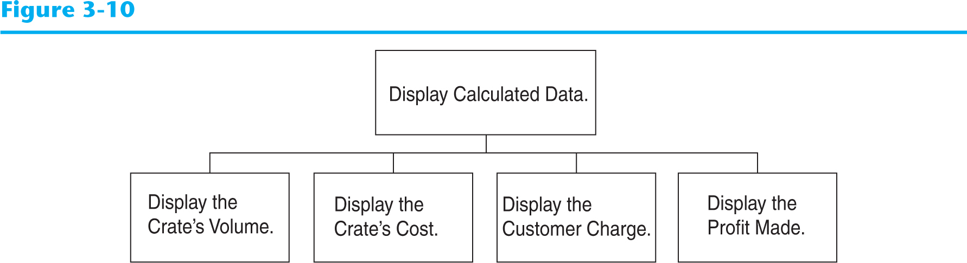
Display Calculated Data

Slide 42
Psuedocode
Ask the user to input the crate's length.
Ask the user to input the crate's width.
Ask the user to input the crate's height.
Calculate the crate's volume.
Calculate the cost of building the crate.
Calculate the customer's charge for the crate.
Calculate the profit made from the crate.
Display the crate's volume.
Display the cost of building the crate.
Display the customer's charge for the crate.
Display the profit made from the crate.

Slide 43
Calculations
The following formulas will be used to calculate the crate’s volume, cost, charge, and profit:
volume = length × width × height
cost = volume × 0.23
charge = volume × 0.5
profit = charge − cost

Slide 44
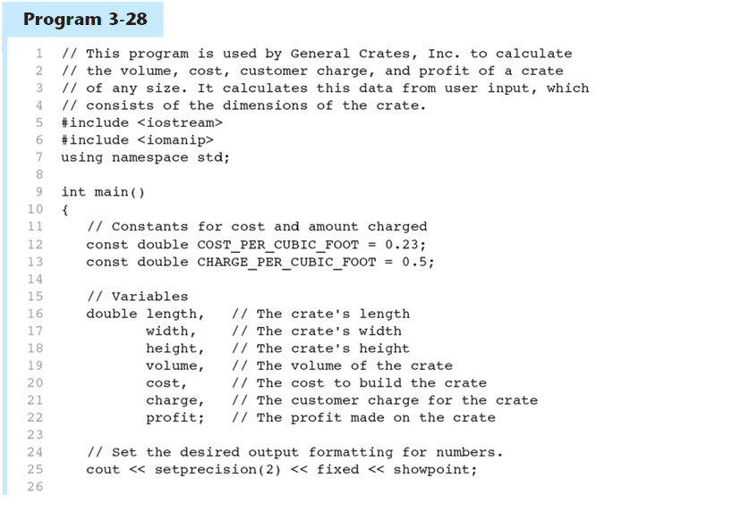
The Program
Continued…

Slide 45
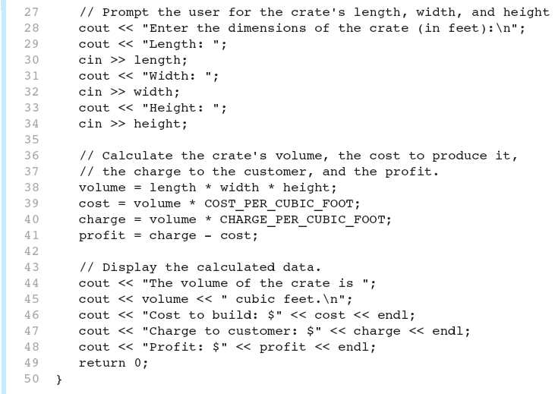
The Program
Continued…

Slide 46
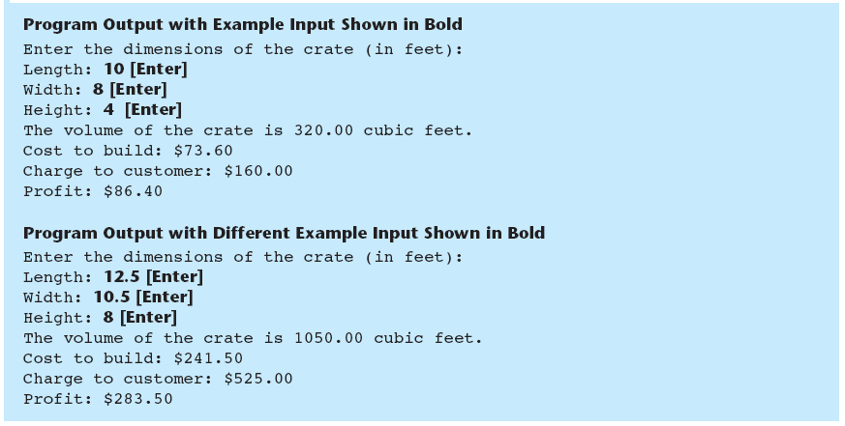
The Program

