Slide 1
string Member Functions and Operators
To find the length of a string:
To concatenate (join) multiple strings:
stringDemo.cpp
string state = "Texas";
int size = state.length();
greeting2 = greeting1 + name1;
greeting1 = greeting1 + name2;
Or using the += combined assignment operator:
greeting1 += name2;

Slide 2
3.9
More Mathematical Library Functions

Slide 3
More Mathematical Library Functions
Require cmath header file 3.24
Take double as input, return a double
Commonly used functions:
mathsFunctions.cpp
sin | Sine
cos | Cosine
tan | Tangent
sqrt | Square root
log | Natural (e) log
abs | Absolute value (takes and returns an int)

Slide 4
Go to Random numbers chapter.

Slide 5
More Mathematical Library Functions
These require cstdlib header file
rand(): returns a random number (int) between 0 and the largest int the compute holds. Yields same sequence of numbers each time program is run.
srand(x): initializes random number generator with unsigned int x
3.25

Slide 6
Generate Random numbers within a range
Get one end of the range and store -> end1
Get the other end and store -> end2
Range = end2 – end1 + 1
Seed the random number generator with current time
Output = end1 + random() % range
Rand_test1.cpp

Slide 7
3.10
Hand Tracing a Program

Slide 8
Hand Tracing a Program
Hand trace a program: act as if you are the computer, executing a program:
step through and ‘execute’ each statement, one-by-one
record the contents of variables after statement execution, using a hand trace chart (table)
Useful to locate logic or mathematical errors

Slide 9
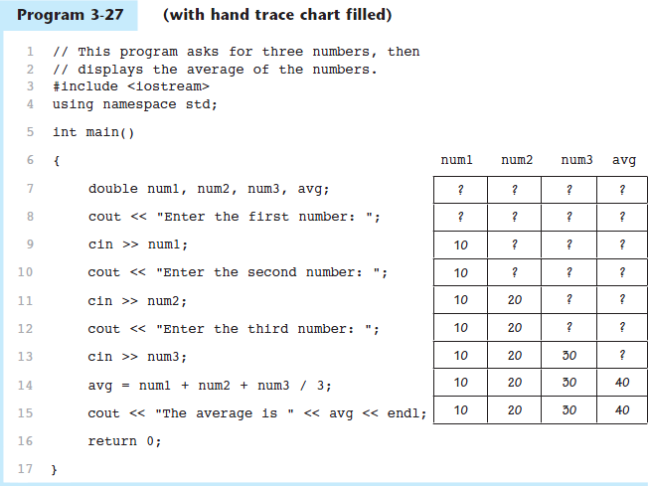

Program 3-27 with Hand Trace Chart

Slide 10
3.11
A Case Study

Slide 11
A Case Study
General Crates, Inc. builds custom-designed wooden crates.
You have been asked to write a program that calculates the:
Volume (in cubic feet)
Cost
Customer price
Profit of any crate GCI builds

Slide 12
Variables
Table 3-14 Named Constants and Variables
Constant or Variable | Description
COST_PER_CUBIC_FOOT | A named constant, declared as a double and initialized with the value 0.23. This represents the cost to build a crate, per cubic foot.
CHARGE_PER_CUBIC_FOOT | A named constant, declared as a double and initialized with the value 0.5. This represents the amount charged for a crate, per cubic foot.
length | A double variable to hold the length of the crate, which is input by the user.
width | A double variable to hold the width of the crate, which is input by the user.
height | A double variable to hold the height of the crate, which is input by the user.
volume | A double variable to hold the volume of the crate. The value stored in this variable is calculated.
cost | A double variable to hold the cost of building the crate. The value stored in this variable is calculated.
charge | A double variable to hold the amount charged to the customer for the crate. The value stored in this variable is calculated.
profit | A double variable to hold the profit GCI makes from the crate. The value stored in this variable is calculated.

Slide 13
Program Design
The program must perform the following general steps:
Step 1:
Ask the user to enter the dimensions of the crate
Step 2:
Calculate:
the crate’s volume
the cost of building the crate
the customer’s charge
the profit made
Step 3:
Display the data calculated in Step 2.

Slide 14
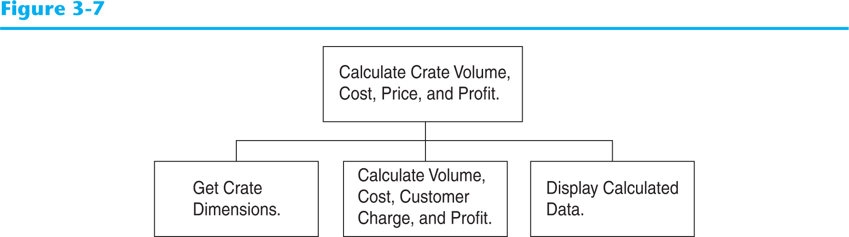
General Hierarchy Chart

Slide 15
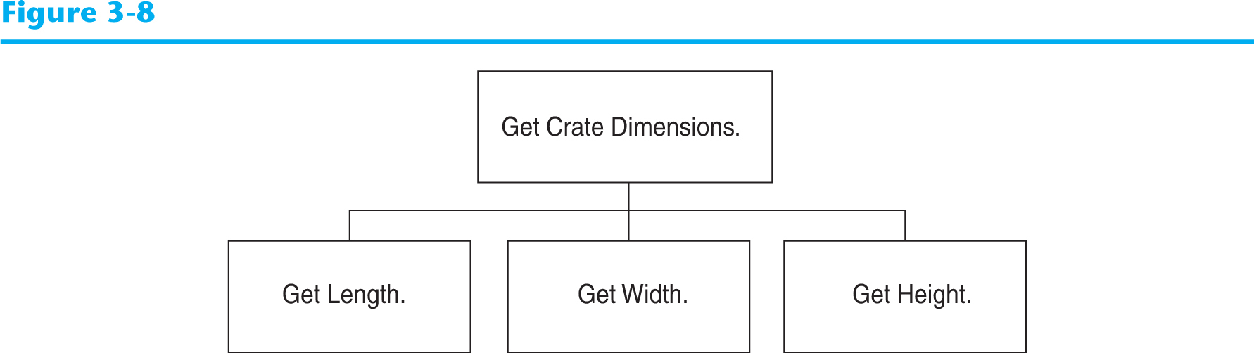
Get Crate Dimensions

Slide 16
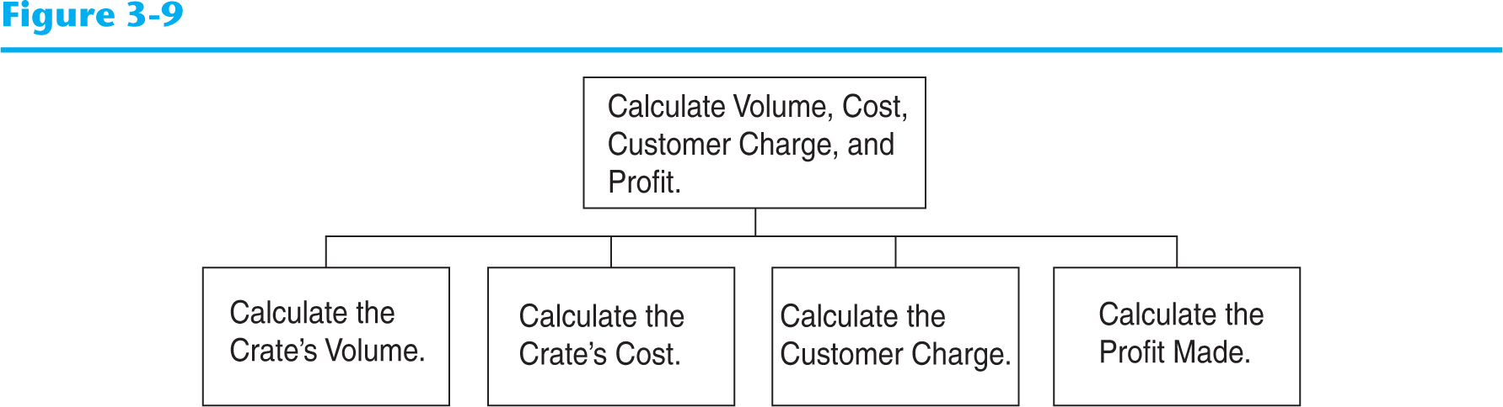
Calculate Volume, Cost, Customer Charge, and Profit

Slide 17
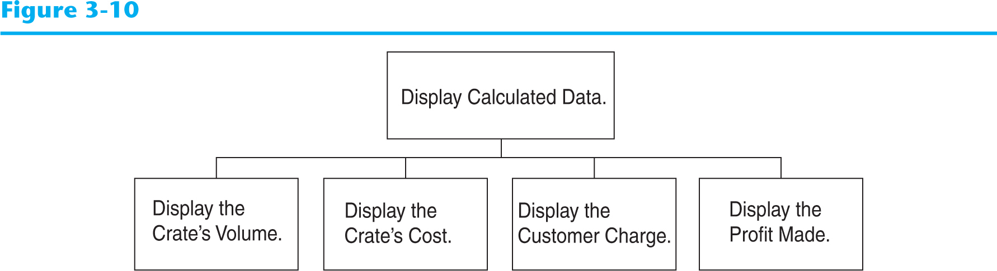
Display Calculated Data

Slide 18
Psuedocode
Ask the user to input the crate's length.
Ask the user to input the crate's width.
Ask the user to input the crate's height.
Calculate the crate's volume.
Calculate the cost of building the crate.
Calculate the customer's charge for the crate.
Calculate the profit made from the crate.
Display the crate's volume.
Display the cost of building the crate.
Display the customer's charge for the crate.
Display the profit made from the crate.

Slide 19
Calculations
The following formulas will be used to calculate the crate’s volume, cost, charge, and profit:
volume = length × width × height
cost = volume × 0.23
charge = volume × 0.5
profit = charge − cost

Slide 20
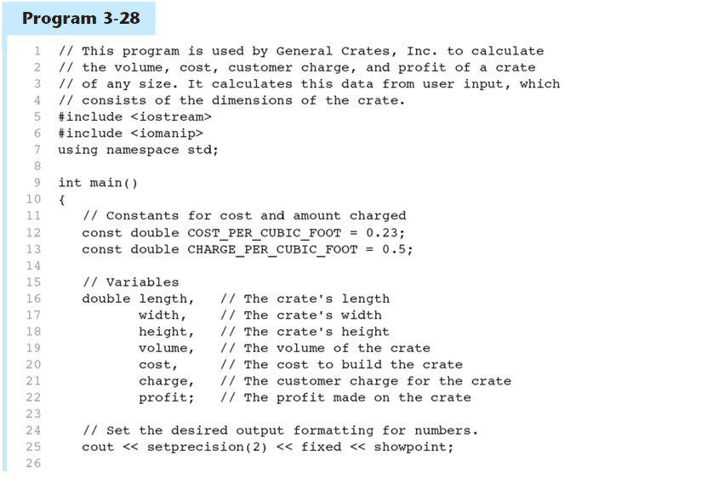
The Program
Continued…

Slide 21
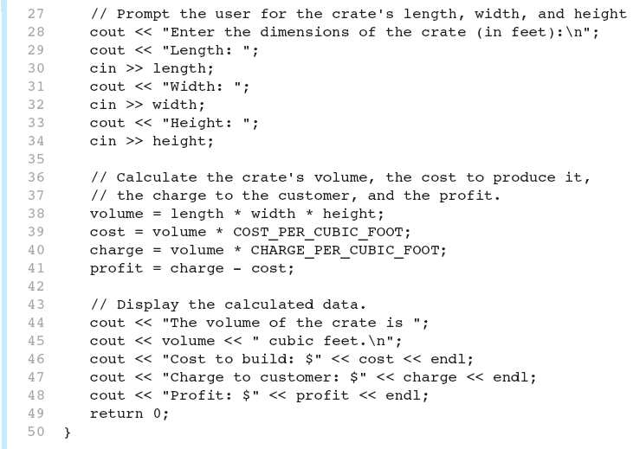
The Program
Continued…

Slide 22
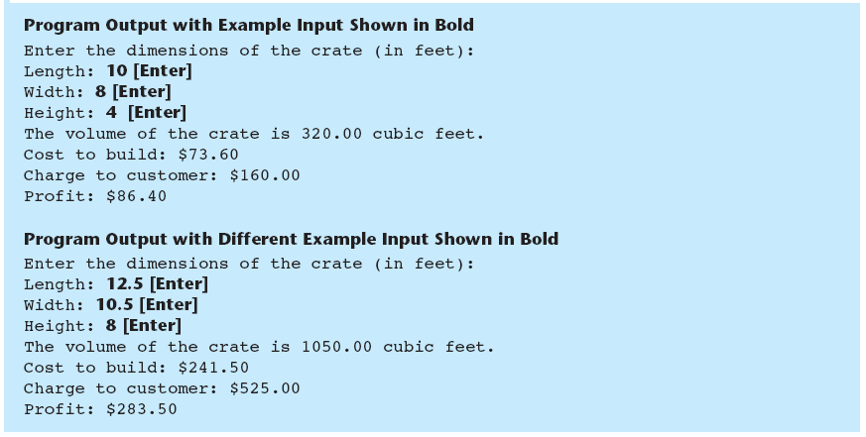
The Program

