Slide 1
Making Decisions

Slide 2

Motivations
If you assigned a negative value for radius in ComputeArea.cpp, the program would print an invalid result.
If the radius is negative, you don't want the program to compute the area.
How can you deal with this situation?
Liang, Introduction to Java Programming, 11th Edition, (c) 2018 Pearson Education, Inc. All rights reserved.

Slide 3
The boolean Type and Operators
Often in a program you need to compare two values, such as
C++ provides six comparison operators (also known as relational operators) that can be used to compare two values.
whether i > j or not?
whether radius > 0 or not?
Liang, Introduction to Java Programming, 11th Edition, (c) 2018 Pearson Education, Inc. All rights reserved.

Slide 4
4.1
Relational Operators

Slide 5
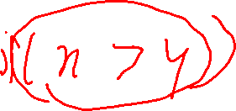
Relational Operators
Used to compare numbers to determine relative order
Operators:
> | Greater than
< | Less than
>= | Greater than or equal to
<= | Less than or equal to
== | Equal to
!= | Not equal to

Slide 6
Relational Operators

Slide 7
Relational Expressions
Boolean expressions – true or false
Examples:
12 > 5 is true
7 <= 5 is false
if x is 10, then
x == 10 is true,
x != 8 is true, and
x == 8 is false

Slide 8
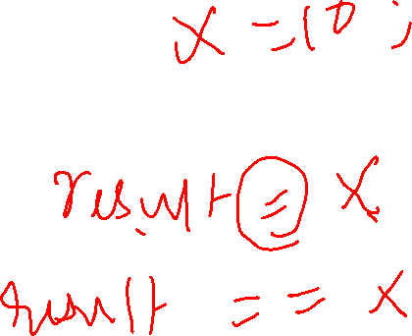
Relational Expressions
Can be assigned to a variable:
result = x <= y;
Assigns 0 for false, 1 for true
Do not confuse = and ==

Slide 9
4.2
The if Statement

Slide 10
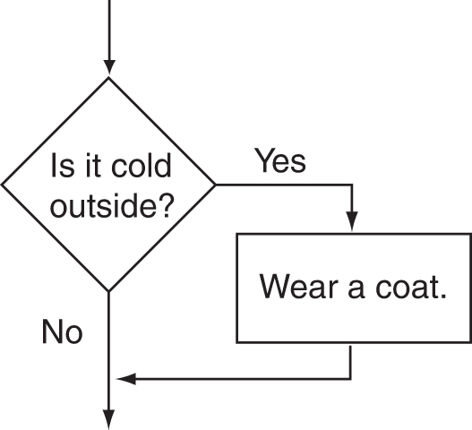
Flowchart for Evaluating a Decision

Slide 11
The if Statement
Allows statements to be conditionally executed or skipped over
Models the way we mentally evaluate situations:
"If it is raining, take an umbrella."
"If it is cold outside, wear a coat."

Slide 12
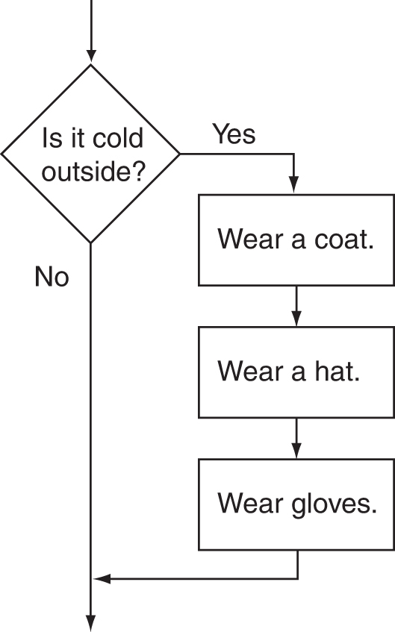
Flowchart for Evaluating a Decision

Slide 13
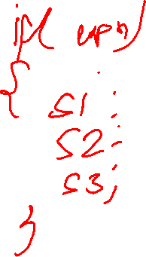

The if Statement
General Format:
if (expression)
statement;

Slide 14
The if Statement-What Happens
To evaluate:
if (expression)
statement;
If the expression is true, then statement is executed.
If the expression is false, then statement is skipped.

Slide 15
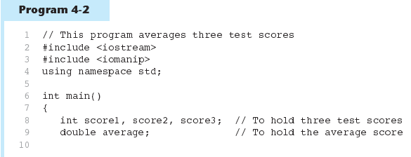
if Statement in Program 4-2
Continued…

Slide 16
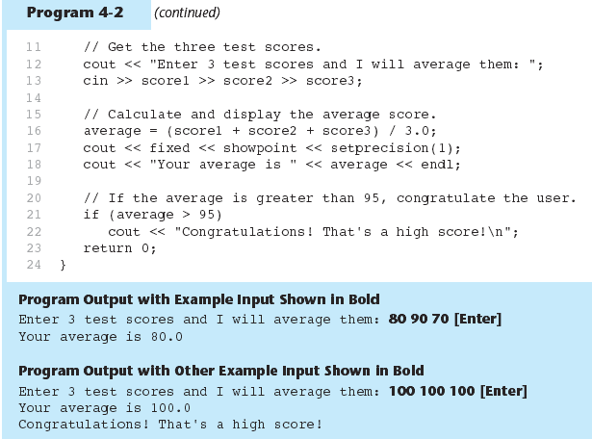
if Statement in Program 4-2

Slide 17
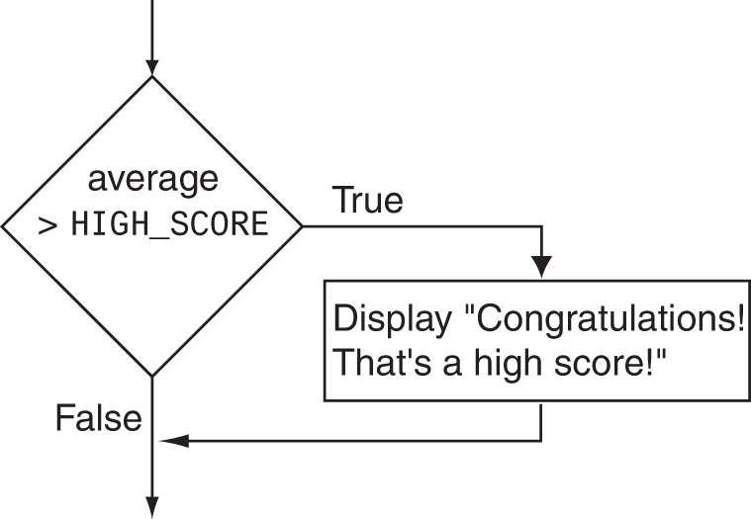
Flowchart for Program 4-2 Lines 21 and 22

Slide 18
if Statement Notes
Do not place ; after (expression)
Place statement; on a separate line after expression), indented:
if (score > 90)
grade = 'A’;
Be careful testing floats and doubles for equality
0 is false; any other value is true

Slide 19
Caution
Adding a semicolon at the end of an if clause is a common mistake.
This mistake is hard to find, because it is not a compilation error or a runtime error, it is a logic error.
This error often occurs when you use the next-line block style.

Slide 20

Note

Slide 21
4.3
Expanding the if Statement

Slide 22
Expanding the if Statement
To execute more than one statement as part of an if statement, enclose them in { }:
if (score > 90)
{
grade = 'A';
cout << "Good Job!\n";
}
{ } creates a block of code

Slide 23
4.3 Misplaced semicolon
4.4 Floating point comparison
4.5 Assignment operator
4.6 Several statements enclosing in {}
4.7 What if your forget {}

Slide 24
Classroom Exercise
Write a program that prompts the user to enter an integer. If the number is a multiple of 5, display HiFive. If the number is even, display HiEven.
What should be the result if the input is 4?
What should be the result if the input is 30?

Slide 25
4.4
The if/else Statement

Slide 26
The if/else statement
Provides two possible paths of execution
Performs one statement or block if the expression is true, otherwise performs another statement or block.

Slide 27
if-else Statement Flowcharts
No
Yes
Is it cold
outside?
Wear shorts.
Wear a coat.

Slide 28
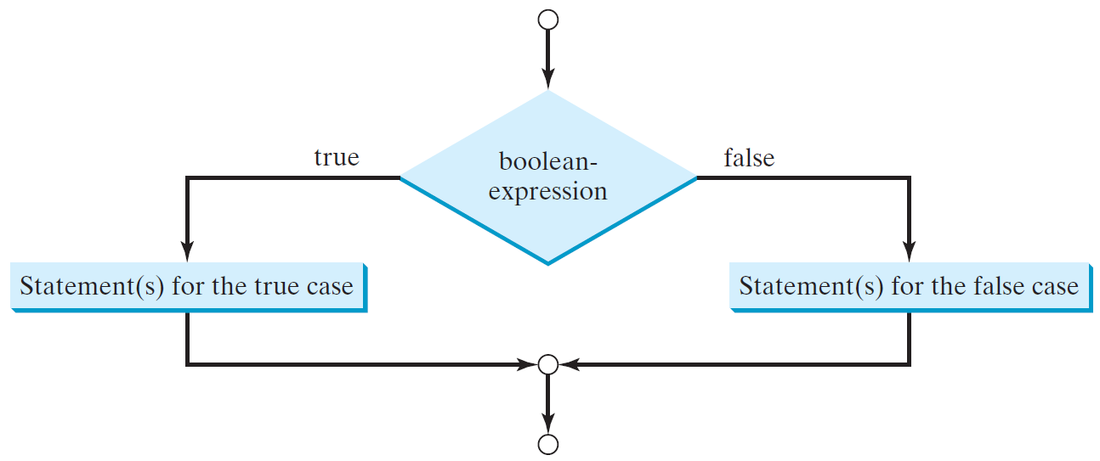
The Two-way if Statement
if (boolean-expression) {
statement(s)-for-the-true-case;
}
else {
statement(s)-for-the-false-case;
}
Liang, Introduction to Java Programming, 11th Edition, (c) 2018 Pearson Education, Inc. All rights reserved.

Slide 29
The if/else statement
General Format:
if (expression)
statement1; // or block
else
statement2; // or block

Slide 30
if/else-What Happens
To evaluate:
if (expression)
statement1;
else
statement2;
If the expression is true, then statement1 is executed and statement2 is skipped.
If the expression is false, then statement1 is skipped and statement2 is executed.

Slide 31
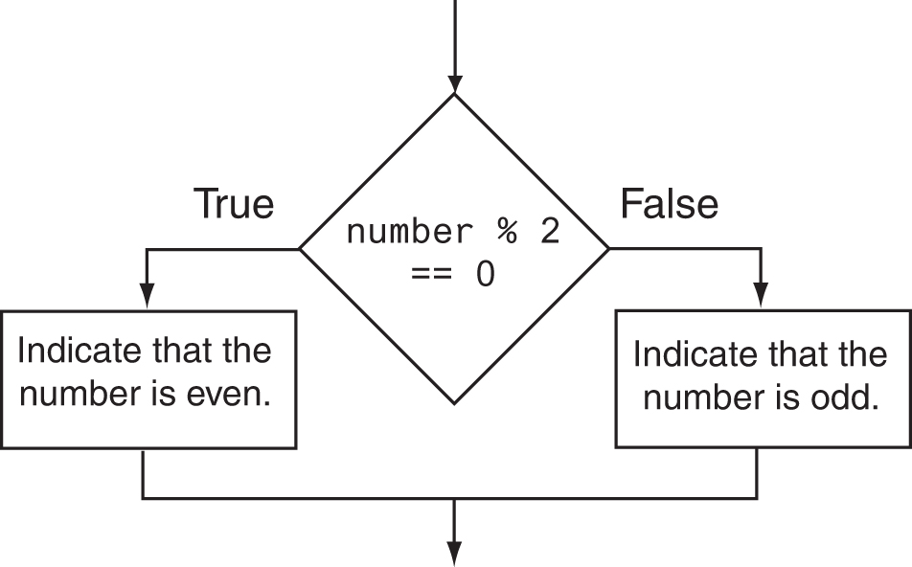
Flowchart for Program 4-8 Lines 14 through 18

Slide 32
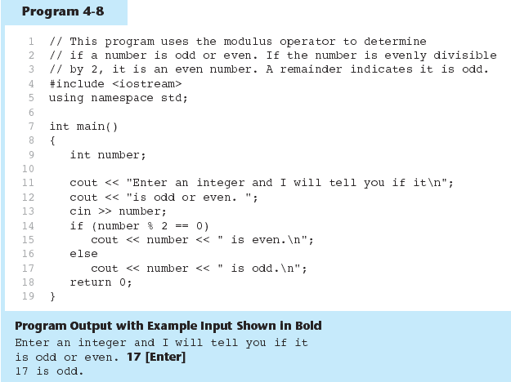
The if/else statement and Modulus Operator in Program 4-8

Slide 33
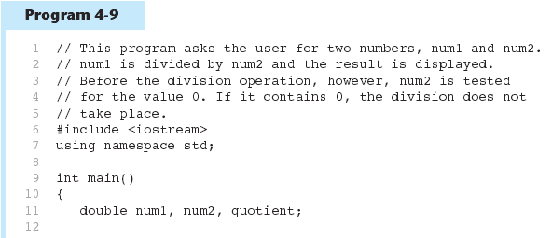
Testing the Divisor in Program 4-9
Continued…

Slide 34
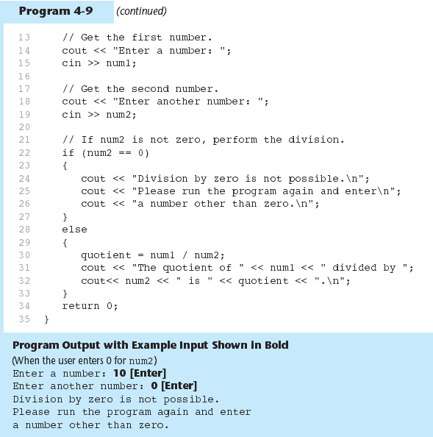
Testing the Divisor in Program 4-9

Slide 35
if-else Example
if (radius >= 0) {
area = radius * radius * 3.14159;
cout << “The area for the circle of radius” << radius << " is "
<< area;
}
else {
cout << “Negative input”;
}
CircleArea.cpp
Liang, Introduction to Java Programming, 11th Edition, (c) 2018 Pearson Education, Inc. All rights reserved.

Slide 36
Classroom Exercise
Create a program for a first grader to practice subtractions. The program randomly generates two single-digit integers number1 and number2. Ask the user to input the difference of the two numbers with always the greater number as the first operand. If the user inputs wrong answer, print a message, “Your answer is wrong. The correct answer is ” with the correct answer. Otherwise print “Your answer is correct.”
Hint:
Check if number1 < number2, otherwise swap them
Ask the user what is “number1 – number2”?
Print the message according to the user input
Liang, Introduction to Java Programming, 11th Edition, (c) 2018 Pearson Education, Inc. All rights reserved.

Slide 37
Writing a Program
Step 1: Designing An Algorithm
Generate two random numbers.
Check if number1 < number2, otherwise swap them
Prompt the student to answer “what is number1 – number2?”
Grade the answer and display the result
Subtraction.cpp

Slide 38
4.5
Nested if Statements

Slide 39
Nested if Statements
An if statement that is nested inside another if statement
Nested if statements can be used to test more than one condition

Slide 40
Nested if Statement Flowcharts
No
Yes
Is it cold
outside?
Wear shorts.
No
Is it
snowing?
Yes
Wear a jacket.
Wear a parka.

Slide 41
Nested if Statement Flowcharts
if (coldOutside)
{
if (snowing)
{
wearParka();
}
else
{
wearJacket();
}
}
else
{
wearShorts();
}

Slide 42
Nested if Statement Flowcharts
Curly brace use is not required if there is only one statement to be conditionally executed.
However, sometimes curly braces can help make the program more readable.
Additionally, proper indentation makes it much easier to match up else statements with their corresponding if statement.

Slide 43
Alignment and Nested if Statements
if (coldOutside)
{
if (snowing)
{
wearParka();
}
else
{
wearJacket();
}
}
else
{
wearShorts();
}
This if and else
go together.
This if and else
go together.

Slide 44
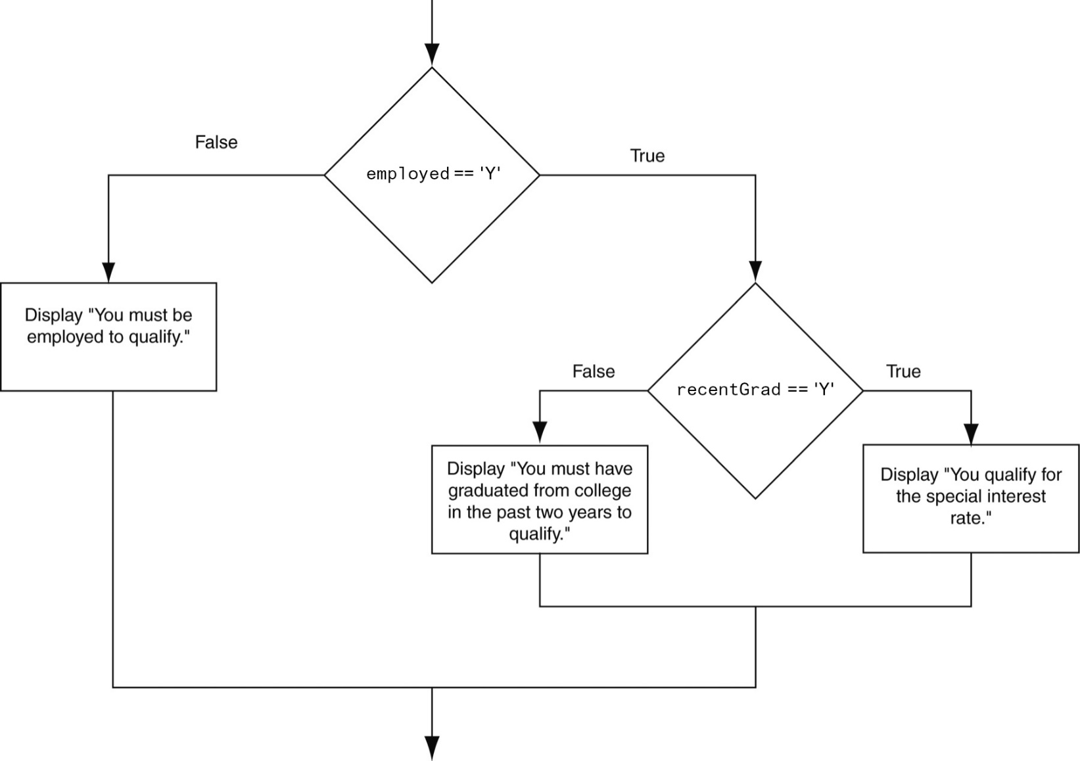
Another Flowchart for a Nested if Statement

Slide 45
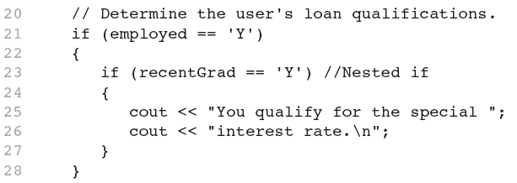
Nested if Statements
From Program 4-10

Slide 46
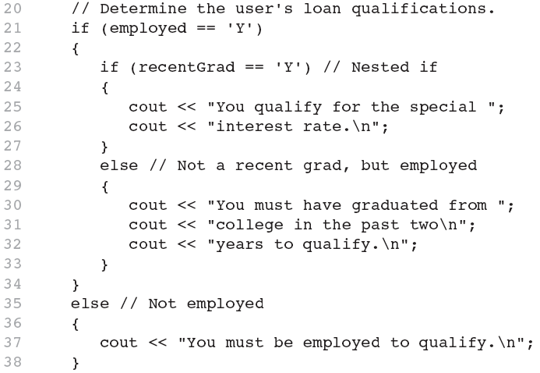
Nested if Statements
Another example, from Program 4-11

Slide 47
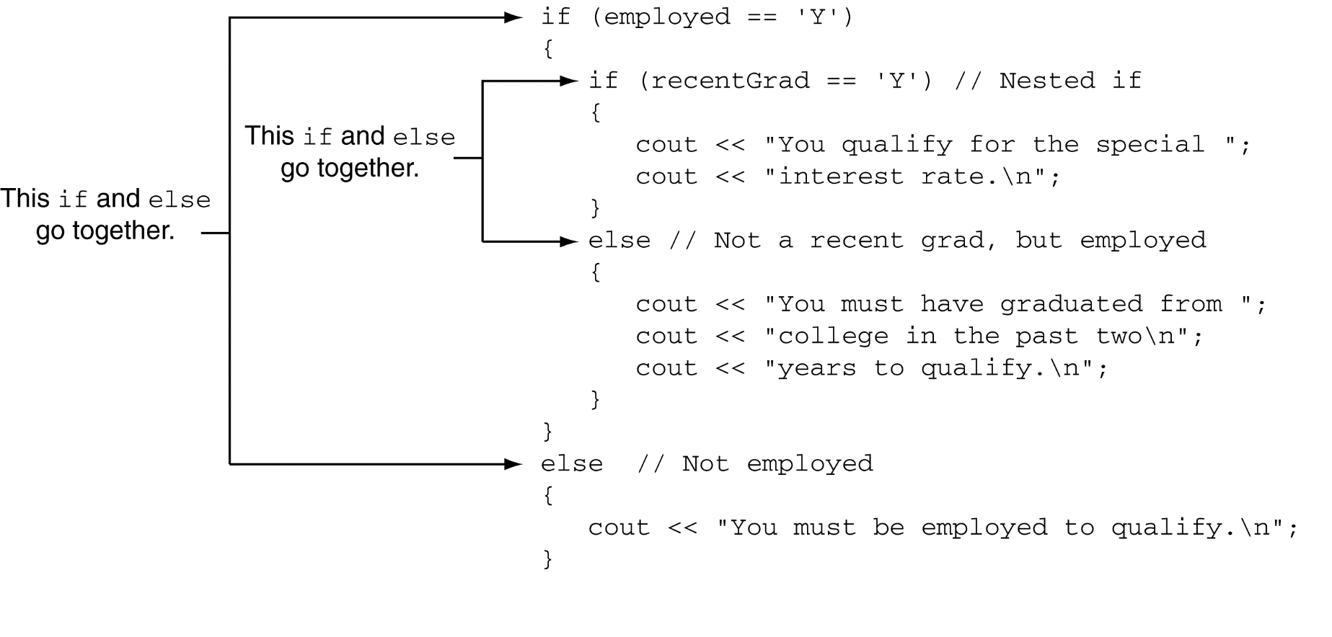
Use Proper Indentation!

Slide 48
4.6
The if/else if Statement

Slide 49
The if/else if Statement
Tests a series of conditions until one is found to be true
Often simpler than using nested if/else statements
Can be used to model thought processes such as:
"If it is raining, take an umbrella, else, if it is windy, take a hat, else, take sunglasses”

Slide 50
if/else if Format
if (expression)
statement1; // or block
else if (expression)
statement2; // or block
.
. // other else ifs .
else if (expression)
statementn; // or block

Slide 51
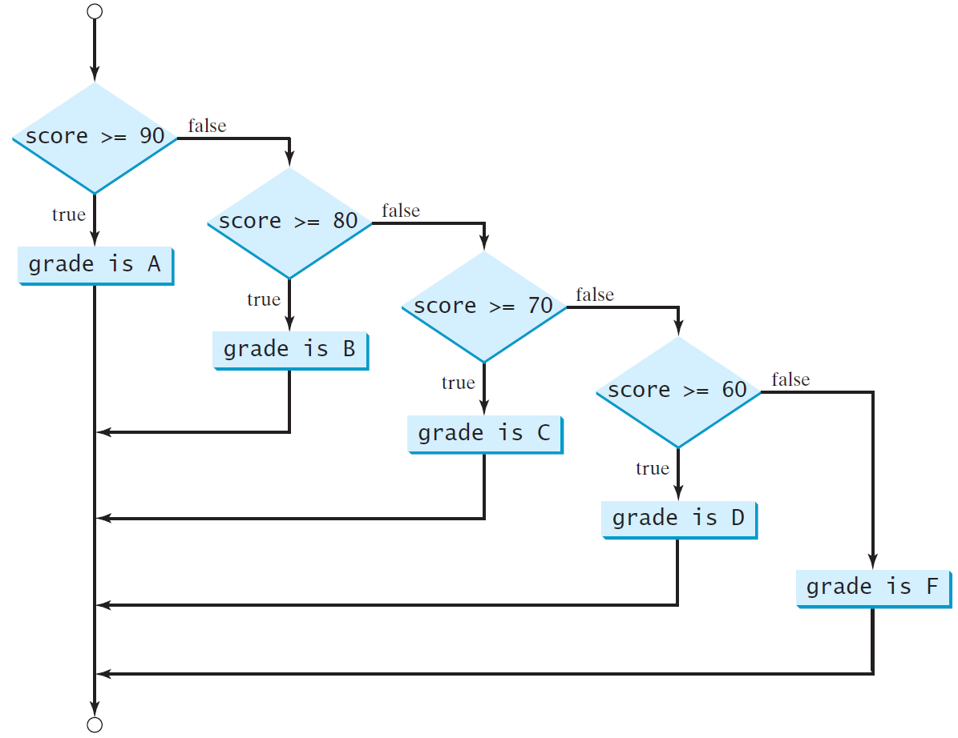
Multi-Way if-else Statements
Liang, Introduction to Java Programming, 11th Edition, (c) 2018 Pearson Education, Inc. All rights reserved.

Slide 52
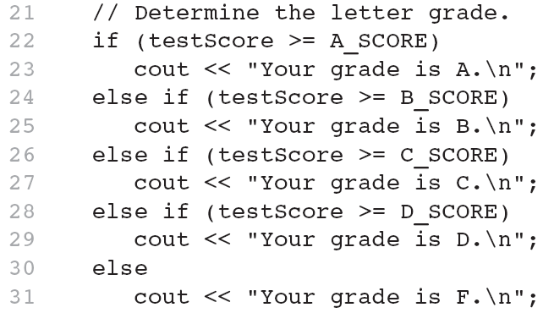
The if/else if Statement in Program 4-13

Slide 53
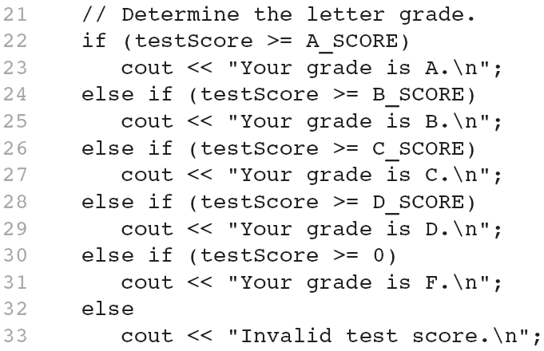
Using a Trailing else to Catch Errors in Program 4-14
The trailing else clause is optional, but it is best used to catch errors.
This trailing else catches invalid test scores

Slide 54
Trace if-else statement
animation
Suppose score is 70.0
The condition is false
if (score >= 90.0)
cout << “Grade is A";
else if (score >= 80.0)
cout << “Grade is B";
else if (score >= 70.0)
cout << “Grade is C";
else if (score >= 60.0)
cout << “Grade is D";
else
cout << “Grade is F";

Slide 55
Trace if-else statement
animation
Suppose score is 70.0
The condition is false
if (score >= 90.0)
cout << “Grade is A";
else if (score >= 80.0)
cout << “Grade is B";
else if (score >= 70.0)
cout << “Grade is C";
else if (score >= 60.0)
cout << “Grade is D";
else
cout << “Grade is F";

Slide 56
Trace if-else statement
animation
Suppose score is 70.0
The condition is true
if (score >= 90.0)
cout << “Grade is A";
else if (score >= 80.0)
cout << “Grade is B";
else if (score >= 70.0)
cout << “Grade is C";
else if (score >= 60.0)
cout << “Grade is D";
else
cout << “Grade is F";

Slide 57
Trace if-else statement
animation
Suppose score is 70.0
grade is C
if (score >= 90.0)
cout << “Grade is A";
else if (score >= 80.0)
cout << “Grade is B";
else if (score >= 70.0)
cout << “Grade is C";
else if (score >= 60.0)
cout << “Grade is D";
else
cout << “Grade is F";

Slide 58
Trace if-else statement
animation
Suppose score is 70.0
Exit the if statement
if (score >= 90.0)
cout << “Grade is A";
else if (score >= 80.0)
cout << “Grade is B";
else if (score >= 70.0)
cout << “Grade is C";
else if (score >= 60.0)
cout << “Grade is D";
else
cout << “Grade is F";

Slide 59
Problem: Body Mass Index
Body Mass Index (BMI) is a measure of health on weight. It can be calculated by taking your weight in kilograms and dividing by the square of your height in meters. The interpretation of BMI for people 16 years or older is as follows:

Slide 60
BagelShop
Do the bagel problem using if and else if

Slide 61
Day2

Slide 62
Pick a card
Write a program that simulates picking a card from a deck of 52 cards. Your program should display the rank (Ace,2,3 --- J, Q,K ) and suit(clubs, D, H and Spades
Output:
The card you picked is Queen of Hearts

Slide 63
Pick a card - Psuedocode
Use a random generator and get a number. Since 52 cards are there , the range will be 52
To determine the rank
If (number % 13 == 0) it is ace
= 10 it is jack
= 11 it is Queen
= 12 it is king
The rest Number(1-9) will number plus 1
To determine the suit
If the card picked divided by 13 is
0 let it be Clubs
1 – Spades
2 – Diamond
3 – Hearts

Slide 64
4.7
Flags

Slide 65
Flags
Variable that signals a condition
Usually implemented as a bool variable
Can also be an integer
The value 0 is considered false
Any nonzero value is considered true
As with other variables in functions, must be assigned an initial value before it is used
validTriangle.cpp

Slide 66
4.8
Logical Operators

Slide 67
Logical Operators
Used to create relational expressions from other relational expressions
Operators, meaning, and explanation:
&& | AND | New relational expression is true if both expressions are true
|| | OR | New relational expression is true if either expression is true
! | NOT | Reverses the value of an expression – true expression becomes false, and false becomes true

Slide 68
Logical Operators
Operator | Name | Description
! | not | logical negation
&& | and | logical conjunction
|| | or | logical disjunction
^ | exclusive or | logical exclusion
Liang, Introduction to Java Programming, 11th Edition, (c) 2018 Pearson Education, Inc. All rights reserved.

Slide 69
The && Operator
The logical AND operator (&&) takes two operands that must both be boolean expressions.
The resulting combined expression is true if (and only if) both operands are true.
See example: LogicalAnd.java w5
Expression 1 | Expression 2 | Expression1 && Expression2
true | false | false
false | true | false
false | false | false
true | true | true

Slide 70
Truth Table for Operator &&
p₁ | p₂ | p₁ && p₂ | Example (assume age = 24, weight = 140)
false | false | false | (age <= 18) && (weight < 140) is false, because (age > 18) and (weight <= 140) are both false.
false | true | false | (age < 18) && (weight >=140) is false, because (age < 18) is false but (weight >) is true.
true | false | false | (age > 18) && (weight > 140) is false, because (weight > 140) is false.
true | true | true | (age > 18) && (weight >= 140) is true, because both (age > 18) and (weight >= 140) are true.
Liang, Introduction to Java Programming, 11th Edition, (c) 2018 Pearson Education, Inc. All rights reserved.

Slide 71
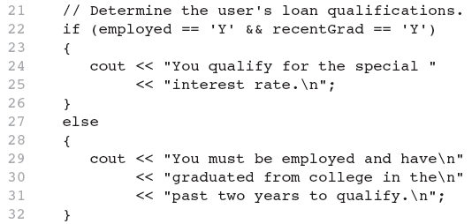
The logical && operator in Program 4-15

Slide 72
The || Operator
The logical OR operator (||) takes two operands that must both be boolean expressions.
The resulting combined expression is false if (and only if) both operands are false.
Example: LogicalOr.java
Expression 1 | Expression 2 | Expression1 || Expression2
true | false | true
false | true | true
false | false | false
true | true | true

Slide 73
Truth Table for Operator ||
p₁ | p₂ | p₁ || p₂ | Example (assume age = 24, weight = 140)
false | false | false | (age > 34) || (weight >140)
false | true | true | (age > 34) || (weight <= 140) is true, because (age > 34) is false, but (weight <= 140) is true.
true | false | true | (age > 14) || (weight >= 150) is false, because (age > 14) is true.
true | true | true
Liang, Introduction to Java Programming, 11th Edition, (c) 2018 Pearson Education, Inc. All rights reserved.

Slide 74
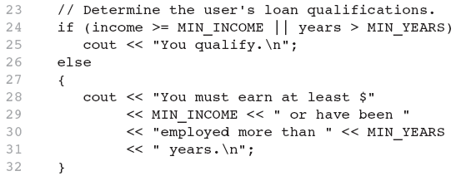
The logical || Operator in Program 4-16

Slide 75
The ! Operator
The ! operator performs a logical NOT operation.
If an expression is true, !expression will be false.
if (!(temperature > 100))
cout << “Below the maximum temperature.";
If temperature > 100 evaluates to false, then the output statement will be run.
Expression 1 | !Expression1
true | false
false | true

Slide 76
Truth Table for Operator !
p | !p | Example (assume age = 24, weight = 140)
true | false | !(age > 18) is false, because (age > 18) is true.
false | true | !(weight == 150) is true, because (weight == 150) is false.
Liang, Introduction to Java Programming, 11th Edition, (c) 2018 Pearson Education, Inc. All rights reserved.

Slide 77
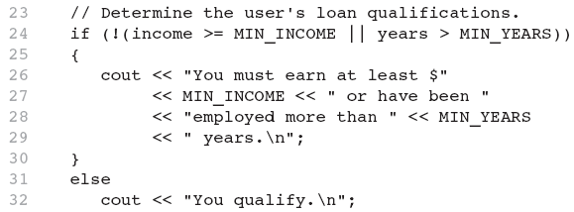
The logical ! Operator in Program 4-17

Slide 78
Truth Table for Operator ^
p₁ | p₂ | p₁ ^ p₂ | Example (assume age = 24, weight = 140)
false | false | false | (age > 34) ^ (weight > 140) is false, because (age > 34) is false and (weight > 140) is false.
false | true | true | (age > 34) ^ (weight >= 140) is true, because (age > 34) is false but (weight >= 140) is true.
true | false | true | (age > 14) ^ (weight > 140) is true, because (age > 14) is true and (weight > 140) is false.
true | true | false
Liang, Introduction to Java Programming, 11th Edition, (c) 2018 Pearson Education, Inc. All rights reserved.

Slide 79
Short Circuiting
Logical AND and logical OR operations perform short-circuit evaluation of expressions.
Logical AND will evaluate to false as soon as it sees that one of its operands is a false expression.
Logical OR will evaluate to true as soon as it sees that one of its operands is a true expression.
ShortCircuiting.cpp

Slide 80
Order of Precedence (1 of 2)
The ! operator has a higher order of precedence than the && and || operators.
The && and || operators have a lower precedence than relational operators like < and >.
Parenthesis can be used to force the precedence to be changed.

Slide 81
Order of Precedence (2 of 2)
Order of Precedence | Operators | Description
1 | (unary negation) ! | Unary negation, logical NOT
2 | * / % | Multiplication, Division, Modulus
3 | + - | Addition, Subtraction
4 | < > <= >= | Less-than, Greater-than, Less-than or equal to, Greater-than or equal to
5 | == != | Is equal to, Is not equal to
6 | && | Logical AND
7 | || | Logical OR
8 | = += -= *= /= %= | Assignment and combined assignment operators.

Slide 82
Logical Operators-Examples
int x = 12, y = 5, z = -4;
(x > y) && (y > z) | true
(x > y) && (z > y) | false
(x <= z) || (y == z) | false
(x <= z) || (y != z) | true
!(x >= z) | false

Slide 83
Divisible by 5, 6
Here is a program that checks
whether a number is divisible by 5 and 6,
whether a number is divisible by 5 or 6,
whether a number is divisible by 5 or 6 but not both
and whether a number is not divisible by both 5 and 6 w5
Liang, Introduction to Java Programming, 11th Edition, (c) 2018 Pearson Education, Inc. All rights reserved.

Slide 84
Example
Enter an integer: 24
24 is divisible by 5 or 6.
24 is divisible by 5 or 6, but not both.
24 not divisible by both 5 and 6.
Enter an integer: 30
30 is divisible by 5 and 6.
30 is divisible by 5 or 6.
Enter an integer: 23
23 not divisible by both 5 and 6.
Liang, Introduction to Java Programming, 11th Edition, (c) 2018 Pearson Education, Inc. All rights reserved.

Slide 85
Leap Year - Class exercise
Write a program that lets the user enter a year and checks whether it is a leap year.
A year is a leap year if it is divisible by 4 but not by 100 or if it is divisible by 400. w5

Slide 86
(year % 4 == 0 && year % 100 != 0) || (year % 400 == 0)

Slide 87
Problem: Lottery - Class exercise
Write a program that randomly generates a lottery of a two-digit number, prompts the user to enter a two-digit number, and determines whether the user wins according to the following rule: P5
If the user input matches the lottery in exact order, the award is $10,000.
If the user input matches the lottery, the award is $3,000.
If one digit in the user input matches a digit in the lottery, the award is $1,000.
Else no award

